Slide 1

Márton Németh (National Széchényi Library, Hungary)
Potential use of microdata in web-archiving context
CDA 2019
Univerzitná knižnica v Bratislave, Centrálny dátový archív, Bratislava
05.11.2019.

Slide 2

Contents
Challenges with web archiving
Microdata: the meeting point between document web and semantic web
The potential ways of use of microdata related to web archiving
Helping the setting of crawling by robots with microdata
Helping the display of the archived material by microdata
Long term preservation support by microdata
Research support of web archives with microdata
Establishing and applying microdata

Slide 3
Challenges with web archiving
Robots cannot follow properly the whole structure of many websites because this structure has not specified clearly.
Old content formats become unsupported by current browsers.
Missing content elements in the archived copy.
Interactive functions cannot be emulated by robots.

Slide 4
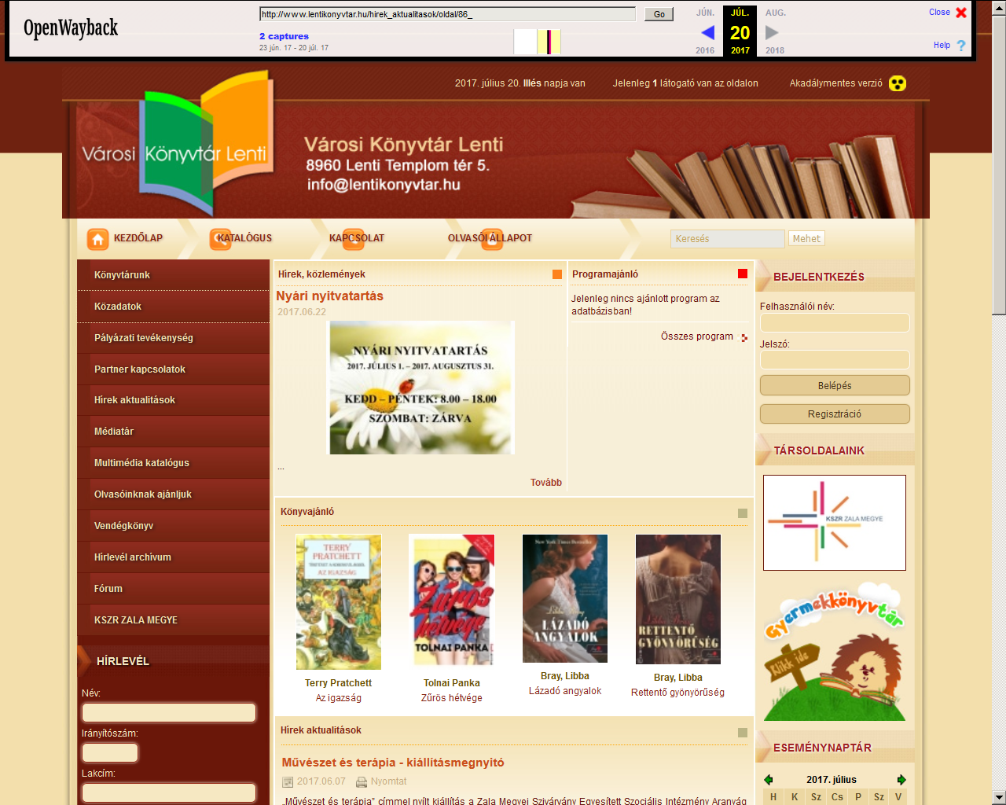
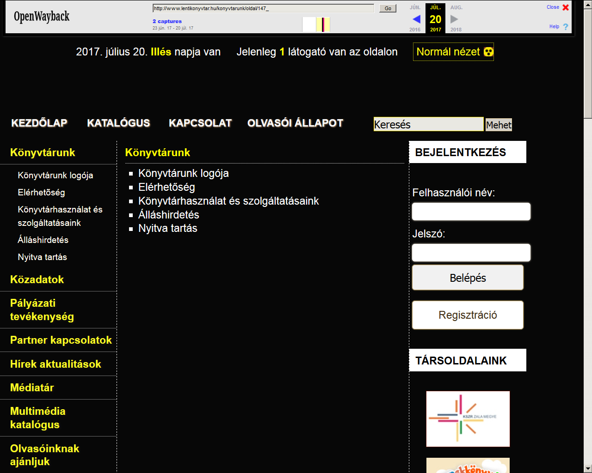
Robot is navigating to the accessible interface
archived starting page
archived subpage

Slide 5
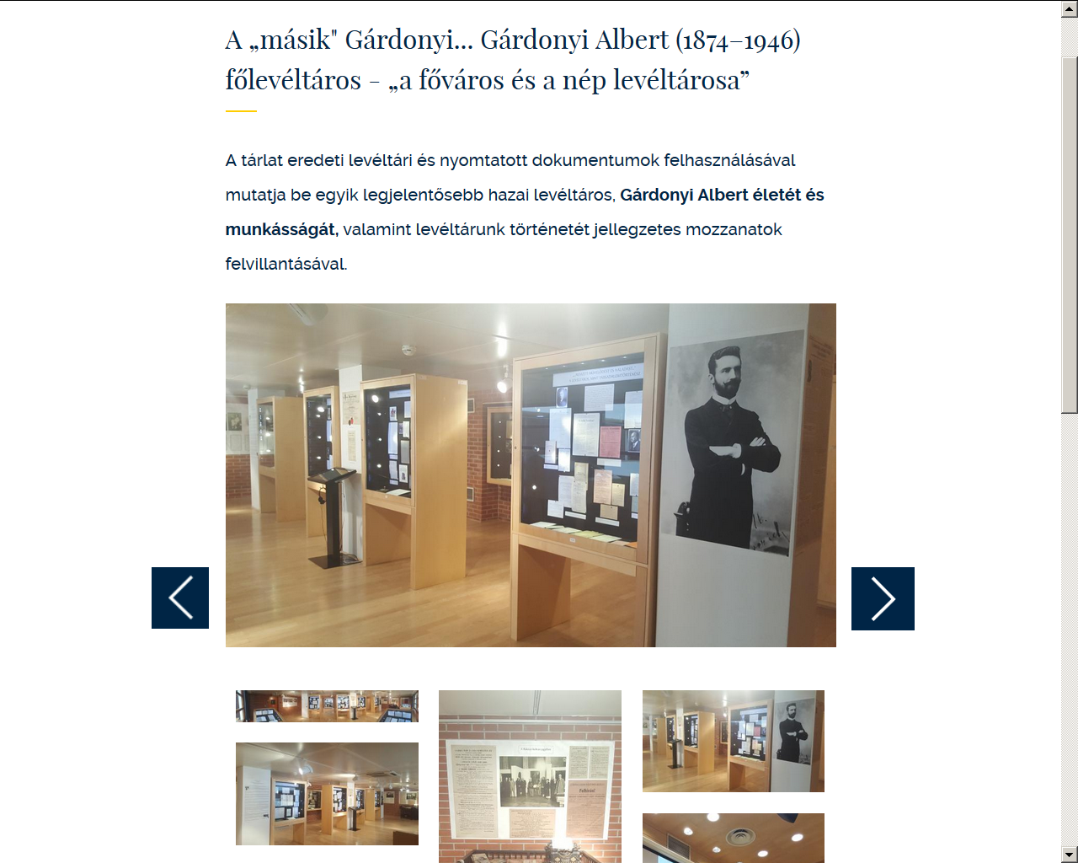
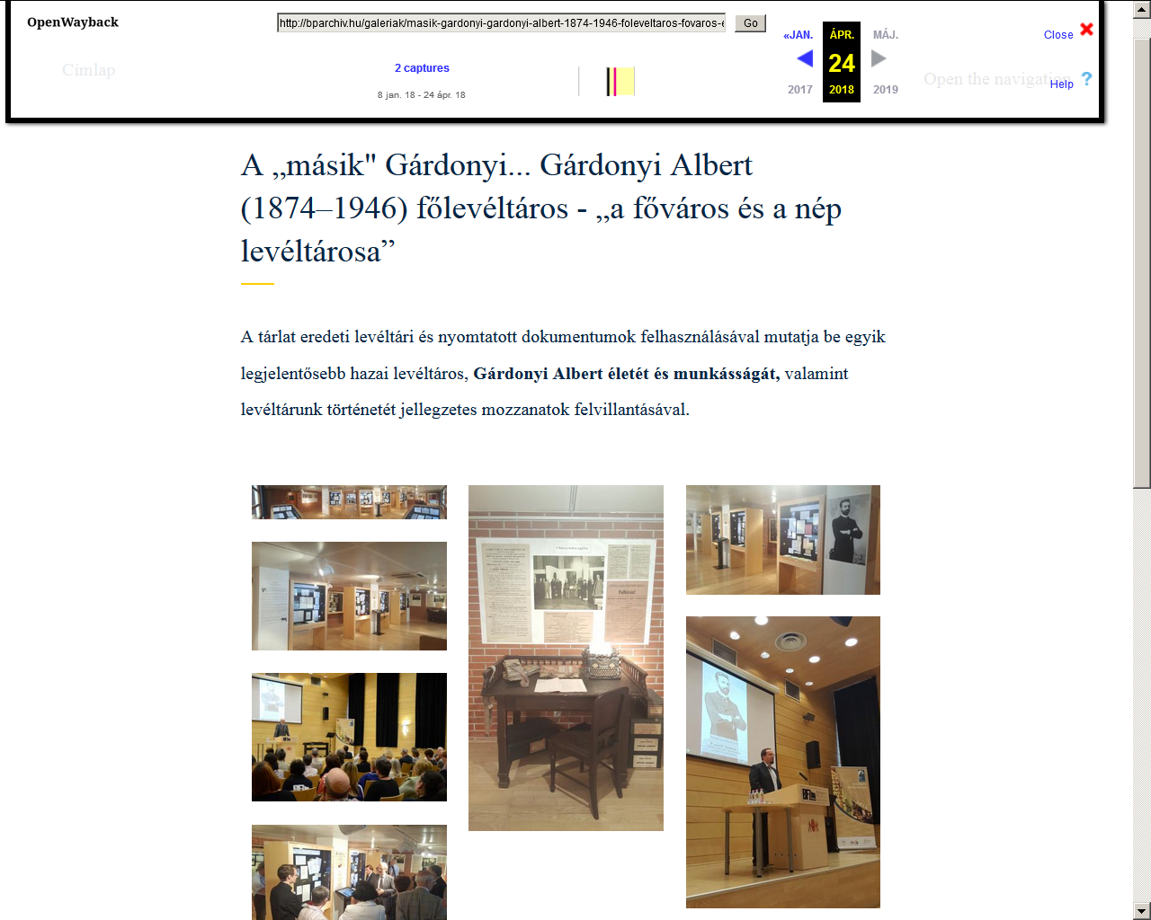
Image browser app not working
original
archived

Slide 6
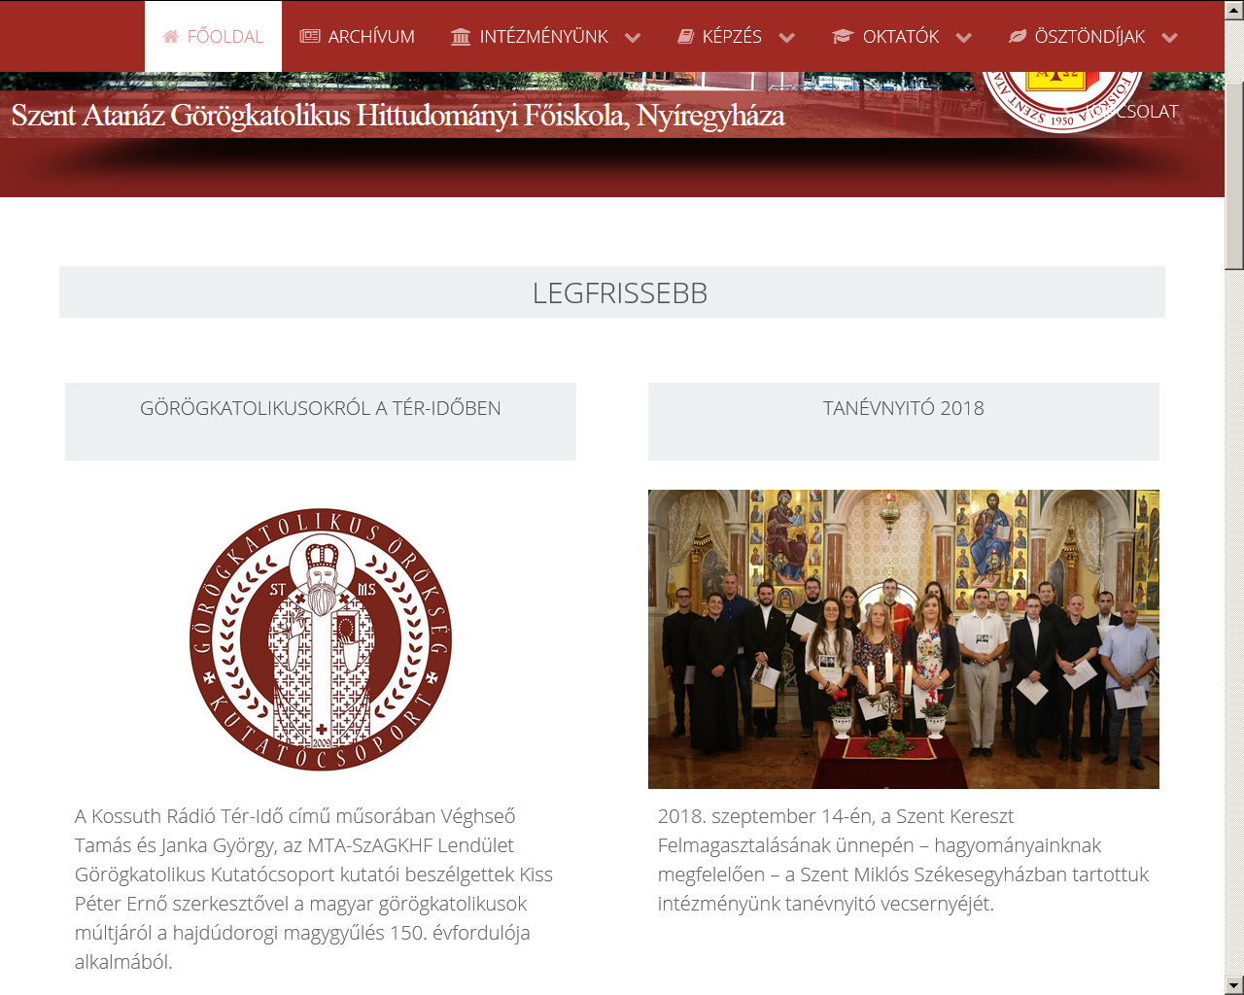
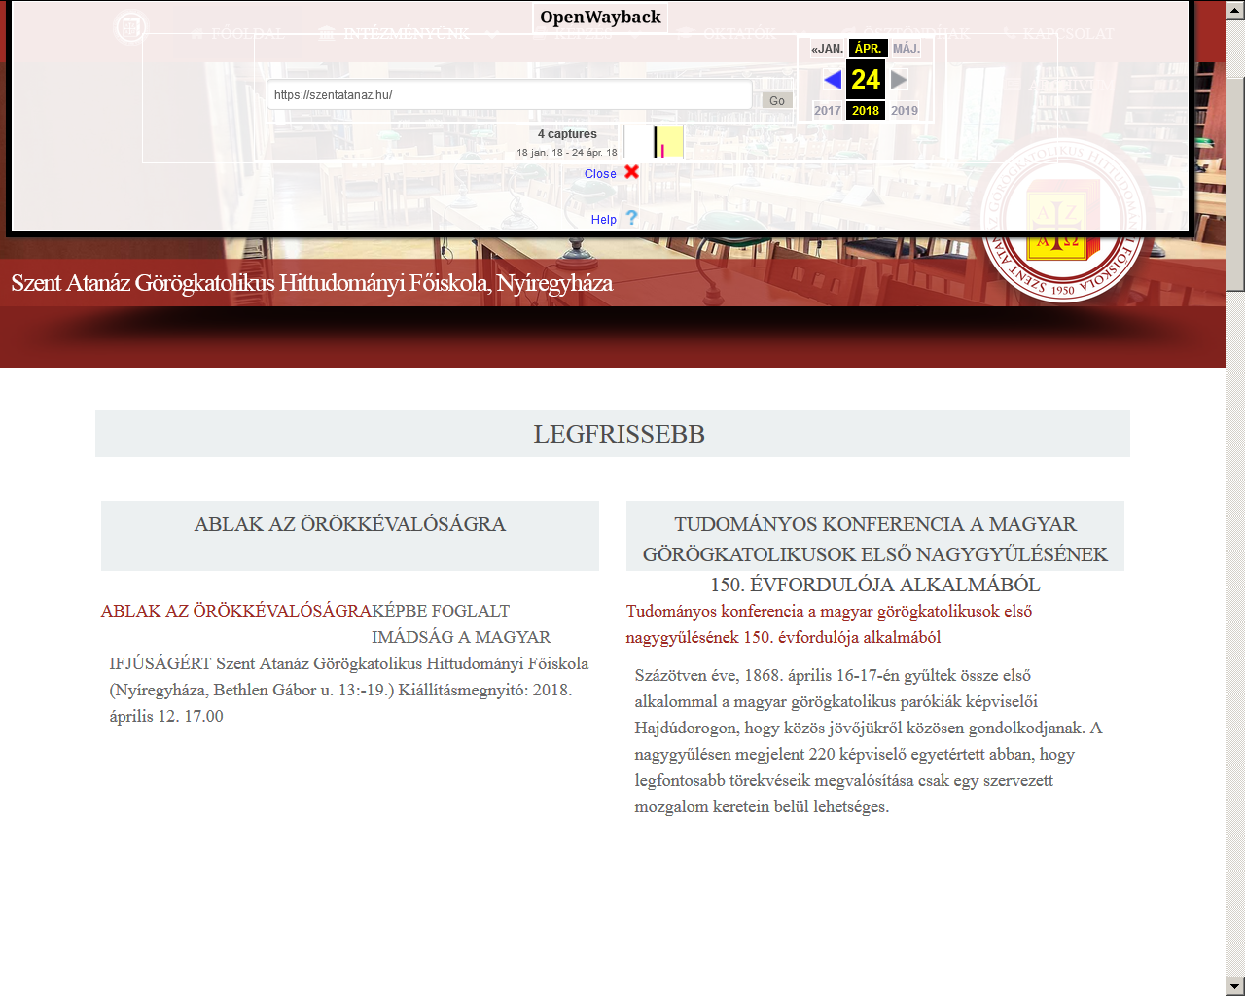
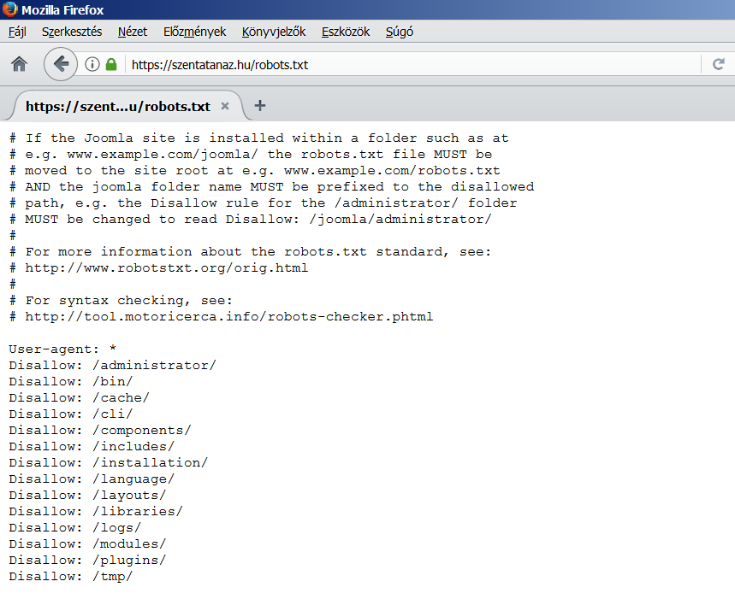
Robots excluded from the libraries contain images
robots.txt
original
archived

Slide 7
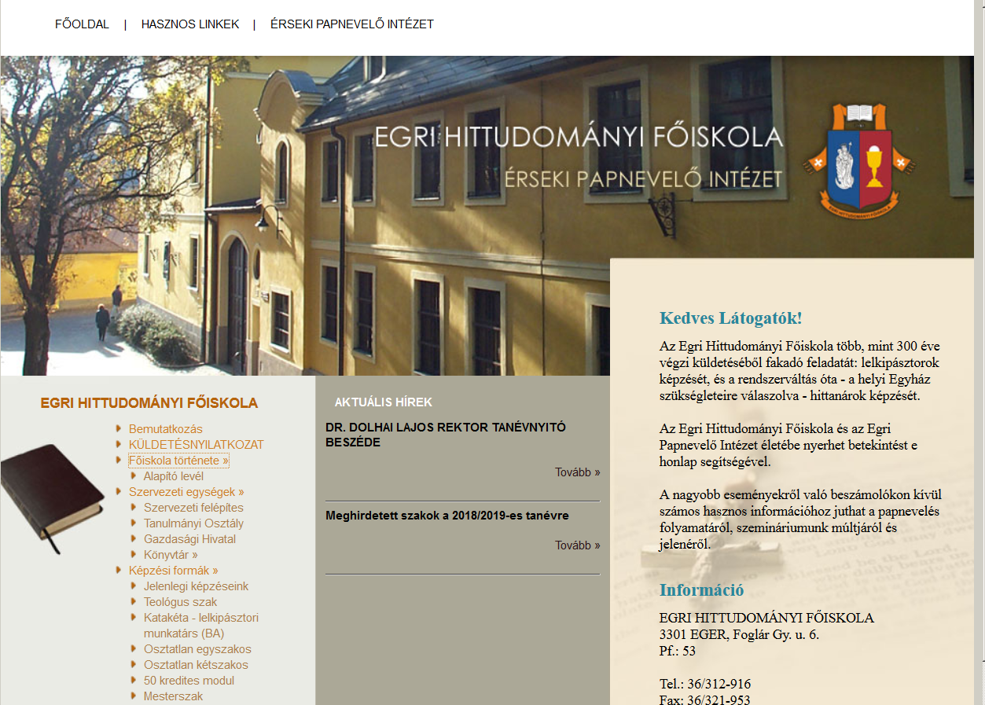
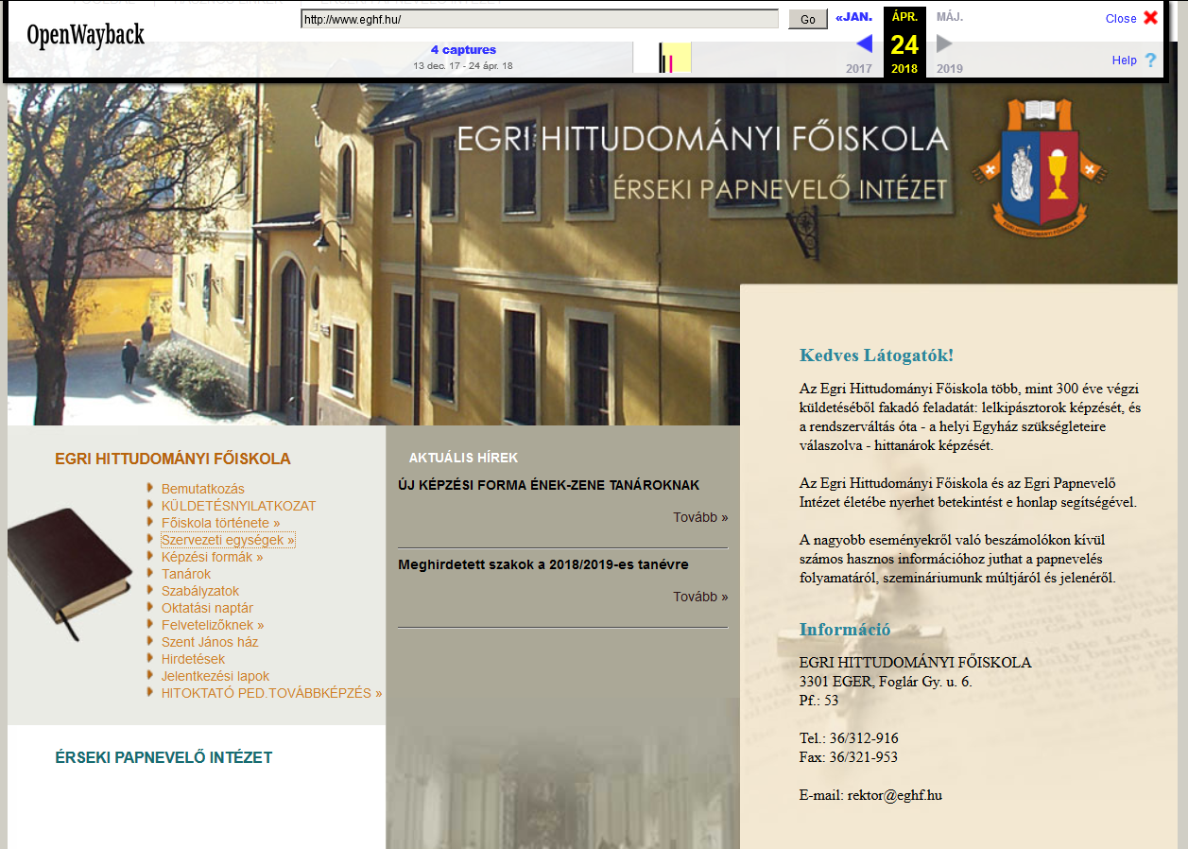
Submenus with javascript cannot be opened
original
archived

Slide 8
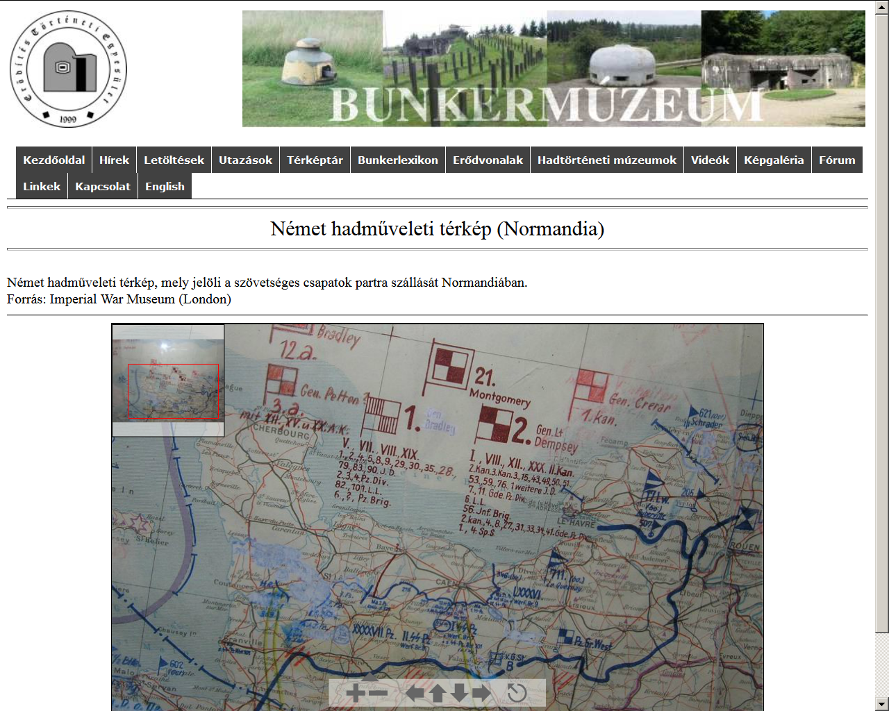
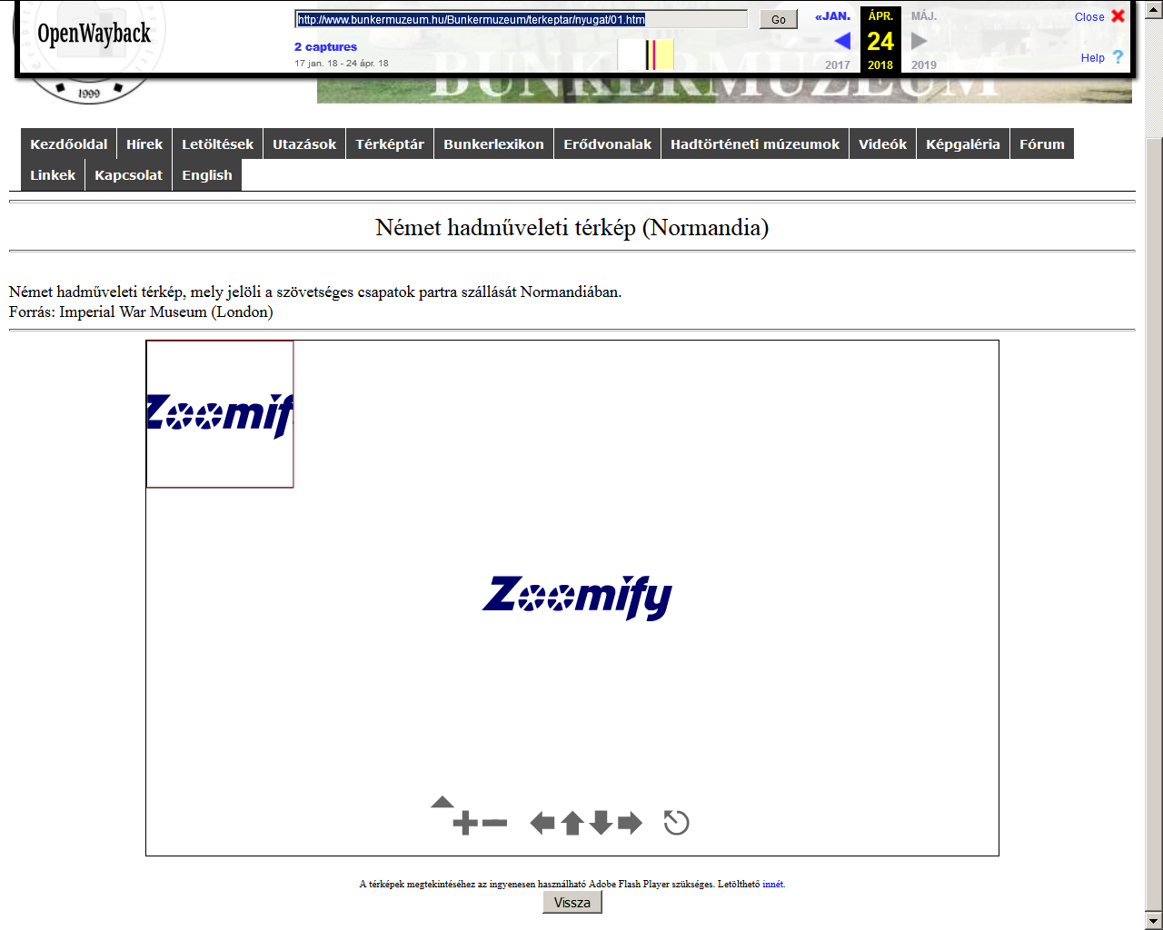
Flash-based map browser cannot be initialized
archived
original

Slide 9
Microdata: the meeting point between document web and semantic web
Basic metadata elements to the header – HTML1- HTML4
Robots.txt – where robot can go
Document web vs. Semantic web: Microdata – a possible bridge
Missing: Retrieve info from the content of a website, linking together contents of different websites
Build semantic statements as metadata to the HTML source code
RDFa – W3C recommendation
RDF predicates from different vocabularies
HTML and schema.org markup – OCLC, Google etc.
How can microdata be used in web archiving context?

Slide 10
Some schema.org examples
Use the time tag with datetime: <time datetime="2011-04-01">04/01/11</time>
Determine a person: <div itemscope itemtype="http://schema.org/Person"> <a href="alice.html" itemprop="url">Alice Jones</a></div>
References to wikipedia: <div itemscope itemtype="http://schema.org/Book"> <span itemprop="name">The Catcher in the Rye</span>—by <span itemprop="author">J.D. Salinger</span>Here is the book's <a itemprop="url" href="http://en.wikipedia.org/wiki/The_Catcher_in_the_Rye"> Wikipedia page</a>. </div>

Slide 11
Helping the setting of crawling by robots with microdata
A sitemap can be built-up in xml format.
In the robots.txt file special set of commands can be inserted to help the handling of robot-specific microdata instructions.
Some specific info can be added to the header of each sub-page.
Currently only non-standard tags and exclusions can be used: noindex metatag, noindex http response header and some directives just like allow, sitemap, host and universal match.
Sitemap must be properly located.
Some specific elements can be marked up: ad sections, pop-up content, compulsory warnings about cookies etc.
Let specific type of interface, language versions, be crawled only.
Set the starting point of a website for crawlers if start page is not suitable.
Link to an interface from where data records can be accessed if the structure and/or layout is not crawler friendly.

Slide 12
Helping the display of archived material with microdata
Specific microdata elements can help to understand the structure and layout of the archived content.
Javascript, different kind of add-ons, pull-down menus.
By providing an alternative way of displaying photos, documents, through a simple menu structure, and refer to them by microdata, the archived content can be totally retrieved.

Slide 13
Long term preservation support by microdata
Specific microdata can help to determine the different content formats in a website with the description of type, version and other important features.
Short statements can be made about all types of software that are being used in a website.
Embedded java applets, embedded flash files and content can be identified with proper version and functions - crucial for future emulation and conversion in an LTP perspective.

Slide 14
Research support of web archives with microdata 1.
Primarily serving semantic data can offer a major help to researchers for effective information retrieval from a huge set of resources and also offering connections among different kind of datasets in the linked data universe.
Main tools in this sense are link relations as descriptive attributes that can be attached to a hyperlink in order to define the type of the link or the relationship among the source and destination resources – use of RDF-type links.
Personal names or geographical names in websites can be filtered and marked-up with various namespace schemas and ID’s. Links to the semantic Wikipedia, or semantic library catalogs can also be added.

Slide 15
Research support of web archives with microdata 2.
Set proper data about the date of creation and date of last modification of a website - to represent valid display of the archived documents from the same period.
Support of digital humanities - a large number of XML-based analyzing tools and procedures that can be also applied through proper semantic vocabularies as microdata. Several personal and geographical name forms, specific terms and quotations can be identified in this way as an example.

Slide 16

Establishing and applying microdata
Who can set vocabularies and managing the embedding of microdata?
Public collections and large content provider platforms.
These stakeholders have the necessary resources to help establish vocabularies and implement their use.
Only a widespread use of microdata can offer us effective benefits.
In web archiving field IIPC can offer the major help to establish relevant vocabularies and build partnership with the major actors in the content development industry in order to implement microdata to their service portfolio.

Slide 17
Recommended sources
IIPC Research Working Group: http://netpreserve.org/about-us/working-groups/research-working-group/
HTML Microdata W3C Working Draft. https://www.w3.org/TR/2018/WD-microdata-20180426/
XHTML+RDFa 1.1 - Third Edition. Support for RDFa via XHTML Modularization. W3C Recommendation 17.03. 2015. https://www.w3.org/TR/xhtml-rdfa/
Getting started with schema.org using microdata. https://schema.org/docs/gs.html Retrieved 23-09-2019
OCLC WorldCat Linked Data Vocabulary. https://www.oclc.org/developer/develop/linked-data/worldcat-vocabulary.en.html
Dooley, Jackie, and Kate Bowers. 2018. Descriptive Metadata for Web Archiving: Recommendations of the OCLC Research Library Partnership Web Archiving Metadata Working Group. Dublin, OH: OCLC Research. https://doi.org/10.25333/C3005C
Bib.schema.org-1.0 an initial release. 24.05.2015 https://www.w3.org/community/schemabibex/wiki/Bib.schema.org-1.0
Robots Exclusion Standards. An article from Wikipedia. https://en.wikipedia.org/wiki/Robots_exclusion_standard
Link relation types. An article from Microformats Wiki. 20.09.2011. http://microformats.org/wiki/link-relation-types

Slide 18

Thank you for your attention! Contact e-mail address: mia@mek.oszk.hu

