Slide 1
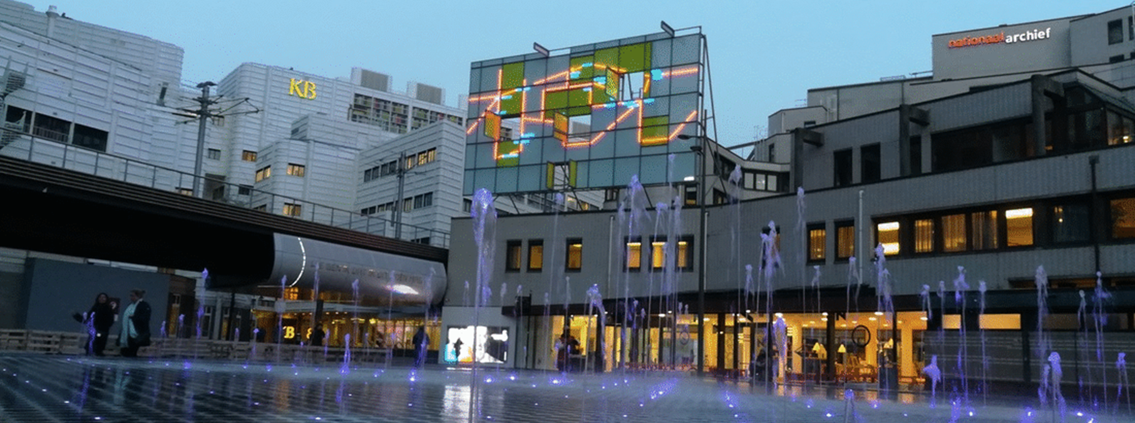
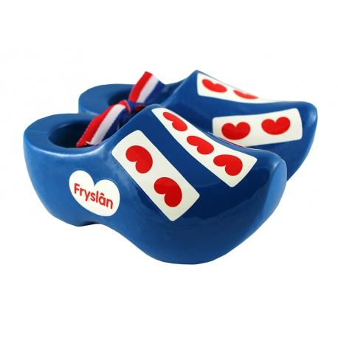
Distant reading the
Frisian web domain
DH_Budapest_2019 24 September 2019
Dr. Kees Teszelszky, curator digital collections,
Koninklijke Bibliotheek, National Library of The Netherlands

Slide 2
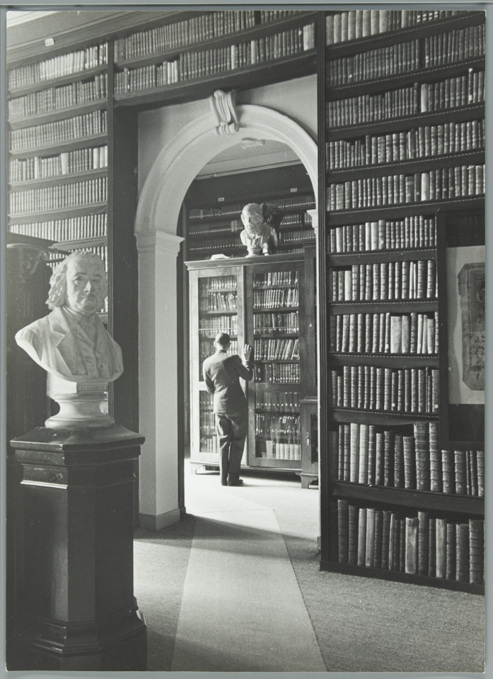
National identity and the
National library
Research on national identity in the past: close reading
Benedict Anderson’s concept of a nation as an ‘imagined community’: a social construction with certain characteristics (territorial, linguïstic, cultural, ethnic)
Benedict Anderson, Imagined Communities: Reflections on the Origin and Spread of Nationalism. London: Verso (1983)
Role of libraries in the 19th century in construction a national identity by providing ‘building blocks’ of an imagined community

Slide 3
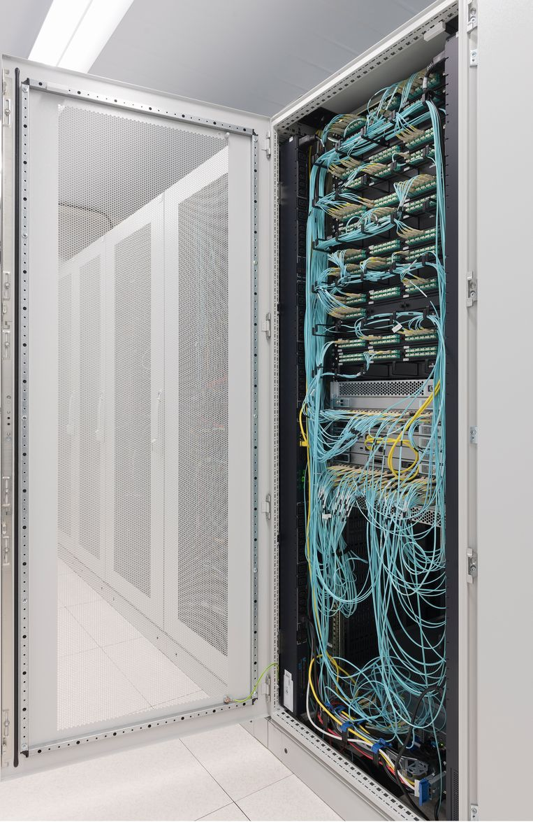
Online identity and the
National library
Research on national identity with help of digital humanities: distant reading of web data
Search for data on a virtual community on the web
How can we define a national web to archive it?
How can we analyse an national community by distant reading the archived data of a national web?

Slide 4
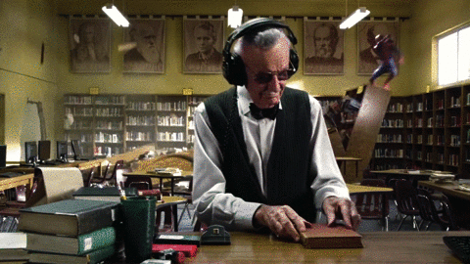
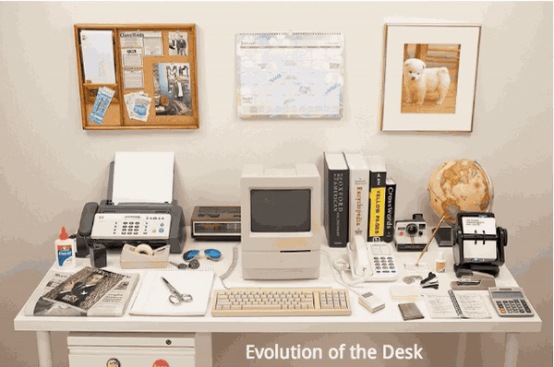
Dutch National Library:
Content strategy
Netherlands Collection: create a digital library based on born digital material, suitable for text- and datamining

Slide 5
Koninklijke Bibliotheek – national library
Web collection
Selection, harvest and making available of digital born publications and other sources from the web.
15,400 selected websites in collection since 2007
35 Terabyte (second biggest digital collection)
Growth +/- 1,500 sites (50 Frisian sites)
Special web collections (a.o. Frisian collection, Chinese community on the web, blogosphere, Post-Truth)
400,000,000 (hyper)links
Only selective archiving: no legal deposit

Slide 6
KB – national library of the Netherlands:
Content strategy
‘Netherlands Collection’: create a national digital library
Collecting all digital born publications from the Dutch national web domain by making a snapshot of the Dutch web (national domain crawl)

Slide 7
KB- National Library:
Content strategy
Nederlands Collection: national digital library.
How to define the Dutch national web domain?
What is a national web domain?
What data do we need to harvest?

Slide 8
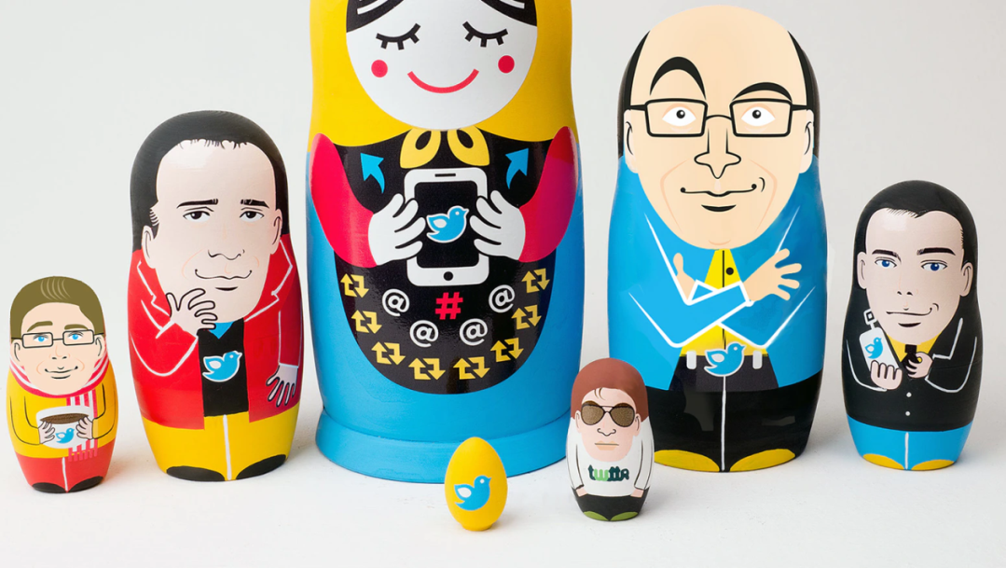
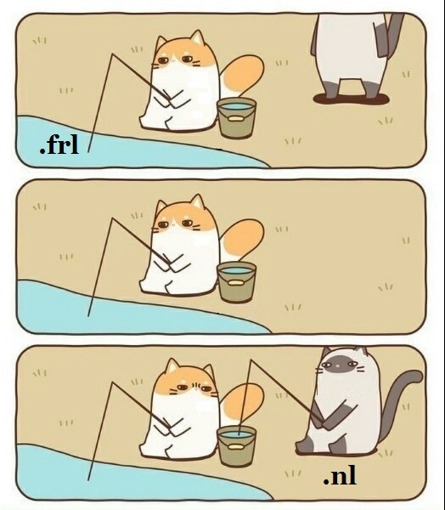
National library pilot project
Frisian web domain
Own web domain: biggest domain within the Dutch national web domain
Great test case: size similar to KB web collection

Slide 9
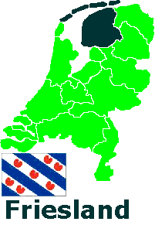
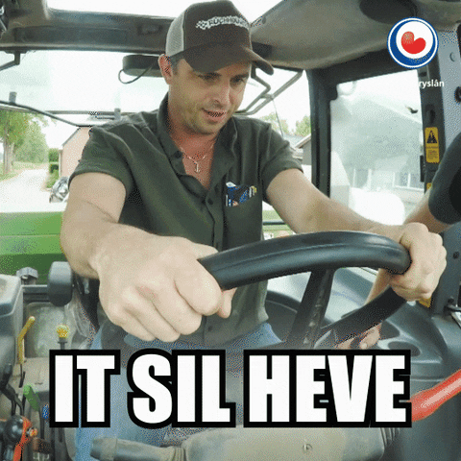
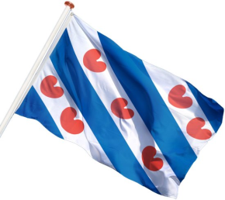
national library:
Frisians and Friesland
Minority language and culture in one region
400,000 native speakers, 600,000 inhabitants
Rich born digital heritage
‘Mienskip’: strong and active online community

Slide 10
National web domain
definition
I. Size
II. Geography
III. Language
Culture
Network
History
Based on Niels Brügger and Ditte Laursen eds., The Historical Web and Digital Humanities: The Case of National Web Domains. London: Routledge (2019)

Slide 11

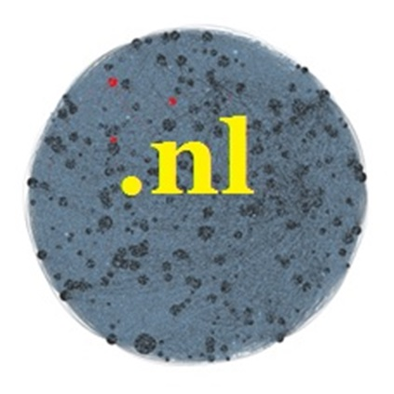
Frisian web domain
I. Size
All websites within a certain Internet or country code Top Level Domain (and all personal home pages)
.frl: 15,000 URLs
.nl: 5,895,623 URLs

Slide 12
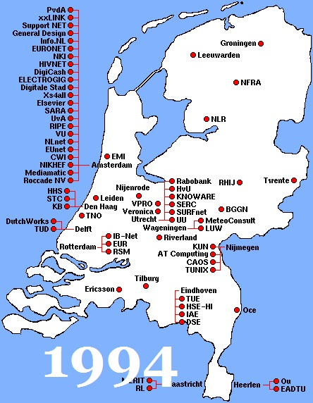
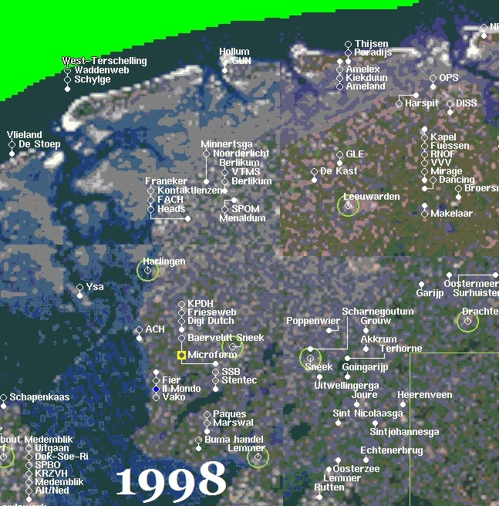
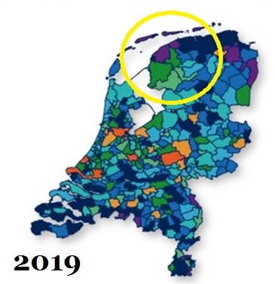
Frisian web domain
II. Geography
Geographical area or the cultural territory of a certain nation, defined by the geographical location of web domains based on a physical contact address on the website or the geo-physical web sphere based on location of IP-address.

Slide 13
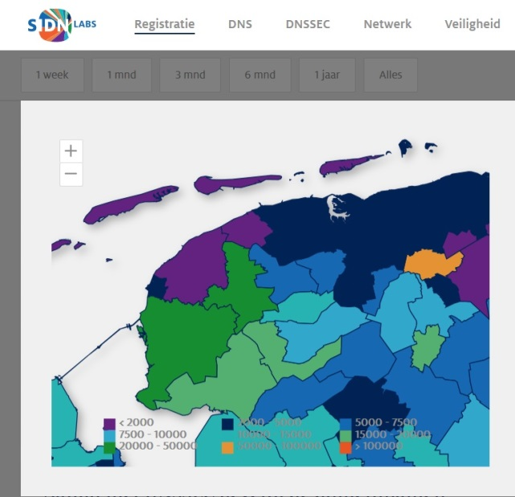

Frisian web domain
II. Geography
175,000 .nl domain names in Friesland

Slide 14
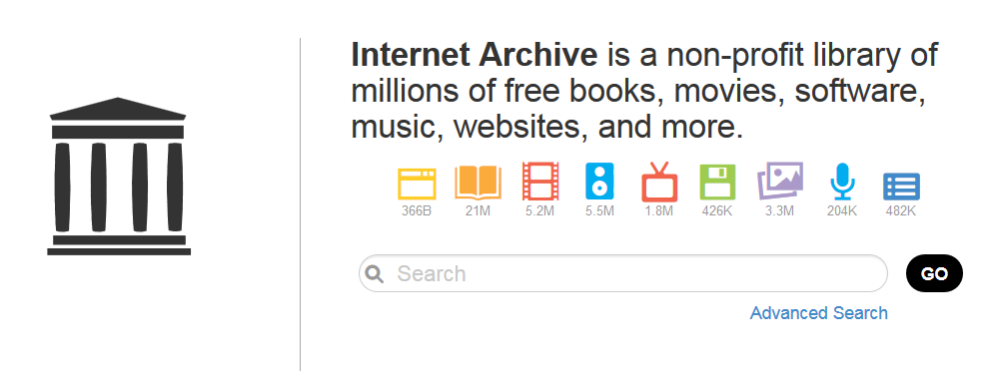
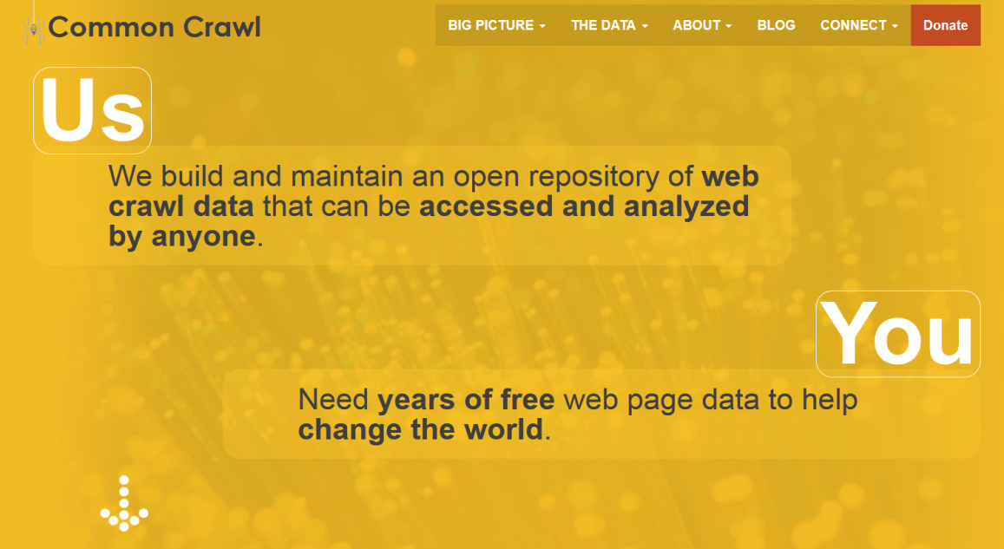
Frisian web domain
III. language
Common Crawl

Slide 15

Frisian web domain
IV. culture
All sites from or about the people who share a certain culture and live in this territory or have a connection with this: sites about Frisian culture, language, history or heritage.
The mapping is done in coöperation with Tresoar, Frisian History and Literature Center and Frisians.
Wikipedia can be used to find relevant keywords.

Slide 16
Frisian web domain
IV. culture
Close reading still necessary…

Slide 17
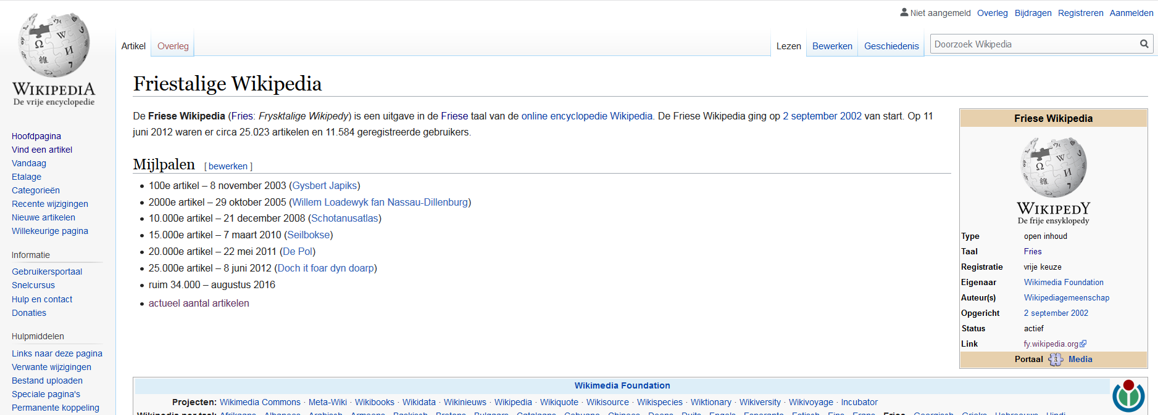
Frisian web domain
IV. culture

Slide 18
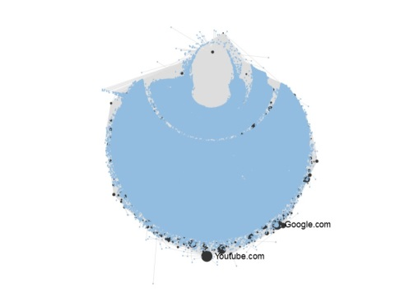

Frisian web domain
V. network
Network analysis based on Frisian web collection of KB

Slide 19
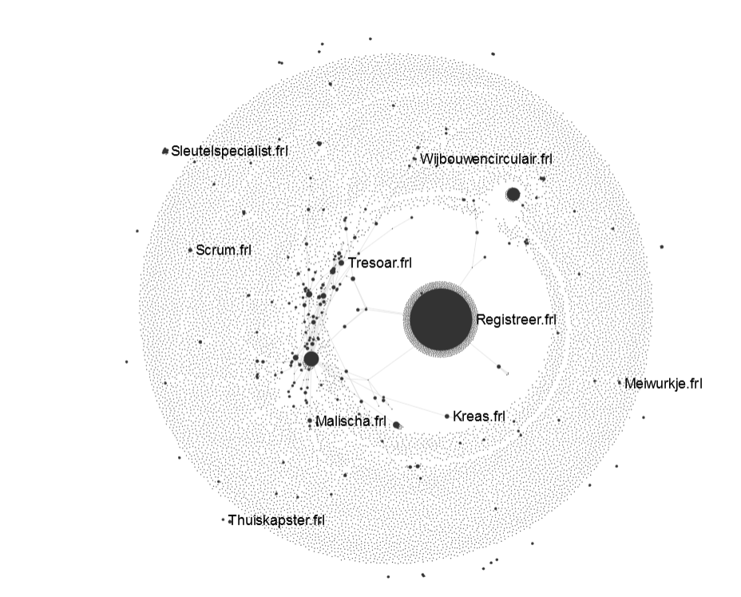

Frisian web domain
V. network

Slide 20
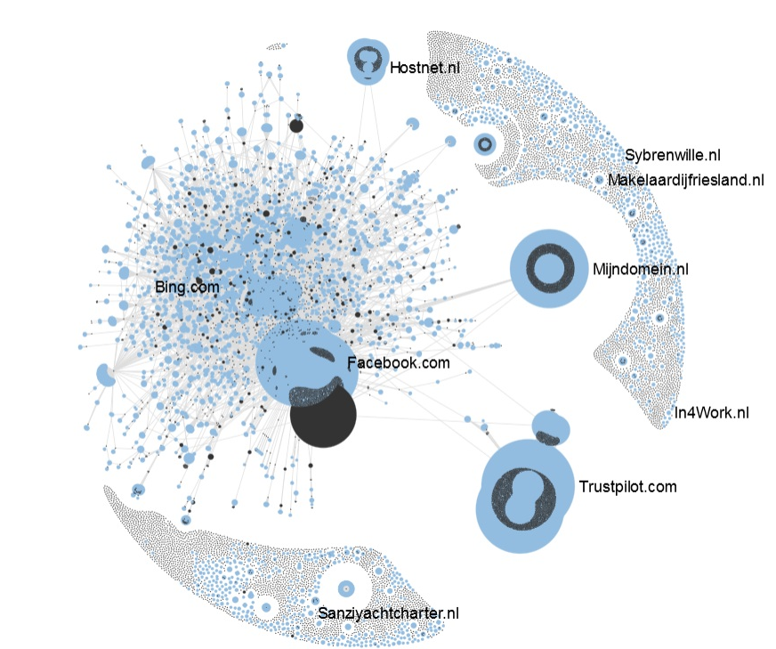

Frisian web domain
V. network

Slide 21
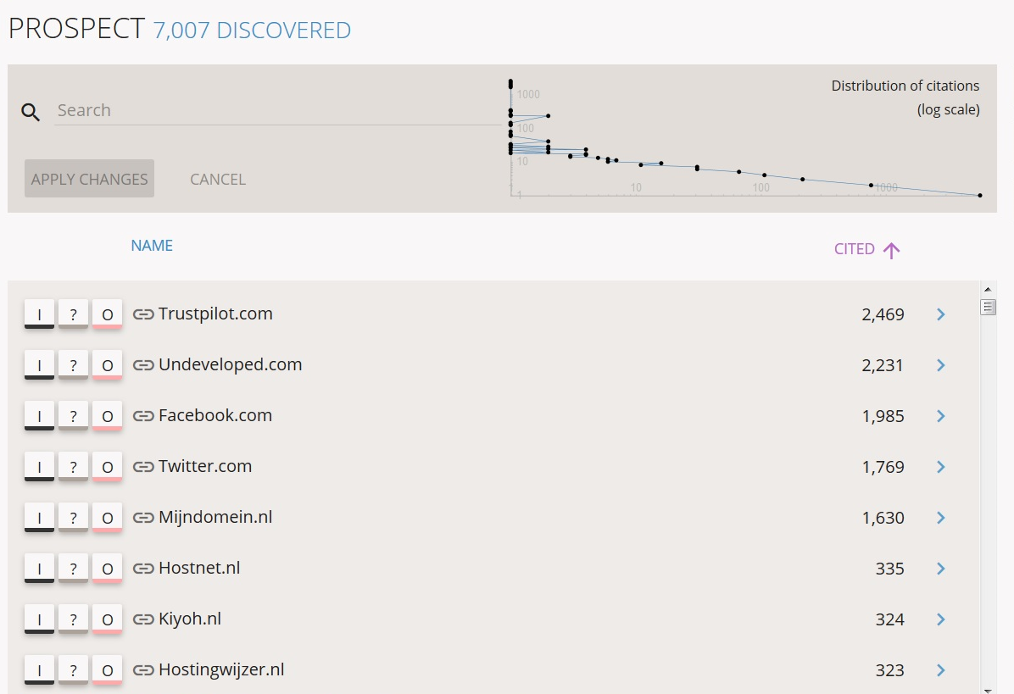
Frisian web domain
V. network

Slide 22
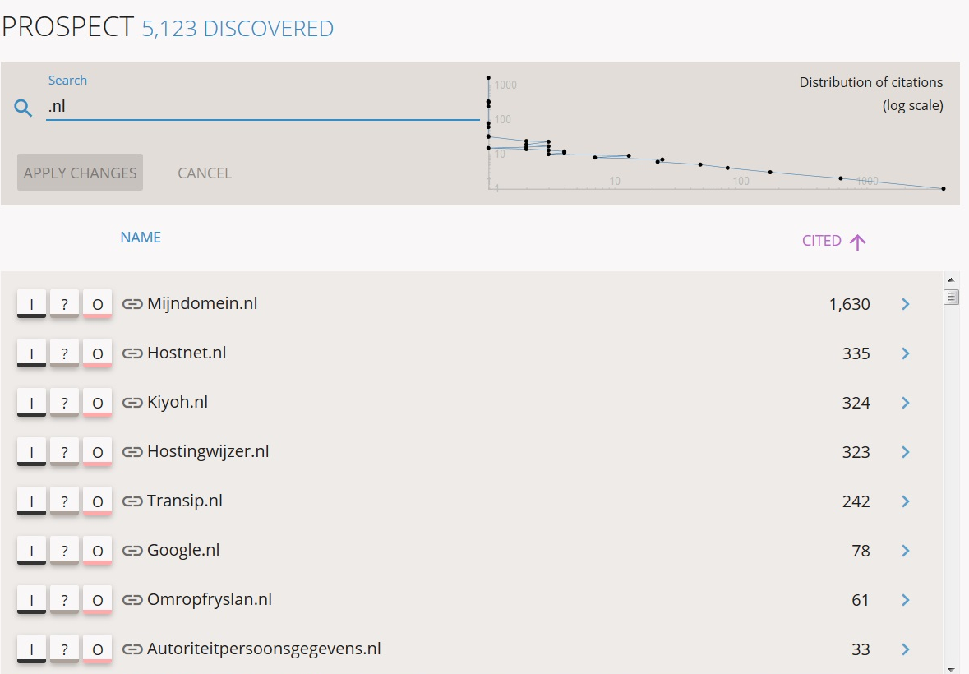

Frisian web domain
V. network

Slide 23
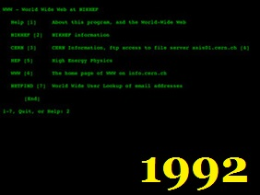
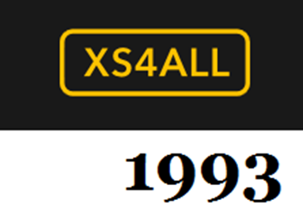
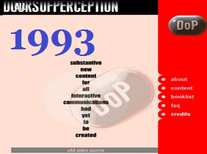
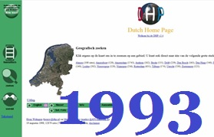
IV. history
.nl: 1986

Slide 24
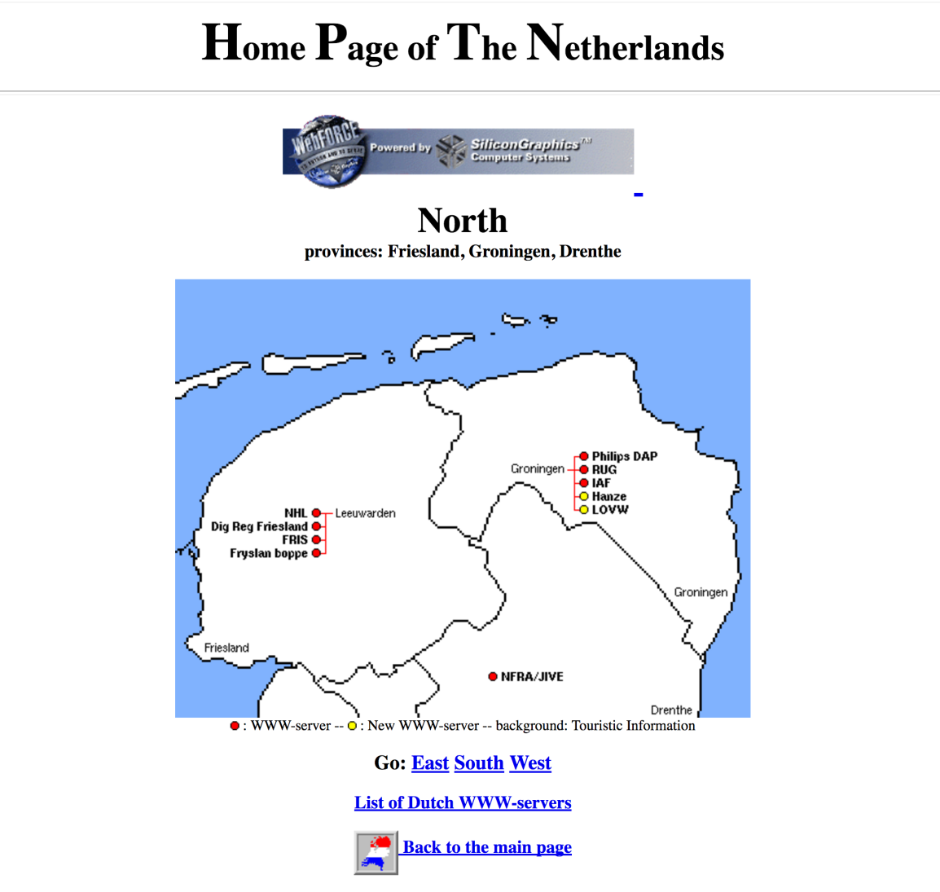
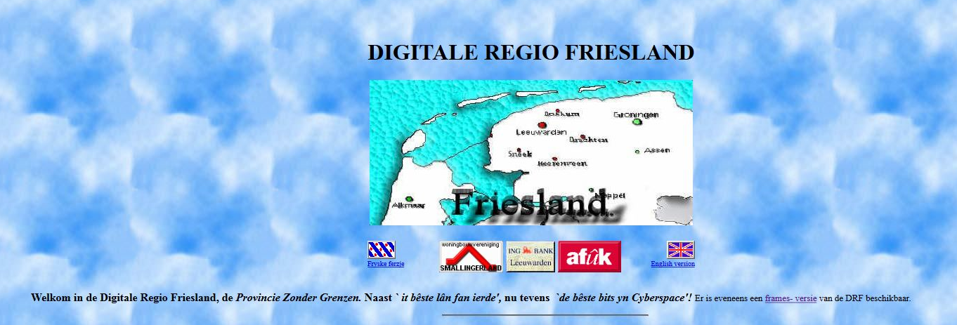
IV. history

Slide 25
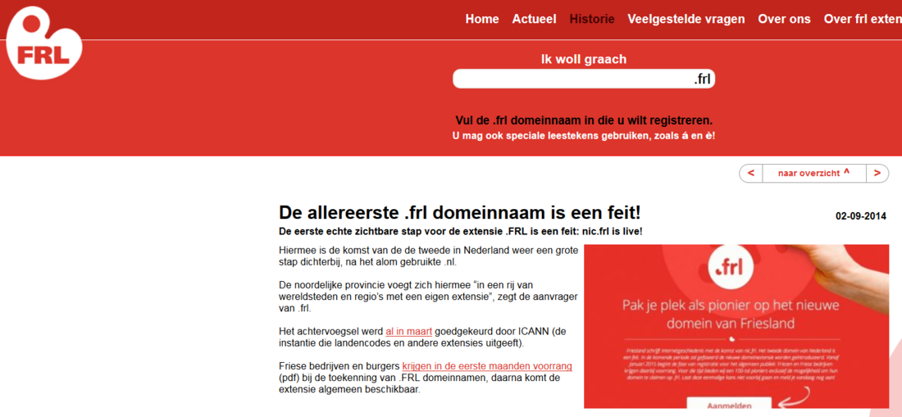
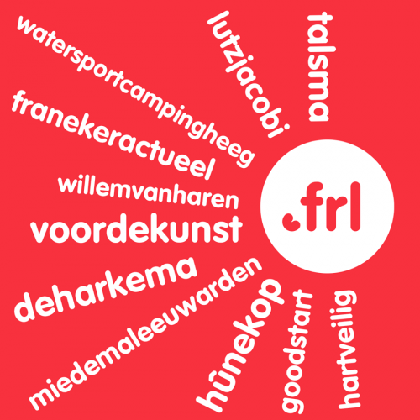
Frisian web domain
IV. history
.frl: 2014

Slide 26
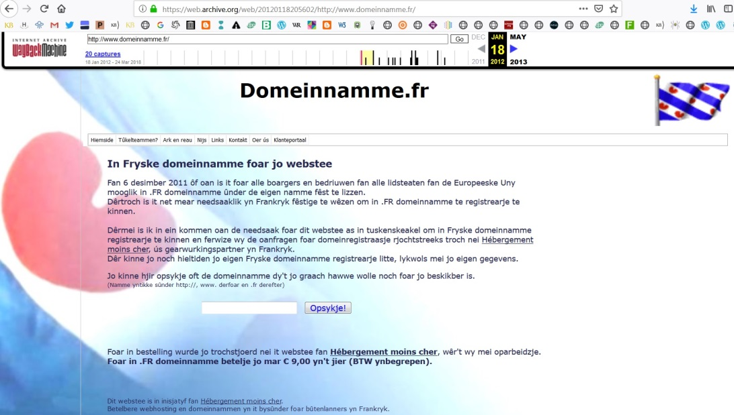
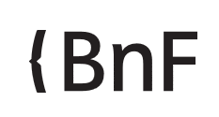
Frisian web domain
IV. history
.fr: 2011

Slide 27
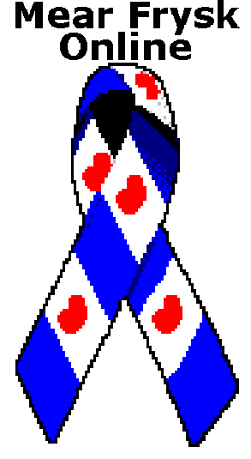




Frisian web domain
VI. history

Slide 28
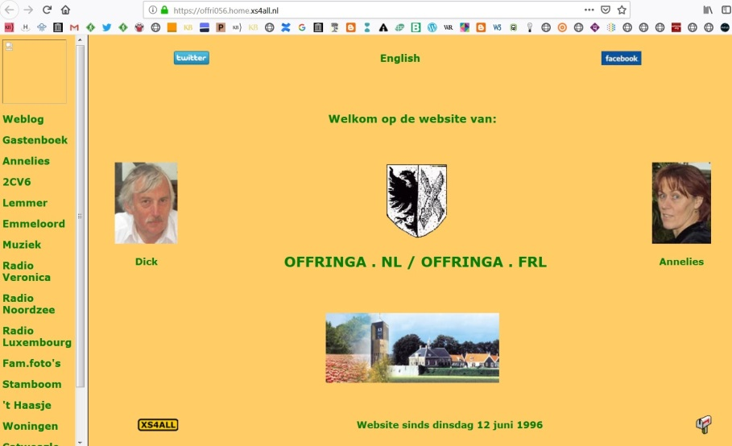
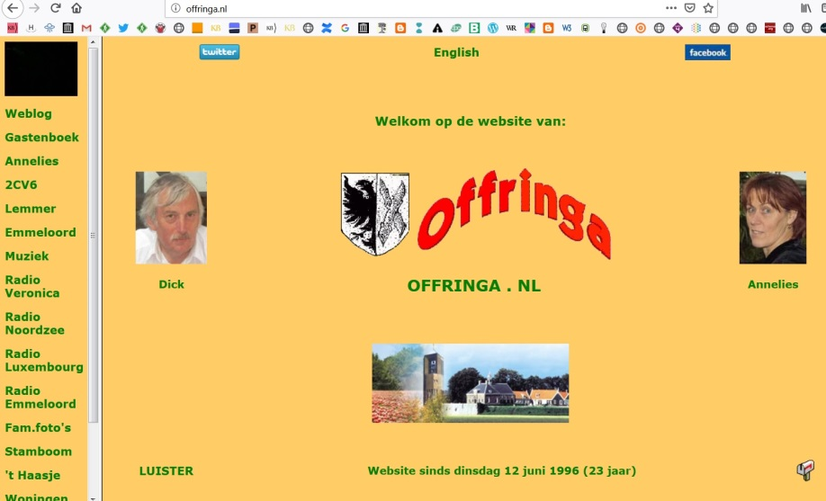
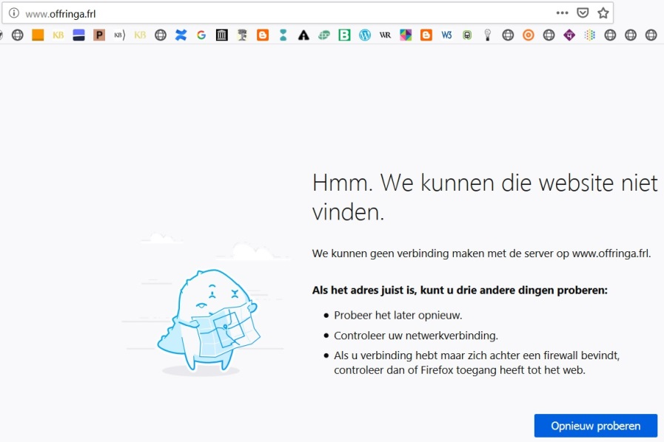
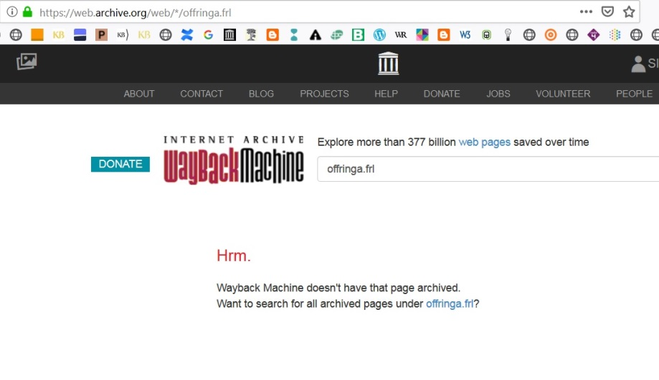
Frisian web domain
VI. history
.homepage
.nl
.frl

Slide 29
Frisian web domain
Future datasets
for DH research:
Curated seed list
Link extraction
Network data
Historic domain data
Text- and datamining

Slide 30
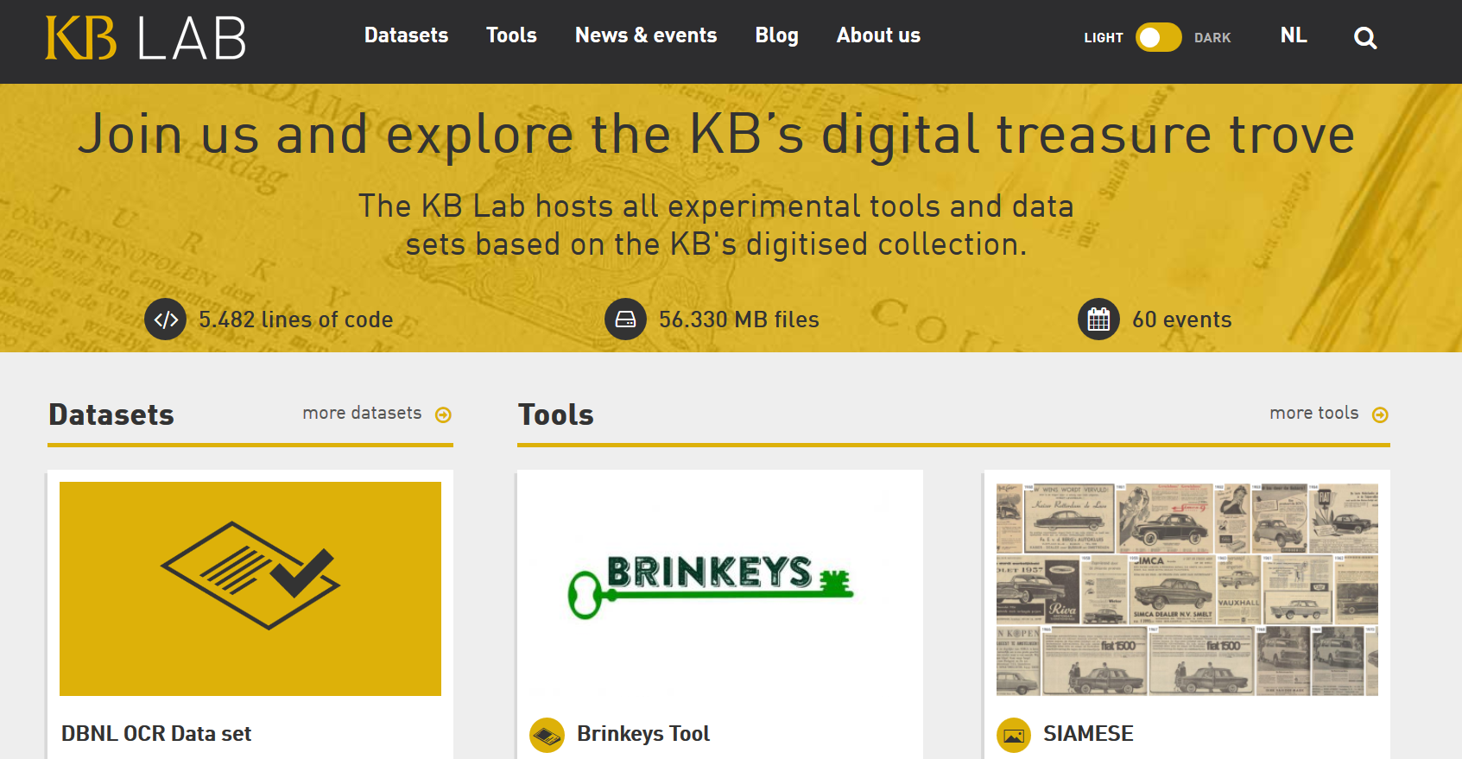
Frisian web domain
Datasets kb.lab.nL

Slide 31
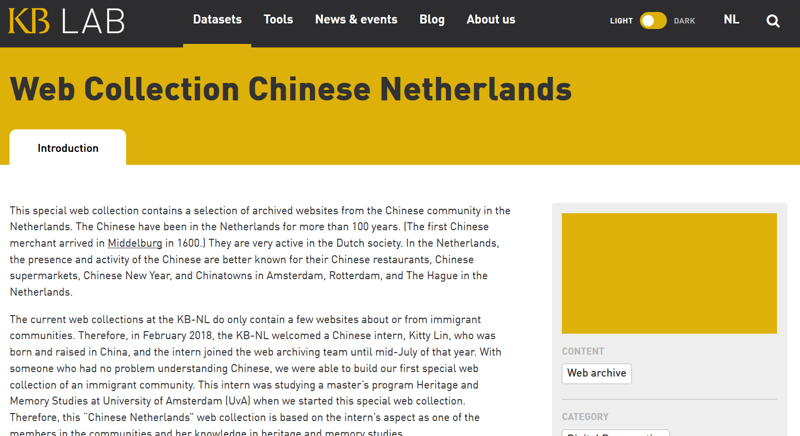
Frisian web domain
Datasets kb.lab.nL

Slide 32
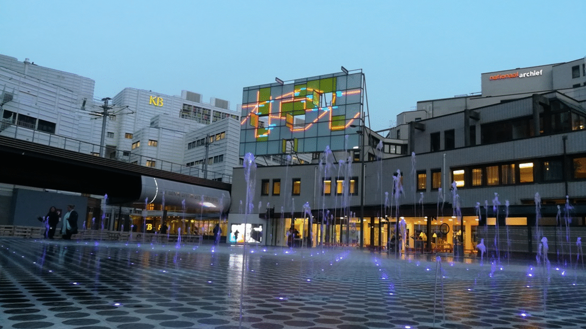
Questions?
webarchivering@kb.nl
Twitter: @keesone

