Slide 1

Introduction to web archiving in Digital Humanities context
Márton Németh
(National Széchényi Library, Hungary)
ELTE DH, Budapest 25 September 2019

Slide 2
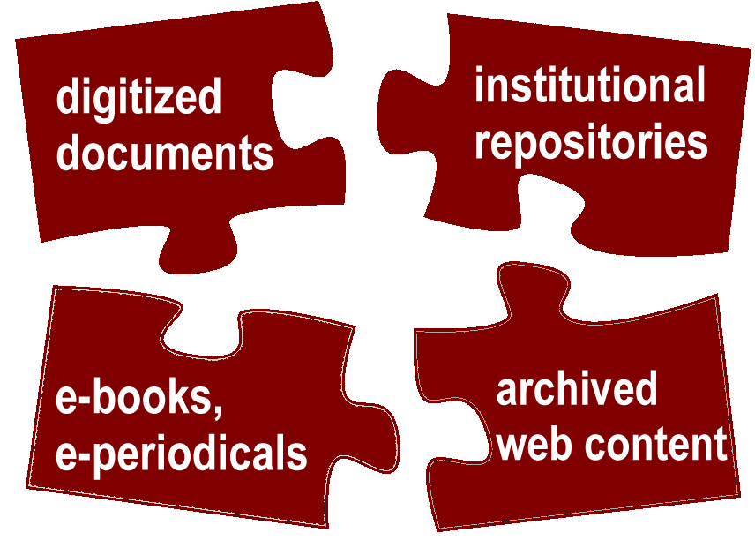
Digital sources of research
The archived web material can be defined as a major research subject itself.
Librarians, archivists, information scientists, professionals in Digital Humanities, data scientists and IT-developers can work together on analysing large archived web corpora focusing on several structural and content-based features.
New scientific disciplines have emerged through these research activities in the past ten years, such as web history.
2

Slide 3
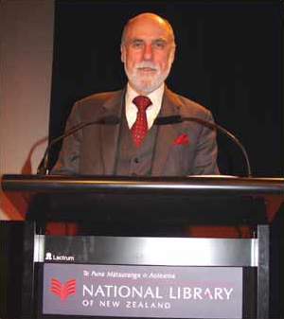
Guardian 13 February 2015. „Google boss warns of forgotten century” https://www.theguardian.com/technology/2015/feb/13/google-boss-warns-forgotten-century-email-photos-vint-cerf
Vint Cerf, a main founder of the TCP/IP protocol. From 2005 a Vice President and a main Internet Evangelist of Google
„Digital Dark Age” threats
We need virtual machines and describe the recent IT service environments (software, hardware) in order to emulate them in the next centuries.
Not just service architectures but digital documents must be preserved to the future.
Source: https://commons.wikimedia.org/

Slide 4

Are we losing the battle to archive the web? http://dpconline.org David S.H Rosenthal
“With an unlimited budget collection and preservation isn’t a problem. The reason we’re collecting and preserving less than half the classic Web of quasi-static linked documents is that no-one has the money to do much better. The other half is more difficult and thus more expensive. Collecting and preserving the whole of the classic Web would need the current global Web archiving budget to be roughly tripled, perhaps an additional $50M/yr. Then there are the much higher costs involved in preserving the much more than half of the dynamic ‘Web 2.0’ we currently miss.”
“The Internet Archive's budget is in the region of $15M/yr, about half of which goes to Web archiving. The budgets of all the other public Web archives might add another $20M/yr. The total worldwide spend on archiving Web content is probably less than $30M/yr, for content that [probably] cost hundreds of billions to create.”
Action Plan:
Use the Wayback Machine's Save Page Now facility to preserve pages you think are important.
Support the work of the Internet Archive by donating money and materials.
Make sure your national library is preserving your nation's Web presence.
Push back against any attempt by W3C to extend Web DRM.
Source:http://dpconline.org

Slide 5
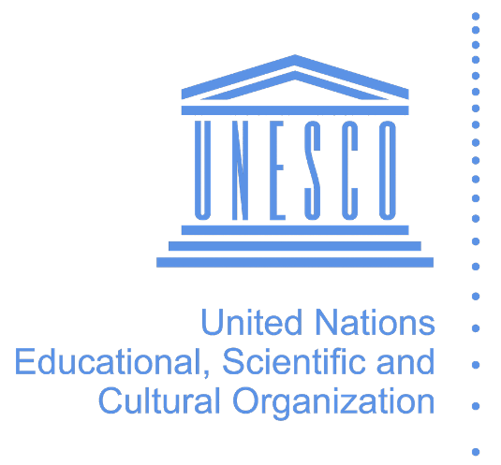
UNESCO 2003 Charta about preserving Digital Cultural Heritage http://portal.unesco.org/en/ev.php-URL_ID=17721&URL_DO=DO_TOPIC&URL_SECTION=201.html
”The digital heritage consists of unique resources of human knowledge and expression. It embraces cultural, educational, scientific and administrative resources, as well as technical, legal, medical and other kinds of information created digitally, or converted into digital form from existing analogue resources.”
”The world’s digital heritage is at risk of being lost to posterity. Contributing factors include the rapid obsolescence of the hardware and software which brings it to life, uncertainties about resources, responsibility and methods for maintenance and preservation, and the lack of supportive legislation. Attitudinal change has fallen behind technological change. Digital evolution has been too rapid and costly for governments and institutions to develop timely and informed preservation strategies. The threat to the economic, social, intellectual and cultural potential of the heritage – the building blocks of the future – has not been fully grasped.”
UNESCO advices to establish strategies, policy guidelines, training programmes together with the cultural heritage sector

Slide 6
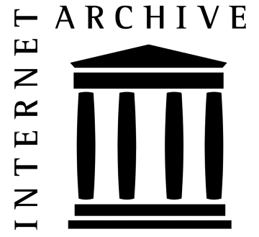
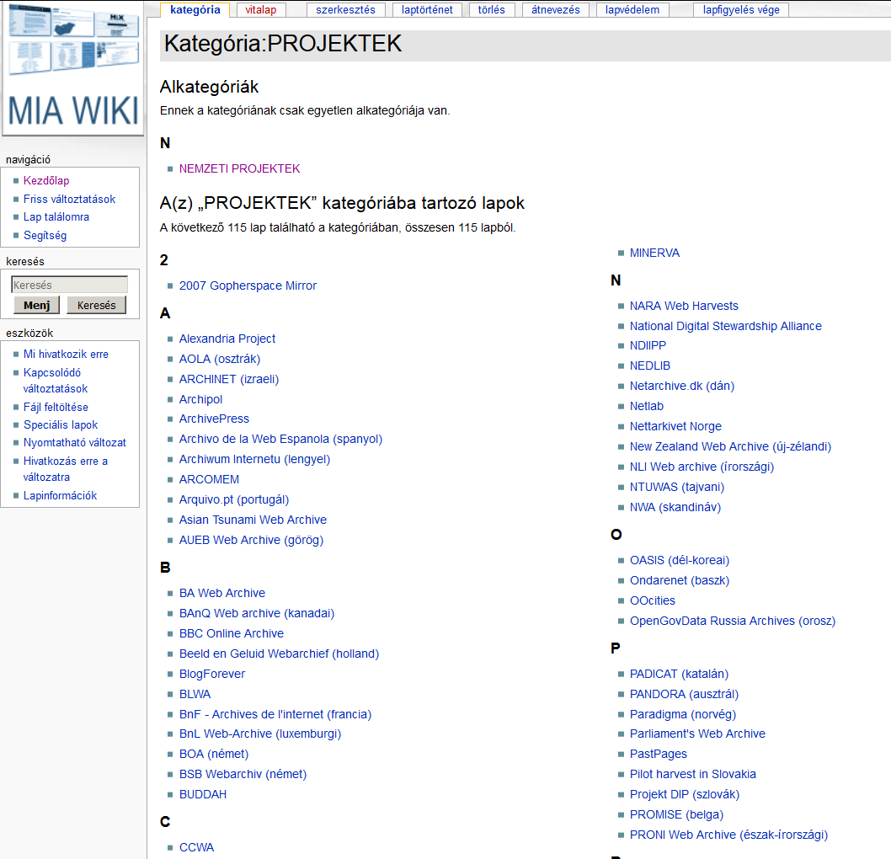
1996 Internet Archive http://web.archive.org
Basic facts (September 2019): 376 billion webpage, more than 15 petabyte. Weekly aquisition by approx 1 billion webpage
More than one hundred web archiving projects have existed throughout the world since 1996
Approx. 40 national webarchives (in operation or in demo-phase) in about 30 countries
Source: http://mekosztaly.oszk.hu/miawiki

Slide 7

International Internet Preservation Consortium (IIPC) http://netpreserve.org
Formally chartered in 2003 at the National Library of France with 12 participating institutions for a 3-year long programme
Nowadays an open organisation with members from 45 countries
National, university and regional libraries, archives
Fund and participate in projects and working groups
Major platform of research and development in web archiving field.
Training Working Group: Developing course materials with the Digital Preservation Coalition
Research Working Group: Support digital humanities research

Slide 8
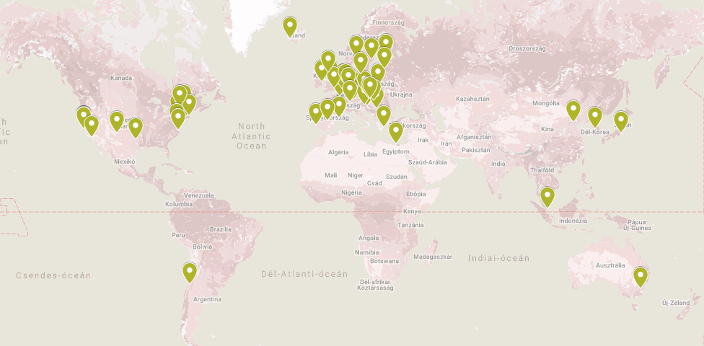

Slide 9
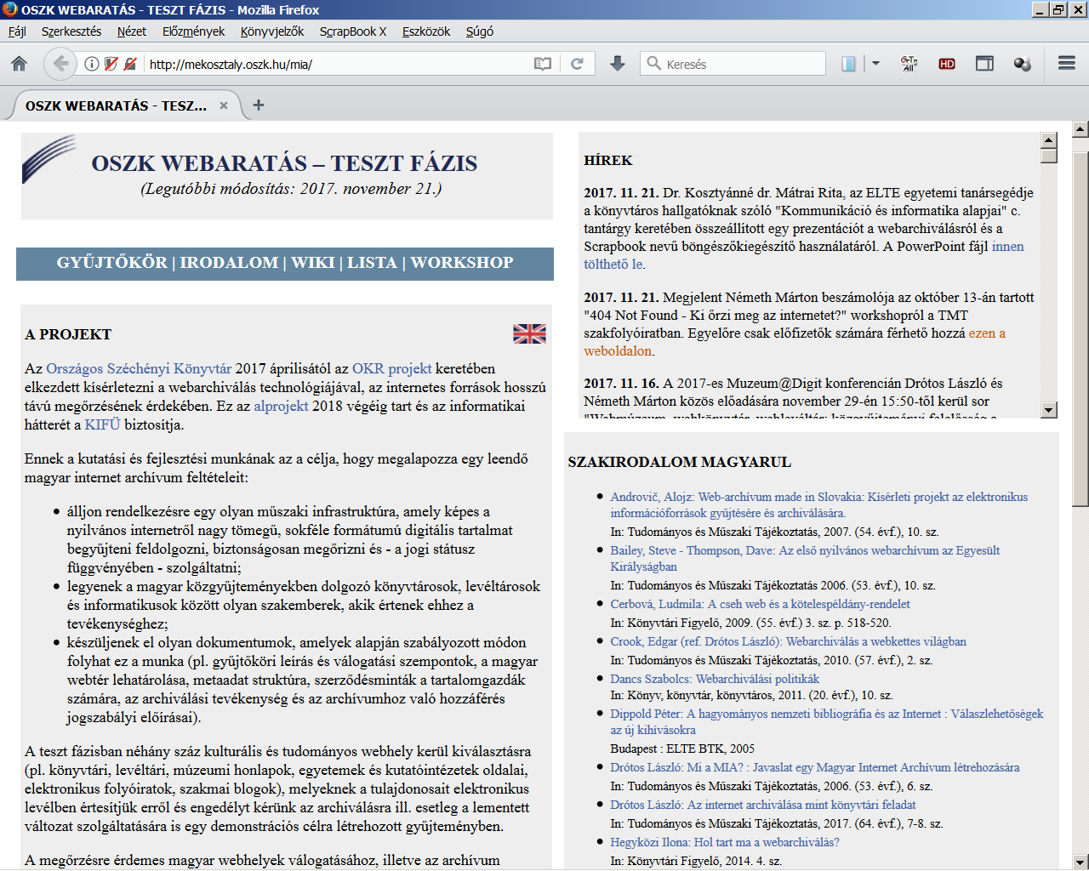
2017- Pilot project at the National Széchényi Library http://mekosztaly.oszk.hu/mia/
Establish a permanent workflow for web archiving to the future. All the basic conditions to run a permanent service project must be guaranteed (IT background, human resource, organisation framework, legal conditions)
Education activities in web archiving field directed to the cultural heritage sector. Helping to establish local archiving projects.
Participation in international collaboration among web archives
Source: http://mekosztaly.oszk.hu/mia

Slide 10
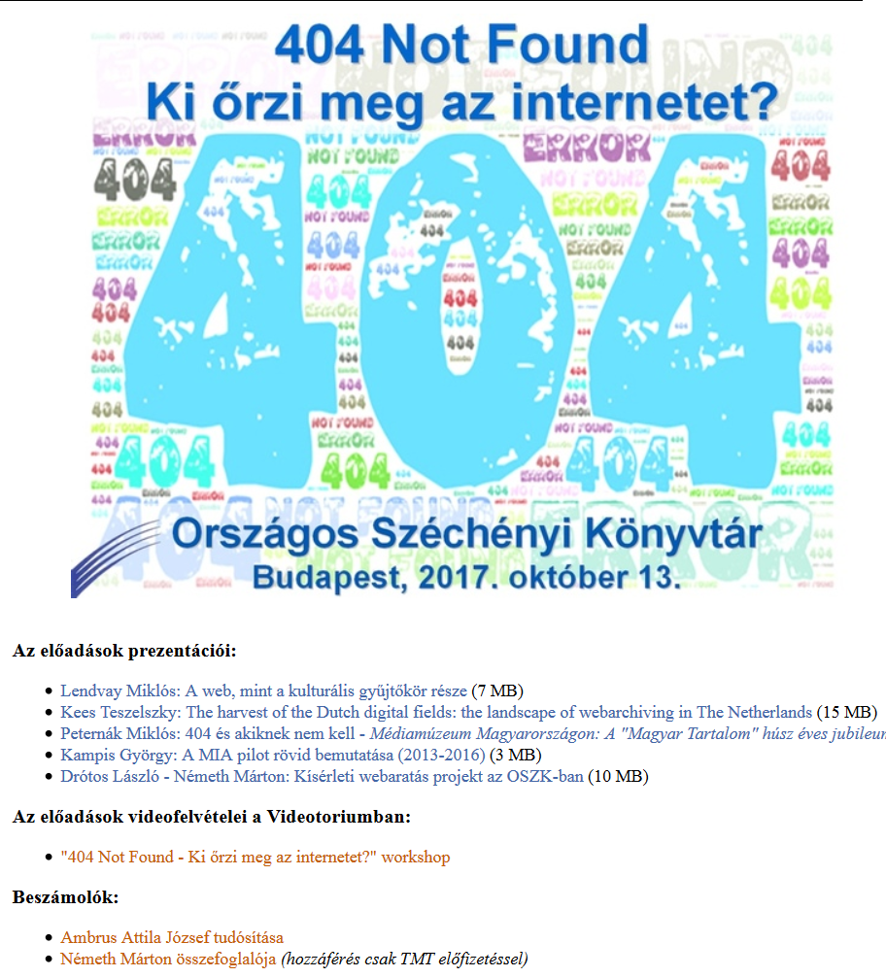
Current results
Professional networking: establish partnerships in Hungary and in international field, IIPC membership
Education: wiki, articles, mailing list, presentations, 404 workshop
Software tests: Heritrix, Open Wayback, Web Curator Tool (furthermore: HTTrack, WARCreate, Webrecorder.io, Webrecorder Player, WAIL, Brozzler, PyWb, SolrWayback)
Test harvesting: libraries, museums, archives, universities, e-periodicals etc.
Source: http://mekosztaly.oszk.hu/mia/404_workshop.html

Slide 11
Main research topics
Web history and web historiography
Web archives and big data
Web archives and the semantic web

Slide 12
The object of research
history of the web as a technical infrastructure;
history of the web as a communication and publication platform;
history of a certain topic, event, institution, person etc. as it was reflected on the web;
archived textual and visual web content or webserver logs as subjects of big data analysis (e.g. for machine learning, for analyzing user characteristics).
12

Slide 13
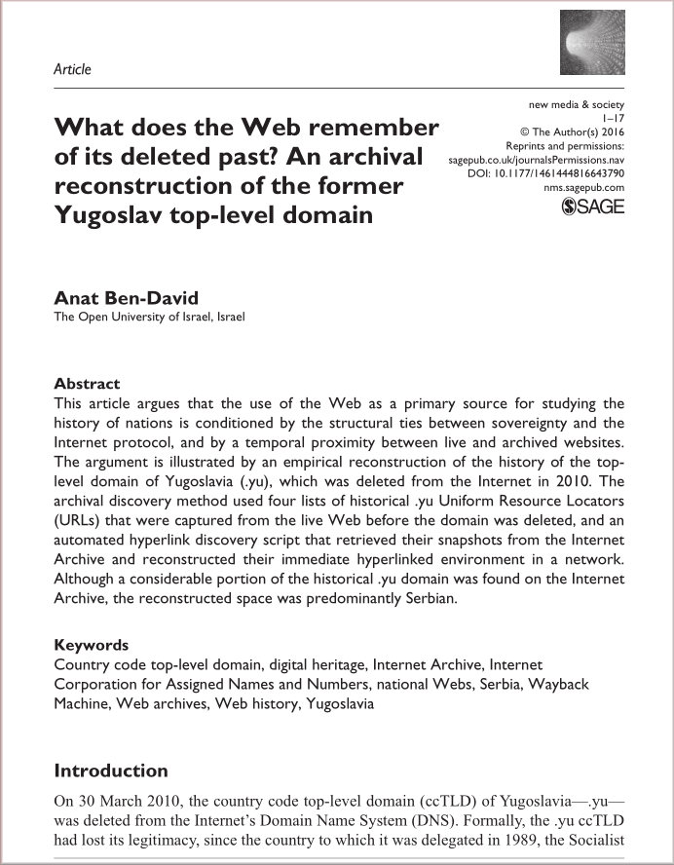
The level of research
individual files or webpages;
individual website(s);
certain domain(s);
the whole websphere.
13

Slide 14
Problems
incomplete mementos, archive or playback errors;
temporal drift and live web leakage (different chronological versions of the elements of a certain webpage or website displayed together);
authenticity of the archived files;
duplicates and URL address changes of websites;
change of the whole content on a certain domain, etc.
14

Slide 15
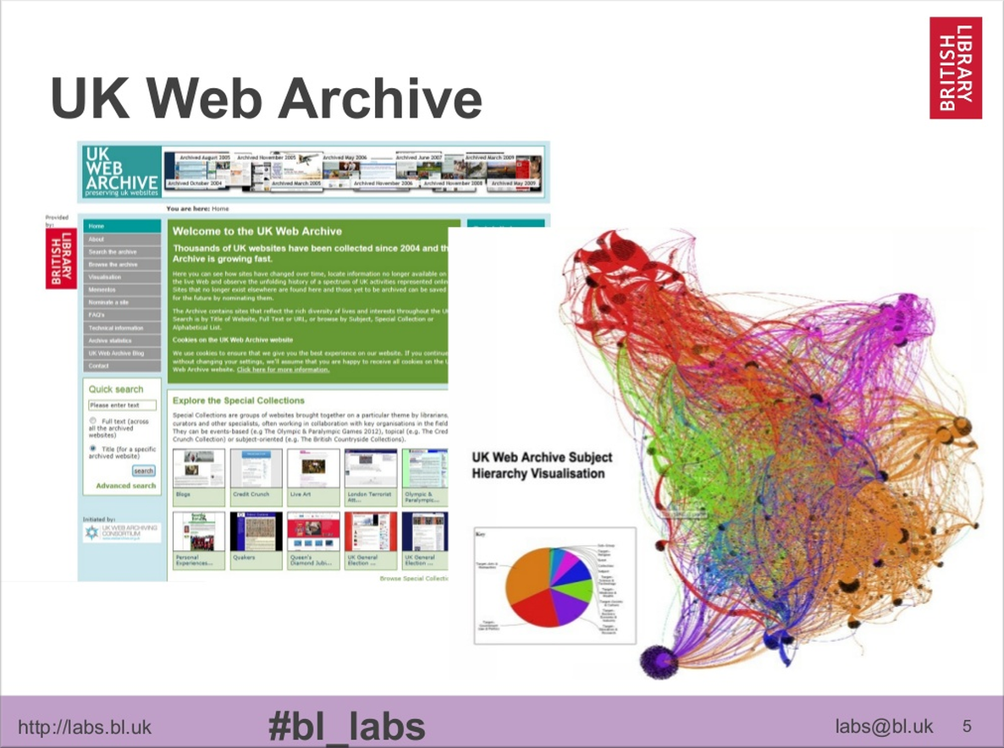
Web archives and big data
The web archives as large corpora can be a research subject of several projects in data science field.
The concept of linked and open data have led the necessity of processing large amounts of semi-structured data in web archives quickly, and retrieve valuable information.
A new way of collaboration can be formed among public collections, web archivists and data scientists in this context.
15

Slide 16
Types of data and mining
web and transaction data (e.g. log data, geolocations);
structural data (e.g. link graphs)
content data (e.g. textual or visual information).
web usage mining;
web structure mining;
web content mining.
16

Slide 17
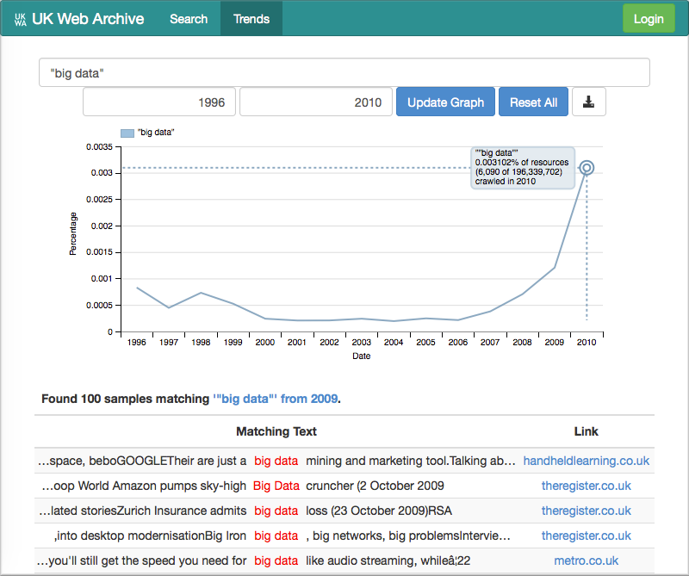
Example: BUDDAH (Big UK Domain Data for the Arts and Humanities)
65 TB dataset containing crawls of the .uk domain from 1996 to 2013;
SHINE historical search engine;
trend analysis;
information visualizations ...
homepage: buddah.projects.history.ac.uk
17

Slide 18
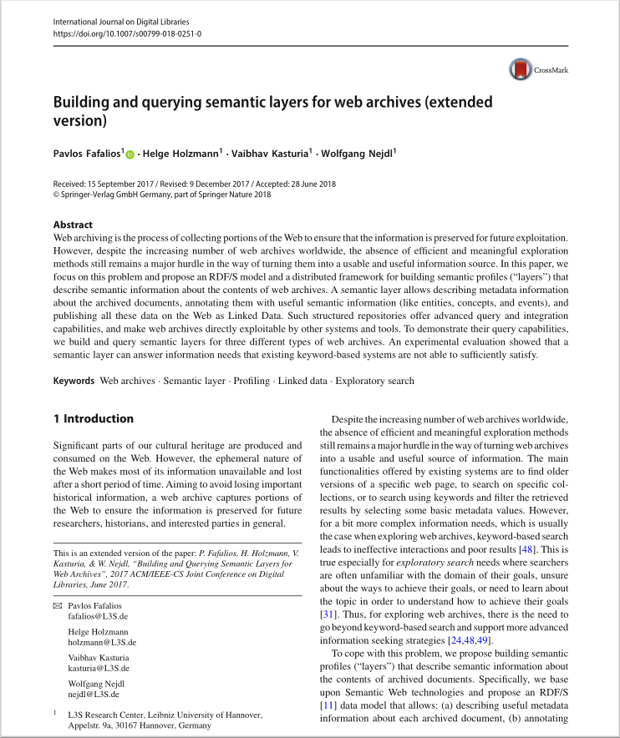
Web archives and the semantic web
The absence of efficient and meaningful exploration methods of the archived content is a really major hurdle in the way to turn web archives to a usable and useful information resource.
A major challenge in information science can be the adaptation of semantic web tools and methods to web archive environments.
The web archives must be a part of the linked data universe with advanced query and integration capabilities, must be able to directly exploitable by other systems and tools.
18

Slide 19
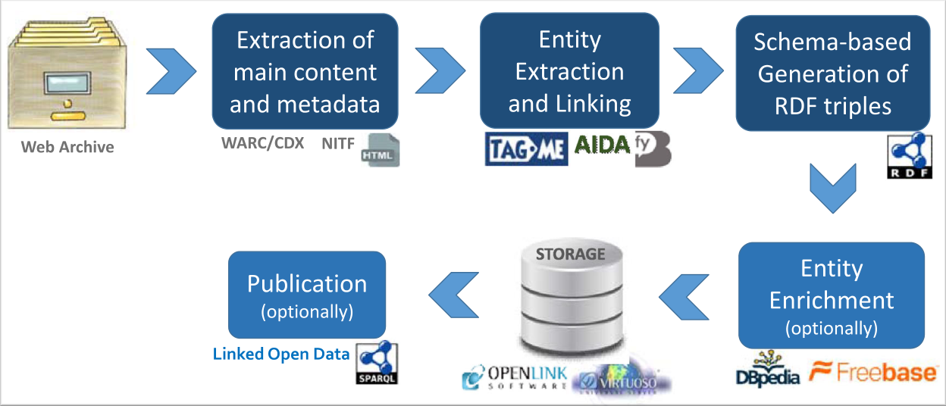
Possible methods
extracting entities;
generation of RDF triples;
enrichment of entities from external sources;
publication of linked data;
advanced queries and ranking models based on semantic data.
The process of constructing a semantic layer in the Open Web Archive data model, proposed by Fafalios, Holzmann, et al. in 2018.
19

Slide 20
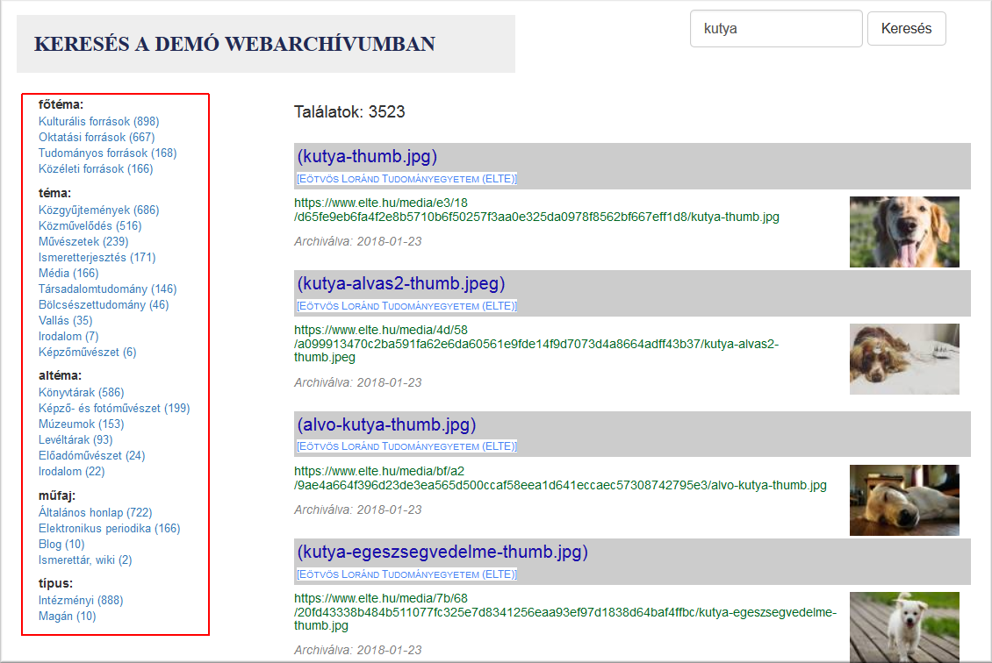
SolrMIA (search engine of the Hungarian demo web archive)
webadmin.oszk.hu/solrmia
Solr-based full text index;
metadata-aided filtering and displaying of hit lists;
future plans:
entity extraction;
metadata enrichment from namespaces and thesauri.
20

Slide 21
DIGICULTES project
Submitted EU-funded project proposal by 20 European Countries (including Hungary) plus USA and Canada. (EU COST – programme)
„The DIGICULTES Action aims to structure and develop a transnational interdisciplinary network and platform for researchers who study the archived Web and for Web archivists in a large number of European national Web archives. The immense untapped research potential of European Web archives, which represents millions of archived Web pages, has not yet been unlocked. To overcome this challenge, all stakeholders need to come together, supported by strong networking activities.”

Slide 22
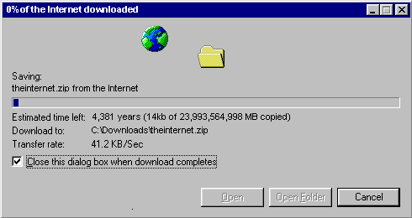
Main task: Archive everything from the Internet that is possible and important to you, until it is not too late…
Source: https://www.w3schools.com/downloadwww.htm
Thank you for your attention!

