Slide 1
Márton Németh – László Drótos
How to catalogue a web archive?
Some solutions for metadata management at the web harvesting pilot project of National Széchényi Library, Hungary
INFINT 2018, Bratislava, October 23, 2018

Slide 2
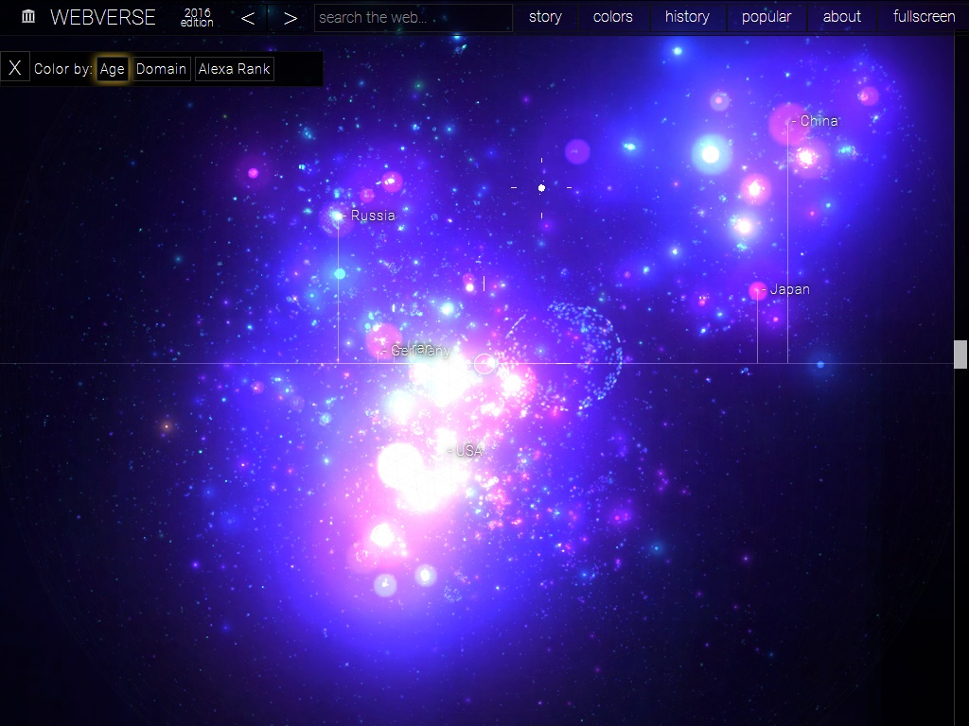
questions:
what is the subject of the description?
what kind of metadata is needed?
in what format?
how this data can be produced?
what can this data be used for?

Slide 3
Source: webverse.org

Slide 4
granularity
the living web is one single document
(a huge, ever-changing, unlimited hypermedia)
the archived web is a versioned (time-stamped) file depository
collection method: selective / event-based / domain-wide harvest, automatic submit, deposit
levels of description: collection, sub-collection, website, website unit, document, file
user needs, scale of archiving, available staff

Slide 5
metadata types (website level)
bibliographic: e.g. title (lots of variations), creator/contributor/publisher (uncertain roles), rights (unclear legal status), dates (what kind of dates?), subject/type (very mixed content) ...
administrative: e.g. curator, nominator, urgency, permission request, harvesting schedule, quality assurance, access ...
technical: original CMS, harvester software, harvest parameters, size of the downloaded content, storage, long-term preservation ...

Slide 6
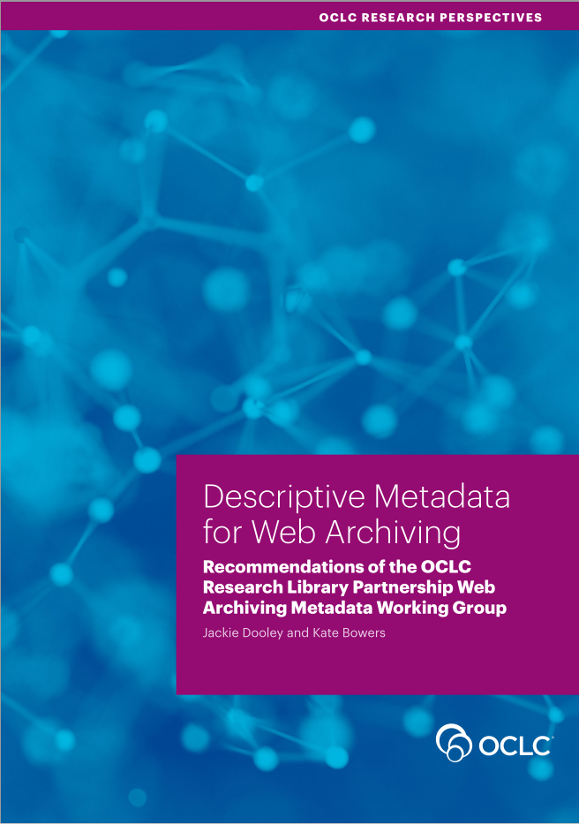
recommendations
ISO/TR 14873:2013 – Statistics and quality issues
for web archiving (collection level indicators)
Descriptive Metadata for Web
Archiving / OCLC Web Archiving
Metadata Working Group (mostly
site-level bibliographic data fields,
based on the Dublin Core schema)
Metadata Application Profile for
Description of Websites with Archived
Versions / New York Art Resources
Consortium (site-level, MARC/RDA)

Slide 7
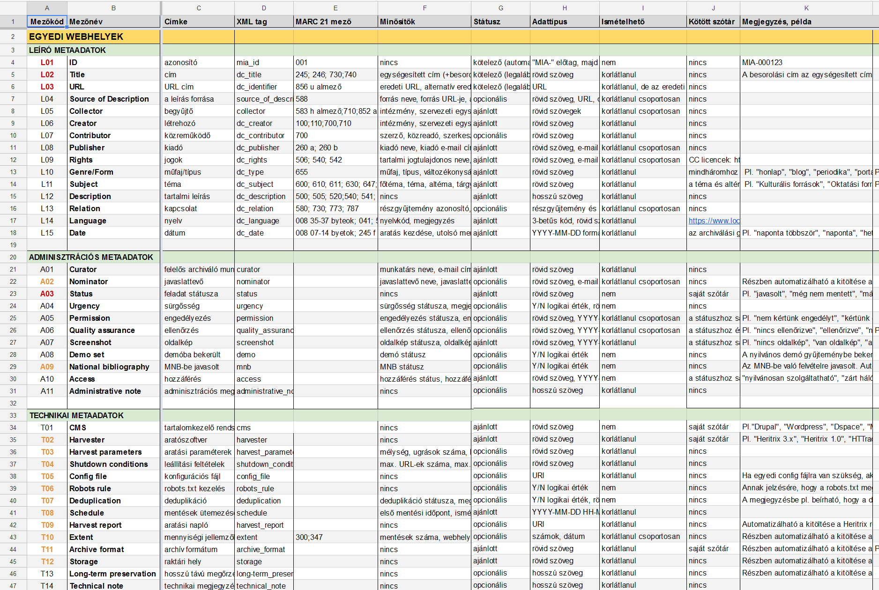
database plan for the Hungarian webarchive (website level)

Slide 8
our metadata records
a small publicly available demo collection
XSD (XML Schema Definition) and XSLT (Extensible Stylesheet Language Transformations) files
predefined lists (e.g. genre, type, topic, subtopic, change frequency, harvest frequency, quality level)
namespace links (person and geographic names)
related sites (on the living web and in the archive)
site-level and subcollection-level XML records
manual data entry with XML Notepad (temporarily)

Slide 9
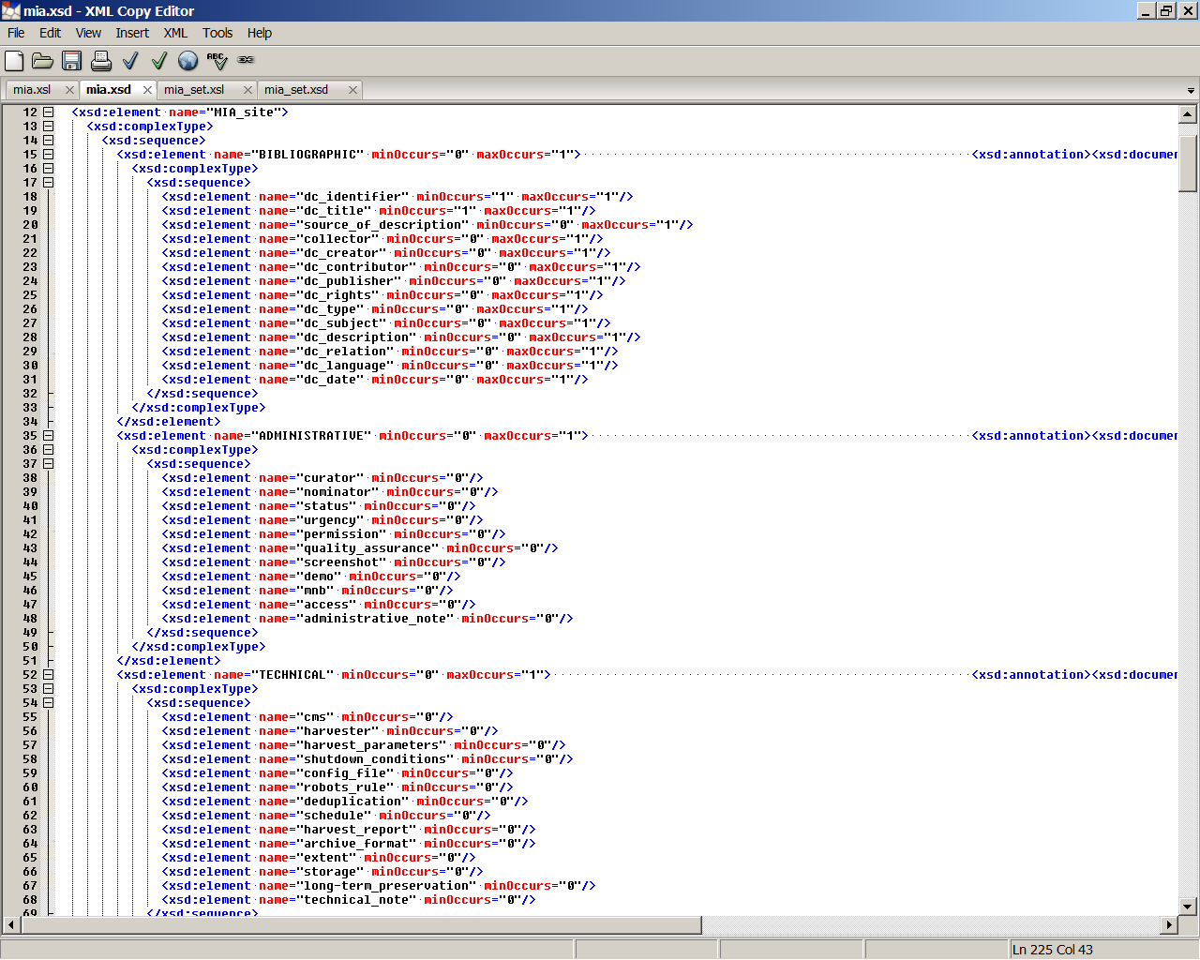
the mia.xsd file (website level)

Slide 10
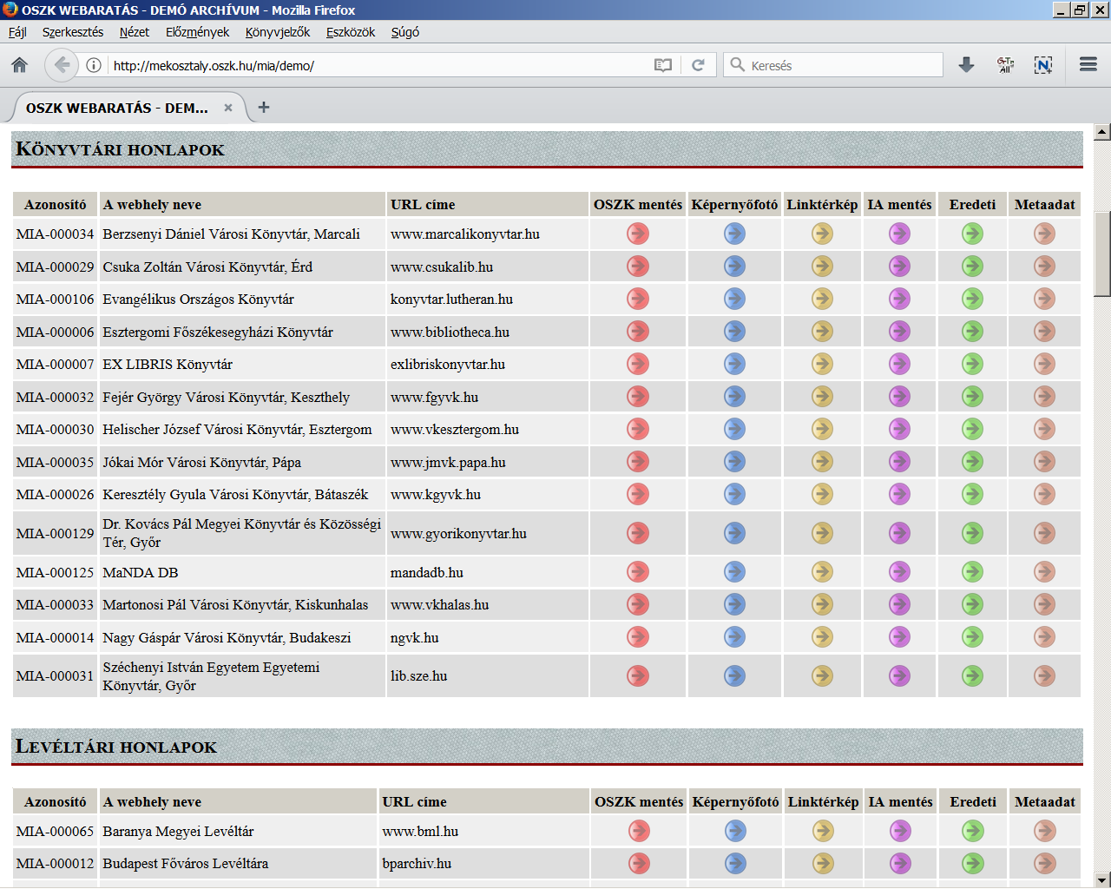
a snippet from the public demo collection webpage
icons: archived | screenshot | linkgraph | Internet Archive | original | metadata

Slide 11
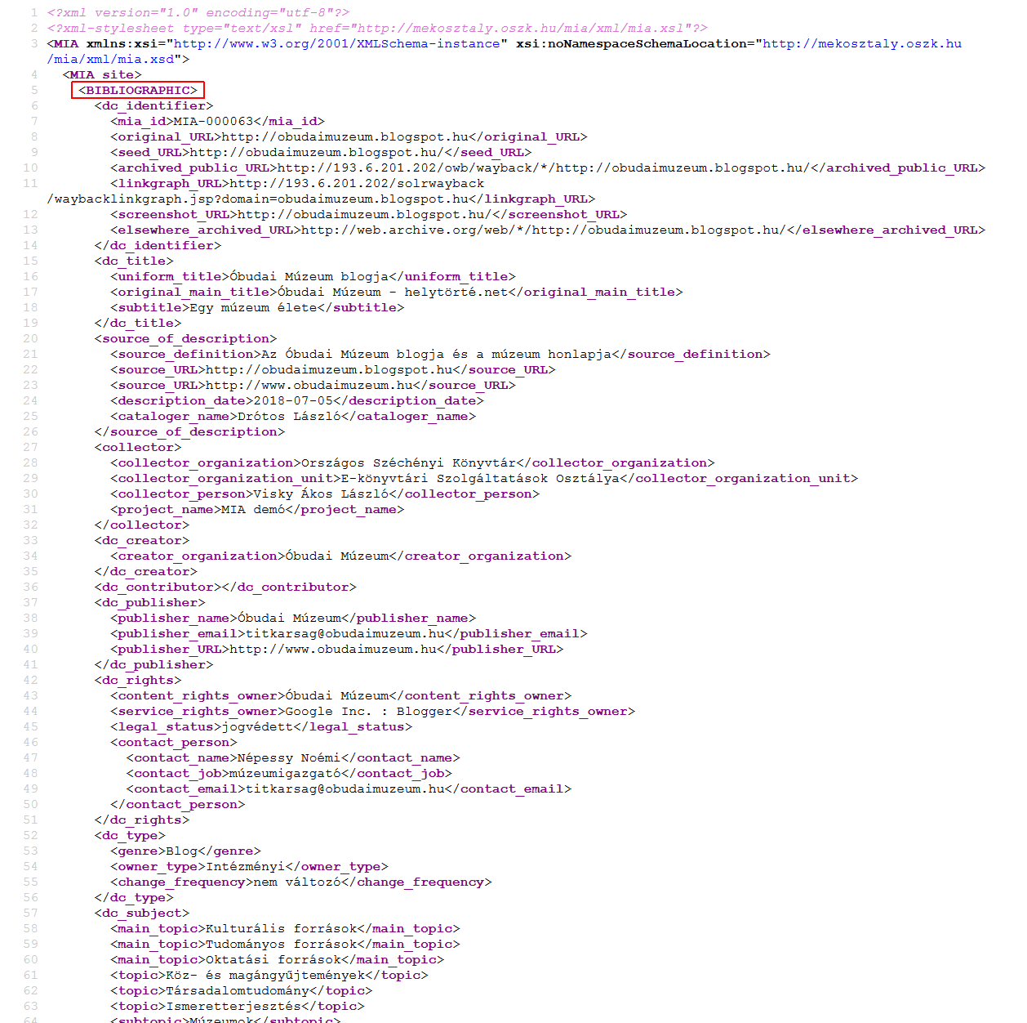
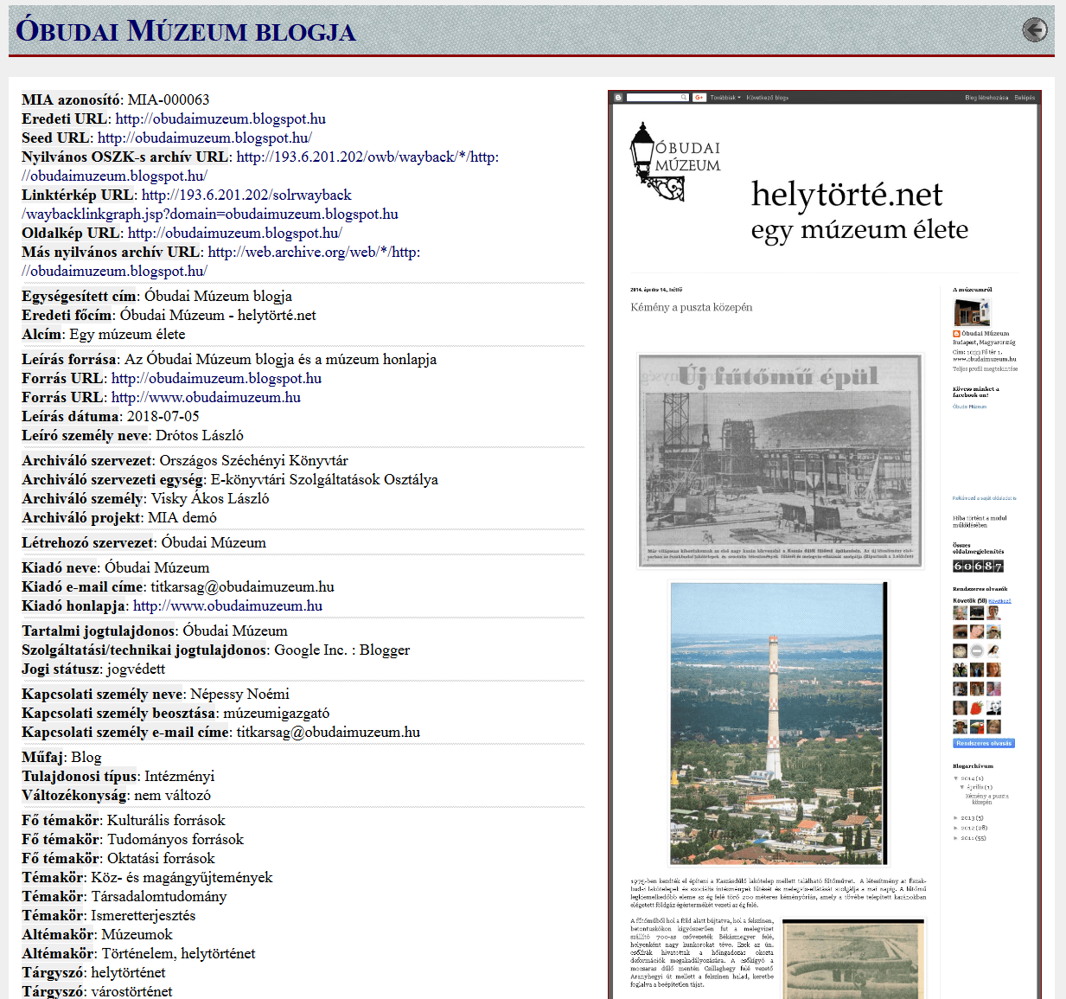
metadata of the Óbuda Museum’s blog
(original XML and converted HTML format)

Slide 12
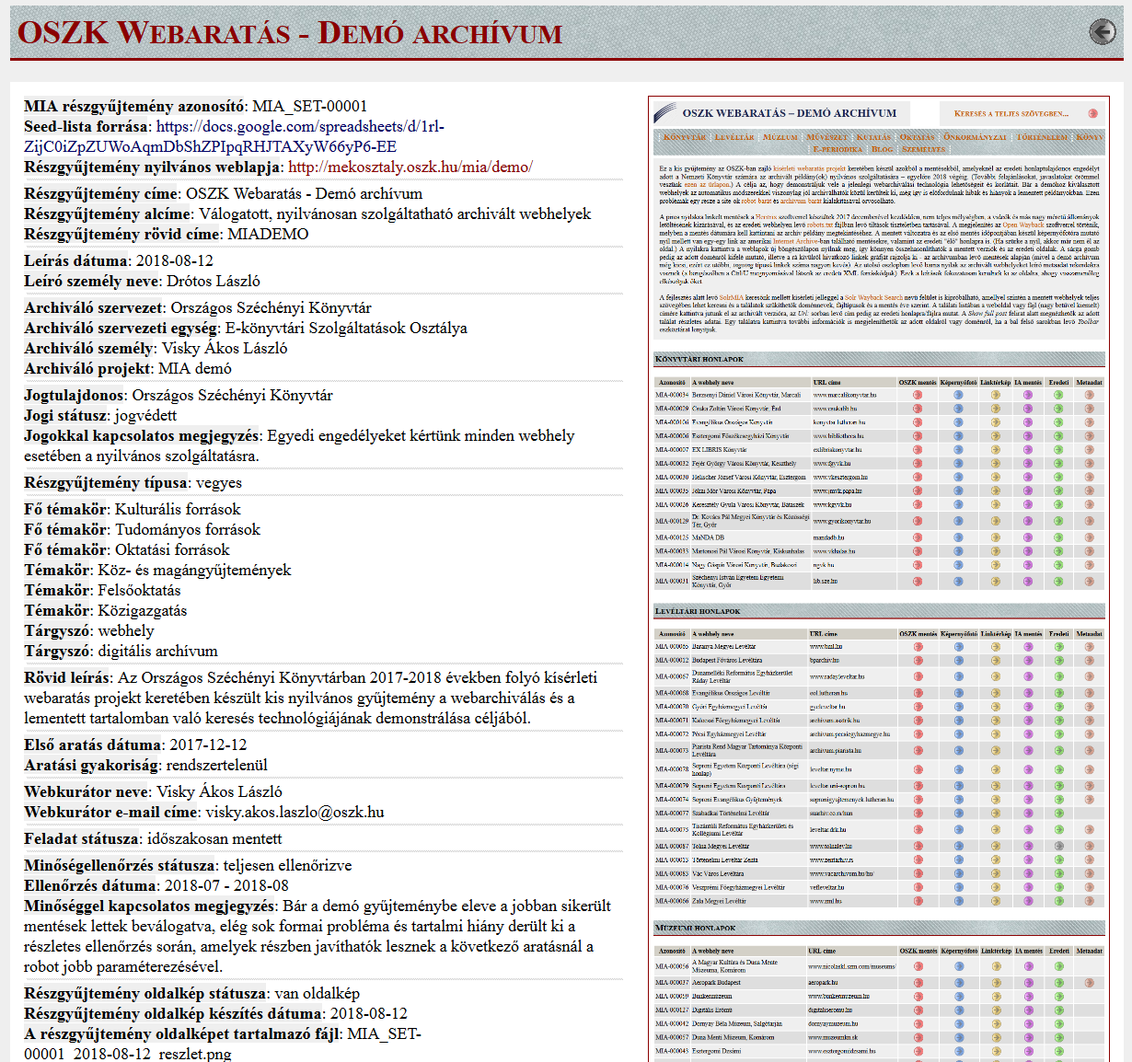
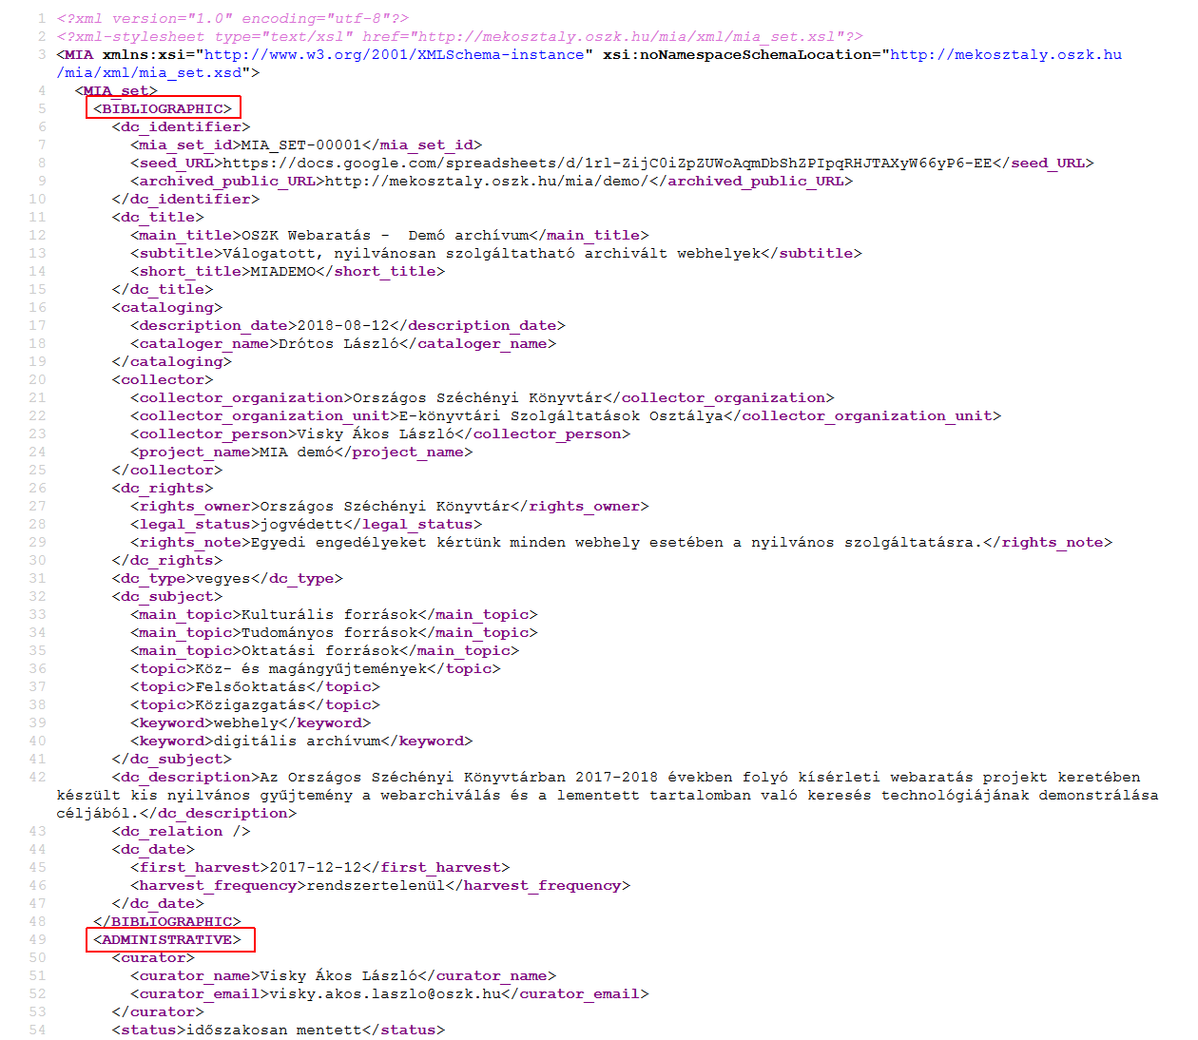
metadata of the demo collection
(original XML and converted HTML format)

Slide 13
future plans
database and form-based data entry interface
(as part of the new nation-wide library system)
cooperation with other memory institutions
(e.g. shared cataloging)
automatic and semi-automatic metadata generation (mostly technical and administrative data)
automatic entity identification and extraction from the full text (e.g. names, events, concepts)
enriching metadata from external sources (e.g. DBpedia)
incorporate metadata of important archived websites into the national bibliography
faceted full text hit lists by metadata

Slide 14
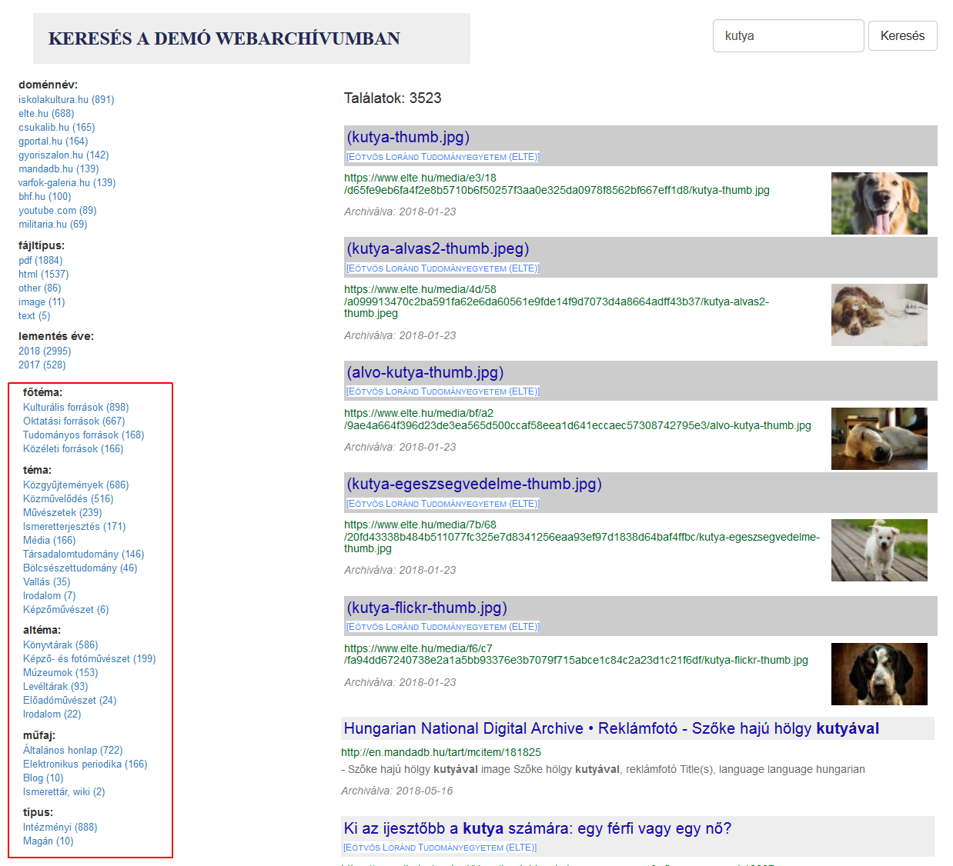
filtering options by topic, subtopic, genre and type
(in-house developed Solr-based full text search engine)

Slide 15
thank you for your attention!
project homepage: http://mekosztaly.oszk.hu/mia/
project description in English: http://netpreserve.org/about-us/members/orszagos-szechenyi-konyvtar/
demo web archive: http://mekosztaly.oszk.hu/mia/demo/
“404 not found” workshop (Budapest, November 15, 2018): http://mekosztaly.oszk.hu/mia/404_workshop.html
contact e-mail address: mia@mek.oszk.hu

