Slide 1

Metadata supported full-text search in a web archive
Márton Németh – László Drótos National Széchényi Library Hungary

Slide 2
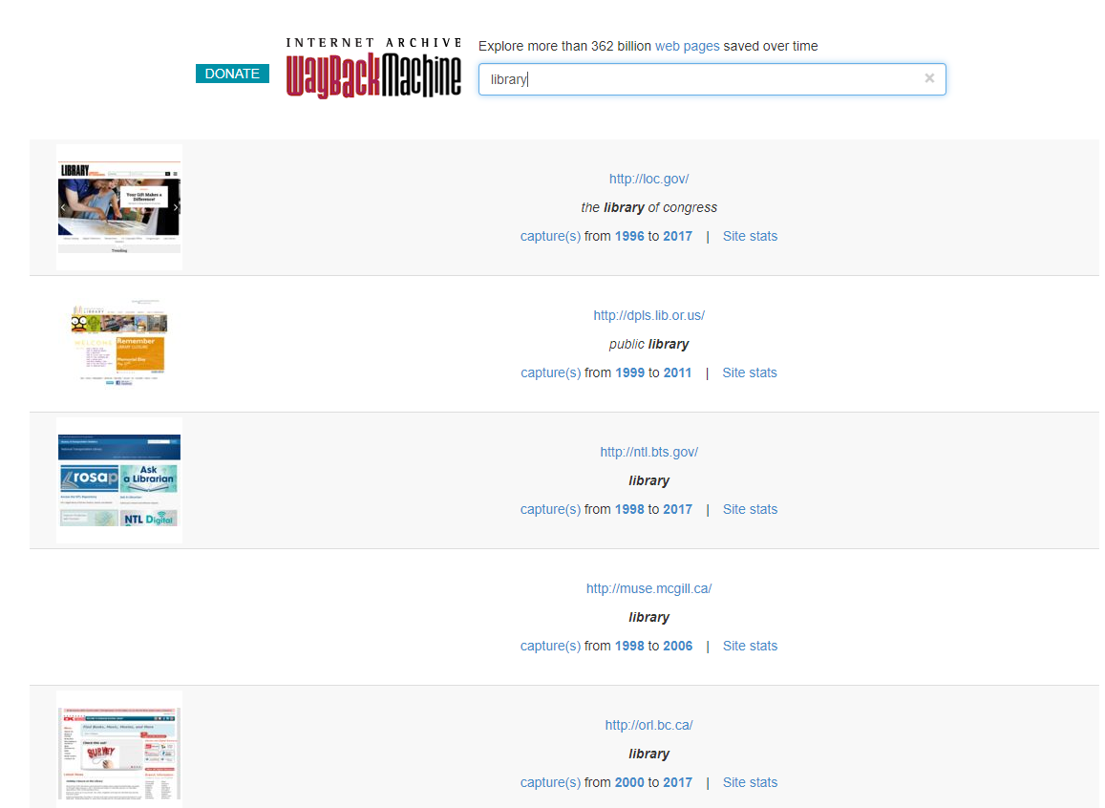
search by web site names in the Wayback Machine

Slide 3
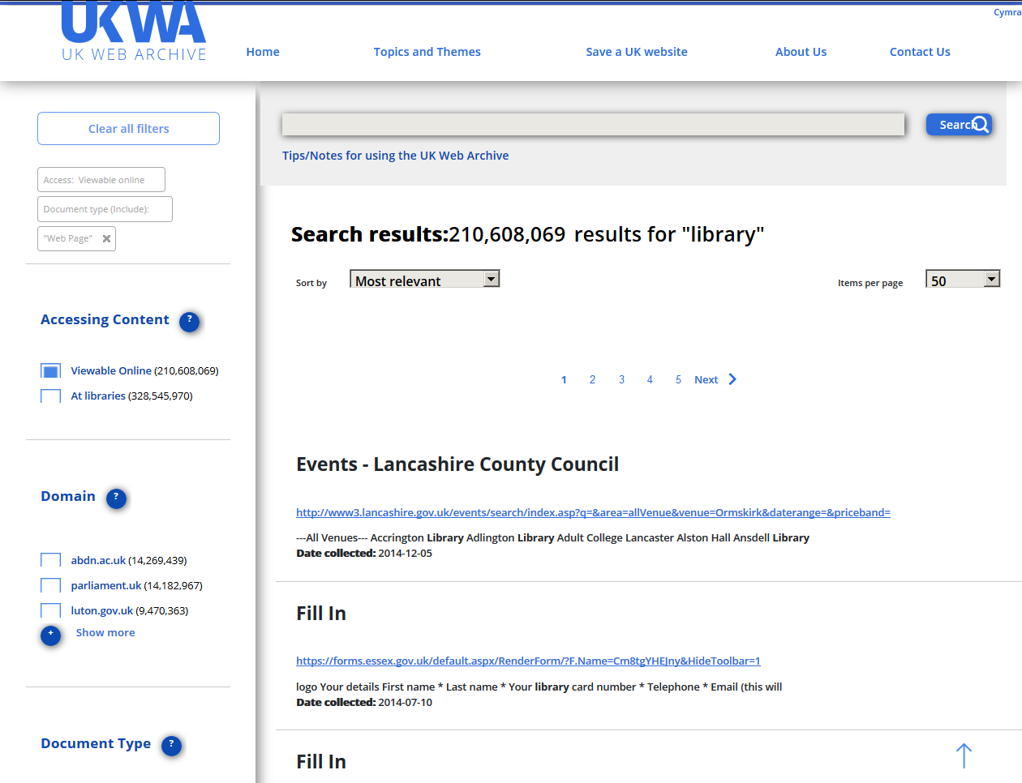
full-text search in the UK Web Archive

Slide 4
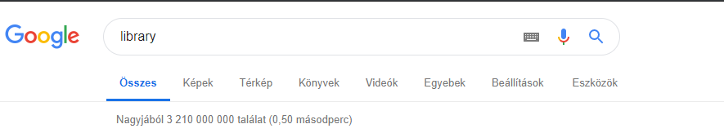
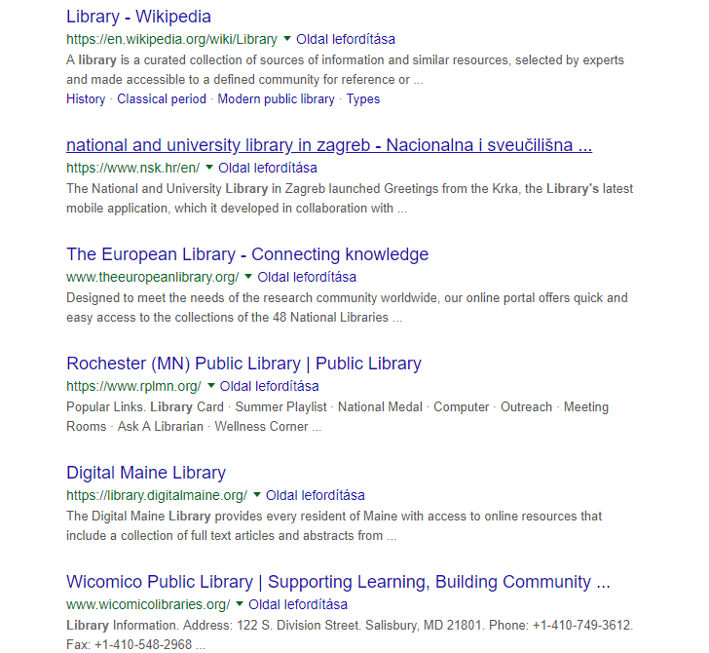
full-text search on the live web with Google

Slide 5
Main challenges for web archives:
lack of full-text search capability (e.g. because of the sheer size of the archive, or because GDPR considerations);
lack of relevance (how to get relevant hits from a huge set of archived webpages full of partially duplicated content and „garbage”?);
such a knowledge base, that Google has, is out of question for the web archiving community (over 200 ranking factors: geo targeting, user browsing and search history, freshness of the content, number of organic clicks, artificial intelligence etc.)
What can we do instead?
metadata supported full-text search
semantic web-based query tools and services

Slide 6
Metadata types (on website level):
bibliographic: e.g. title (lots of variations), creator/contributor/publisher (uncertain roles), rights (unclear legal status), dates (what kind of dates?), subject/type (very mixed content) ...
administrative: e.g. curator, nominator, urgency, permission request, harvesting schedule, quality assurance, access ...
technical: e.g. original CMS, harvester software, harvest parameters, size of the downloaded content, storage, long-term preservation ...

Slide 7
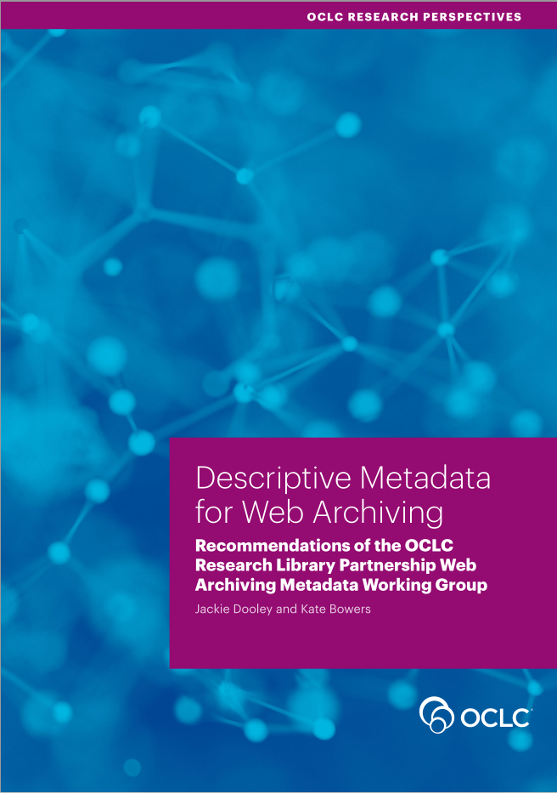
Recommendations for metadata:
ISO/TR 14873:2013 – Statistics and quality issues for web archiving (collection level indicators)
Descriptive Metadata for Web Archiving OCLC Web Archiving Metadata Working Group (mostly site-level bibliographic data fields, based on the Dublin Core schema)
Metadata Application Profile for Description of Websites with Archived Versions New York Art Resources Consortium (site-level, MARC/RDA)

Slide 8
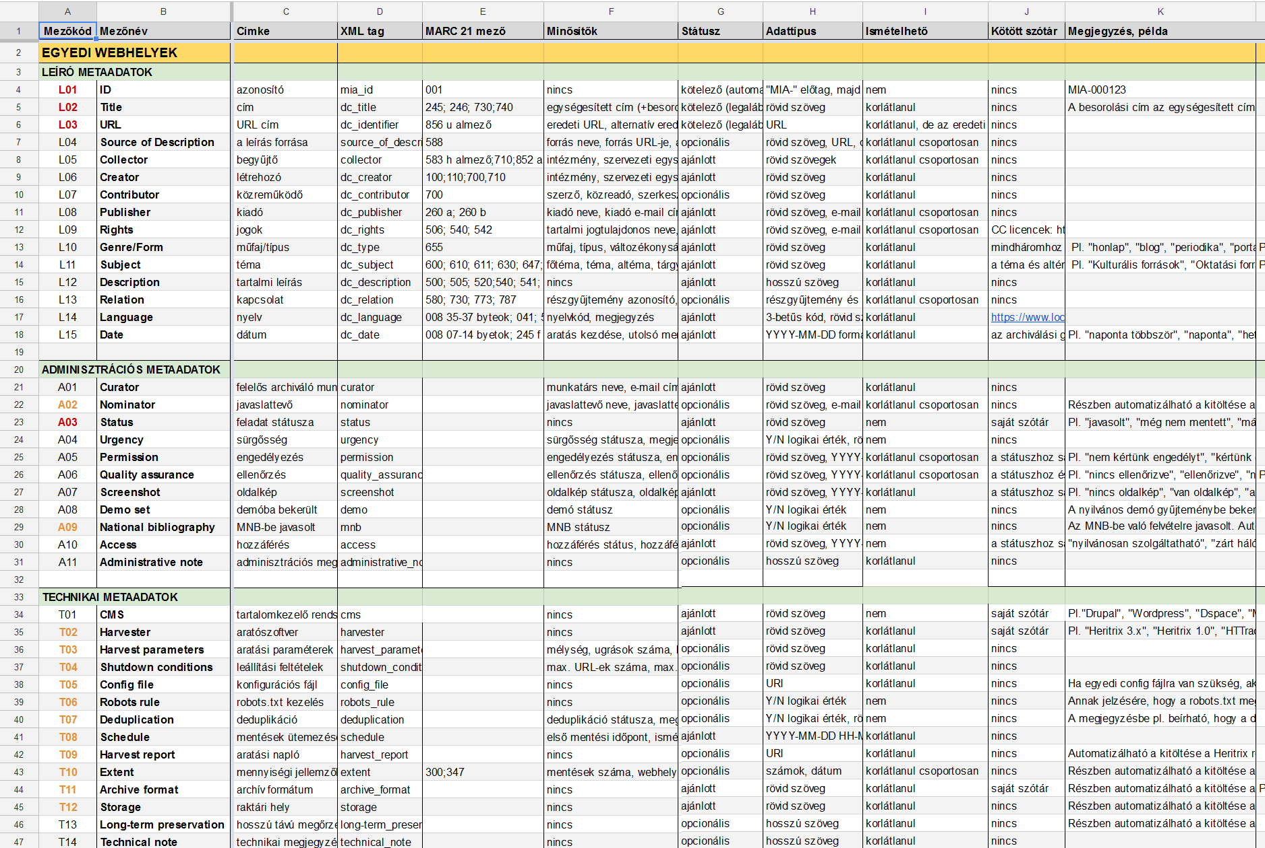
database plan for the Hungarian webarchive (website level)

Slide 9
Our metadata records:
a small publicly available demo collection
XSD (XML Schema Definition) and XSLT (Extensible Stylesheet Language Transformations) files
predefined lists (e.g. genre, type, topic, subtopic, change frequency, harvest frequency, quality level)
namespace links (person and geographic names)
related sites (on the living web and in the archive)
site-level and subcollection-level XML records
manual data entry with XML Notepad (temporarily)

Slide 10
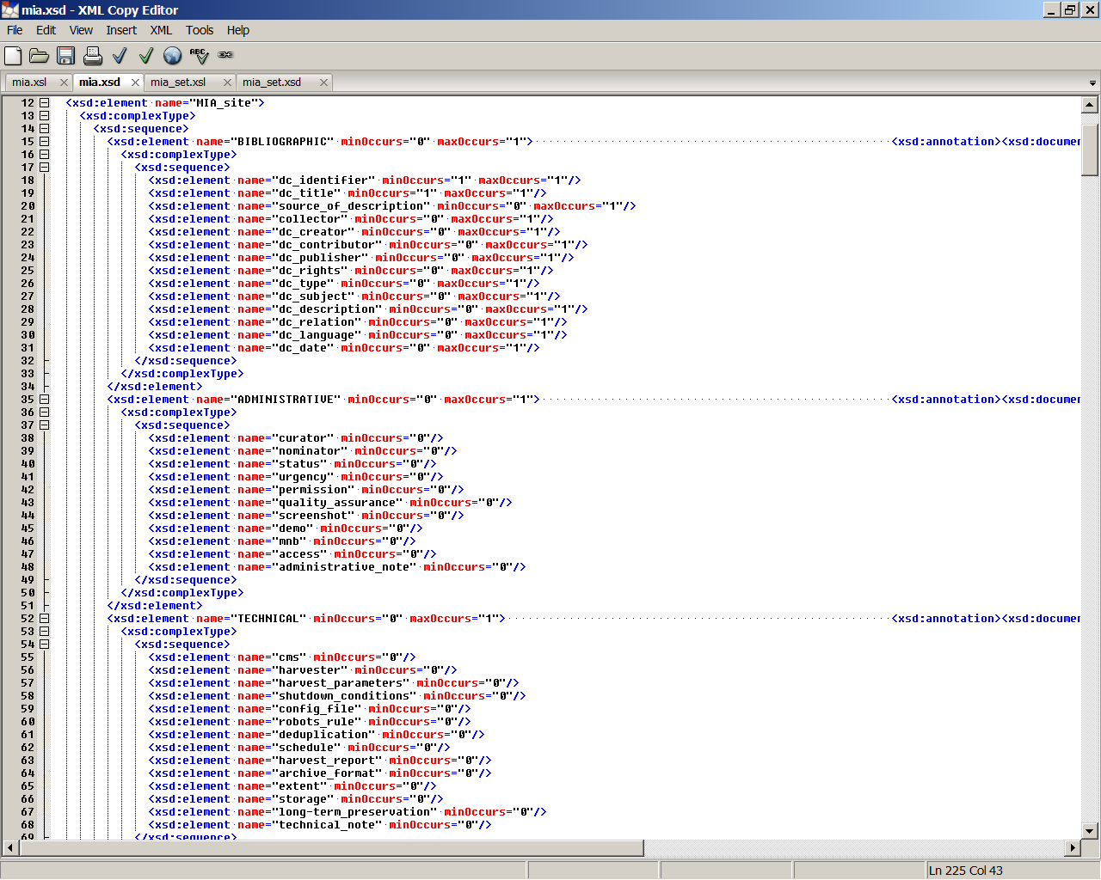
mia.xsd file (website level)

Slide 11
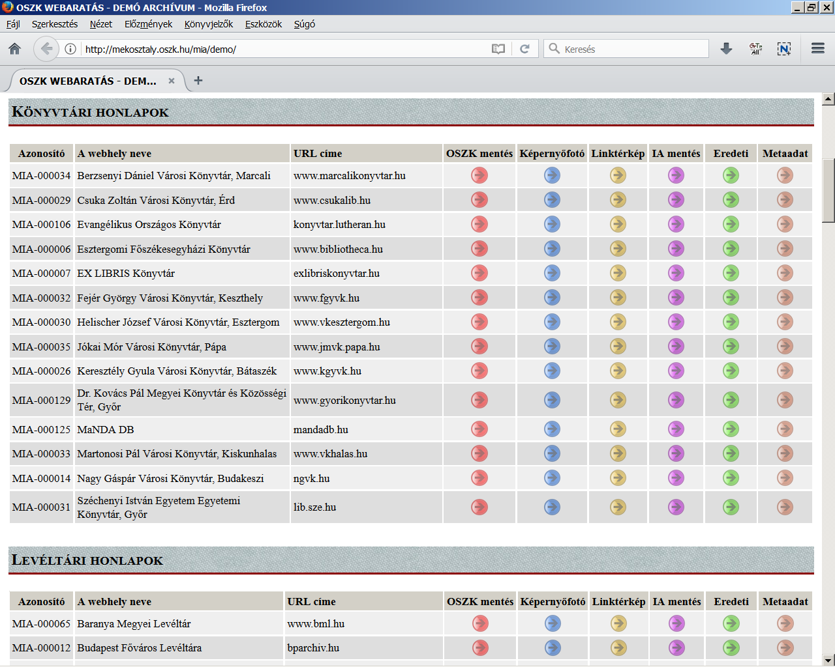
a snippet from the public demo collection webpage
icons: archived | screenshot | linkgraph | Internet Archive | original | metadata

Slide 12
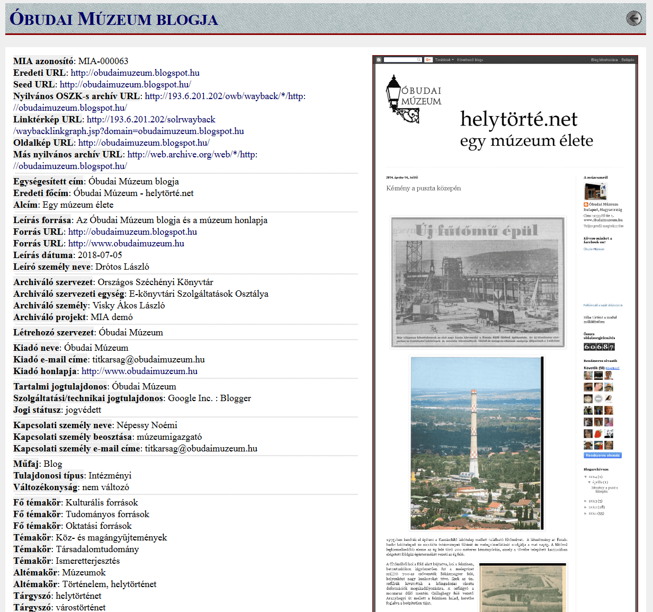
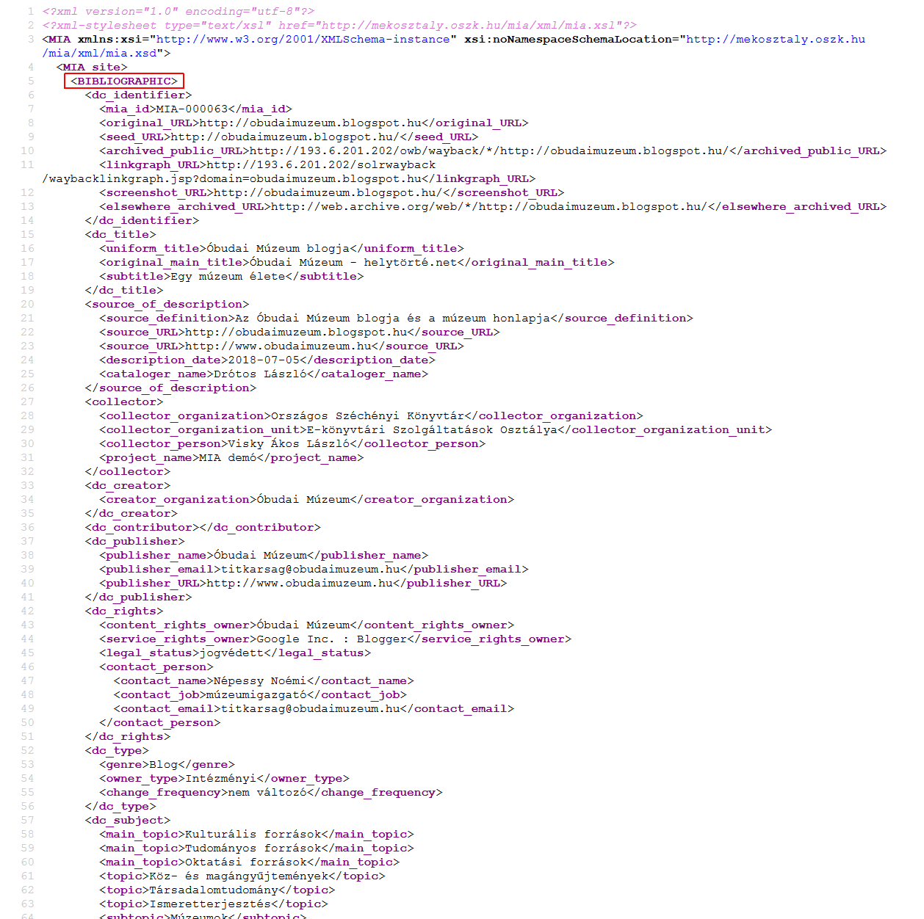
metadata of the Óbuda Museum’s blog (original XML and converted HTML format)

Slide 13
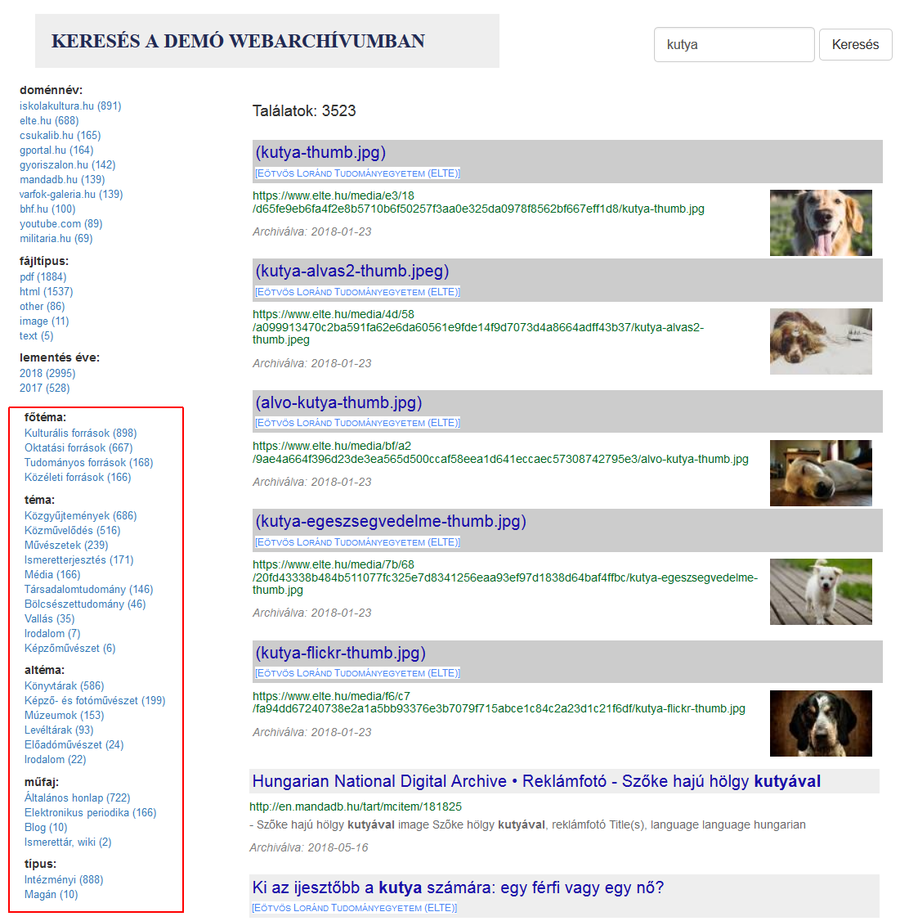
The unified name of the original web site (blue in white) comes from the XML metadata record
Filtering options are being generated from the XML metadata records
filtering options by topic, subtopic, genre and type, (in-house developed Solr-based full-text search engine)

Slide 14
Future plans:
database and form-based data entry interface (as part of the new nation-wide library system)
cooperation with other memory institutions (e.g. shared cataloging)
automatic and semi-automatic metadata generation (mostly technical and administrative data)
incorporate metadata of important archived websites into the national bibliography
faceted full-text hit lists filtered by metadata

Slide 15
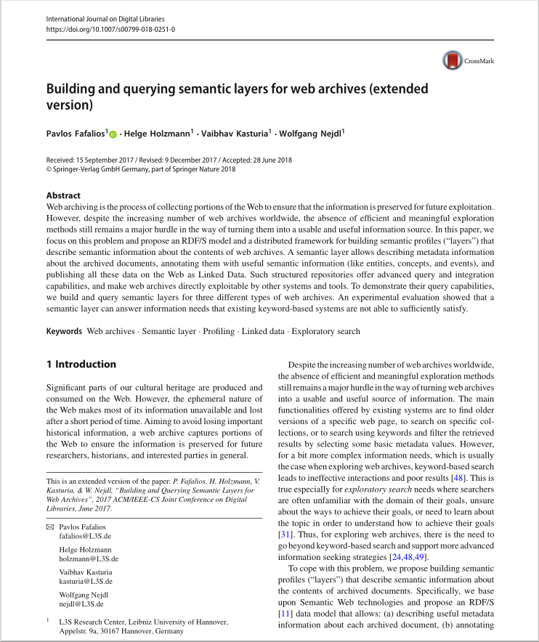
Web archives and the semantic web:
The absence of efficient and meaningful exploration methods of the archived content is a really major hurdle in the way to turn web archives to a usable and useful information resource.
A major challenge in information science can be the adaptation of semantic web tools and methods to web archive environments.
The web archives must be a part of the linked data universe with advanced query and integration capabilities, must be able to directly exploitable by other systems and tools.

Slide 16
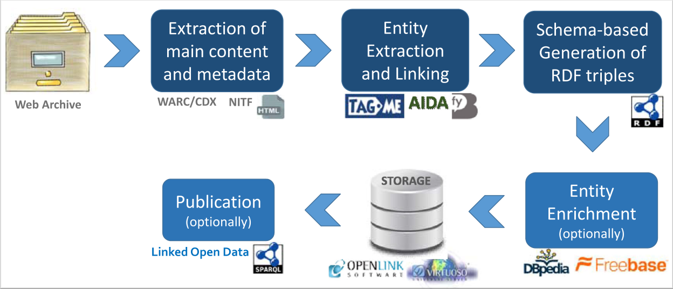
Possible methods:
extracting entities;
generation of RDF triples;
enrichment of entities from external sources;
publication of linked data;
advanced queries and ranking models based on semantic data.
The process of constructing a semantic layer in the Open Web Archive data model, proposed by Fafalios, Holzmann, et al. in 2018.

Slide 17
Future plans:
automatic entity identification and extraction from the full text (e.g. names, events, concepts)
enriching metadata from external sources (e.g. DBpedia)
combining with the national namespace of the NSZL (in beta phase)
metadata enrichment from namespaces and thesauri
elaborate a PhD project (partners needed)

Slide 18
Thank you for your attention! Questions?
Hungarian web archiving project: http://mekosztaly.oszk.hu/mia/
Demo web archive: http://mekosztaly.oszk.hu/mia/demo/
Selected bibliography on web archiving: http://mekosztaly.oszk.hu/mia/doc/webarchivalas-irodalom.html
Contact e-mail: mia@mek.oszk.hu

