Slide 1

Web archives as a research subject
Márton Németh – László Drótos
(National Széchényi Library, Hungary)
BOBCATSSS 2019, Osijek
24 January 2019

Slide 2
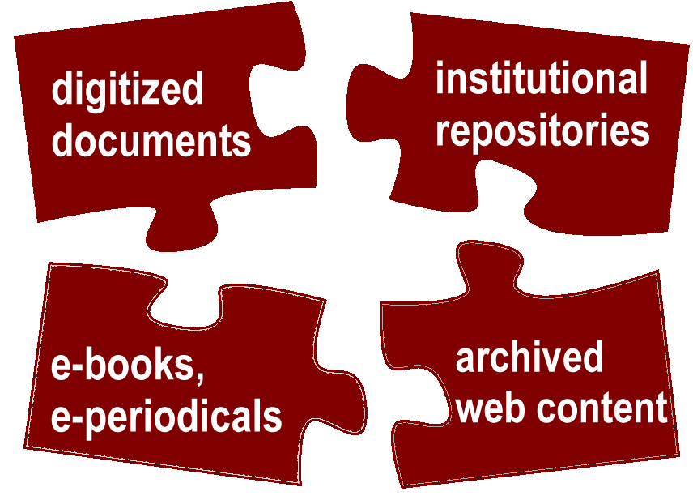
Digital sources of research
The archived web material can be defined as a major research subject itself.
Librarians, archivists, information scientists, professionals in Digital Humanities, data scientists and IT-developers can work together on analysing large archived web corpora focusing on several structural and content-based features.
New scientific disciplines have emerged through these research activities in the past ten years, such as web history.
2

Slide 3
Main topics
Web history and web historiography
Web archives and big data
Web archives and the semantic web

Slide 4
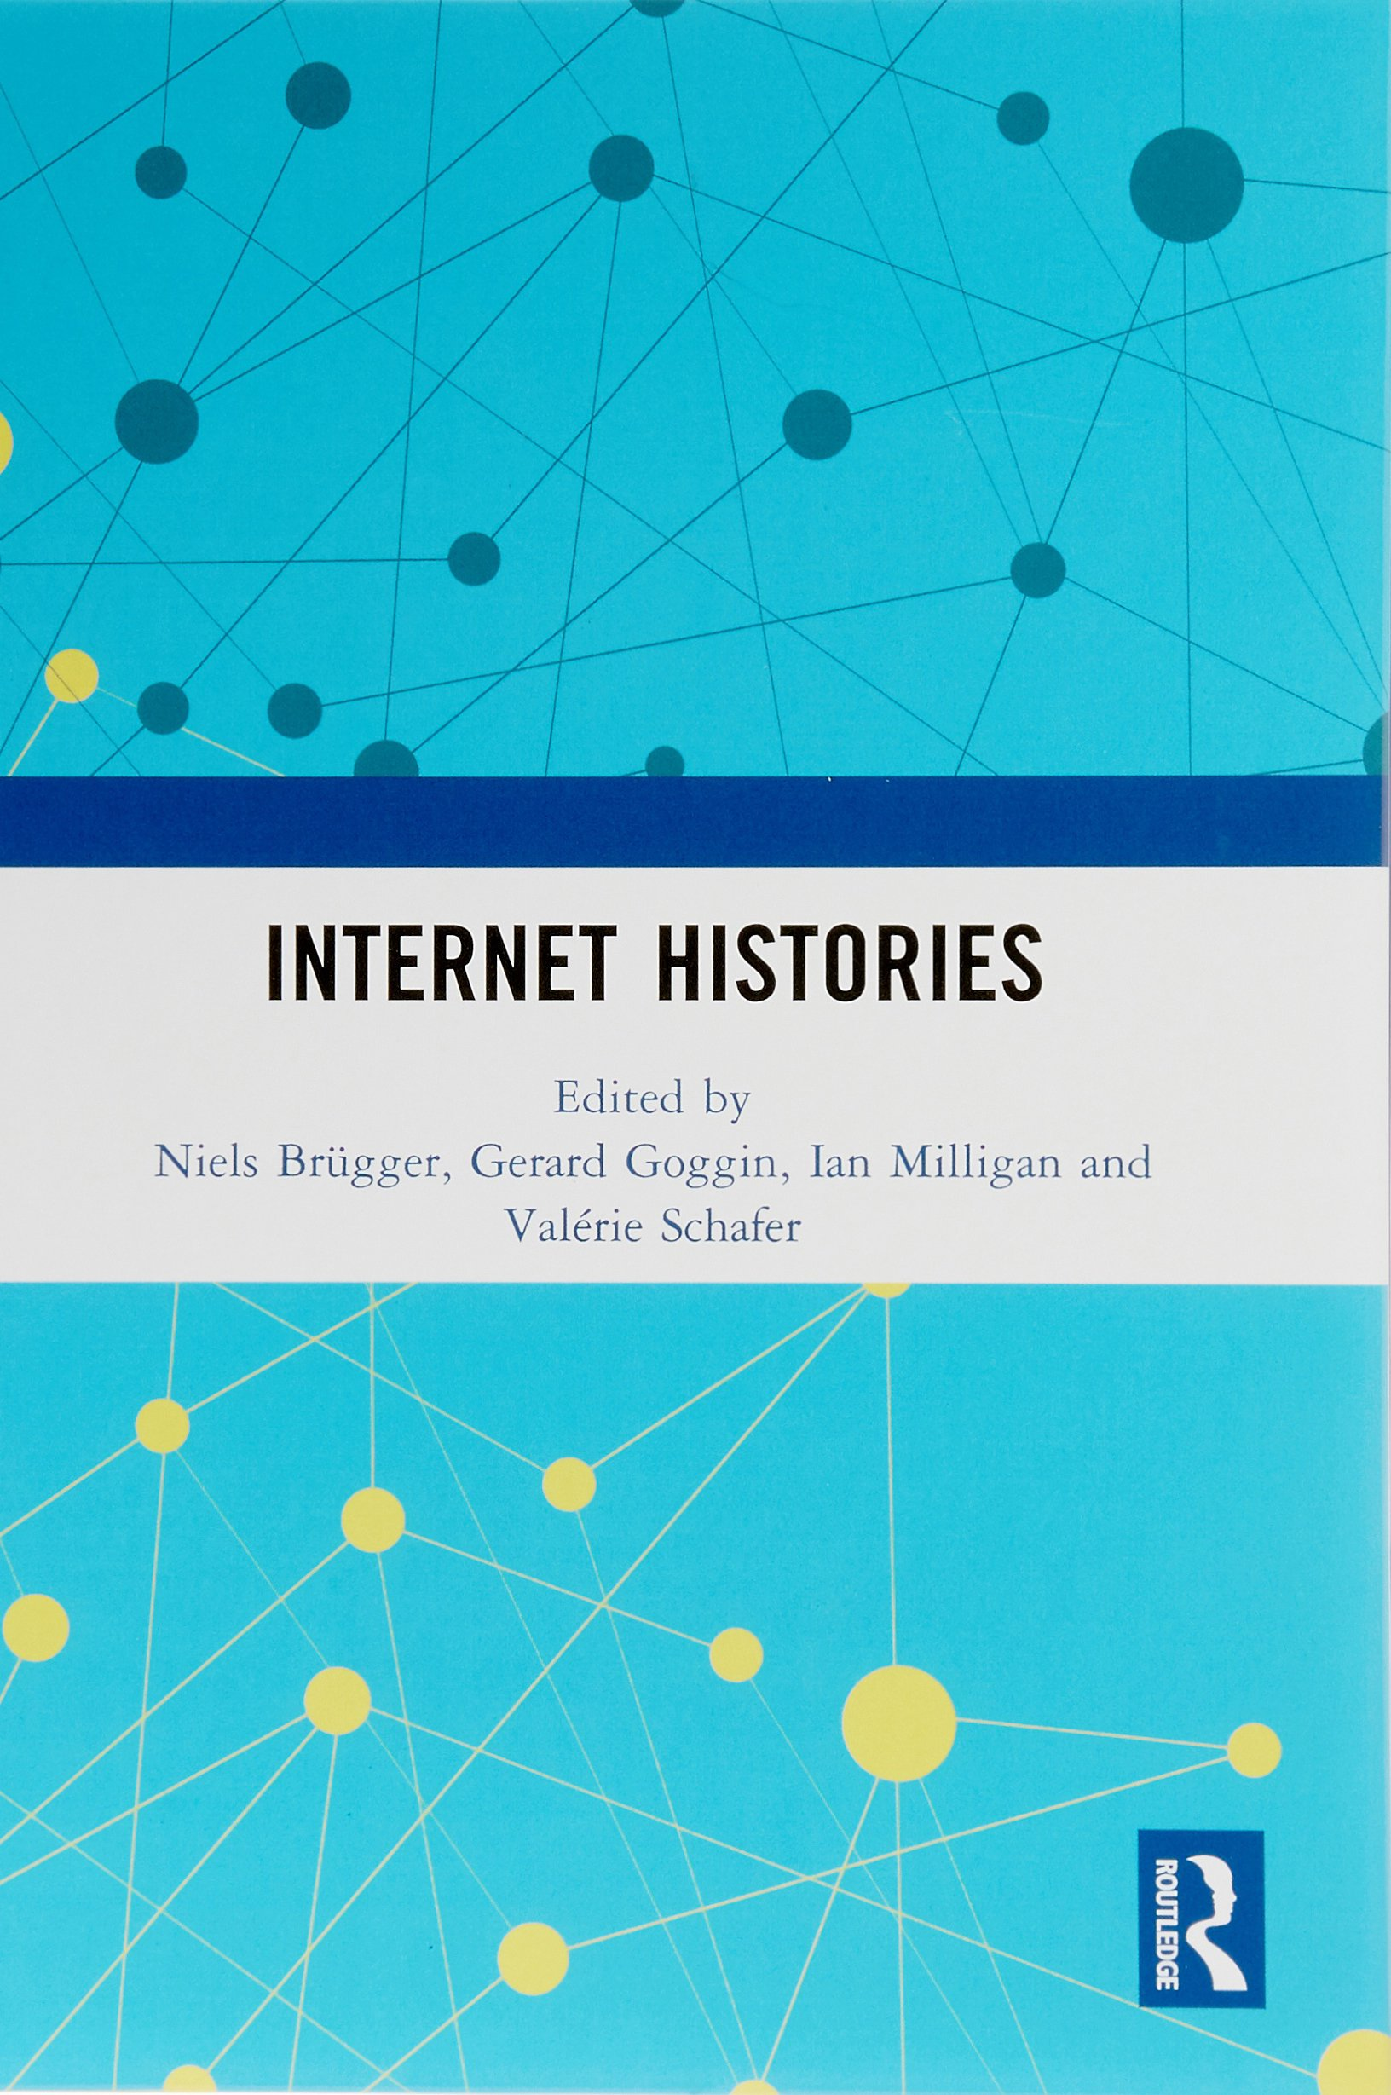
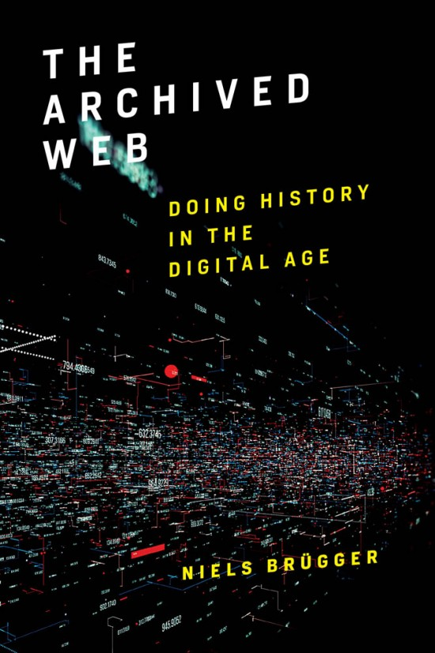
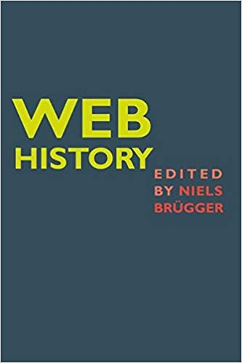
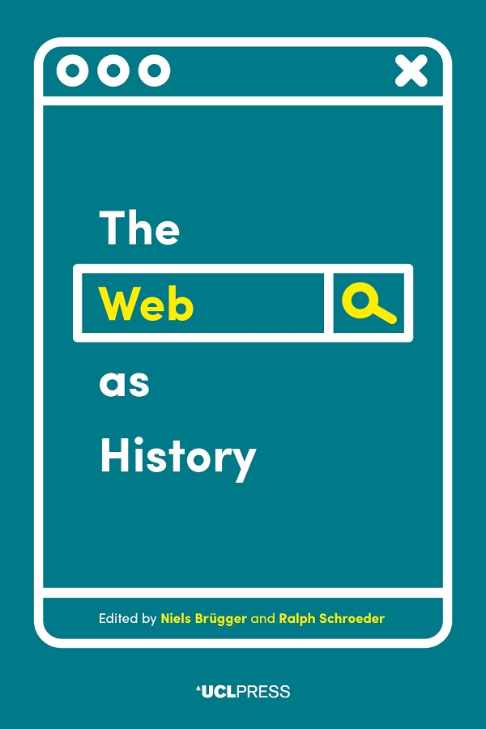

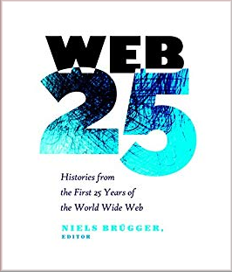
Web history and web historiography
4

Slide 5
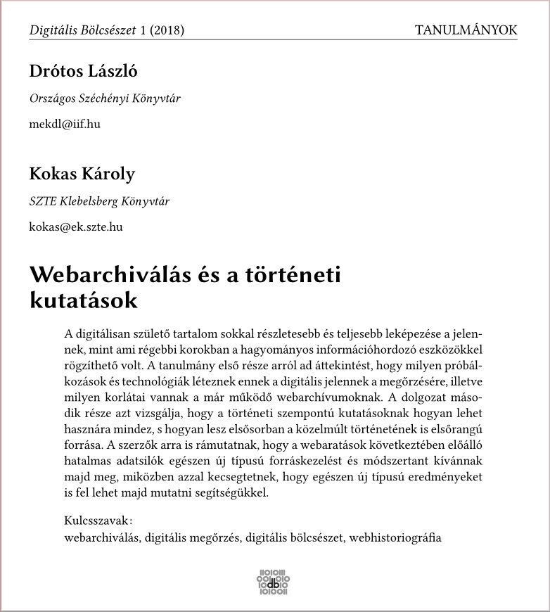

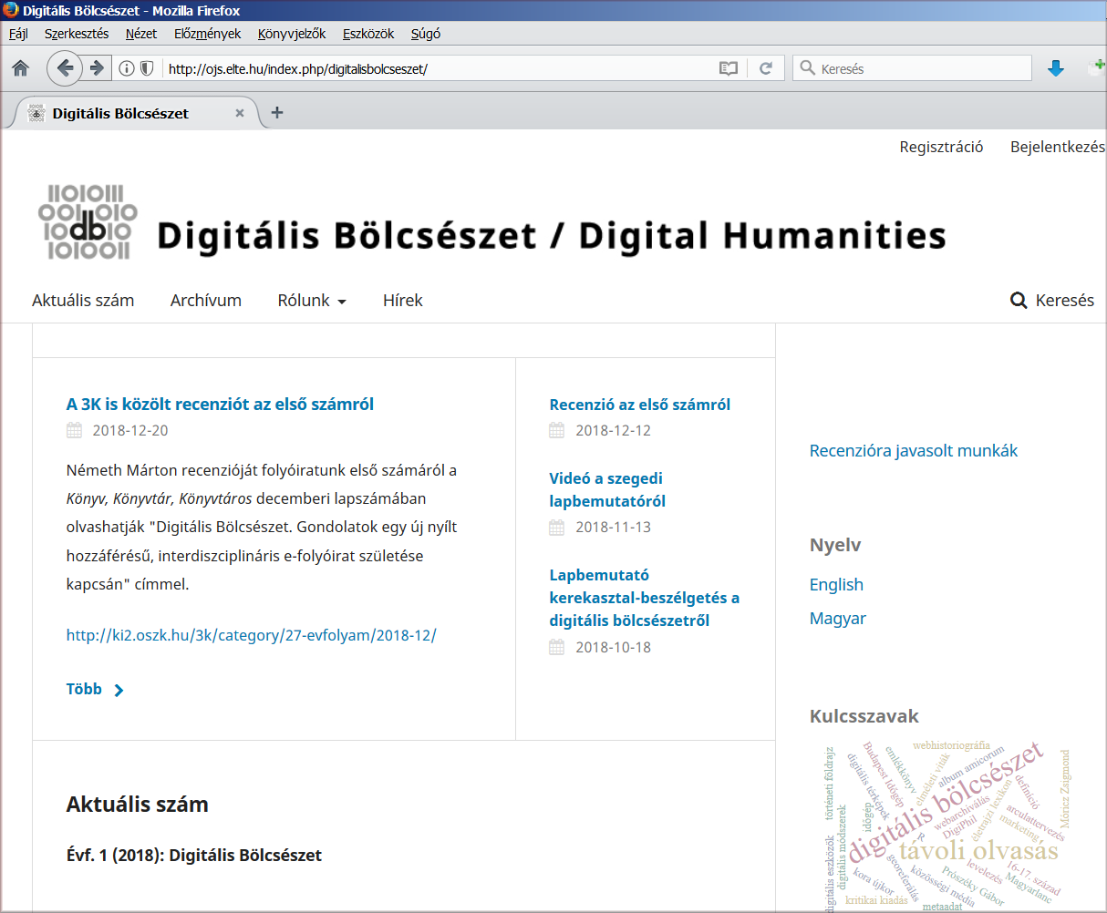
Digitális Bölcsészet - Digital Humanities
(Hungarian open access journal)
5

Slide 6
The object of research
history of the web as a technical infrastructure;
history of the web as a communication and publication platform;
history of a certain topic, event, institution, person etc. as it was reflected on the web;
archived textual and visual web content or webserver logs as subjects of big data analysis (e.g. for machine learning, for analyzing user characteristics).
6

Slide 7
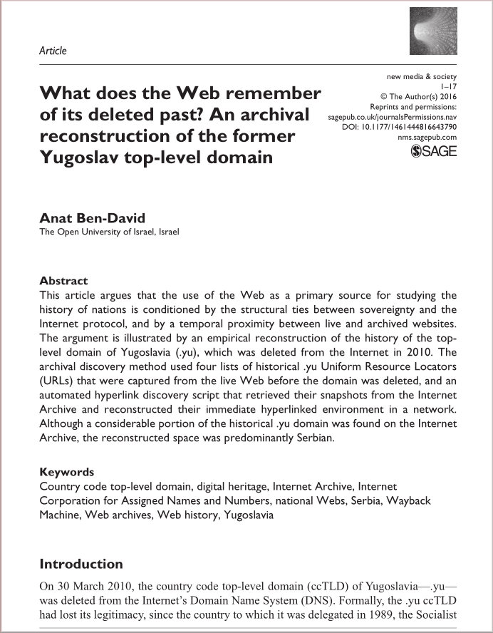
The level of research
individual files or webpages;
individual website(s);
certain domain(s);
the whole websphere.
7

Slide 8
Problems
incomplete mementos, archive or playback errors;
temporal drift and live web leakage
(different chronological versions of the elements of
a certain webpage or website displayed together);
authenticity of the archived files;
duplicates and URL address changes of websites;
change of the whole content on a certain domain, etc.
8

Slide 9
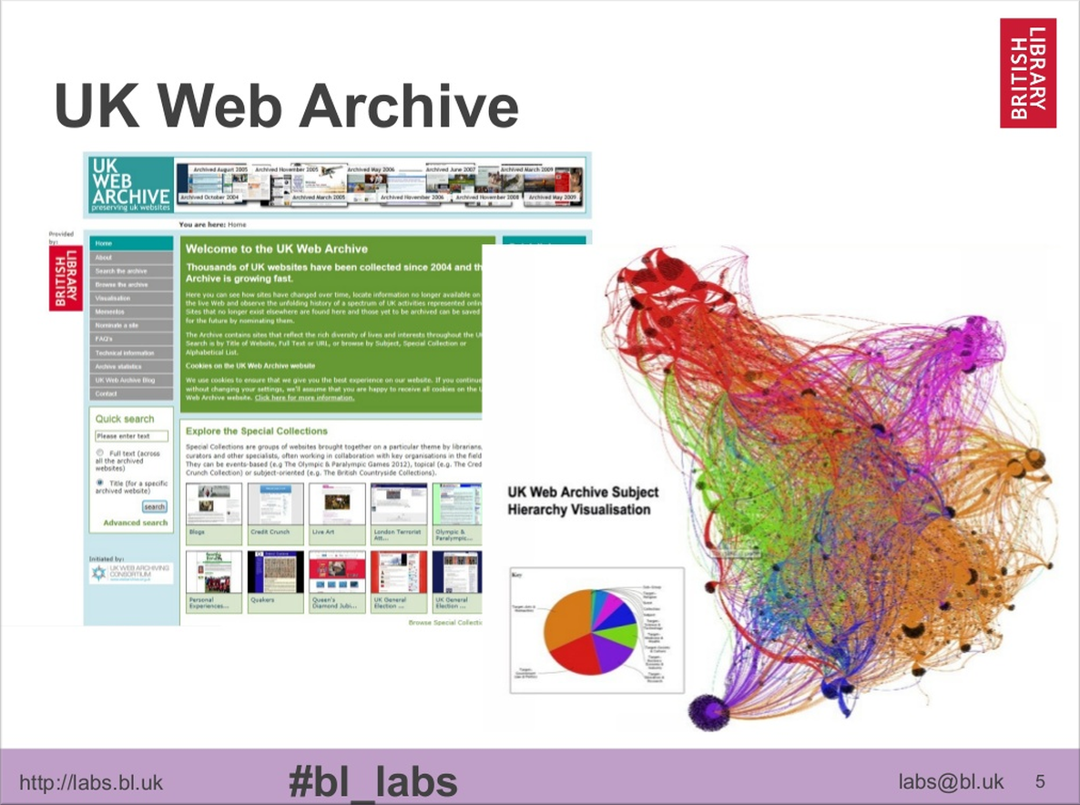
Web archives and big data
The web archives as large corpora
can be a research subject of several projects in data science field.
The concept of linked and open data have led the necessity of processing large amounts of semi-structured data in web archives quickly, and retrieve valuable information.
A new way of collaboration can be formed among public collections, web archivists and data scientists in this context.
9

Slide 10
Types of data and mining
web and transaction data (e.g. log data, geolocations);
structural data (e.g. link graphs)
content data (e.g. textual or visual information).
web usage mining;
web structure mining;
web content mining.
10

Slide 11
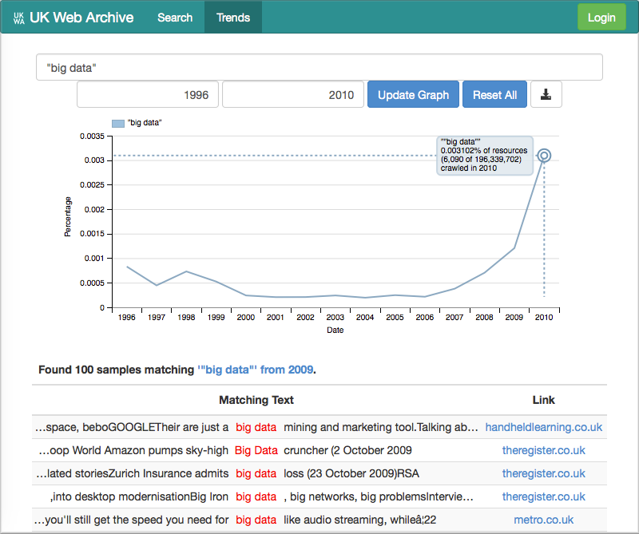
Example: BUDDAH
(Big UK Domain Data for the Arts and Humanities)
65 TB dataset containing crawls of the .uk domain from 1996 to 2013;
SHINE historical search engine;
trend analysis;
information visualizations ...
homepage: buddah.projects.history.ac.uk
11

Slide 12
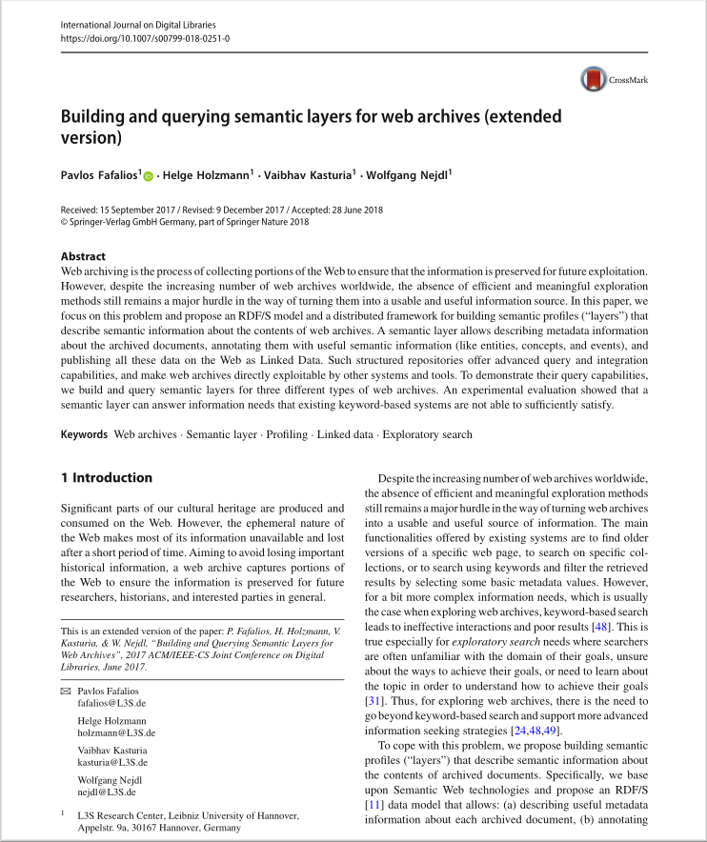
Web archives and the semantic web
The absence of efficient and meaningful exploration methods of the archived content
is a really major hurdle in the way to turn web archives to a usable and useful information resource.
A major challenge in information science can
be the adaptation of semantic web tools and methods to web archive environments.
The web archives must be a part of the linked data universe with advanced query and integration capabilities, must be able to directly exploitable by other systems and tools.
12

Slide 13
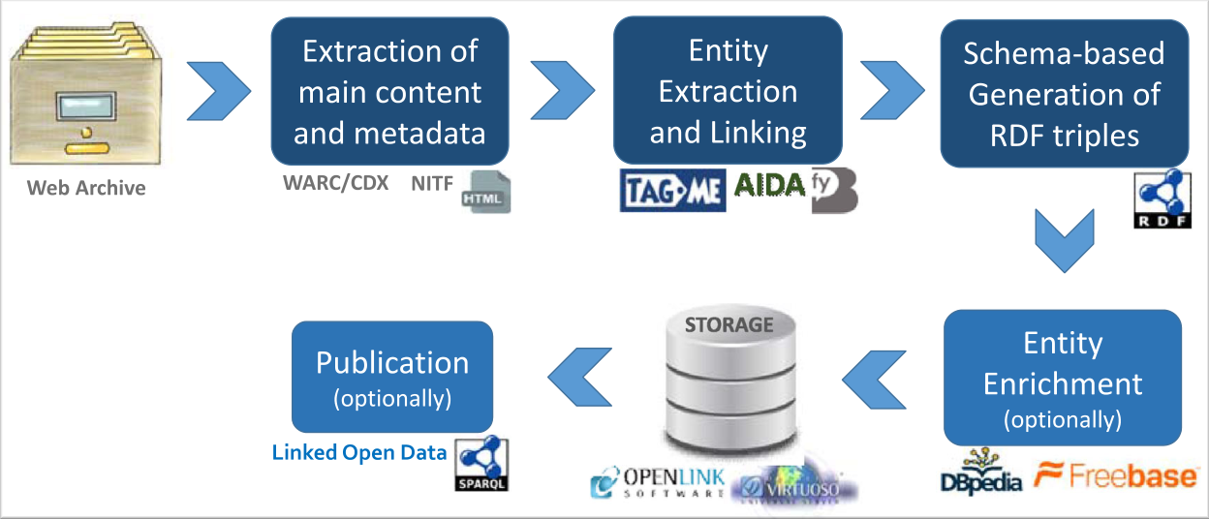
Possible methods
extracting entities;
generation of RDF triples;
enrichment of entities from external sources;
publication of linked data;
advanced queries and ranking models based
on semantic data.
The process of constructing a semantic layer
in the Open Web Archive data model,
proposed by Fafalios, Holzmann, et al. in 2018.
13

Slide 14
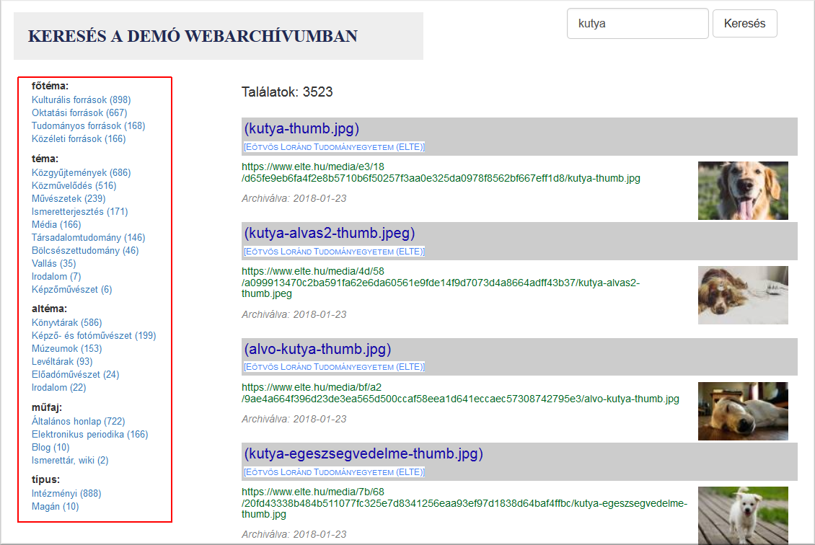
SolrMIA
(search engine of the Hungarian demo web archive)
webadmin.oszk.hu/solrmia
Solr-based full text index;
metadata-aided filtering
and displaying of hit lists;
future plans:
entity extraction;
metadata enrichment from namespaces and thesauri.
14

Slide 15
Thank you for your attention! Questions?
Hungarian web archiving project:
http://mekosztaly.oszk.hu/mia/
Demo web archive:
http://mekosztaly.oszk.hu/mia/demo/
Selected bibliography on web archiving:
http://mekosztaly.oszk.hu/mia/doc/webarchivalas-irodalom.html
Contact e-mail:
mia@mek.oszk.hu

