Slide 1

Márton Németh – László Drótos
(National Széchényi Library, Hungary)
The education of web-archiving
CDA 2018
Univerzitná knižnica v Bratislave,
Centrálny dátový archív, Bratislava
08.11.2018

Slide 2
Contents
We have to learn to preserve the Internet
About the Danish NetLab online course
Activities of the IIPC Training Working Group
Webarchiving education plans
in the National Széchényi Library
Recommended sources

Slide 3

We have to learn to preserve the Internet
The preservation of our born-digital culture is also the responsibility of public collections
We need weblibraries, webarchives and webmuseums
To do this, special technical, collection development, metadata, service, legal, etc. knowledge is needed
This knowledge must be built into higher education, vocational training and self-education

Slide 4
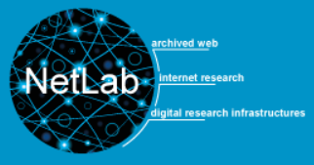
The online course of the Danish NetLab
Free English seminar held in Autumn 2017 with the DIGHUMLAB research team at Aarhus University
Moodle-based distance learning interface
Five assignments, then joint discussion of the results
  Your Areas of Interest
  Reassessing Your Goals
  Hands-on with Web Archives and Evaluating Your Finds
  Hands-on with Doing Your Own Archiving
  Web Archiving Course Evaluation
Handbook: Jan Nielsen: Using the
Web Archives in Research

Slide 5
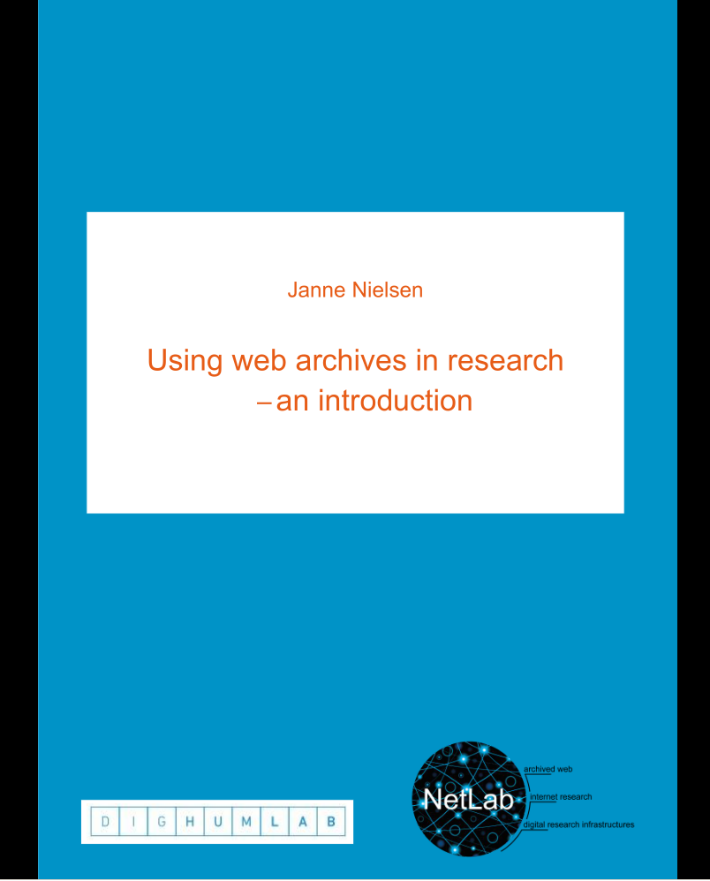
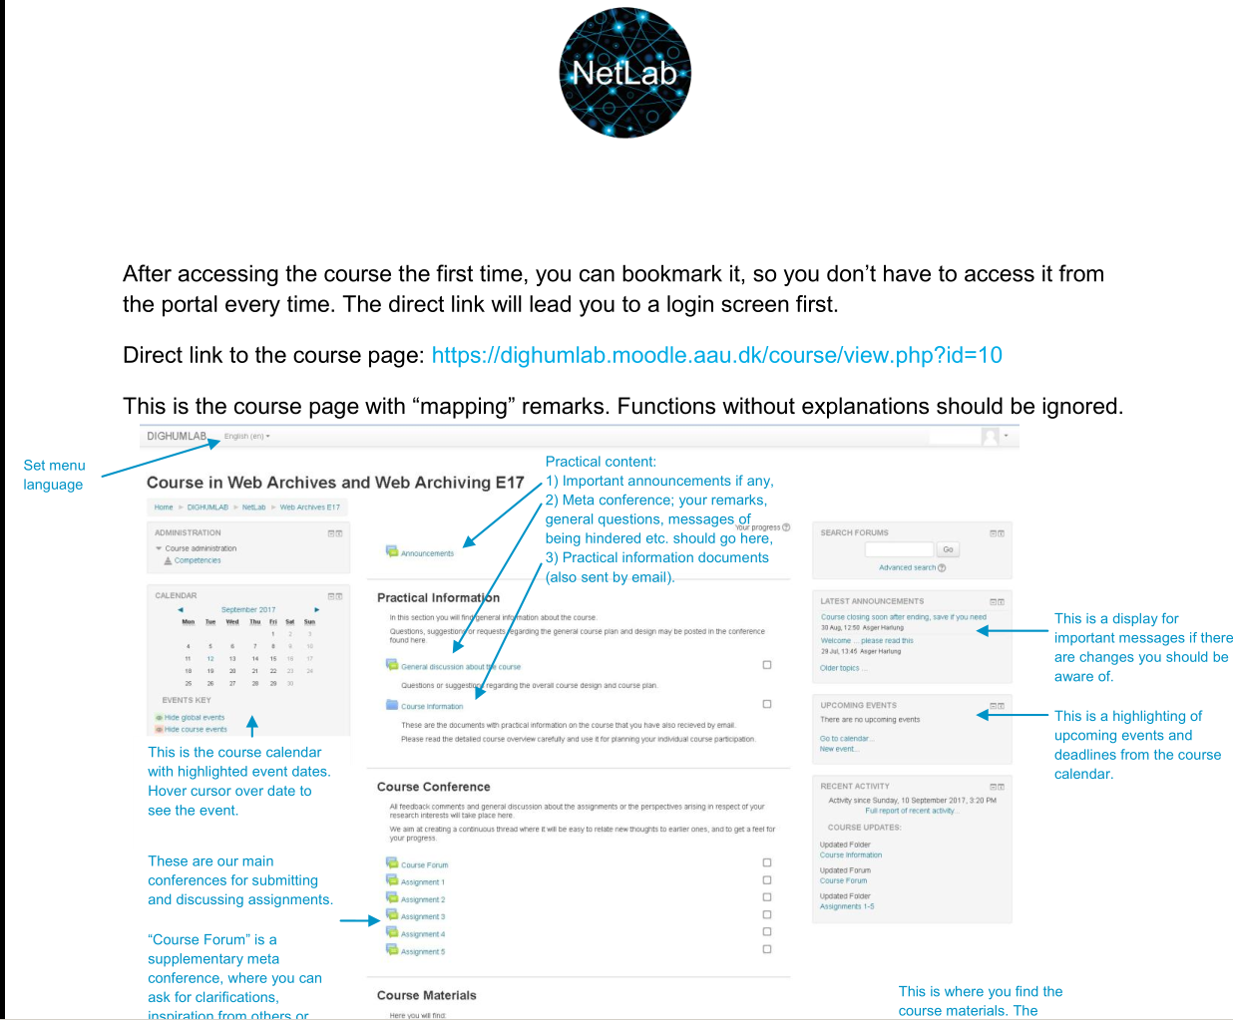
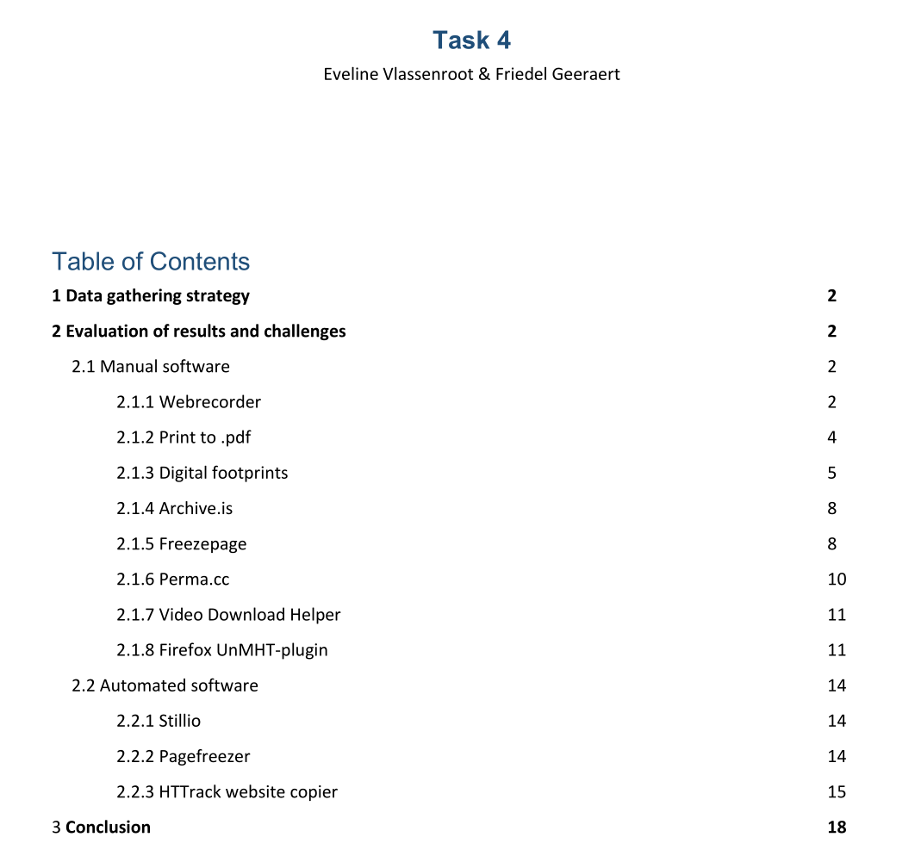
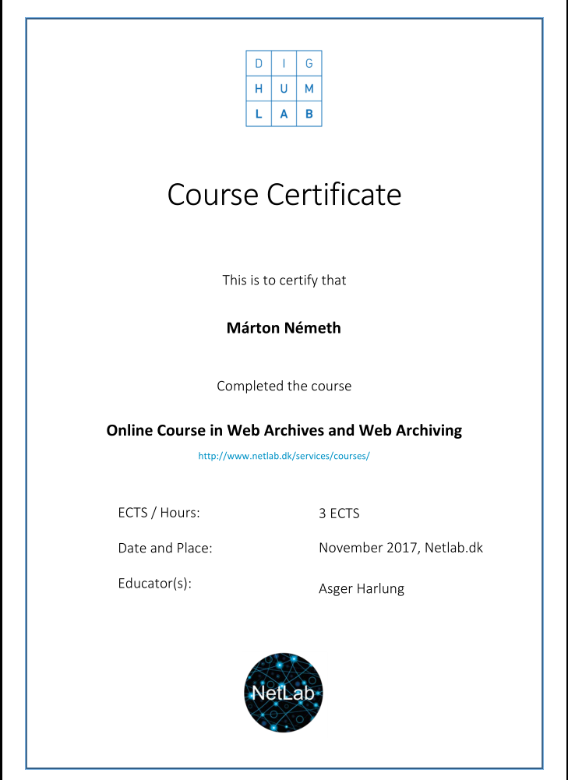
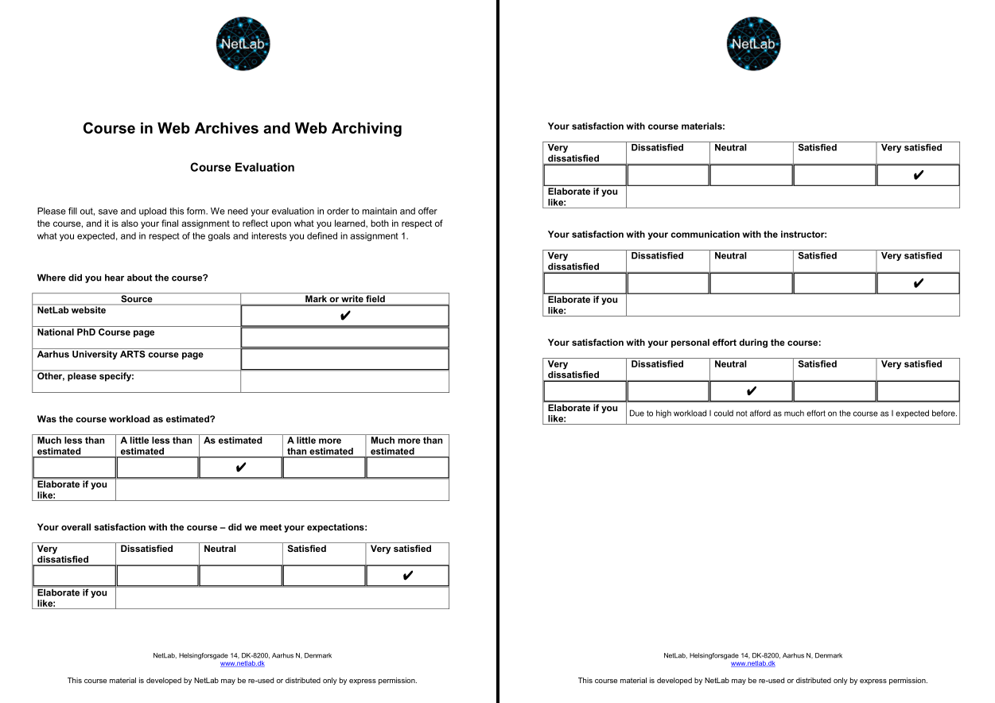
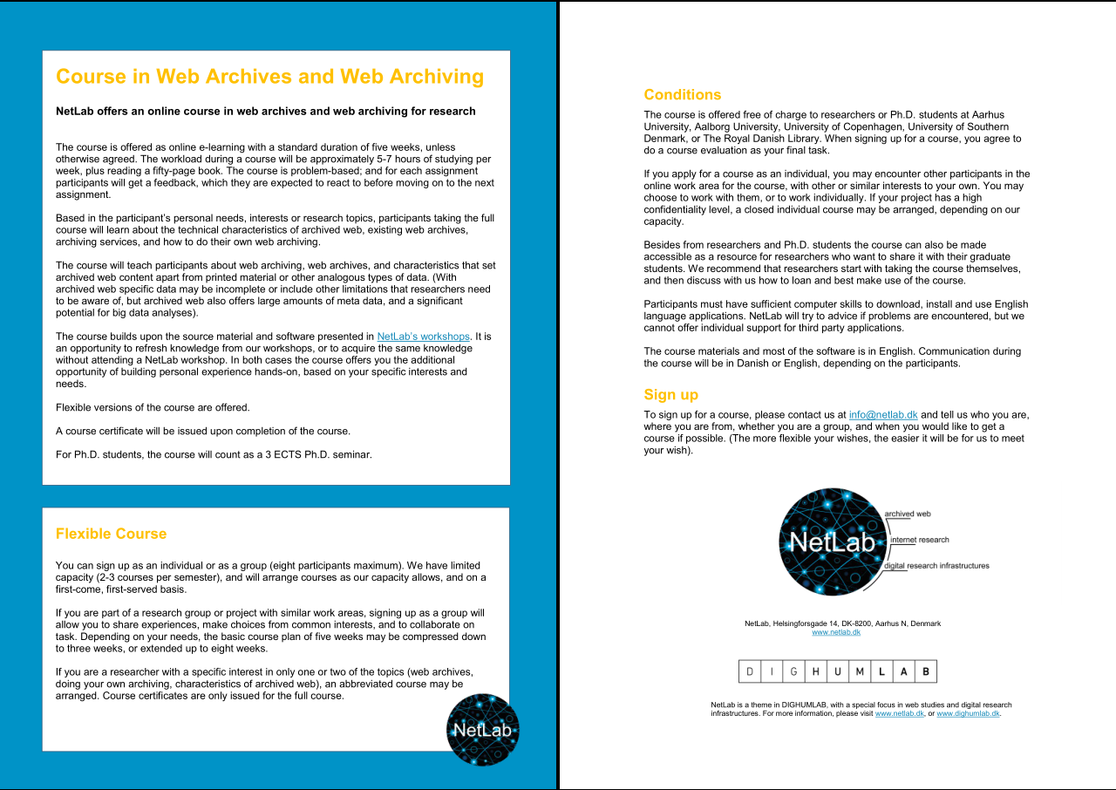
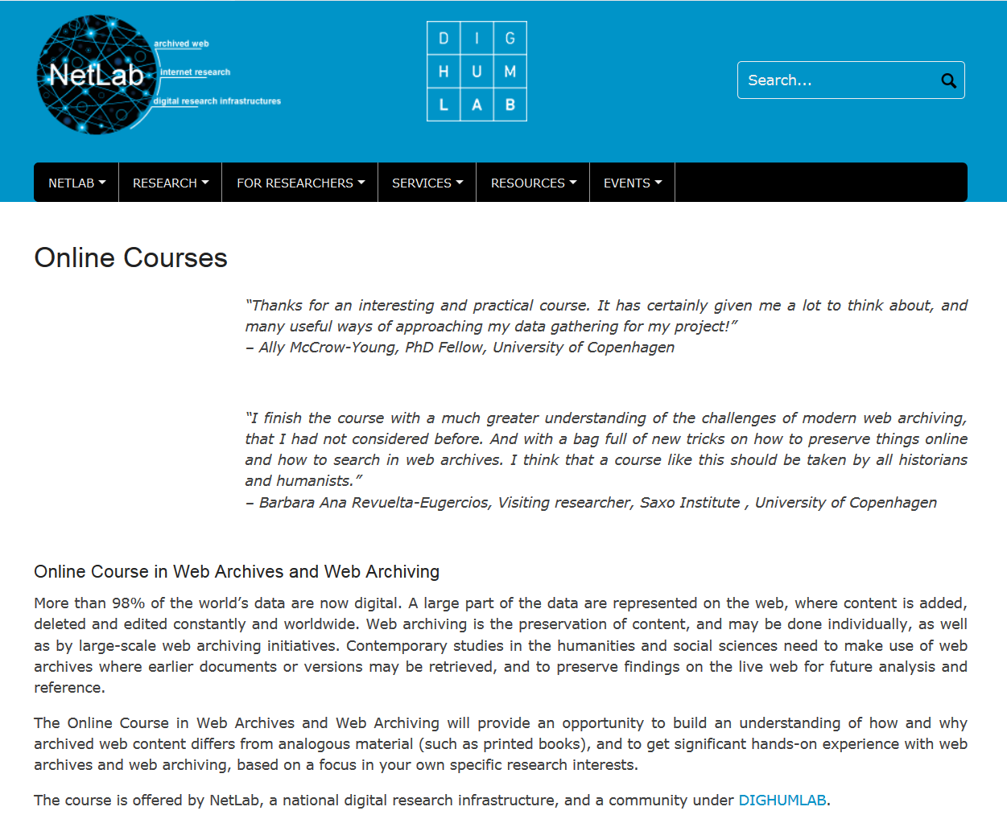

Slide 6

IIPC Training Working Group
A new working group of the International Internet Preservation Consortium organized at the end of 2017
Meetings using the Zoom video conferencing system
Questionnaire survey on education and training needs in January 2018 (224 responses received)
The greatest need is the education of web archiving technologies, software and standards
The most popular forms of training are webinars and courses requiring personal presence
Inventory and review of existing
training materials

Slide 7
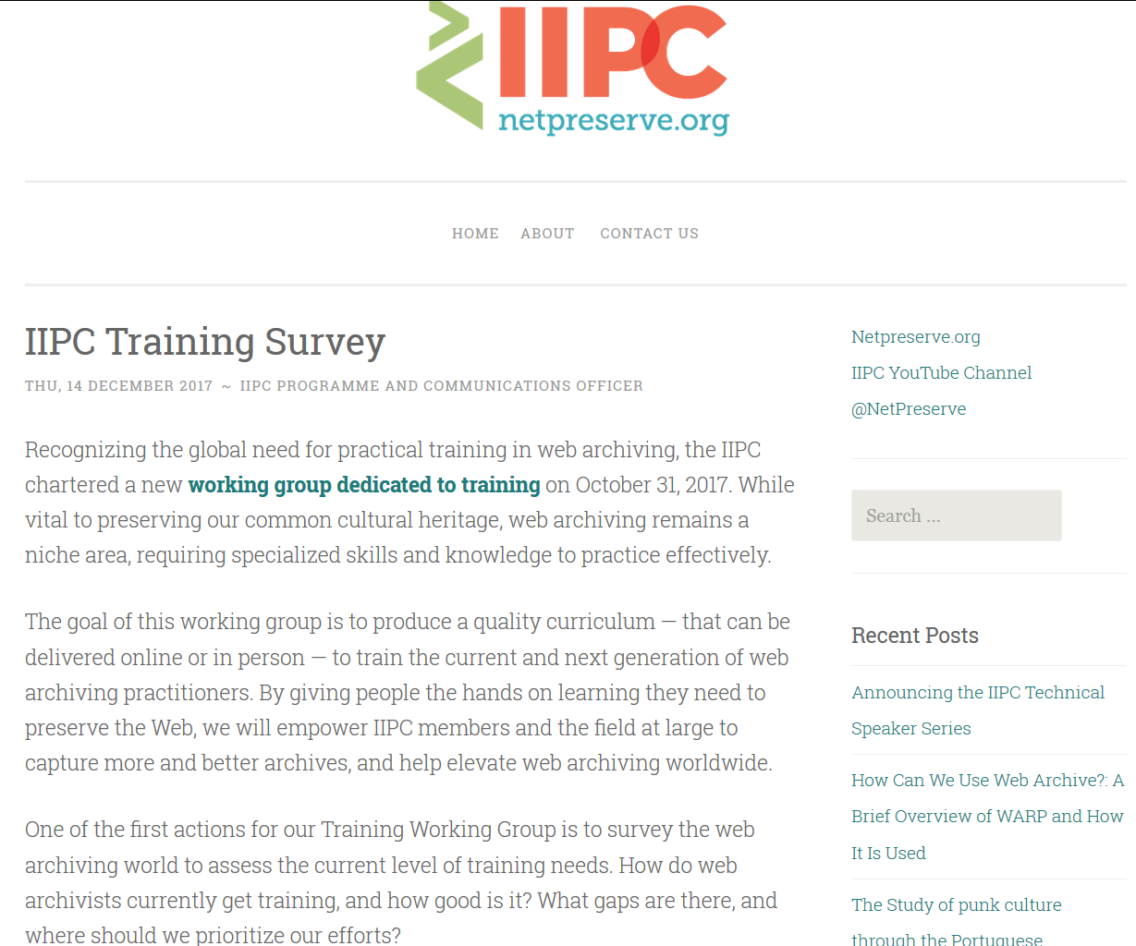
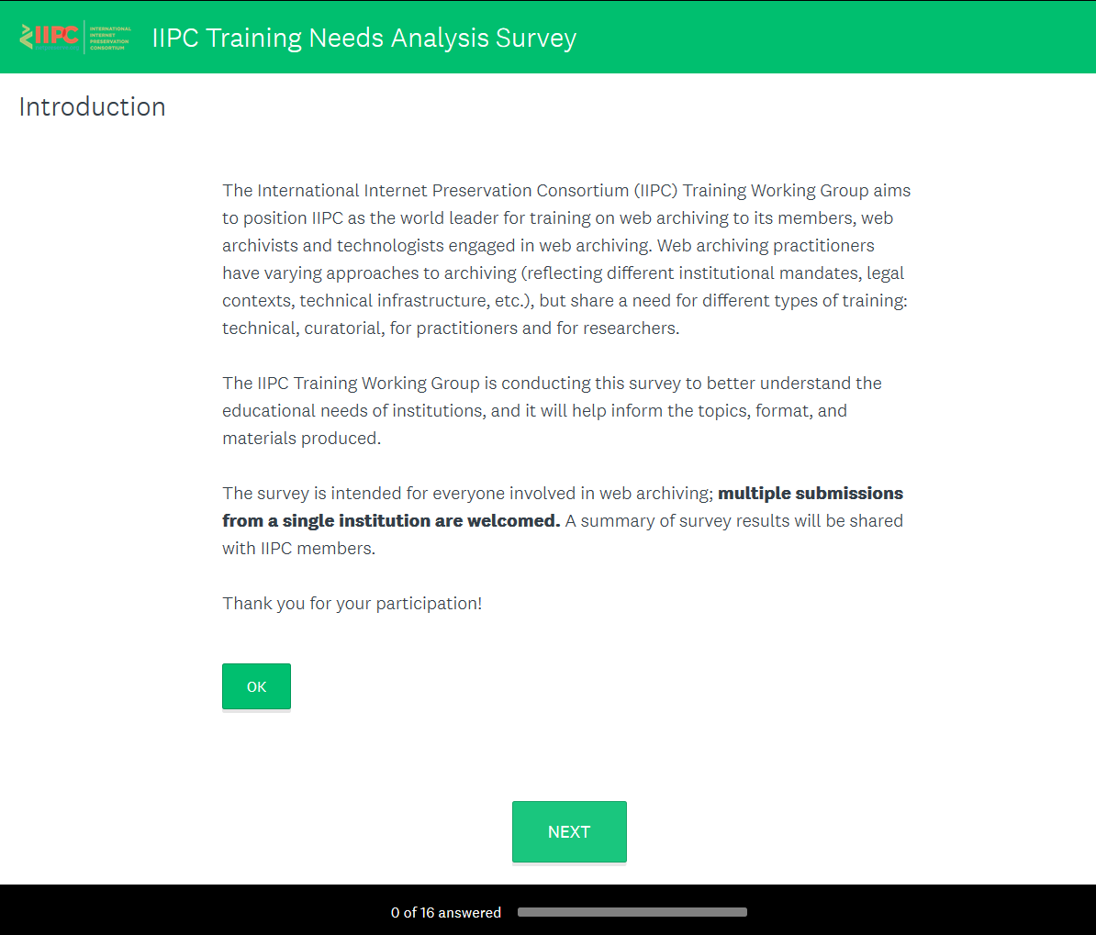
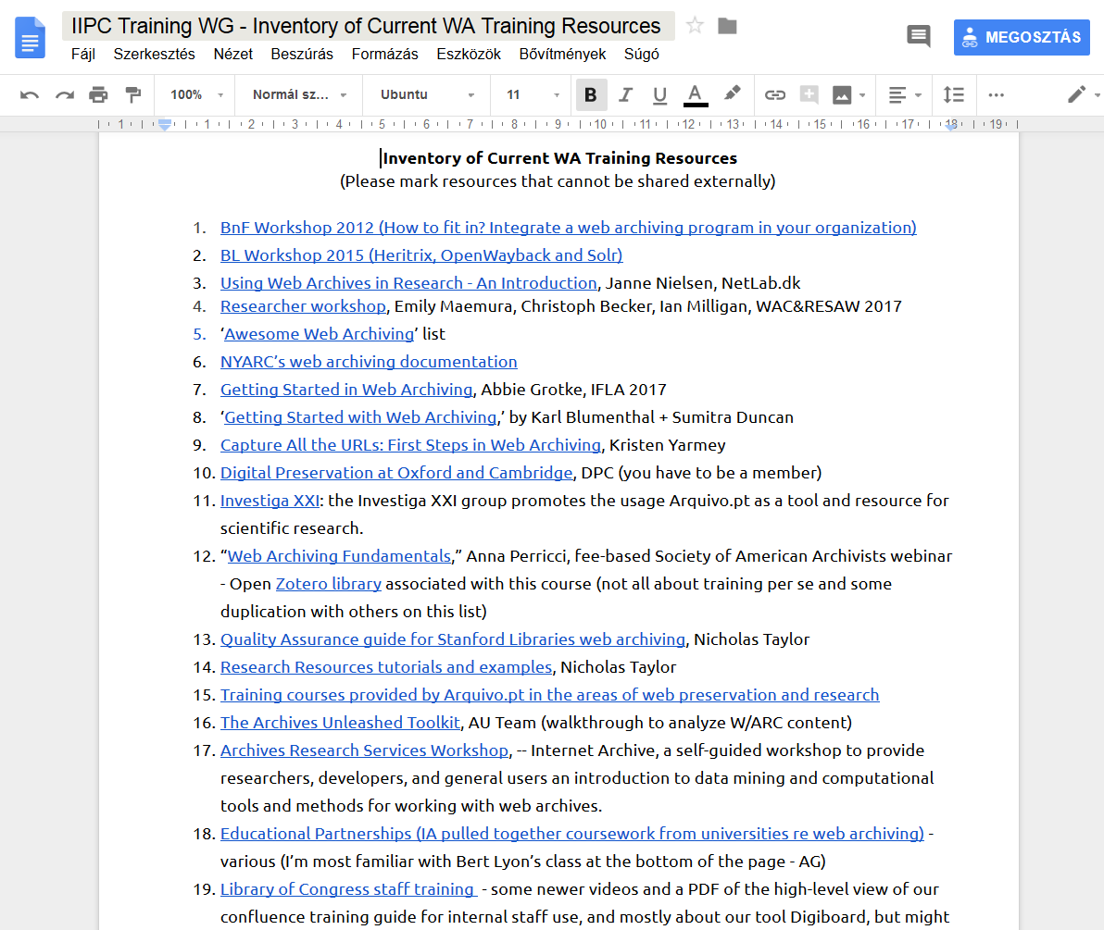
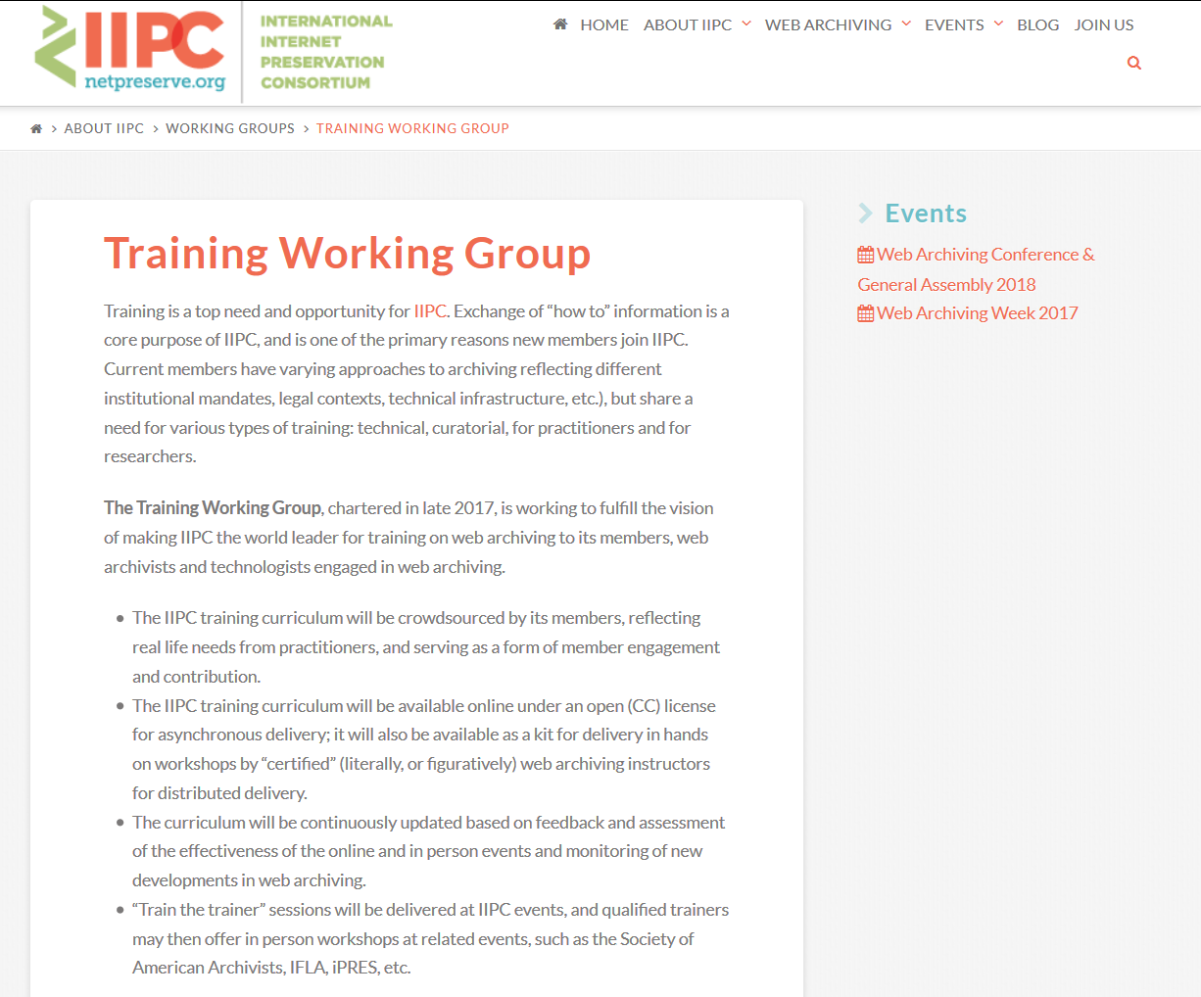
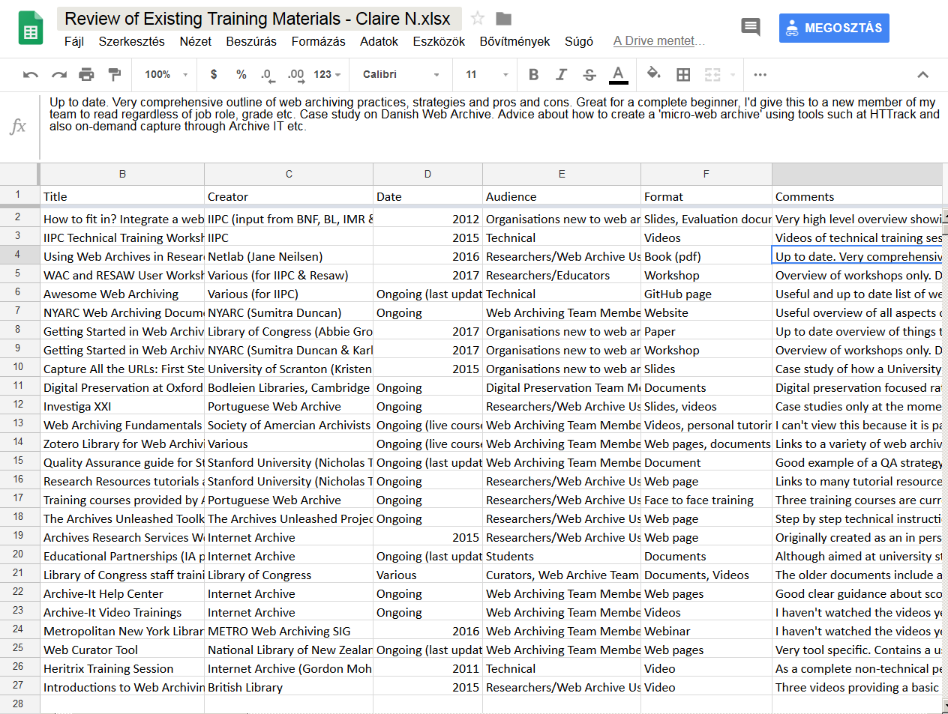
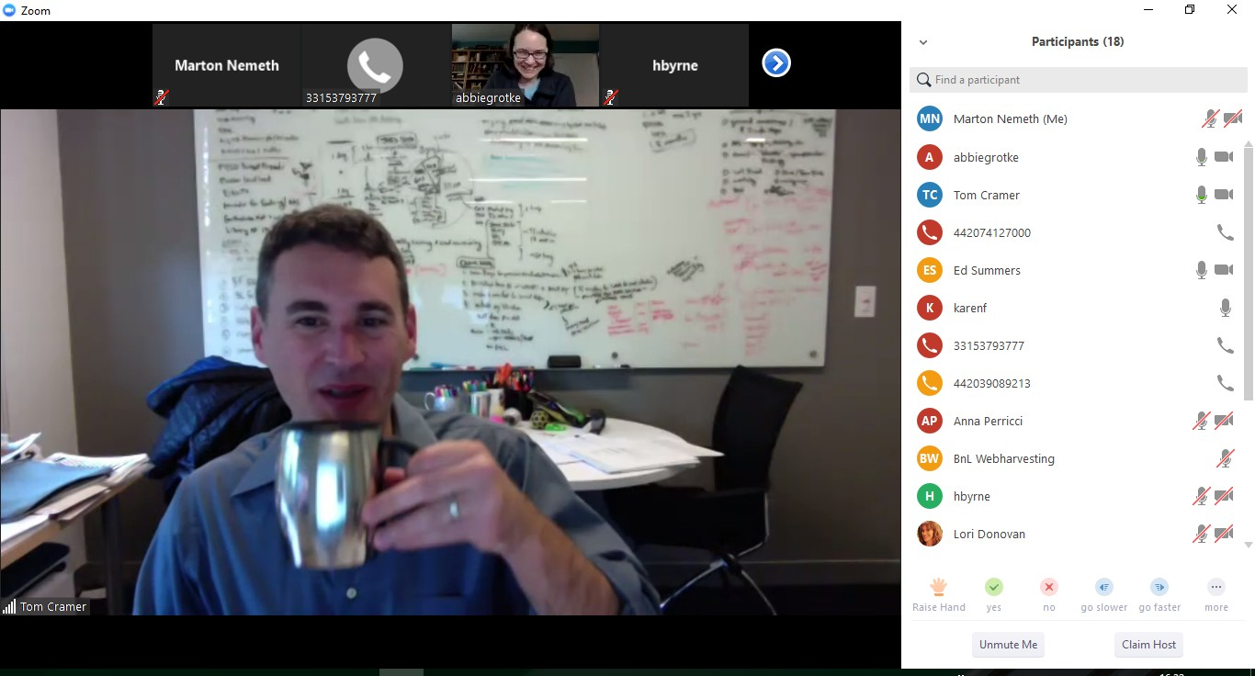

Slide 8
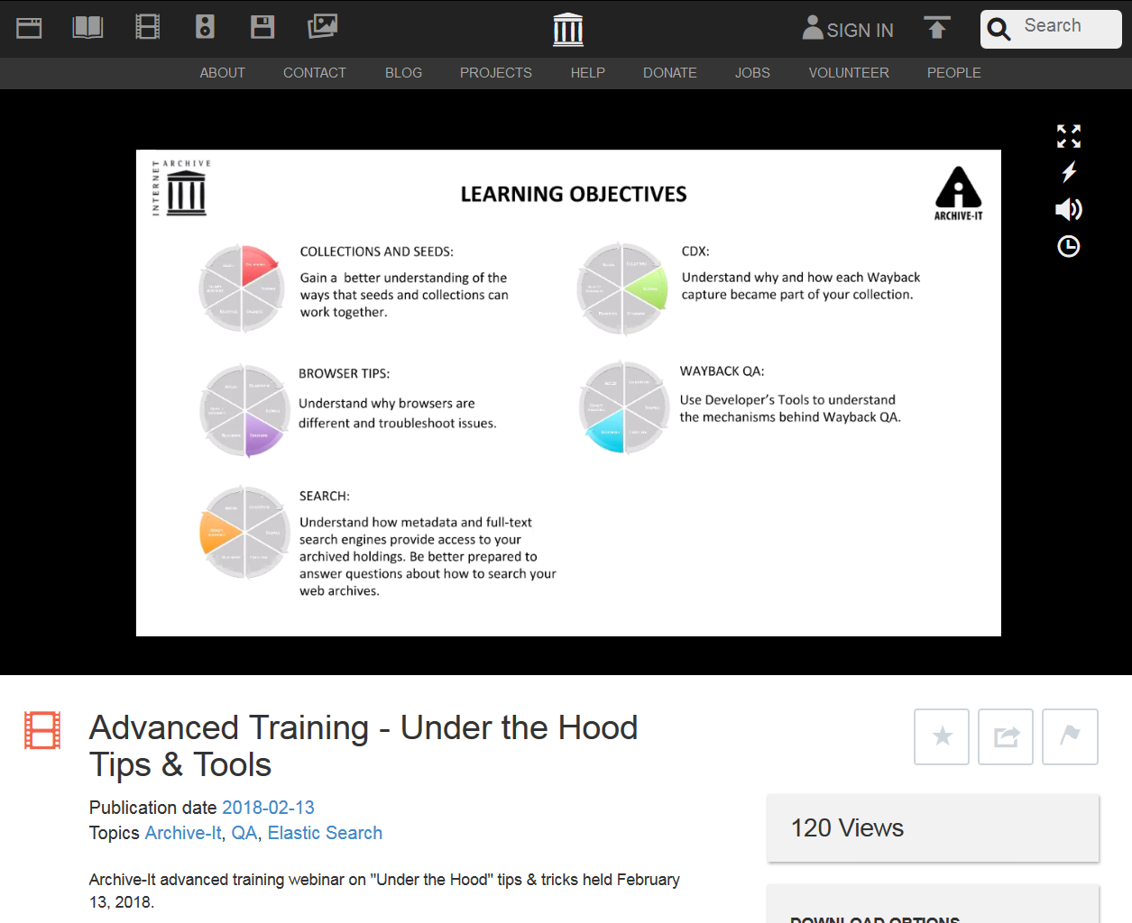
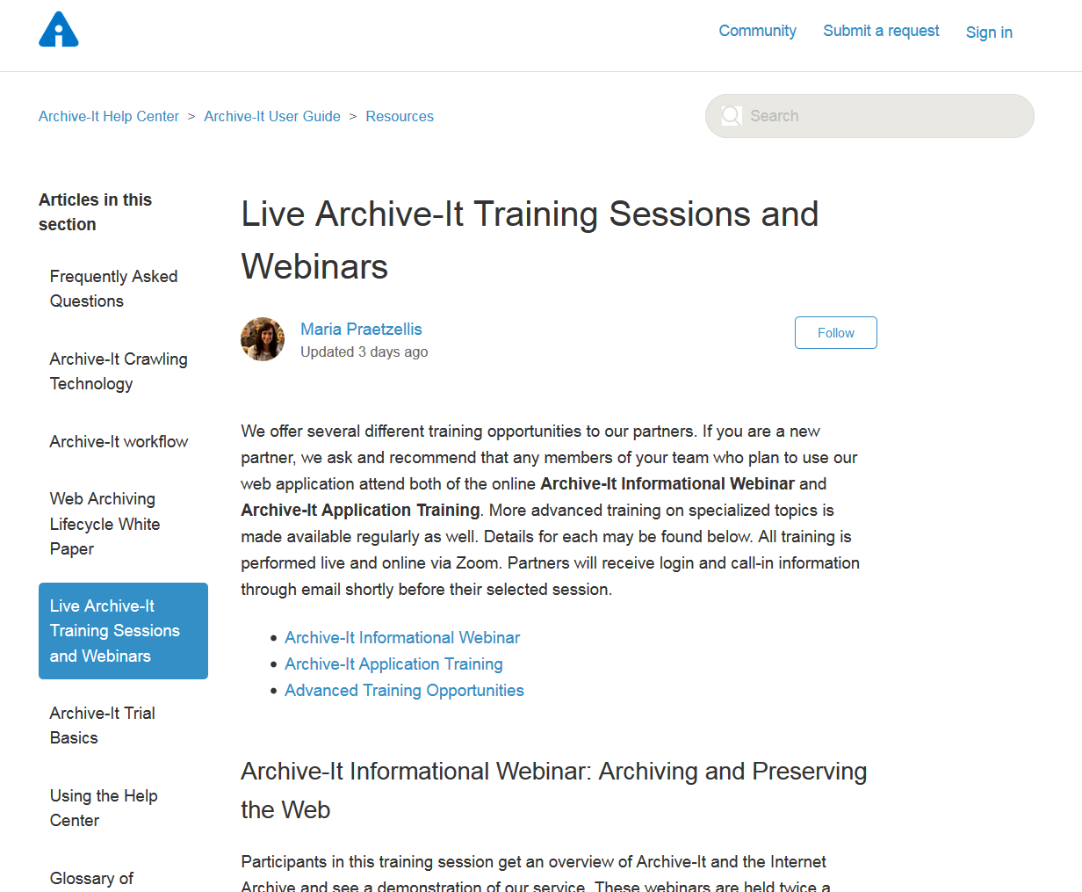
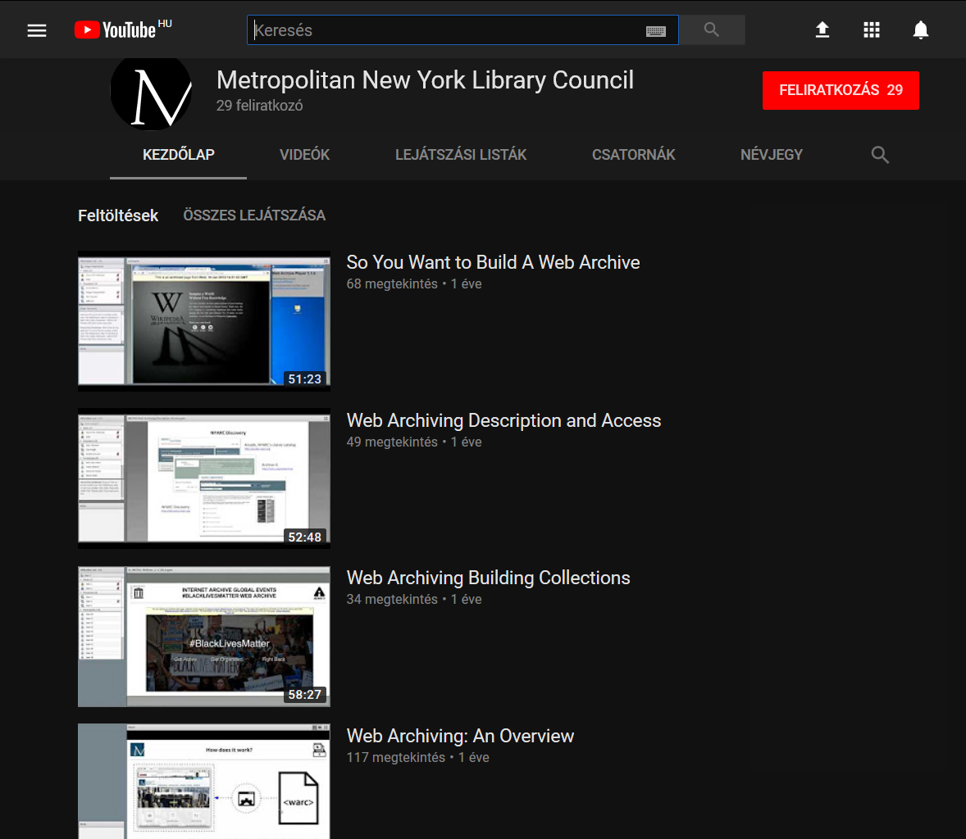
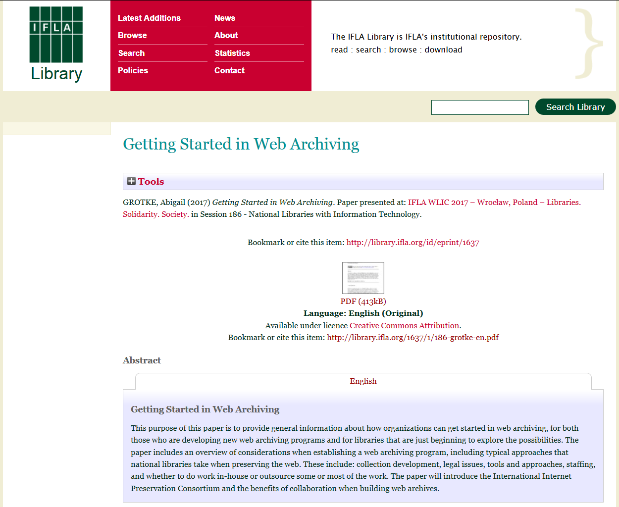
Examples of existing training materials

Slide 9
Webarchiving education plans in the National Széchényi Library
At the spring of 2017 a webarchiving pilot project has been started
Test harvests, public demo archive, website, wiki
„404 Not Found” workshop in October 2017
Presentations, demonstrations, publications
Contacting the university departments
Training course at the Hungarian Library Institute
Blended learning curriculum

Slide 10
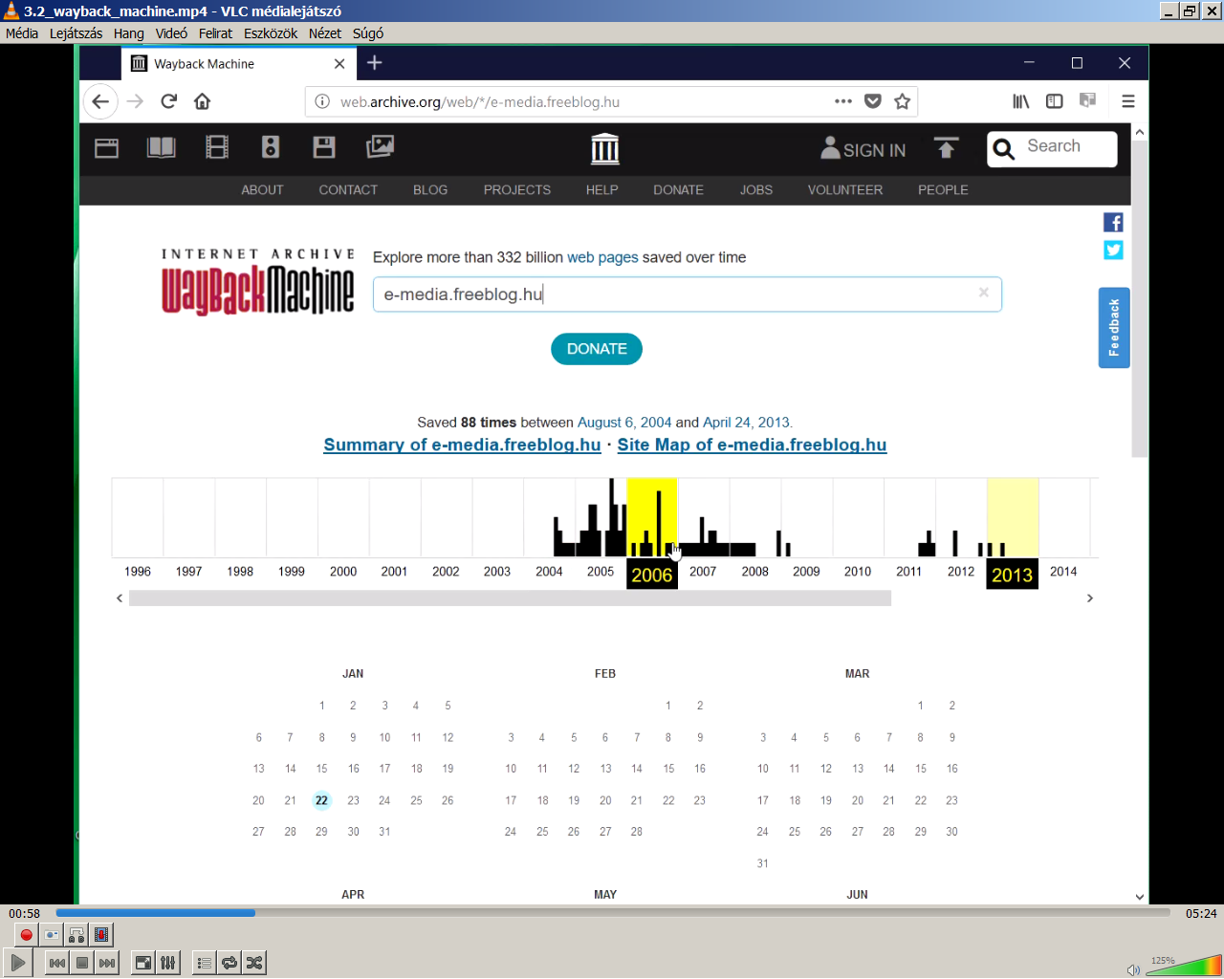
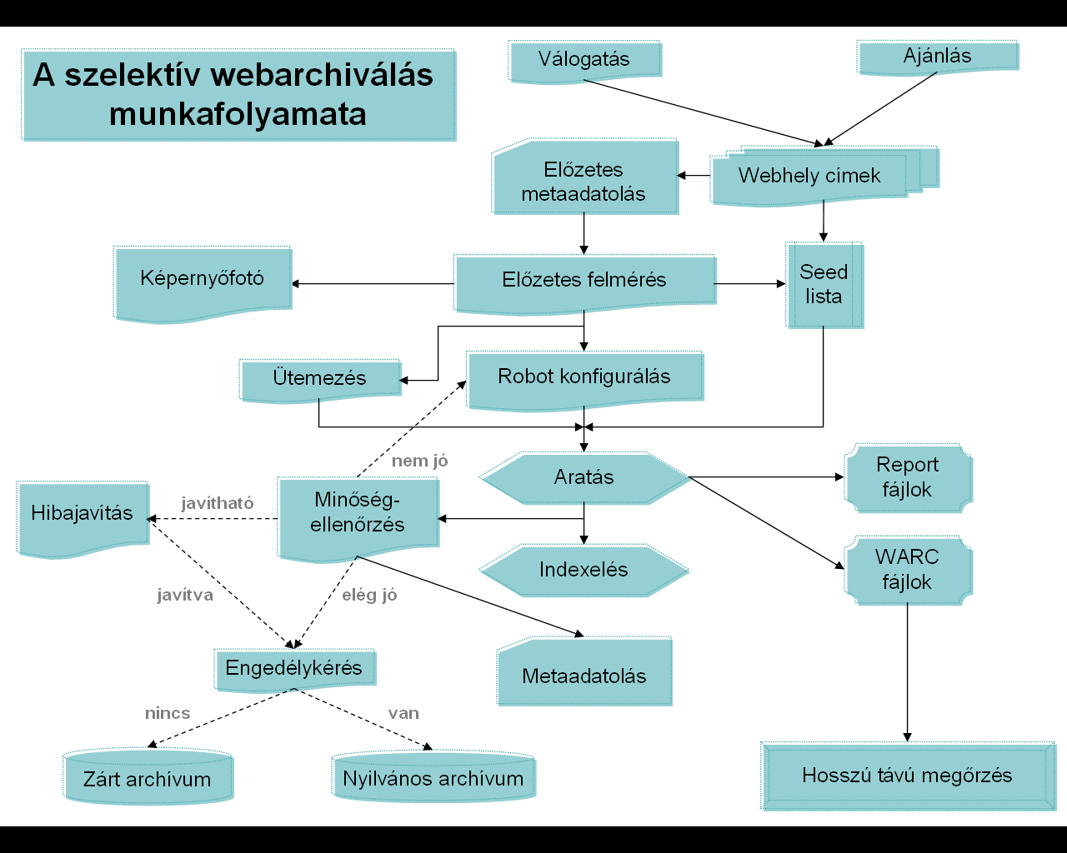
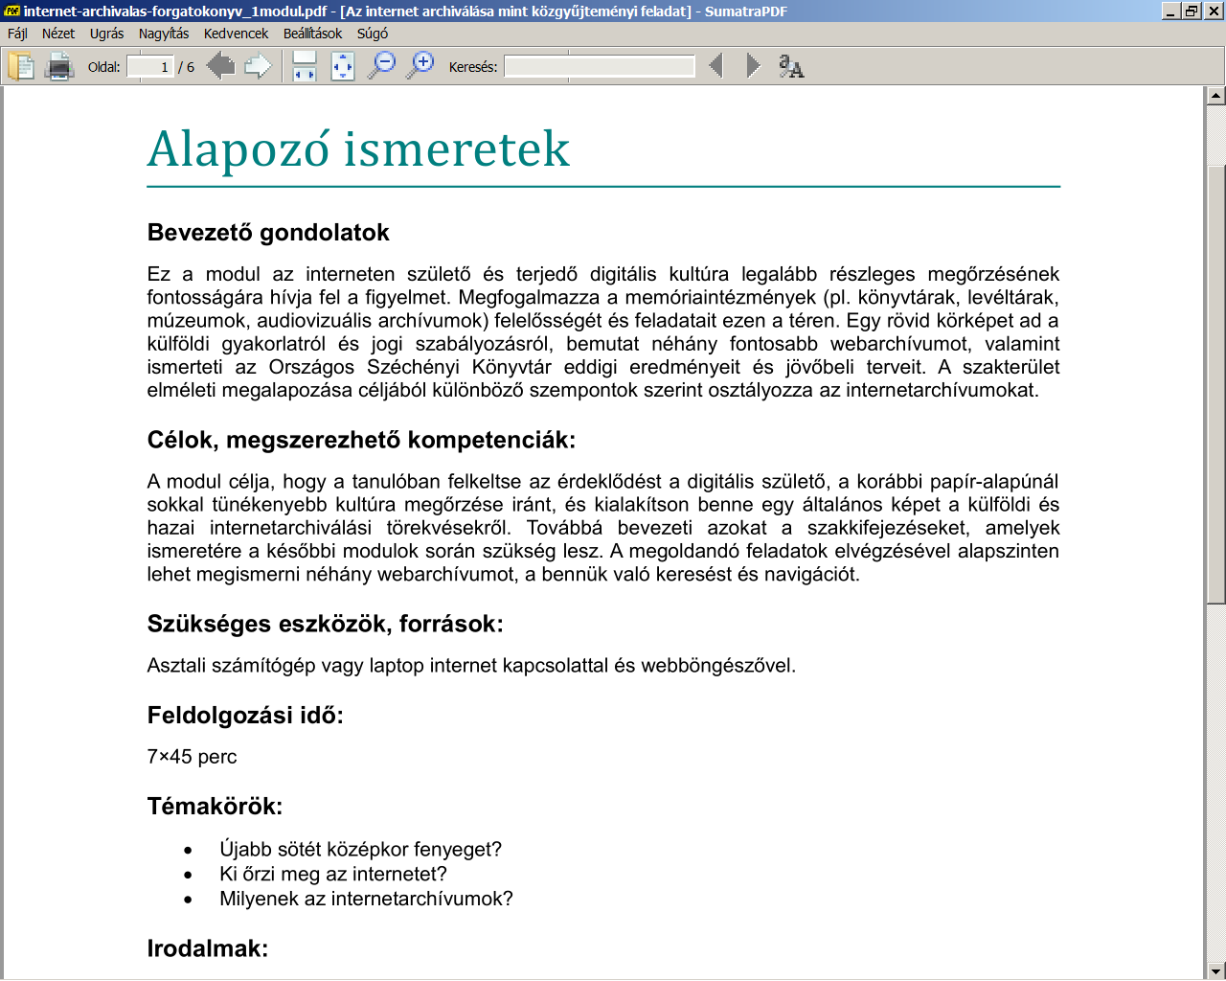
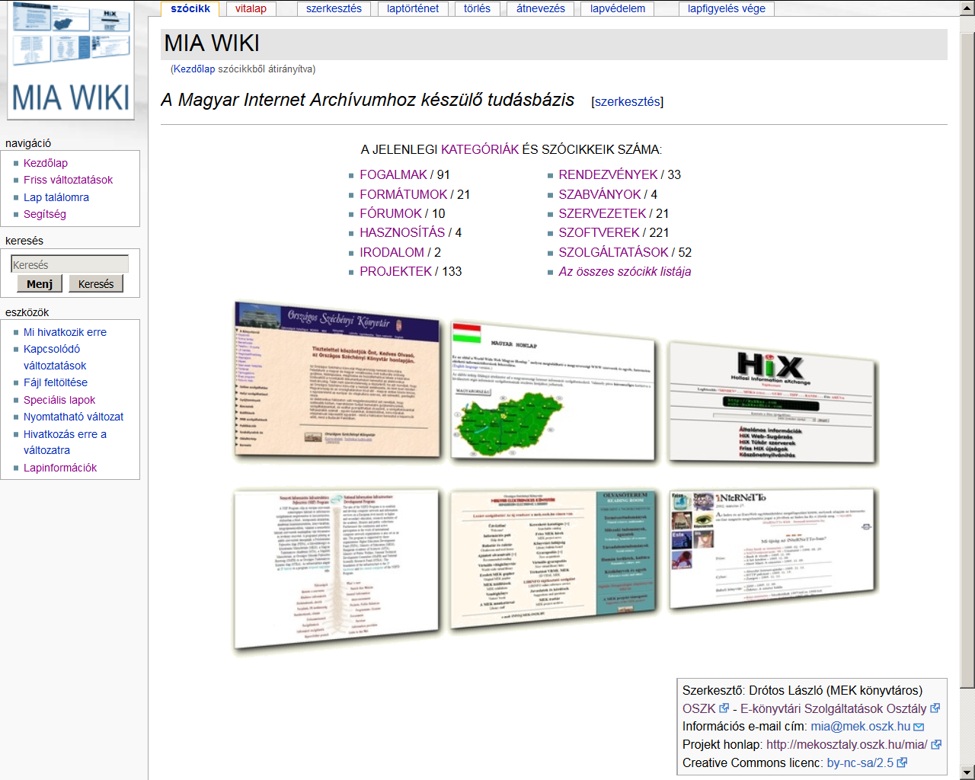
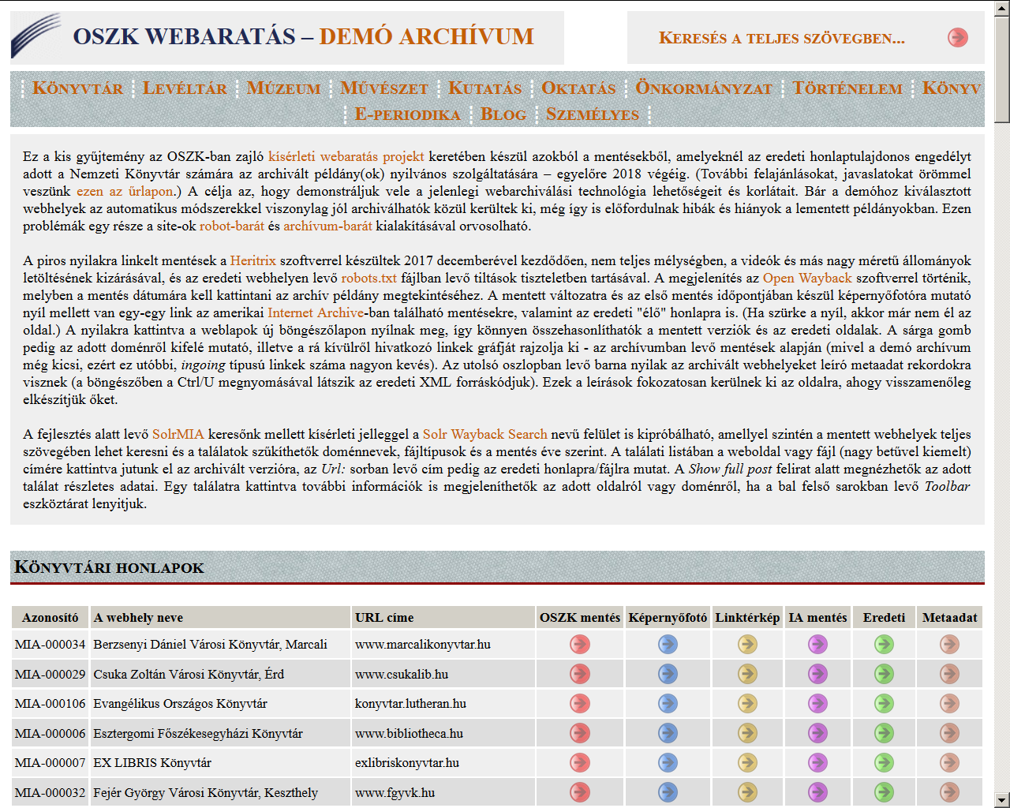
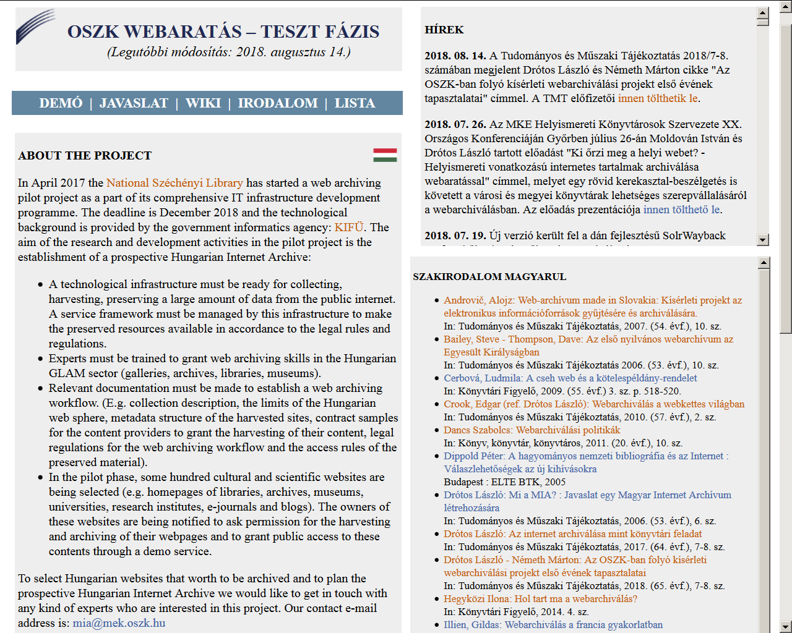
Using of the Wayback Machine (a video from the curriculum)
Web archiving wiki
First module of the curriculum
Project homepage
Demo collection
Workflow of the archiving
(a figure from the curriculum)

Slide 11
Recommended sources
Hungarian web harvesting pilot project:
http://mekosztaly.oszk.hu/mia
NetLab Online Course in Web Archives and
Web Archiving:
http://www.netlab.dk/services/courses/
Janne Nielsen: Using the web archives in research:
http://www.netlab.dk/wp-content/uploads/2016/10/ Nielsen_Using_Web_Archives_in_Research.pdf
IIPC Training Working Group:
http://netpreserve.org/about-us/working-groups/ training-working-group/

Slide 12
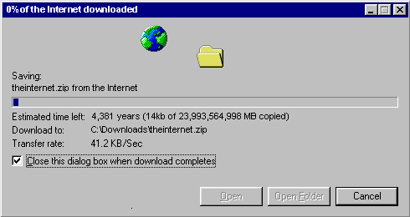
Thank you for your attention!
Contact e-mail address: mia@mek.oszk.hu

