Slide 1

Web museum, web library, web archive
The responsibility of public collections to preserve digital culture
László Drótos – Márton Németh
(National Széchényi Library, Hungary)
Bobcatsss 2018 conference Riga
26 January 2018.

Slide 2
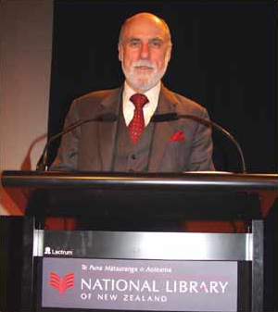
Guardian 13 February 2015.
„Google boss warns of forgotten century” https://www.theguardian.com/technology/2015/feb/13/google-boss-warns-forgotten-century-email-photos-vint-cerf
Vint Cerf, a main founder of the TCP/IP protocol. From 2005 a Vice President and a main Internet Evangelist of Google
„Digital Dark Age” threats
We need virtual machines and describe the recent IT service environments (software, hardware) in order to emulate them in the next centuries.
Not just service architectures but digital documents must be preserved to the future.
Source: https://commons.wikimedia.org/

Slide 3
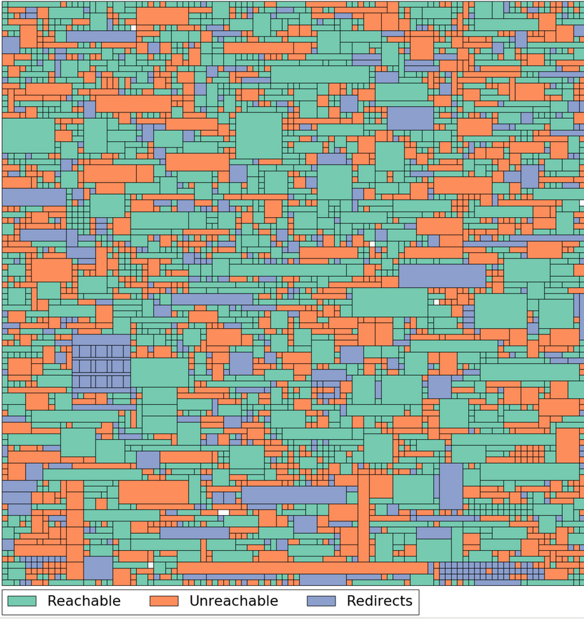
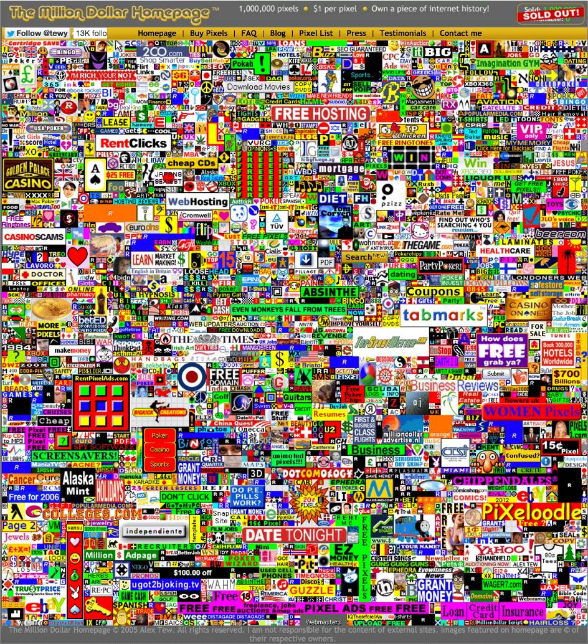
Boing Boing 2017. 07. 27.
Link Rot: only half of the links on 2005's
Million Dollar Homepage are still reachable https://boingboing.net/2017/07/27/link-rot-only-half-of-the-lin.html
Between August 2005 and January 2006 Alex Tew British student sold for one dollar per pixel an advertising space on a webpage with 1000 × 1000 pixel grid. Within 10 years only 1780 links are working from the original 2816
547 websites are totally unreachable (value of 342000 USD), 489 links are being redirected-often to blank domains or domains on sold (value of 145000 USD).
Source: https://lil.law.harvard.edu/blog/

Slide 4
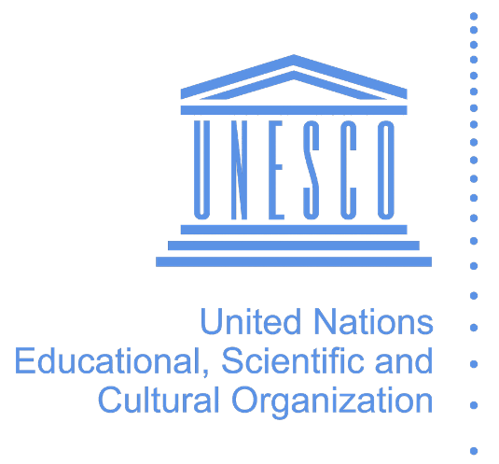
UNESCO 2003
Charta about preserving Digital Cultural Heritage http://portal.unesco.org/en/ev.php-URL_ID=17721&URL_DO=DO_TOPIC&URL_SECTION=201.html
”The digital heritage consists of unique resources of human knowledge and expression. It embraces cultural, educational, scientific and administrative resources, as well as technical, legal, medical and other kinds of information created digitally, or converted into digital form from existing analogue resources.”
”The world’s digital heritage is at risk of being lost to posterity. Contributing factors include the rapid obsolescence of the hardware and software which brings it to life, uncertainties about resources, responsibility and methods for maintenance and preservation, and the lack of supportive legislation. Attitudinal change has fallen behind technological change. Digital evolution has been too rapid and costly for governments and institutions to develop timely and informed preservation strategies. The threat to the economic, social, intellectual and cultural potential of the heritage – the building blocks of the future – has not been fully grasped.”
UNESCO advices to establish strategies, policy guidelines, training programmes together with the cultural heritage sector

Slide 5
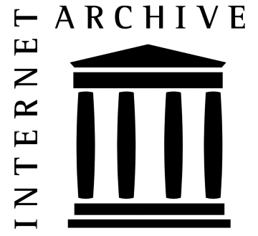
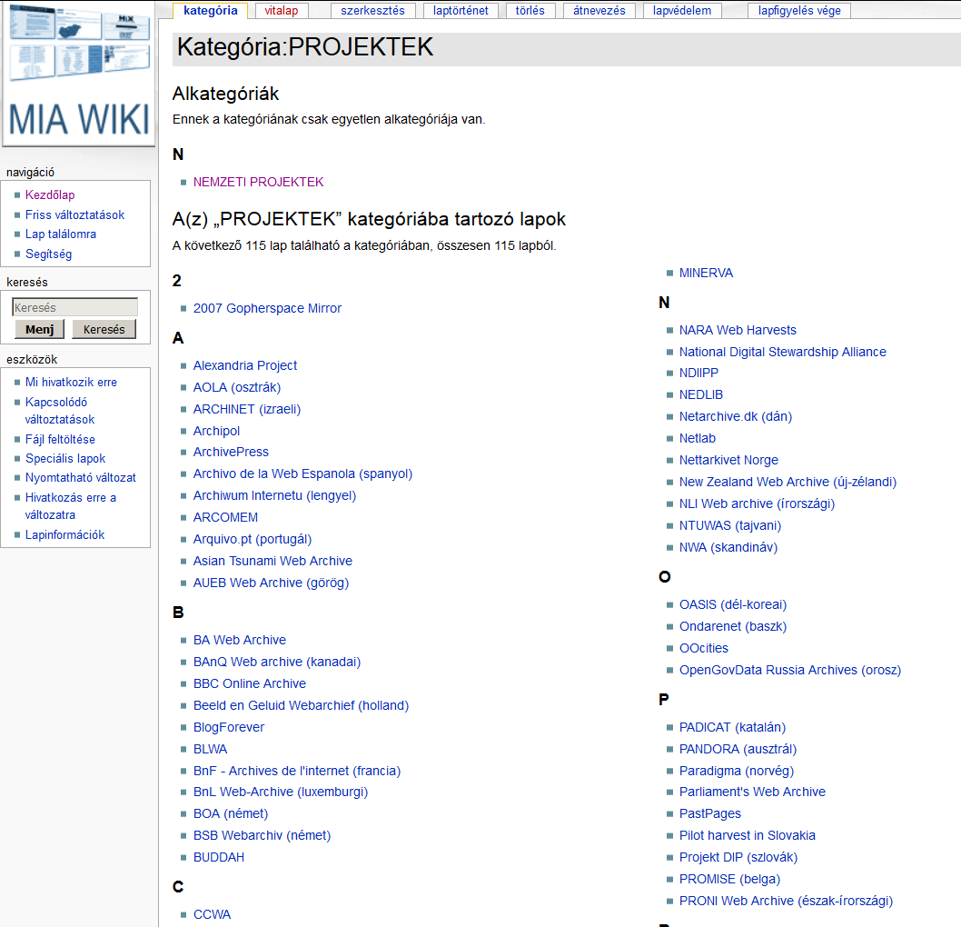
1996
Internet Archive http://web.archive.org
Basic facts: (October 2016): 361 million website, 273 billion webpage (510 billion digital object), total approx 15 petabyte. Weekly aquisition by approx 1 billion webpage
More than one hundred web archiving projects have existed throughout the world since 1996
Approx. 40 national webarchives (in operation or in demo-phase) in about 30 countries
Source: http://mekosztaly.oszk.hu/miawiki

Slide 6

IIPC http://netpreserve.org
Formally chartered in 2003 at the National Library of France with 12 participating institutions for a 3-year long programme
Nowadays an open organisation with members from 45 countries
National, University and Regional libraries, Archives
Fund and participate in projects and working groups
Major platform of research and development in web archiving field.

Slide 7

Are we losing the battle to archive the web? http://dpconline.org
David S.H Rosenthal
“With an unlimited budget collection and preservation isn’t a problem. The reason we’re collecting and preserving less than half the classic Web of quasi-static linked documents is that no-one has the money to do much better. The other half is more difficult and thus more expensive. Collecting and preserving the whole of the classic Web would need the current global Web archiving budget to be roughly tripled, perhaps an additional $50M/yr. Then there are the much higher costs involved in preserving the much more than half of the dynamic ‘Web 2.0’ we currently miss.”
“The Internet Archive's budget is in the region of $15M/yr, about half of which goes to Web archiving. The budgets of all the other public Web archives might add another $20M/yr. The total worldwide spend on archiving Web content is probably less than $30M/yr, for content that [probably] cost hundreds of billions to create.”
Action Plan:
Use the Wayback Machine's Save Page Now facility to preserve pages you think are important.
Support the work of the Internet Archive by donating money and materials.
Make sure your national library is preserving your nation's Web presence.
Push back against any attempt by W3C to extend Web DRM.
Source:http://dpconline.org

Slide 8

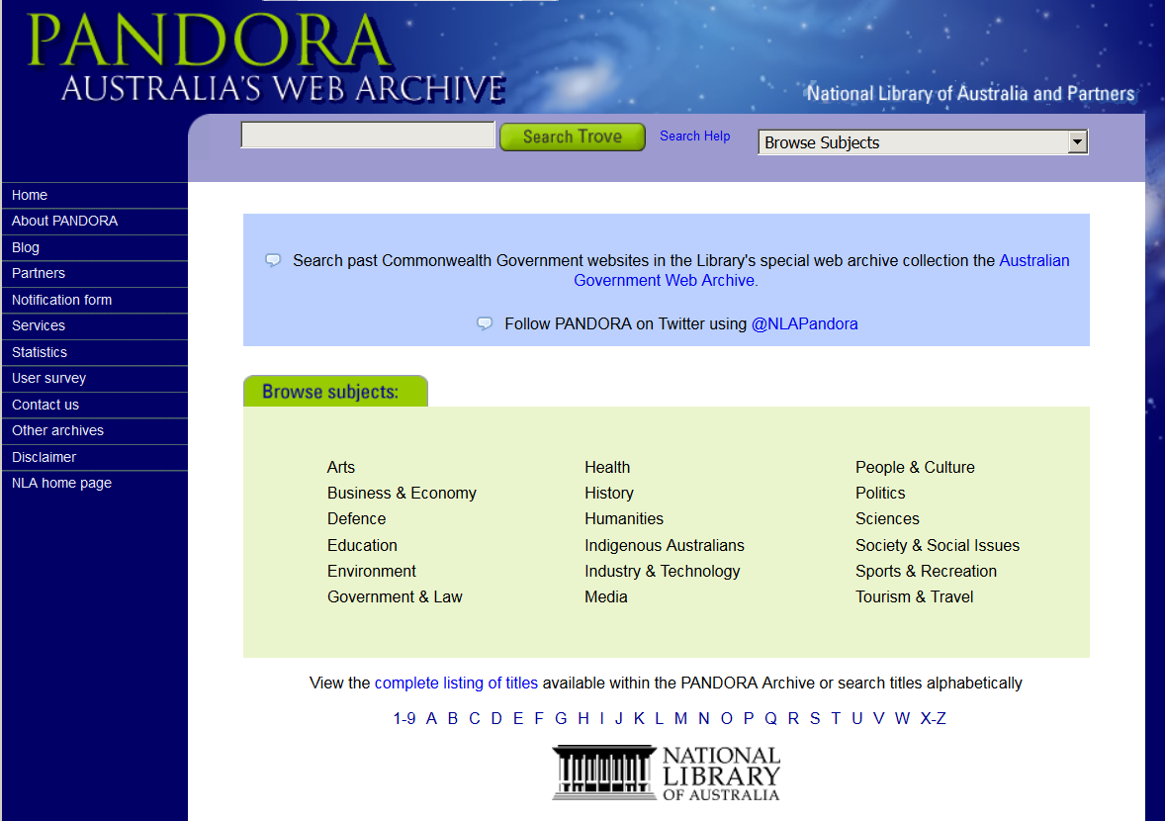
Web Library
Web + Library = Webrary (Niels Brügger)
Regulated by legal deposit law (if possible)
Collection consist mainly public web content
Collaboration with AV - archives
Selected content and enriched with metadata
Selective and event-based harvestings
National libraries are running general non-comprehensive harvesting from the national webspace
Metadata from web-archives can be imported to the library catalogue, national bibliography.
Persistent link resolving service
Selective parts of collections are publicly available. Everything is public on intranet via dedicated terminals.
Source: http://pure.au.dk
Source: http://pandora.nla.gov.au

Slide 9
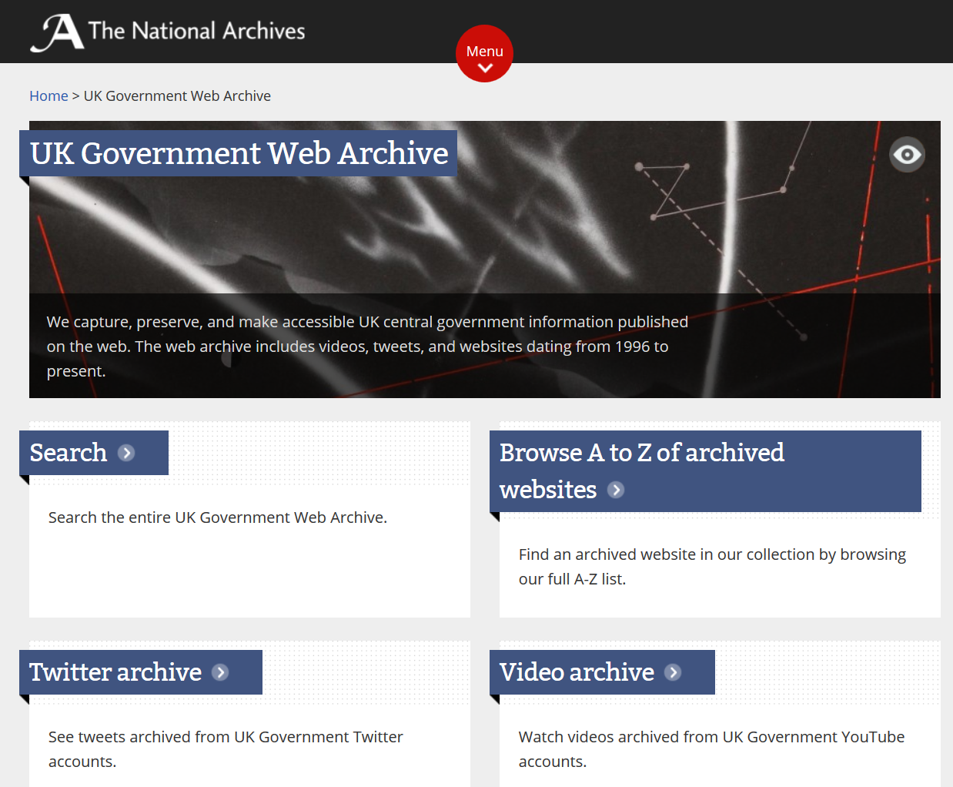
Webarchive
This is the real „webarchive”, however borders are flexible towards other public collections
Non-public web content or at least content intended not to be published to the general public (forums, personal blogs, photos, videos, private social media content and channels, closed webgroups and websites, company intranet and digital documentation)
Organized in e-archive fonds (perhaps together with offline digital contents)
Archiving of government and public administration websites and other digital materials.
Source: http://www.nationalarchives.gov.uk/webarchive/

Slide 10
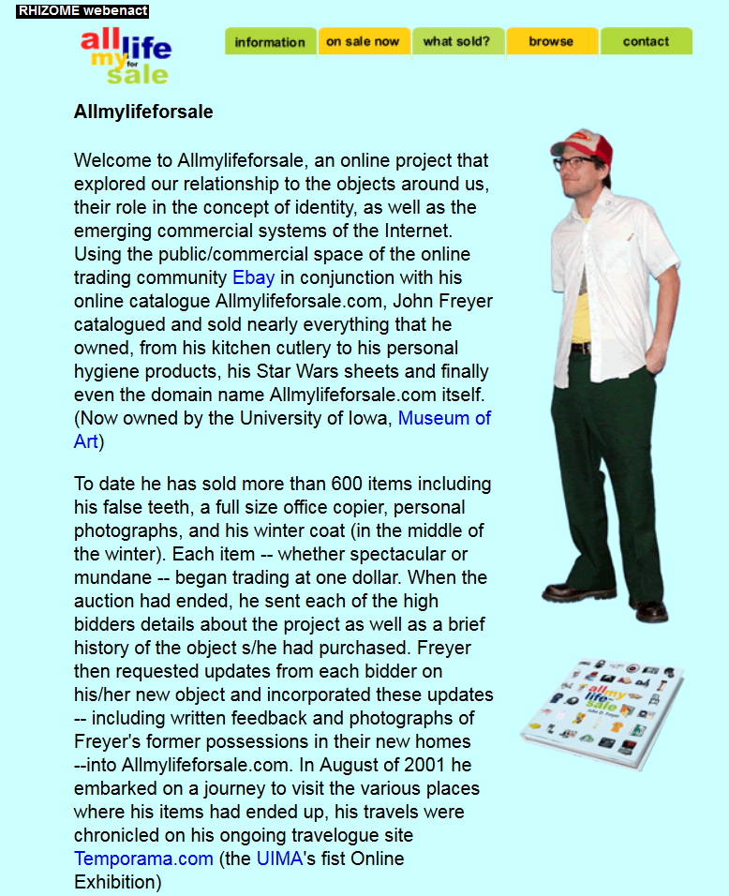
Web Museum
A web archive of a museum is the main repository of the web objects related to fine arts and industrial arts
The web presence of artists also can be archived
Collections that are reflecting to the institutional profile of a museum (f.ex. Local History Museum: online broadcasted local events; Military History Museum: cyber wars; Museum of Sports: e-sports; Photo Museum: digital photos; Museum of Commerce History: online commerce, Museum of Technology: Internet technologies).
Historical research based on web archives
Source: http://webenact.rhizome.org

Slide 11
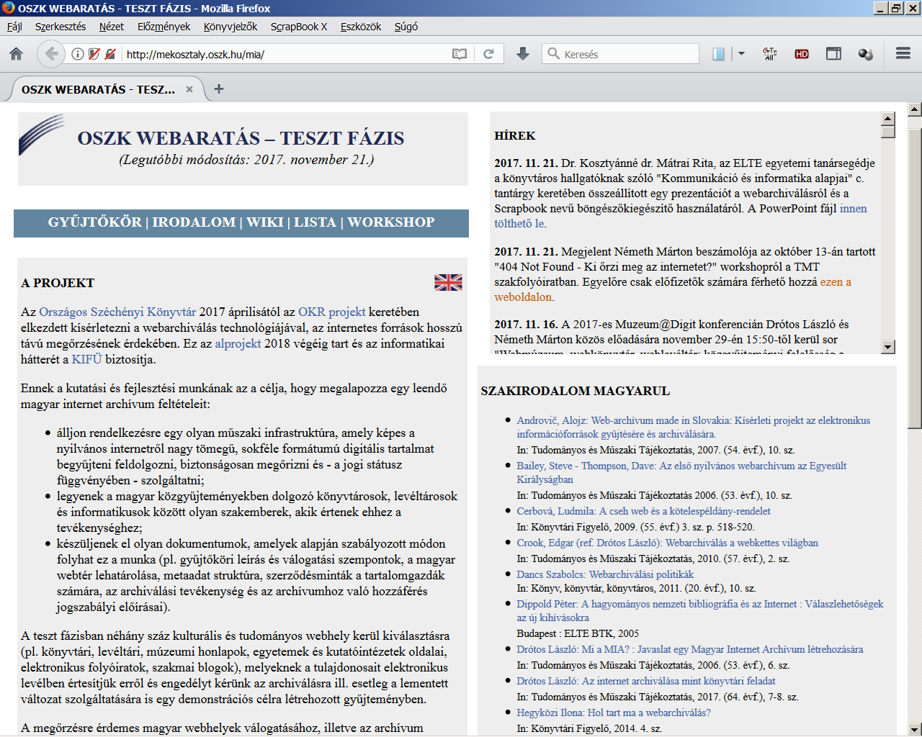
2017
Pilot project at the National Széchényi Library http://mekosztaly.oszk.hu/mia/
Establish a permanent workflow for web archiving to the future. All the basic conditions to run a permanent service project must be guaranteed (IT background, human resource, organisation framework, legal conditions)
Education activities in web archiving field directed to the cultural heritage sector. Helping to establish local archiving projects.
Participation in international collaboration among web archives
Source: http://mekosztaly.oszk.hu/mia

Slide 12
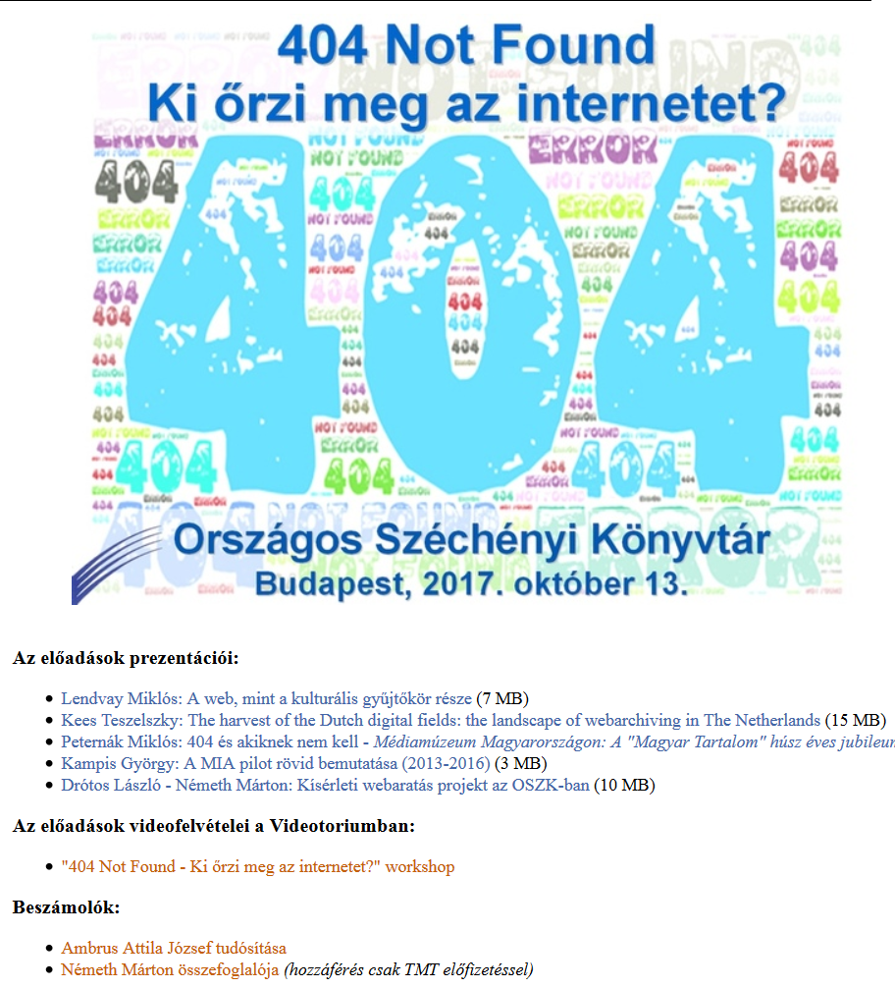
Current results
Professional networking: establish partnerships in Hungary and in international field, IIPC membership
Education: wiki, articles, mailing list, presentations, 404 workshop
Software tests: Heritrix, Open Wayback, Web Curator Tool (furthermore: HTTrack, WARCreate, Webrecorder.io, Webrecorder Player, WAIL, GrabThemAll, Scrapbook X)
Test harvesting: libraries, museums, archives, universities, e-periodicals
Source: http://mekosztaly.oszk.hu/mia/404_workshop.html

Slide 13
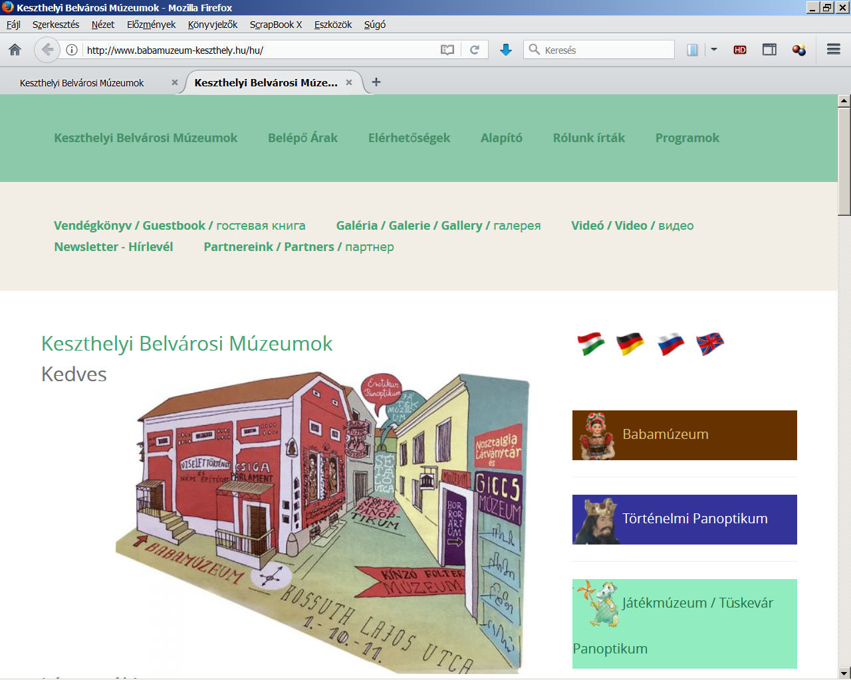
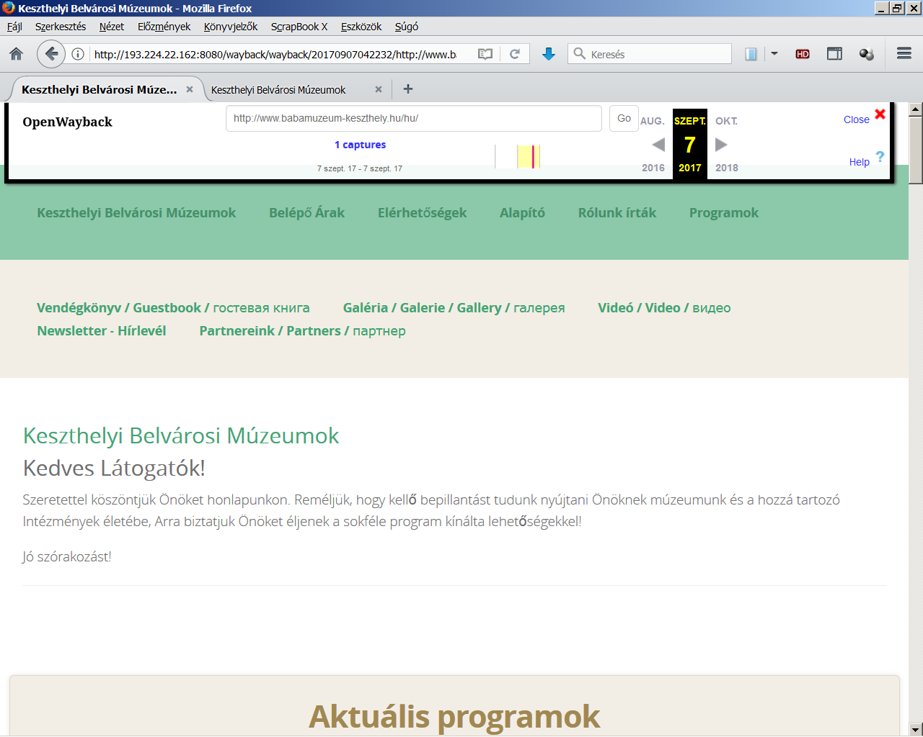
Archiving problems: Loss of website layout
Saved
Original

Slide 14
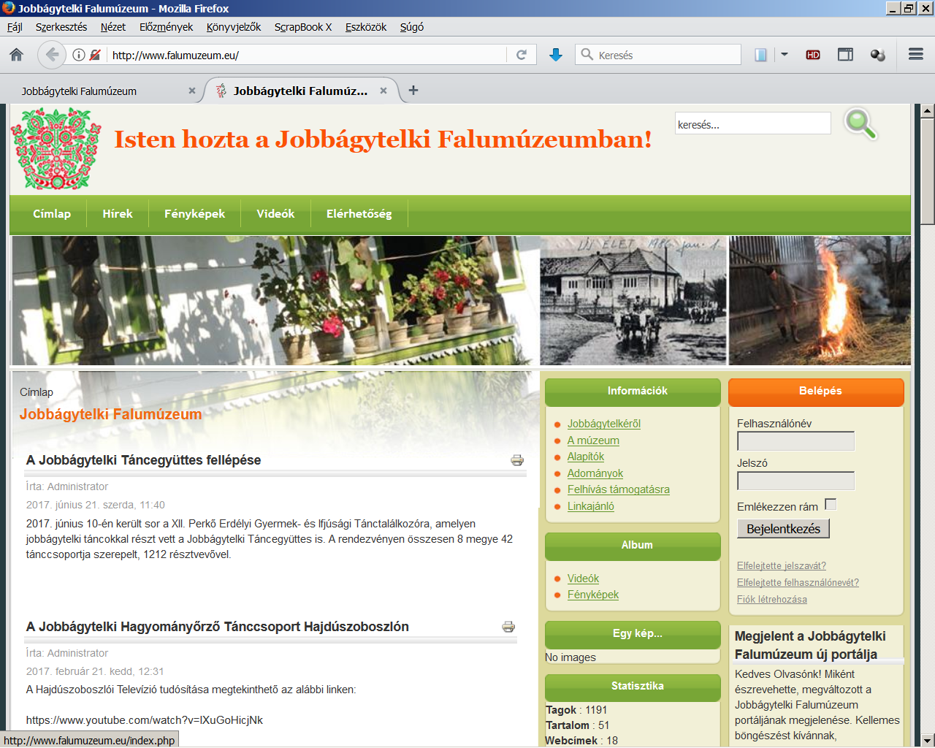
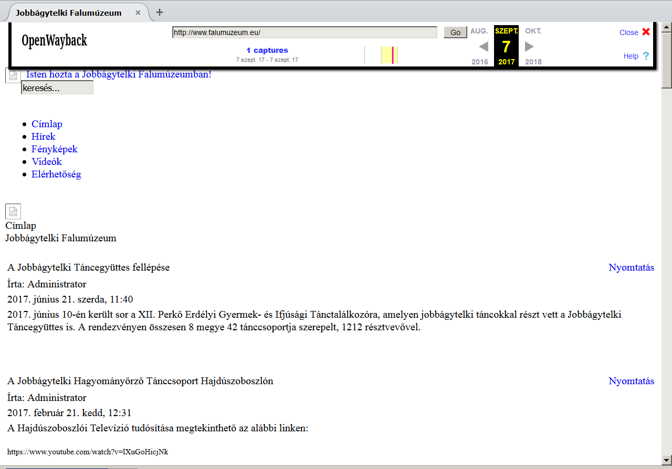
Archiving problems: CSS file has lost
Original
Saved

Slide 15
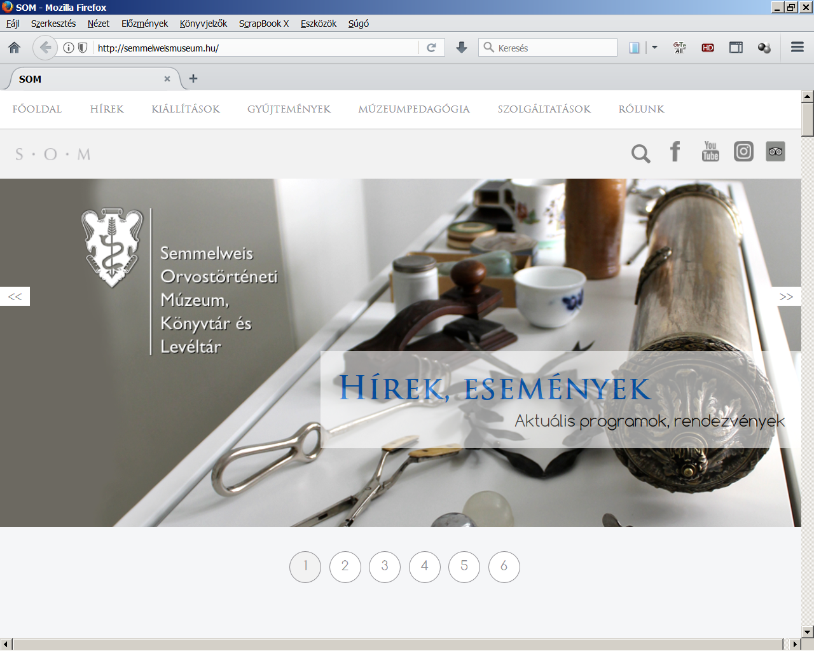
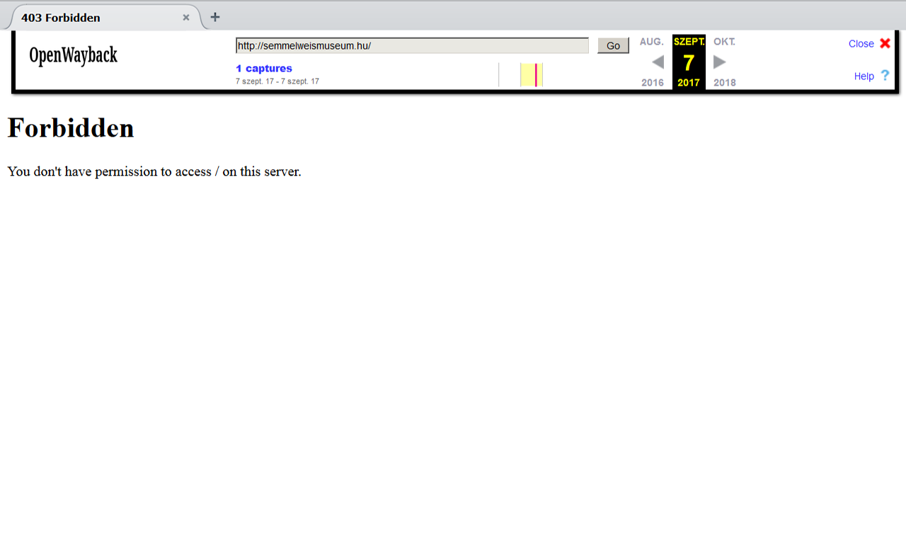
Archiving problems: robot not allowed on a website
Original
Saved

Slide 16
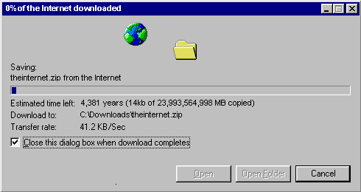
Main task: Archive everything from the Internet that is possible and important to you, until it is not too late…
Source: https://www.w3schools.com/downloadwww.htm
Thank you for your attention!

