Slide 1
A quick update about the Hungarian web archive
Márton Németh
National Széchényi Library Department of Web Archiving

Slide 2
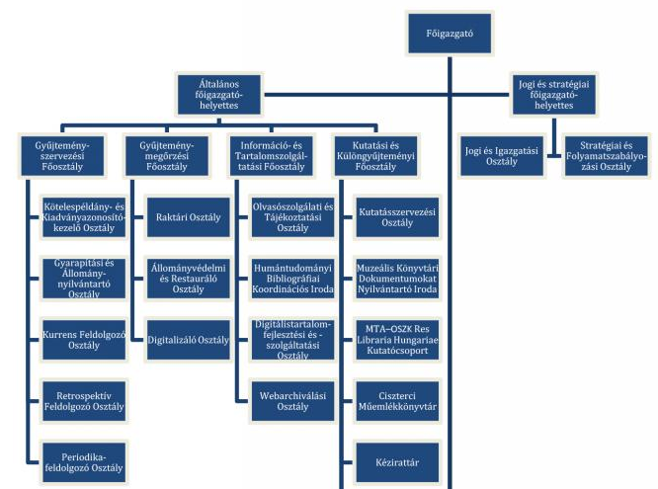
New web archiving department under the Information and Content Services General Department
It still consists of 3 people, but we hope to have 1 or 2 new employees

Slide 3
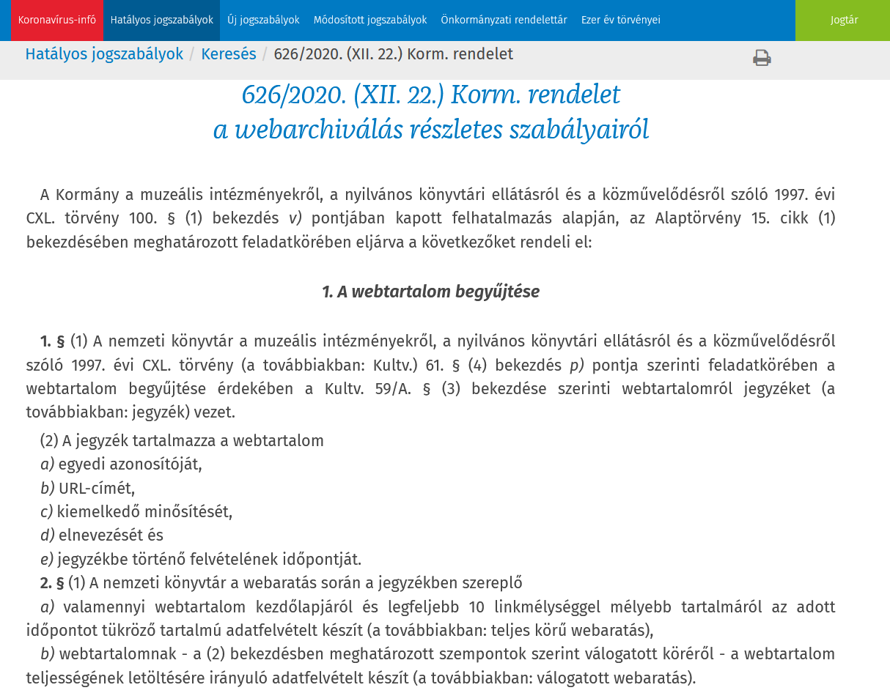
Government decree on web archiving
It entered into force on 1 January 2021

Slide 4
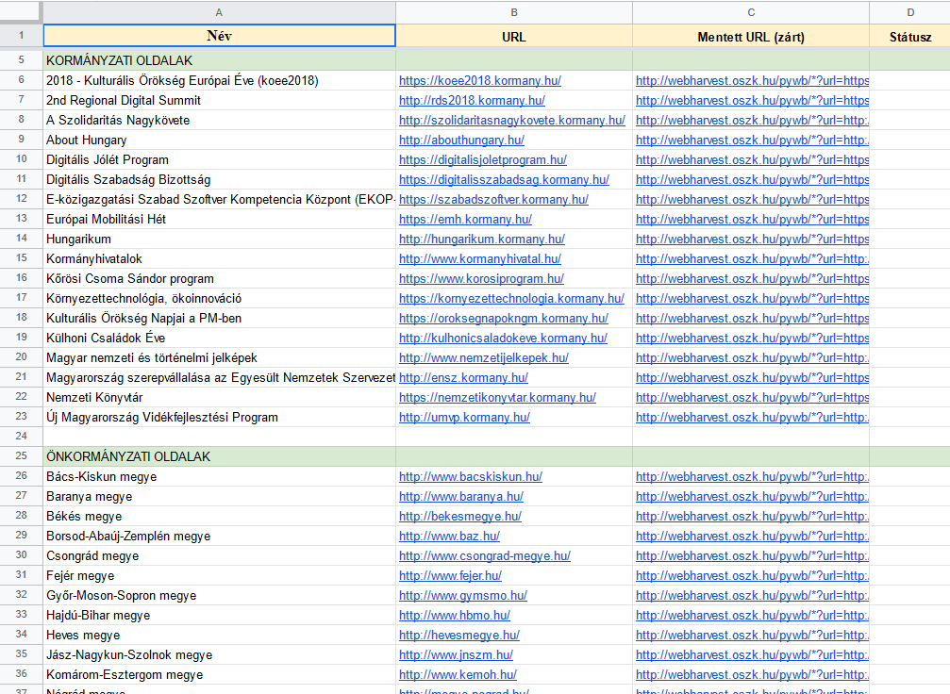
The new legislation will make our job much easier
Archived versions of governmental and publicly funded websites may be made available without special permission

Slide 5
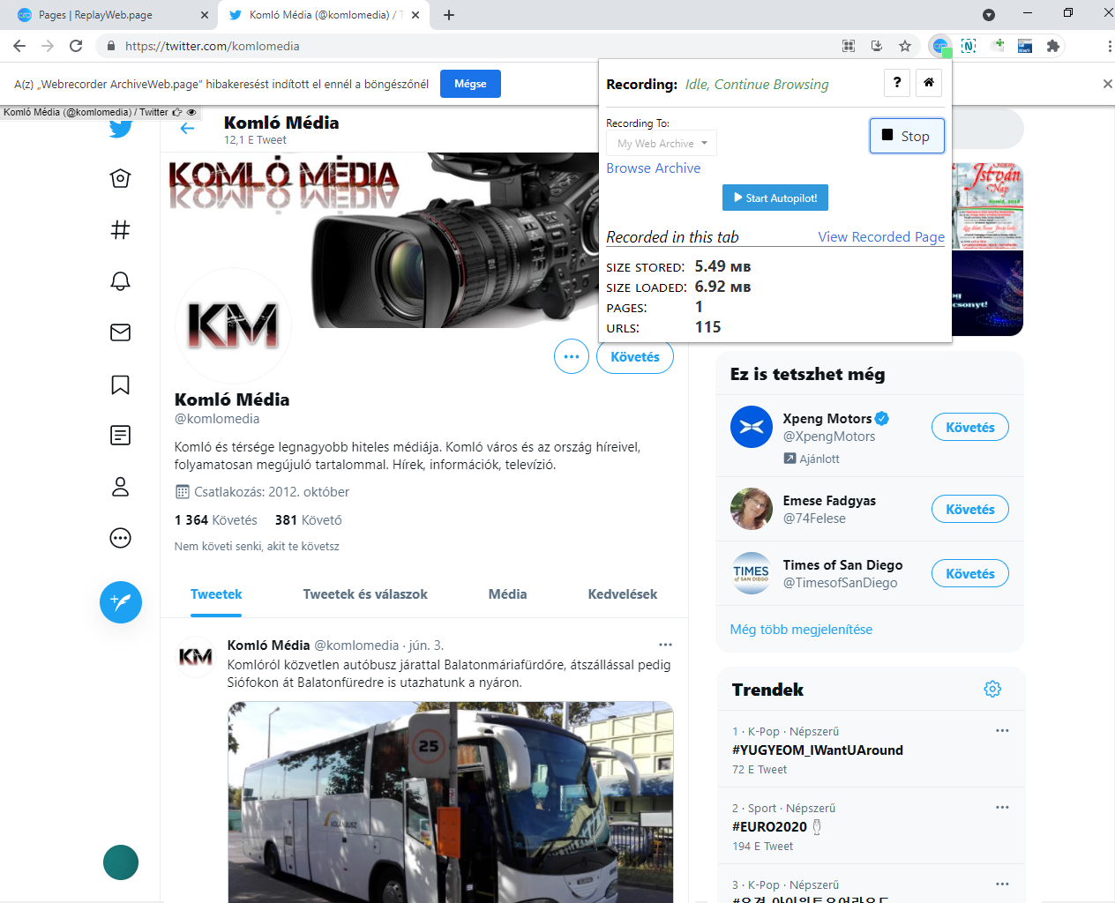
We also started working on social media archiving
We saved Instagram, Facebook and Twitter pages with Webrecoder and ArchiveWeb.page

Slide 6
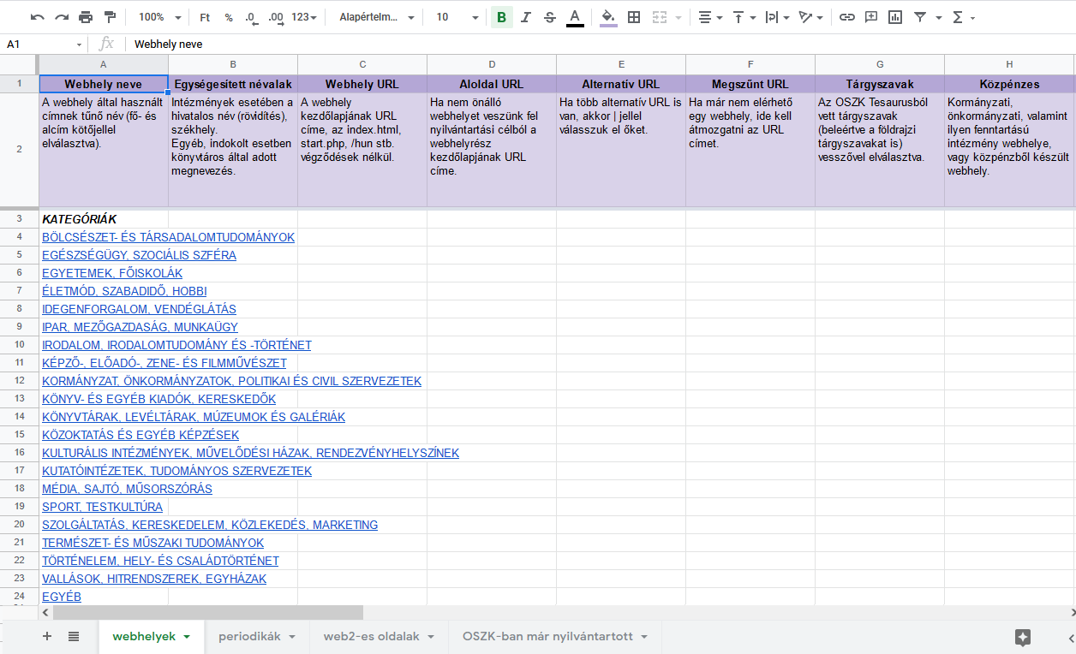
We build relationships with libraries and departments
We plan to create regional virtual sub-collections

Slide 7
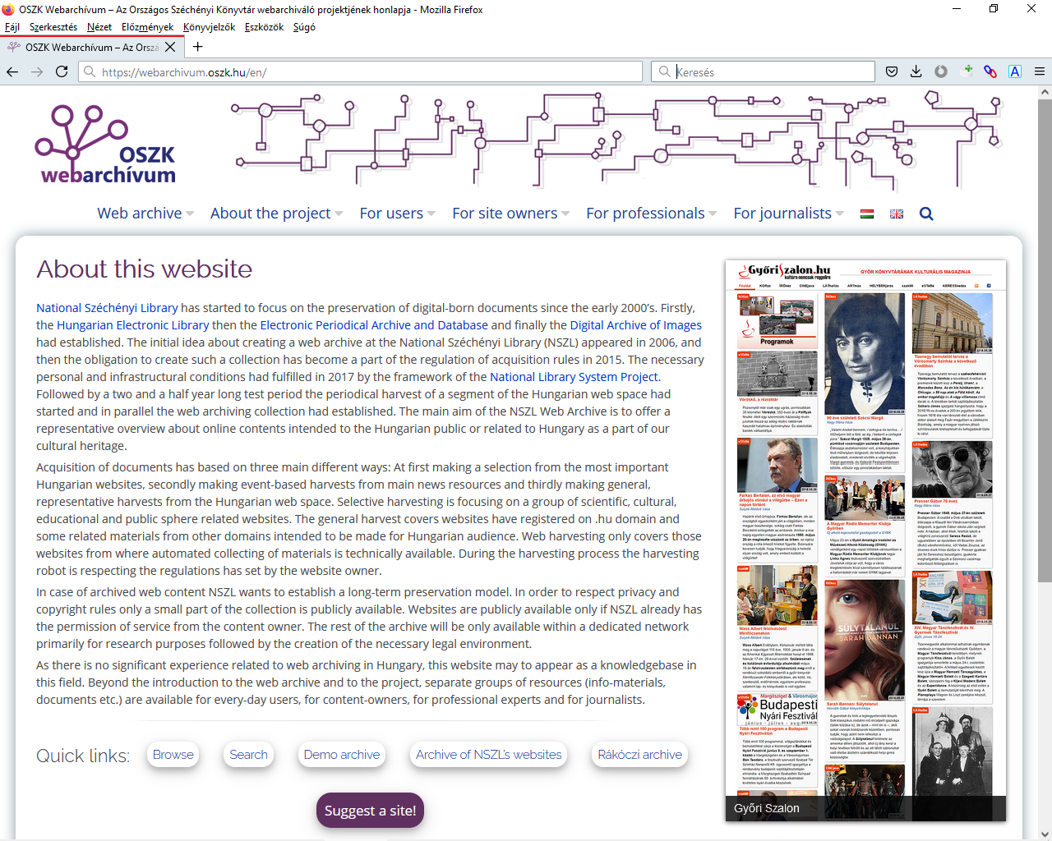
For more information, please visit our website: https://webarchivum.oszk.hu/en/
E-mail: mia@mek.oszk.hu

