Slide 1
The theoretical and practical fundamental elements of web archiving - The first steps of institutional web archiving in Hungary
Supervisor: Mária Eszenyiné Borbély dr.
Márton Németh
DE IK Doctoral School of Informatics – National Széchényi Library – Vera and Donald Blinken Open Society Archives
DH_Budapest_2022 & DARIAH DAYS
23.11.2022

Slide 2
Main aim and topics of research
Scientific overview about web archiving in Hungarian (first attempt)
Interdisciplinary scope
General definition of web archiving, web archiving in the context of digital preservation
Broad context in public collection perspective
International context in Hungarian perspective
From R&D pilot project to regular national library service – description of the practical framework
Development of workflows, IT background
Education of web archiving
Web archive as a research subject
Web archive and semantic web – highlighted sub-topic

Slide 3
Main challenges through writing the thesis
Making an overview from multiple perspectives (information technology, public collection, history etc.)
Limited length, balance of sub-topics
Minimal use of professional language - must be comprehensive to everyone
Clearly differentiate individual research job and collective efforts in the national library
Integrating a large base of professional literature into the thesis
Inspiring further research with solid base

Slide 4
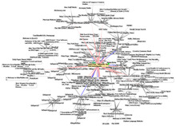
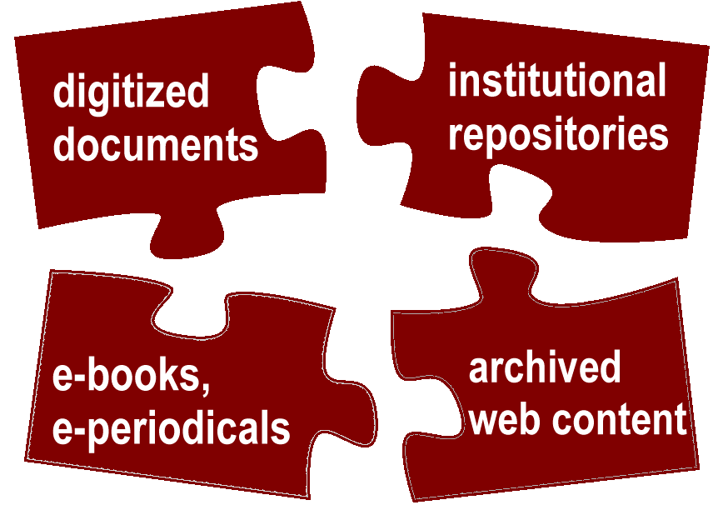
General framework of web archiving
Web as an amorf phenomenon as a whole – cannot be managed, cannot be archived
Grabbing and archiving fragments by subjective viewpoints
Cultural heritage on the web must be preserved
Development of web technology, emerging granularity
IT challenges of long term preservation
Public collections: instead of passive attitudes, proactive mindset
Traditional fundamental principles in new contexts
Activities of web librarians, web curators
Management and legal background
Collaborative network – education, research

Slide 5
International framework
National, institutional practices – effective implementation in Hungary predominantly European examples
International collaboration networks (IIPC, WARCNET)
Hungarian involvement in international collaboration
Advantages and disadvantages of latecomers

Slide 6
Beginnings of web archiving practice in Hungary
R&D in NSZL through the National Library System project
Initial goals, challenges
Personal, technical background
Main activites, workflows in a broad context
Archival methods, metadata, collection scope, quality check, storage
Collaboration forms (within NSZL, Hungary, abroad)
Main elements of IT hardware IT hardware and software infrastructure
Establish legal background
Communication framework
Institutional development of web archiving
Publications

Slide 7
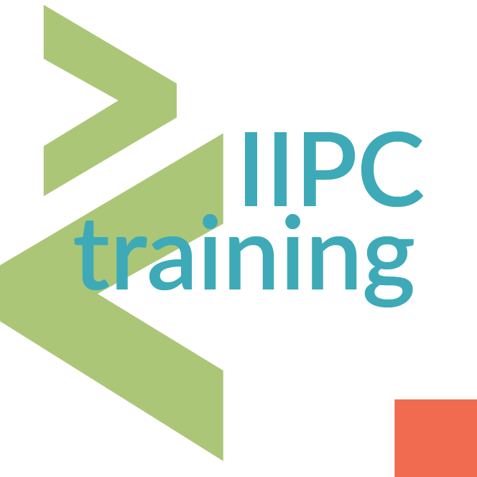
Education of web archiving
An integral part of institutional activities with broad aims – individual chapter
Curriculum development conception of NSZL Library Institute
Education effects of COVID
Virtual machine to introduce Linux-based software products
Integrating IIPC TWG international course materials
Personal web archiving course material
Collaboration with universities (first steps)
Interdisciplinary connection points in higher education

Slide 8
Webarchive as a research subject
Web History – new sub-discipline in History, requires strong IT skills
Interdisciplinary comparative studies on web archives and web archiving -WARCNET project
Webarchive as big data resource, and target of data-mining
Challenges of scientific reference of web materials
Webarchive and digital humanities
Authorized document services from web materials
Webarchives on the semantic web – a case of a missing schema

Slide 9
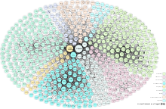
Using microdata
Theoretical modell as a result of research
Improving the effectiveness of retrieval of archived web materials
Regulating web archiving by robots
Support of long-term preservation
Research support services and microdata
Implementing microdata to live and archived web?

Slide 10
Evaluation of research
Fundamentals of theories and research methods, public collection frameworks – first time in Hungarian
Developing a permanent national library service from an R&D pilot project
Describing web librarian, web curating tasks
Applying the results of my numerous research publications in the thesis
Creating a solid base of research related to web archives and web archiving
Aim of broader collaboration with higher education institutions
Requirement of broad professional collaboration
Uncertain future of the Internet
Web archiving as business?
Further research plans to the establishment of using microdata
Planning new web archiving projects at OSA (archiving websites of CEU, OSF, Hungarian human rights organizations, event-based archiving, private archiving projects for academic community)

Slide 11
Thank you for your attention!
Thesis and thesis booklet with resumes in English:
http://mek.oszk.hu/23400/23495/pdf/
E-mail: nemethm@gmail.com nemethm@ceu.edu
National Széchényi Library Web Archive: https://webarchivum.oszk.hu/en/
Vera and Donald Blinken Open Society Archive:
https://osaaarchivum.org

