Slide 1
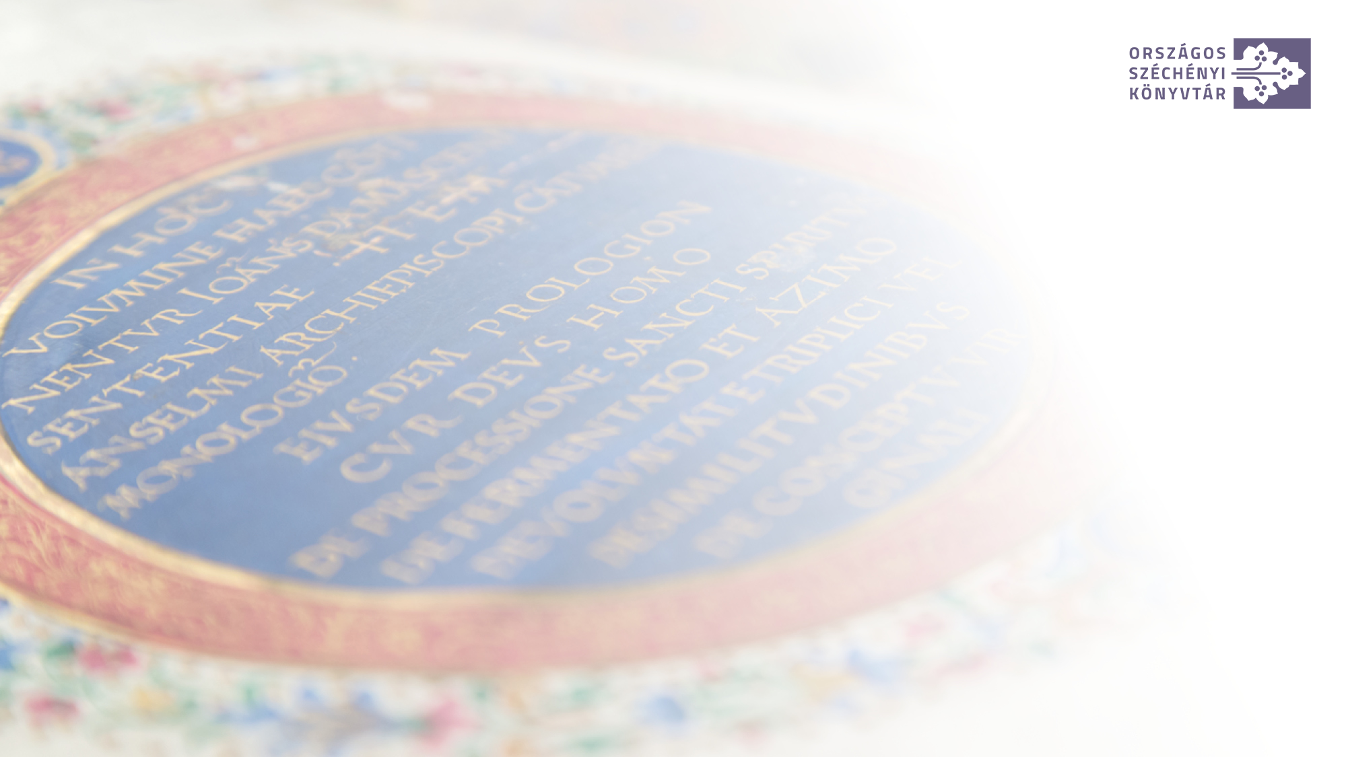
Gyula Kalcsó National Széchényi Library Digital Humanities Centre Department of Digital Philology and Web Archiving Building and Processing Corpora from Archived Web Content
The Case Study of the Ukraine Project
webarchivum.oszk.hu

Slide 2
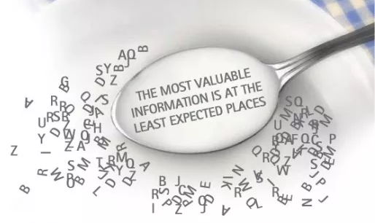
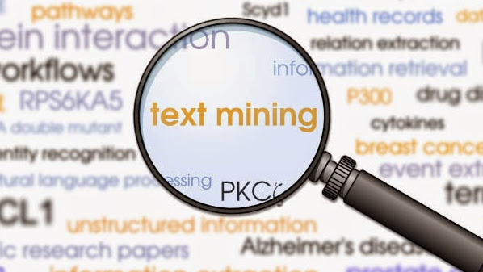
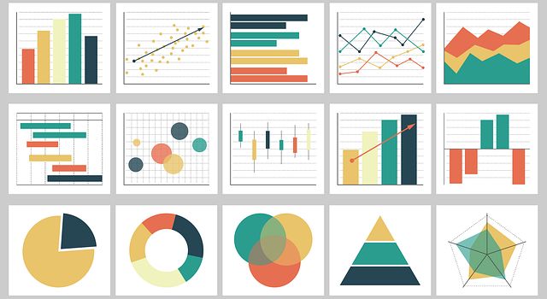
What is it about?
1. Archived web content as research data
2. Building text corpora from archived web content
3. Text and data mining
4. Data visualization

Slide 3
1. Archived web content as research data

Slide 4
Archived web content as research data: projects and literature
IIPC Research Working Group
https://netpreserve.org/about-us/working-groups/research-working-group/
Archives Unleashed Project
Ruest, N., Lin, J., Milligan, I., & Fritz, S. (2020). The Archives Unleashed Project: Technology, Process, and Community to Improve Scholarly Access to Web Archives. Proceedings of the ACM/IEEE Joint Conference on Digital Libraries in 2020, 157–166. https://doi.org/10.1145/3383583.3398513
Gomes, D., Demidova, E., Winters, J., & Risse, T. (Eds.). (2021). The Past Web: Exploring Web Archives. Springer International Publishing. https://doi.org/10.1007/978-3-030-63291-5
Amanda, L. R. (2018). Getting to Know Our Web Archive: A Pilot Project to Collaboratively Increase Access to Digital Cultural Heritage Materials in Wyoming. Digital USD.
Nielsen, J. (2016). Using web archives in research – an introduction (1.). Netlab.

Slide 5
Archived web content as research data
The huge amount of text on the web for building language models (needed for language models like ChatGPT)
Content of texts (various humanities and social science studies: sentiment analysis, discourse analysis, etc.)
Analysis and use of AV content e.g. to train AI (image labelling, object detecting, etc.)
Metadata research, data visualization
Big data research, data visualization

Slide 6
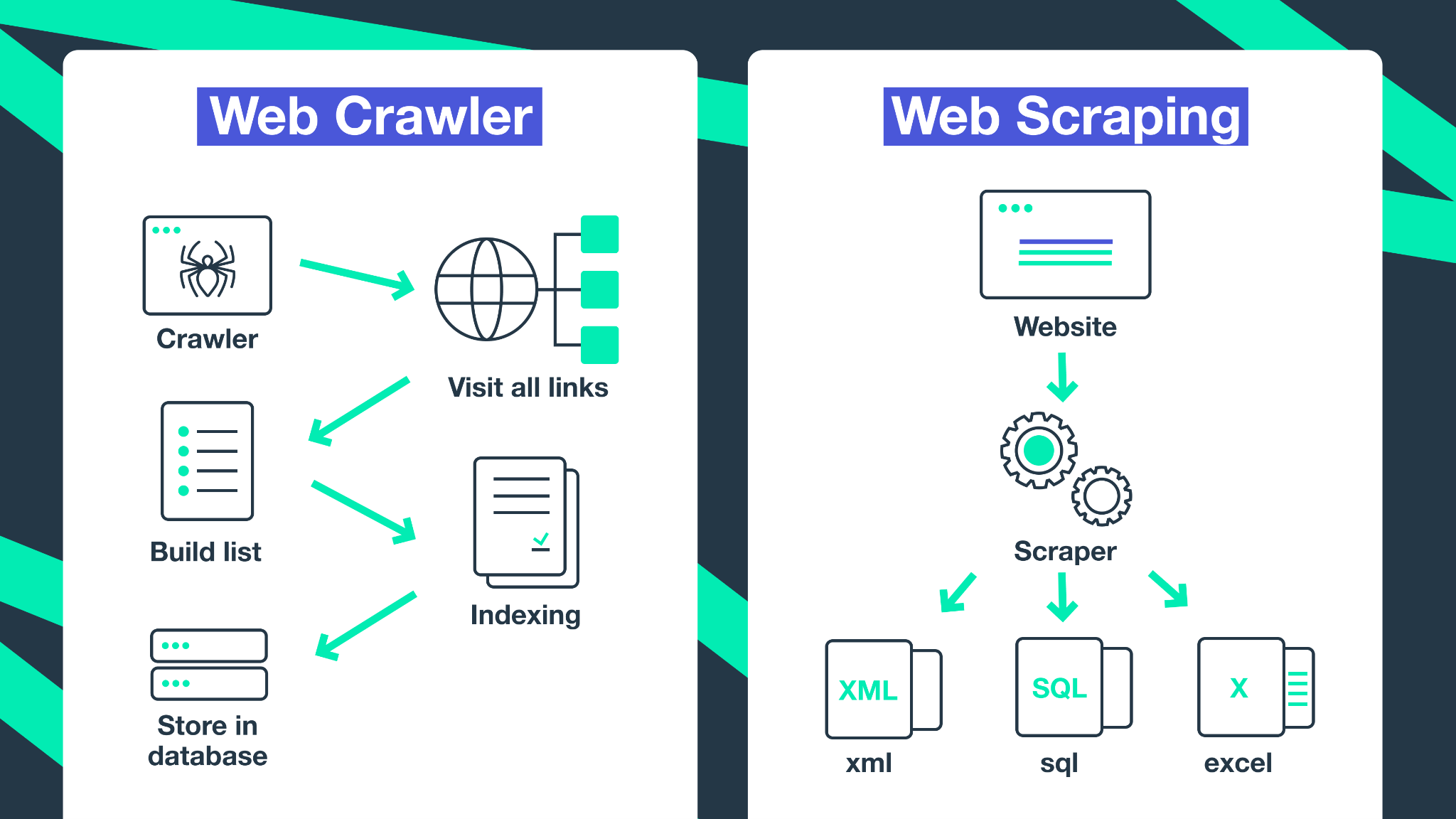
Archived textual web content as research data
Textual content can be extracted in two ways: web crawling vs. web scraping
Workflow of crawling: crawler → harvested content (WARC) → text
Wrokflow of scraping: scraper → text
The result of crawling contains not only text but also other information, but has the advantage that more metadata and contextual information can be extracted from it
(Patel, J. M. (2020). Getting Structured Data from the Internet: Running Web Crawlers/Scrapers on a Big Data Production Scale. Apress.)

Slide 7
The Ukraine Collection
In addition to domain level broad harvests and thematic harvests, the NSZL also produces event-based collections of major cultural, political and sporting events.
Since 21 February 2022, we have been collecting news about the Russian-Ukrainian conflict and later the war from 75 news portals in Hungary and abroad.
The collection of news is based on the tags or categories used on the portals (more than 400 seed URLs).
These harvests run once a week.
The collection is not open to the public for legal reasons (although there is a full text search engine: https://ukrajnapublic.webharvest.oszk.hu/solrwayback).
A workflow was developed in the NSZL DHC to build NLP processed text corpora from archived web content to make it available for research purposes.

Slide 8
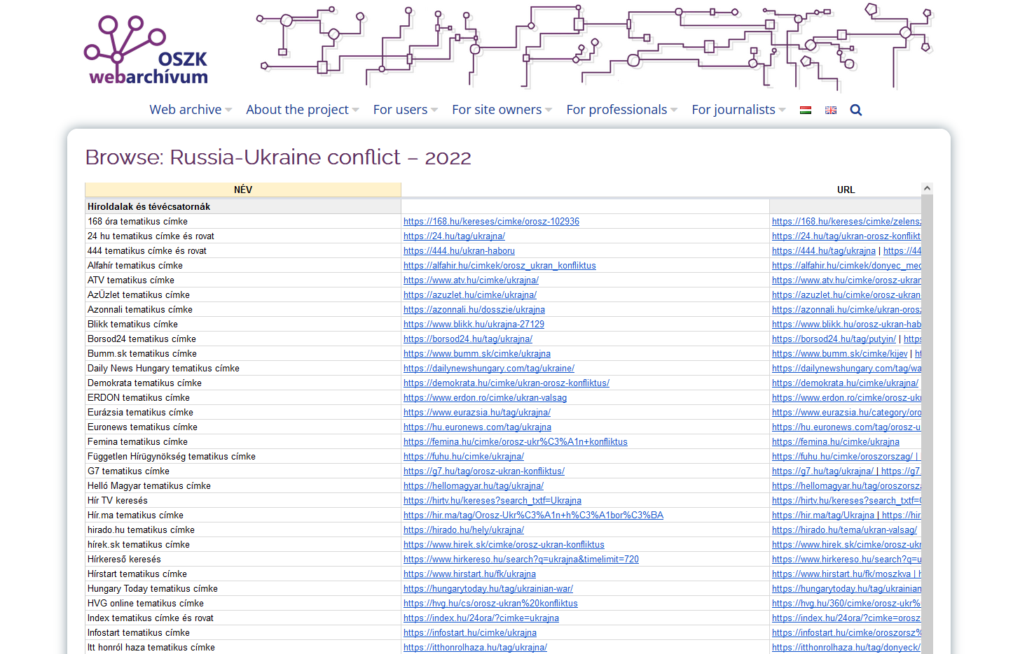

Slide 9
2. Building text corpora from archived web content

Slide 10
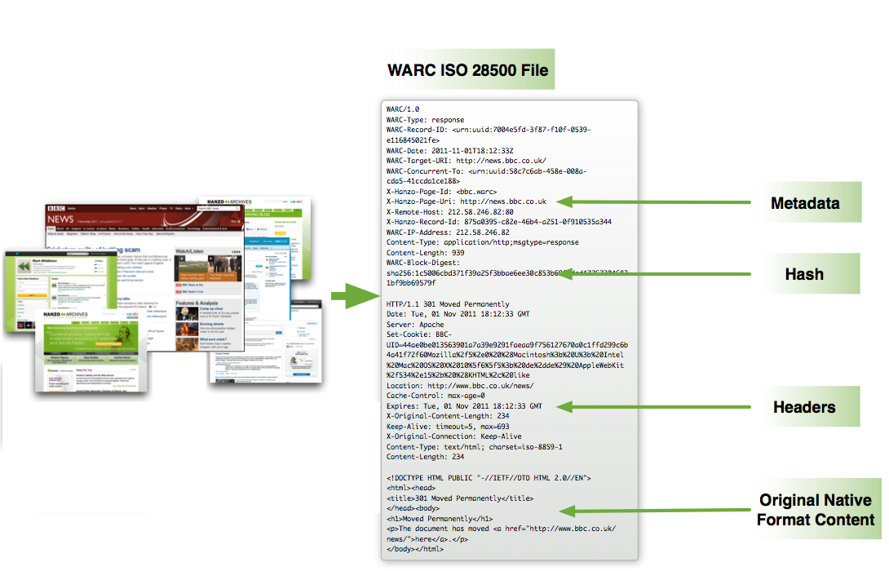
Standard format for web archives: WARC
https://www.hanzo.co/blog/iso-28500-warc

Slide 11
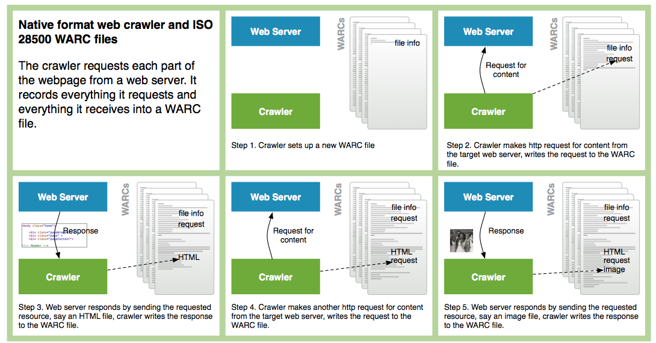
Standard format for web archives: WARC
https://www.hanzo.co/blog/iso-28500-warc

Slide 12
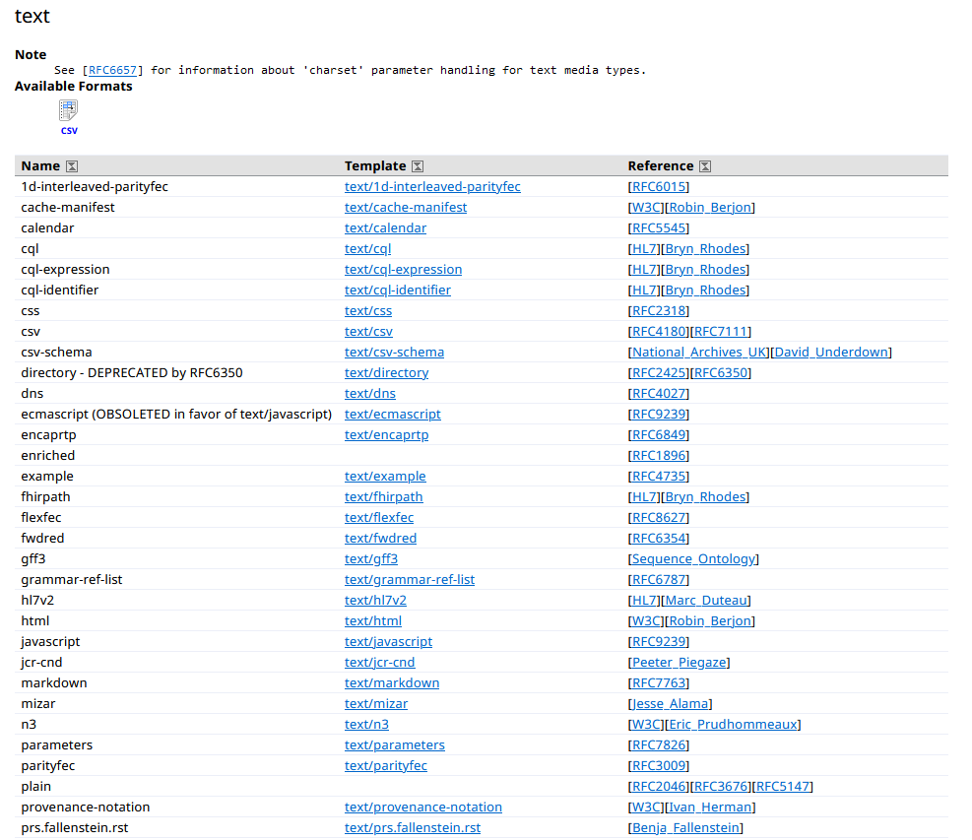
Where is the text in WARCs? (WARC2TXT)
According to the standards, there are 92 MIME types, which are in text format (text/…, see https://datatracker.ietf.org/doc/html/rfc2045)
The text of the news is contained in the HTML in case of WARCs.
So first step is WARC2HTML.

Slide 13
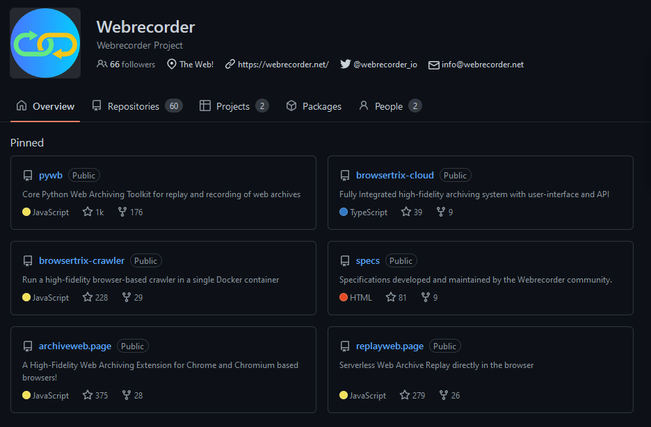
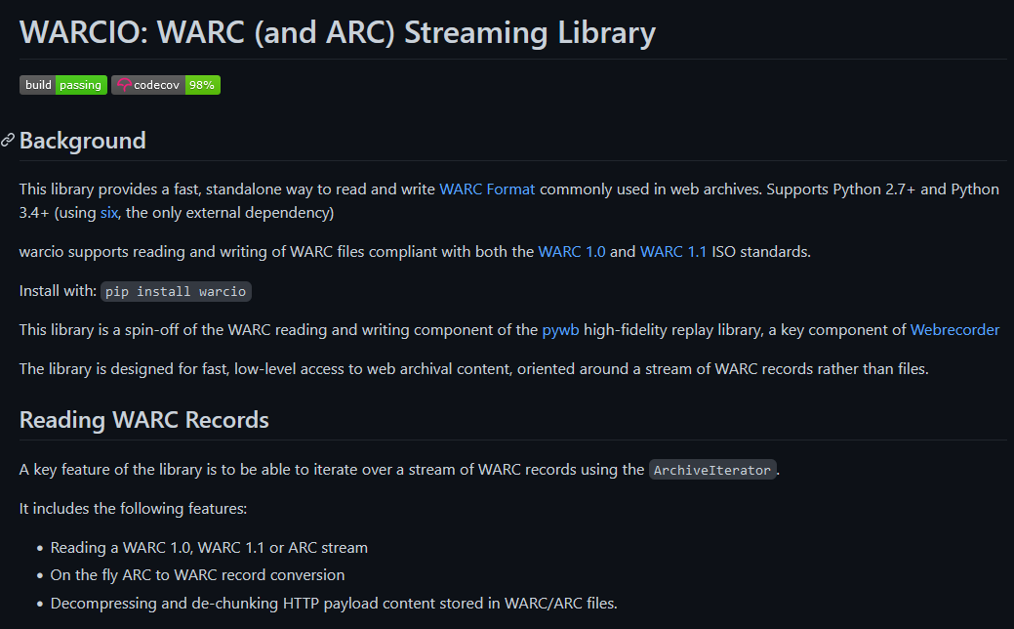
WARC2HTML

Slide 14
HTML2TXT: Background for the Hungarian
Pázmány corpus (Endrédy, Prószéky 2016). To extract the text from CommonCrawl's WARCs, it used the self-developed Goldminer algorithm based on an algorythm called jusText (see bellow).
(Nyelvtudományi Közlemények 112. 191—205. DOI: 10.15776/NyK.2016.112.6)
Webcorpus 2.0 (Nemeskey 2020). He created his own Python tool to download and process the Hungarian part of the CommonCrawl corpus, which is freely available on Github. To extract the text, this project also used jusText.
(https://github.com/DavidNemeskey/cc_corpus;
Nemeskey, Dávid Márk 2020: Natural Language Processing Methods for Language Modeling. PhD thesis. Eötvös Loránd University.)

Slide 15
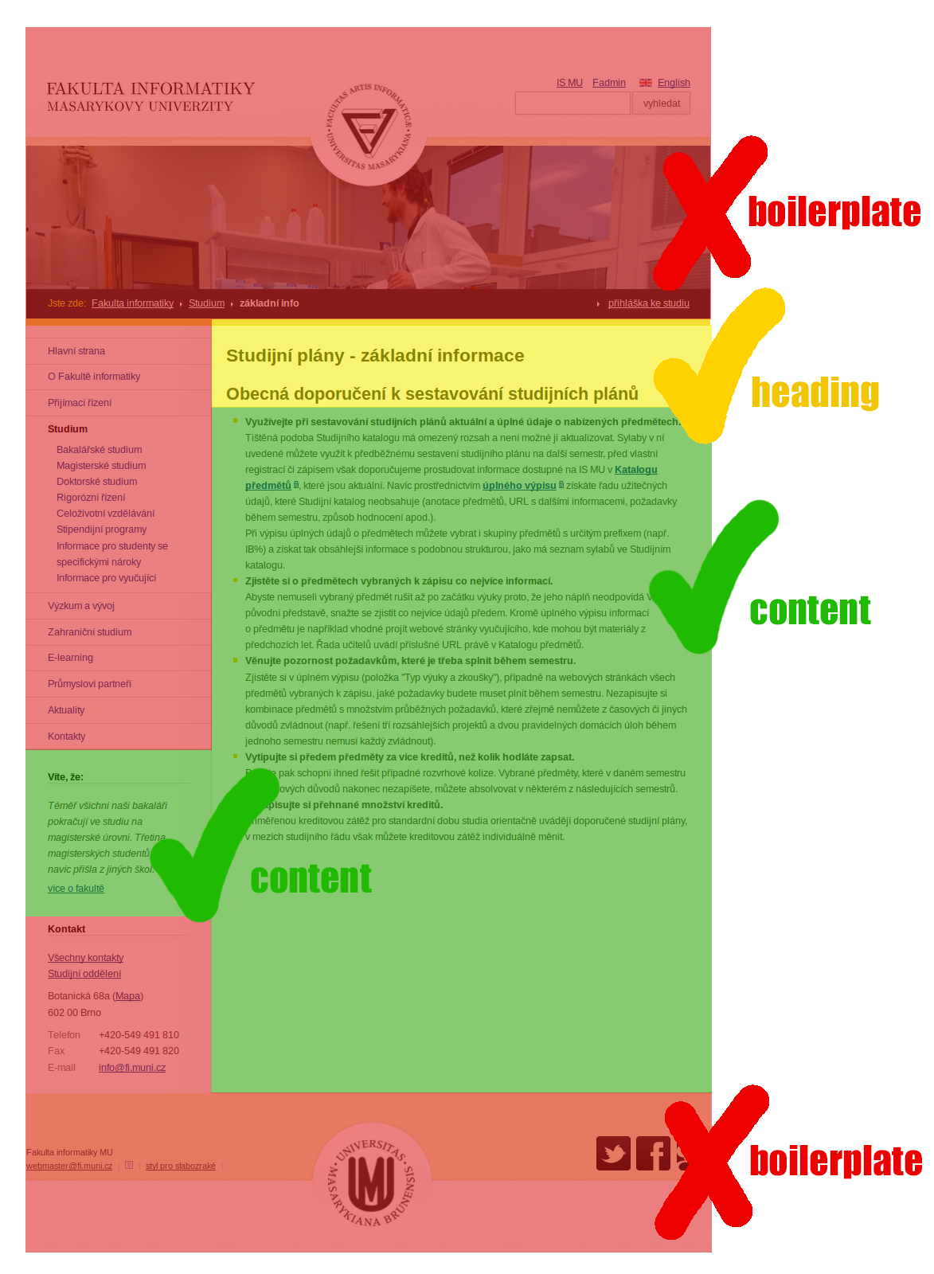
HTML2TXT (boilerplate removal)
jusText Python library:
removes the boilerplate from the HTML in two steps (based on context and language content)
result: plain text
(Pomikálek, J. (2011). Removing boilerplate and duplicate content from web corpora [PhD Thesis]. Masaryk university, Faculty of informatics, Brno, Czech Republic.)

Slide 16
3. Text and data mining

Slide 17
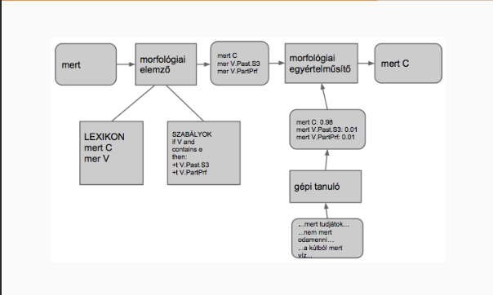
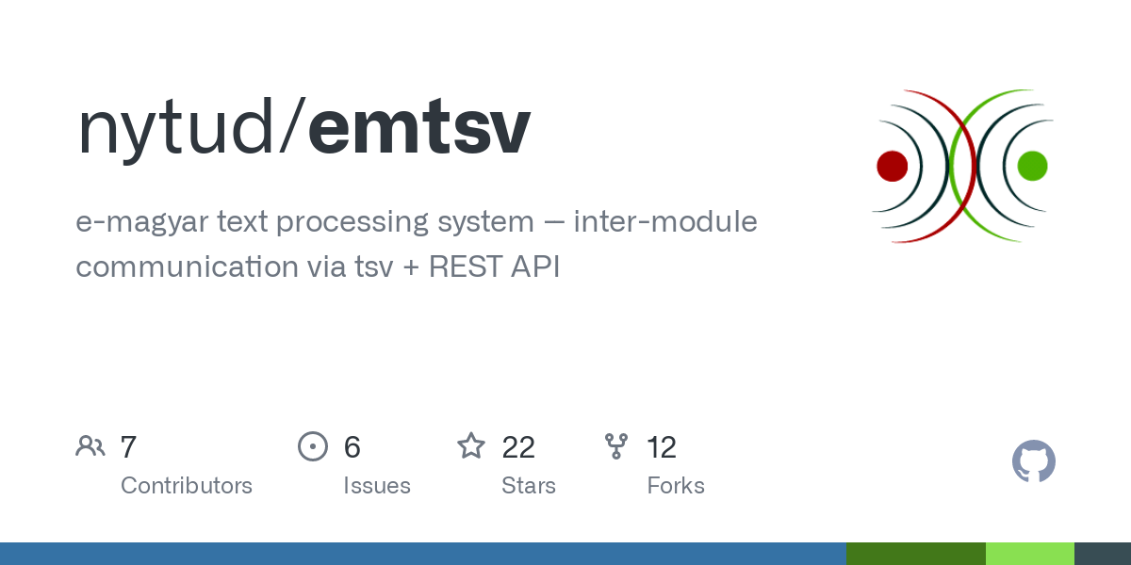
Natural Language Processing
The purpose of NLP:
breaking down the text into sentences
breaking down into words
lemmatization
morphological analysis
POS-tagging
morphological clarification
Benefits:
more precise, linguistically analysed data
the elements irrelevant for data mining (hyphens, pronouns, etc.) can be removed
(Indig, B., Sass, B., Simon, E., Mittelholcz, I., Vadász, N., & Makrai, M. (2019). One format to rule them all – The emtsv pipeline for Hungarian. Proceedings of the 13th Linguistic Annotation Workshop, 155–165. https://doi.org/10.18653/v1/W19-4018)

Slide 18
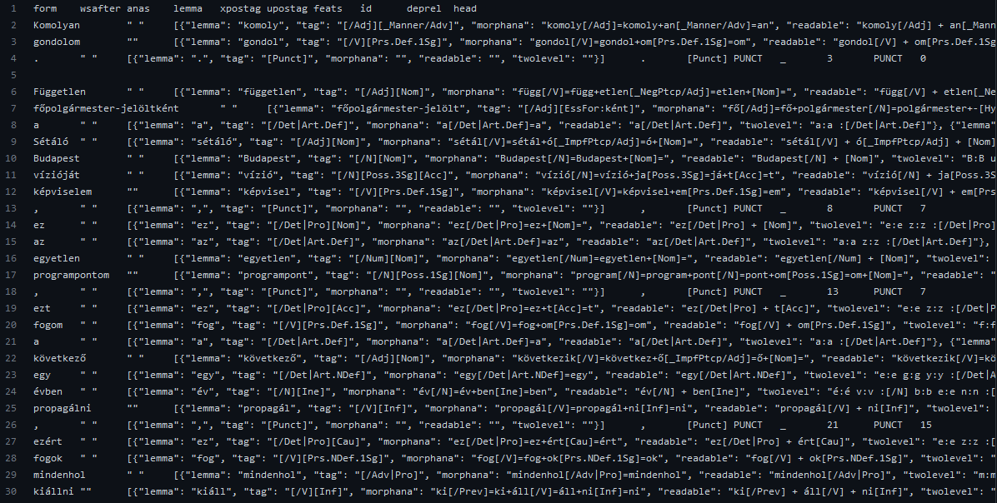

Slide 19
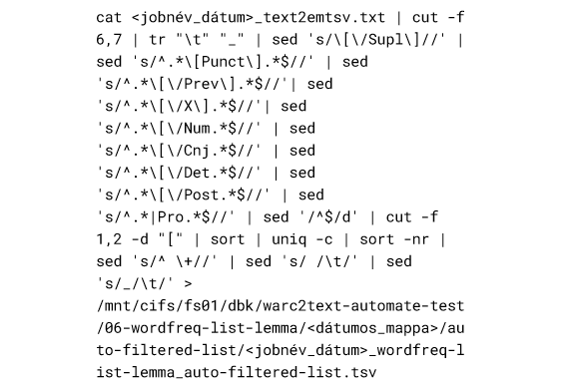
Data mining of the processed text
Data cleaning: removing punctuation and other unnecessary data (e.g. biolerplate left over)
Extraction of the relevant data: processing of the TSV (based on the headers, we split it with Linux commands, keeping the necessary columns)
Further processing: e.g. removing certain POS-tagged tokens (articles, post positions, conjunctions etc.) to create word clouds
Produce data sets, data tables with further Linux commands that extract data from the processed TSV

Slide 20
4. Data visualization

Slide 21
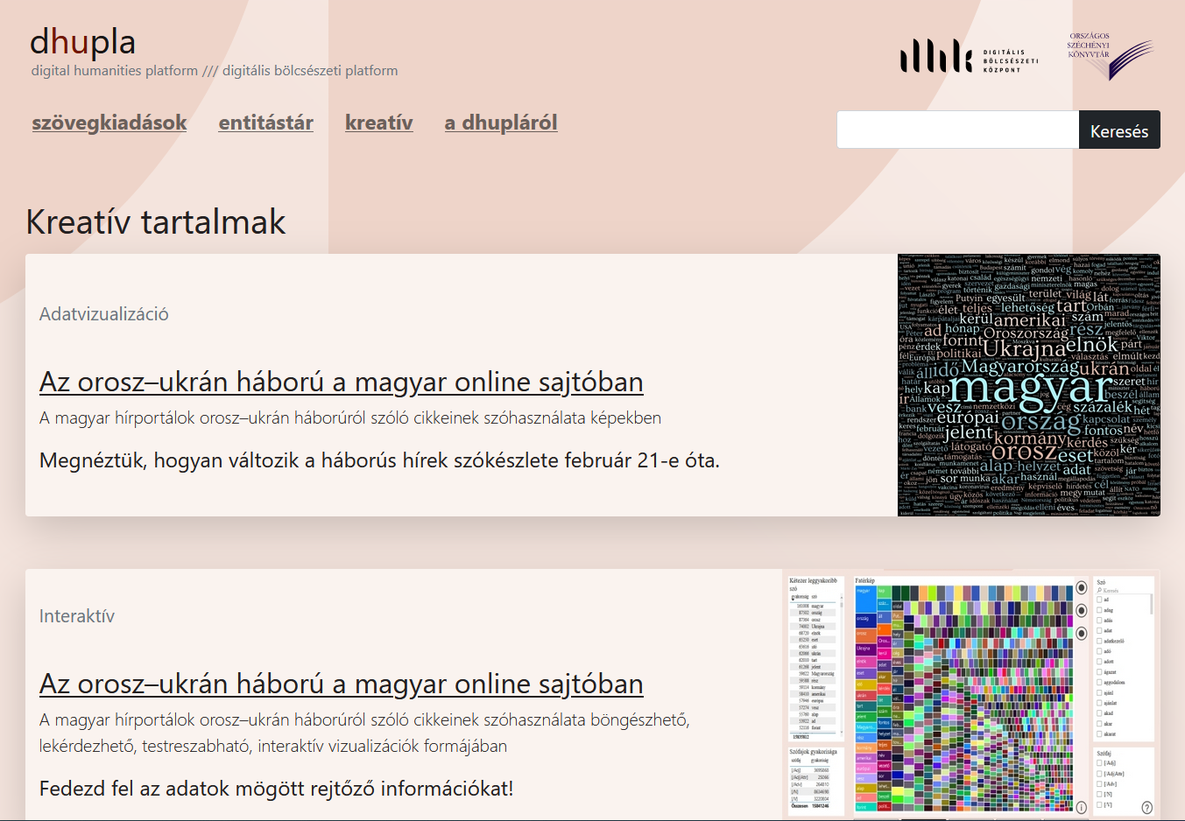
dhupla.hu

Slide 23
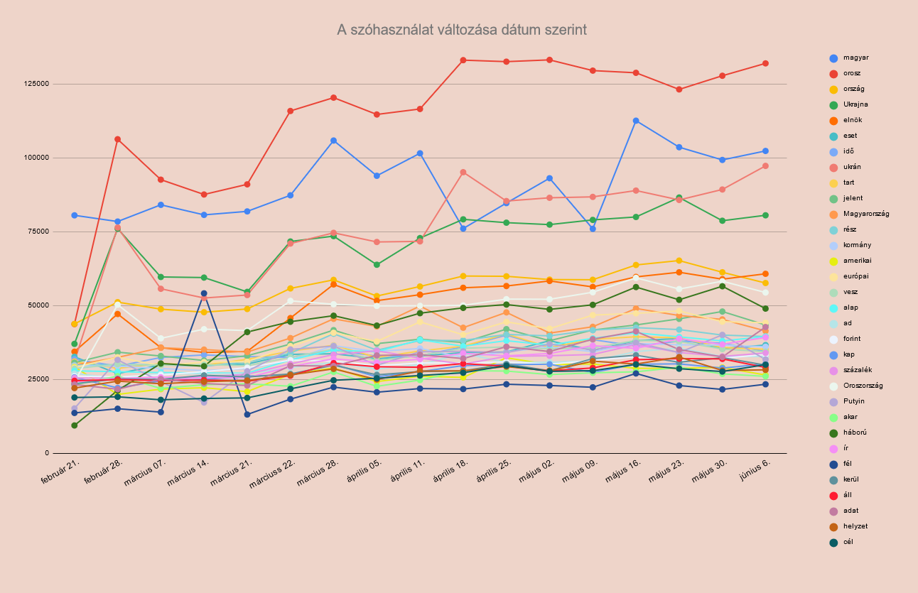

Slide 24
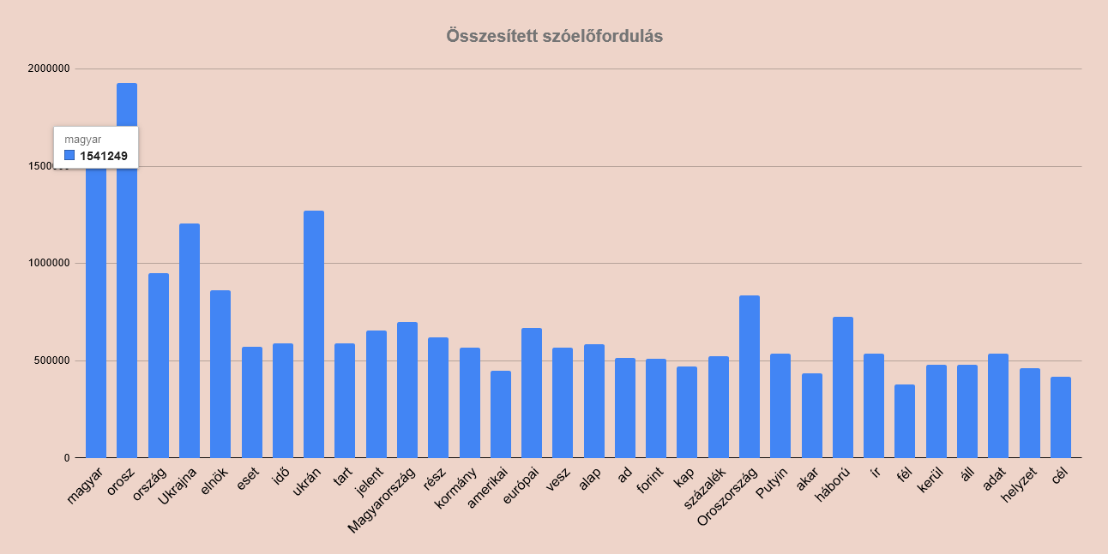

Slide 25
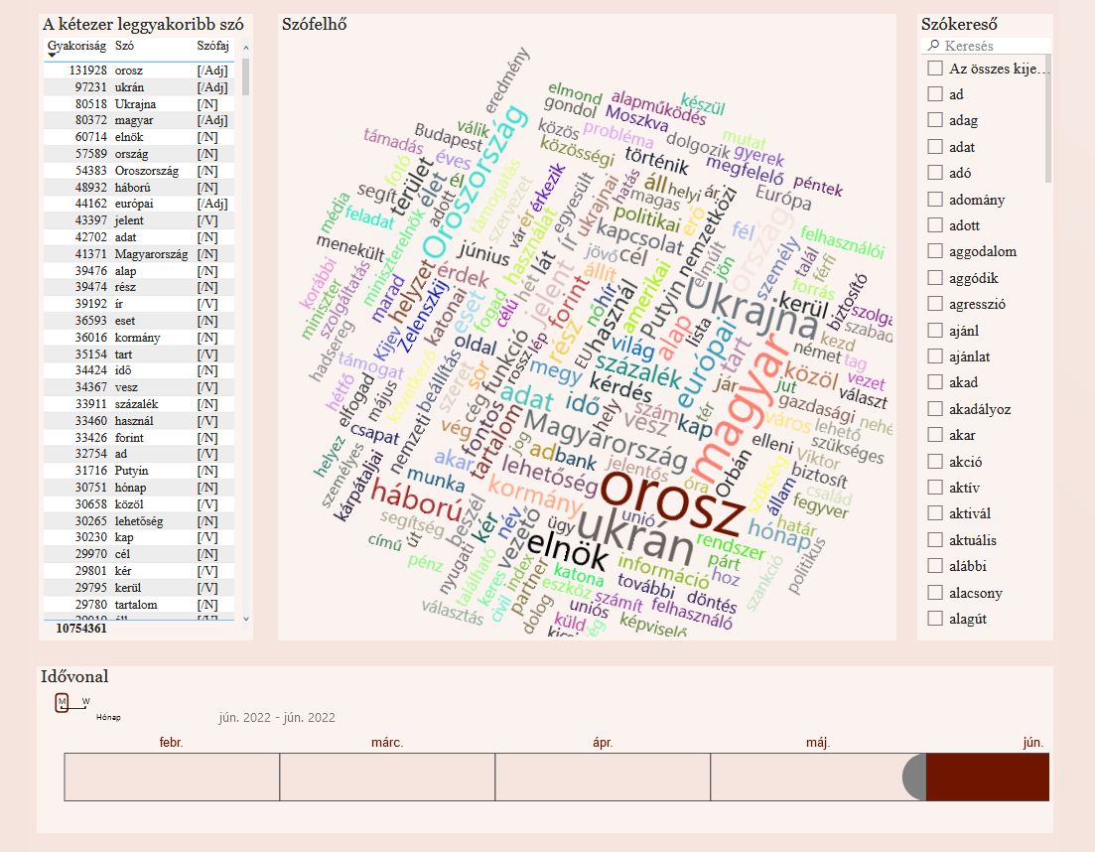

Slide 26
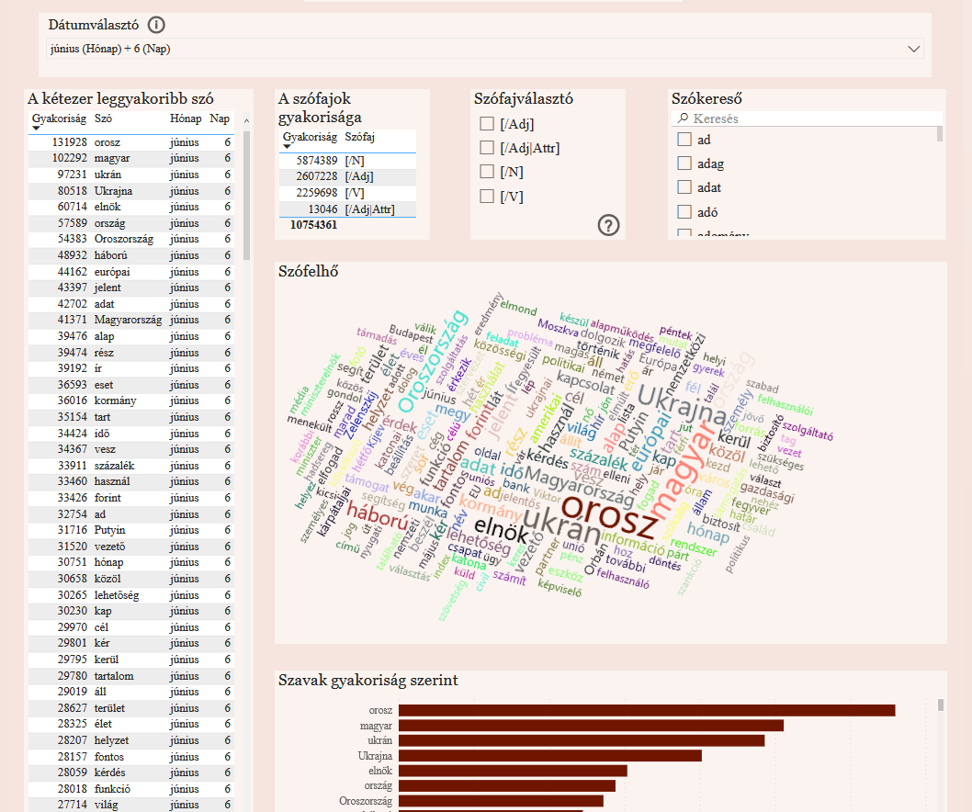

Slide 27
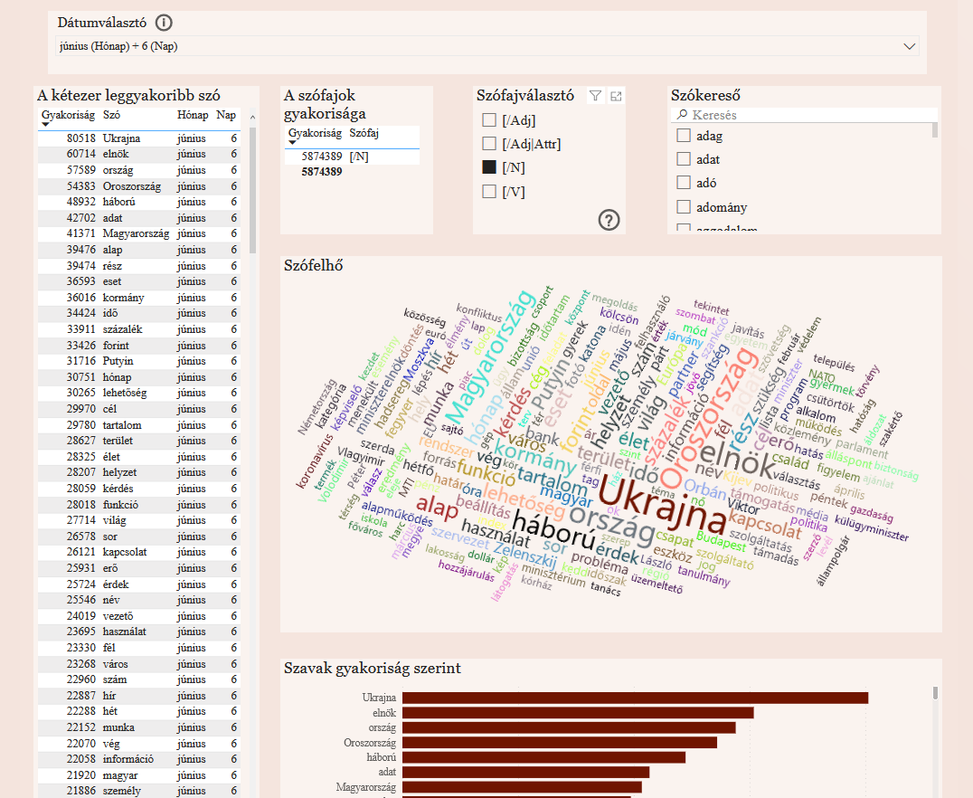

Slide 28
Moving forward
In building text corpora:
Use metadata to refine content classification and filtering
Automate with artificial intelligence (e.g. topic modelling)
The aim: the possibility of building thematic corpora from the web archive based on different approaches
Data mining of other types of archived web content:
Extract and process other MIME content (image, AV, documents, etc.)
Automate with artificial intelligence (e.g. image labelling, object detection, speech to text)
Publishing data:
Establish a research platform through which researchers can produce data from their own corpus and process and visualise it

Slide 29
Thank you for your attention!
László Drótos, Gyula Kalcsó, Csilla Makkai, Eszter Mihály, László Kis-Ádám, Péter Kovács, Eszter Simon, Kata Szűcs, Emese Varga, Ágnes Végvári, Ákos Visky, Gábor Vitéz

