Slide 1
Luxembourg
Web Archive

Slide 2
Yves Maurer Head of IT department
– technical manager – strategic focus
The Team
László Tóth Software Engineer – develops software solutions – indexation, research engines
– manages domain crawls
– administration of technical infrastructure
– QA on the technical level
Ben Els Digital Curator – manages special collections – point of contact for content owners – administration of webarchive.lu
– QA on the content level (with student helper)

Slide 3
Base law for
Luxembourg web legal deposit
IIPC membership
Whitepaper for BnL by Hanzo Archives
BnF visit
DPC membership
BnF & INA visit
Launch of
webarchive.lu
2009
2015
2016
2017
2005
2018
2006
First domain crawl
2004
2020
Proof of concept with Heritrix
Inclusion of websites
in legal deposit ordinance
Team hiring Ben Els
Inclusion of web archive in long-term preservation system

Slide 4
From 2 annual domain crawls to 4
Team hiring László Tóth
in-house crawls of news media behind paywall
Move from OpenWayback to SOLR and PY Wayback
Transfer of web archive collections to new S3 storage
2020
2021
2022
2023
Introduction of a new Curation Tool
Public tender for web archiving services (IA)
Public tender for web archiving services (IA)
BnL hosts the IIPC GA, WAC
Carlo Blum promoted to deputy director
Yves Maurer promoted to head of IT

Slide 5
Luxembourg Web Archive is an extension of the legal deposit law for publications on paper
Règlement grand-ducal du 6 novembre 2009 relatif au dépôt légal
Article 9 et 10 de la Loi du 16 décembre 2022 portant réorganisation des instituts culturels de l’Etat
- For openly accessible websites, no active legal deposit is necessary from the website owners
- The BnL is not required to ask for permission to harvest openly accessible webcontents
The Web Archive is only accessible on the premises of the BnL
Notes:
Firwat këmmert séch grad d’Nationalbibliothéik ëmt de Webarchiv?
Well et ass eng Erweiderung vum dépôt légal fir Publikatiounen op Papeier, sou wéi et an dene meeschte Länner op der Welt och de Fall ass

Slide 6
All sites published in the .lu TLD
Websites published by non-resident Luxembourg citizens
or international websites with relevance to Luxembourg
All websites published by a natural person or legal entity in Luxembourg
Legal Deposit
+
National Heritage
Hosted on servers in Luxembourg

Slide 7
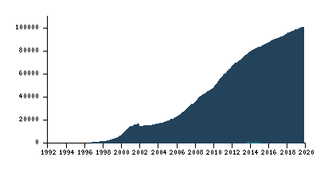
116.000 nov. 2023
10.000
100.000
Domaines
enregistrés
Notes:
Och de lëtzebuerger Web wisst ëmmer weider, wat d’Noutwendegkeet vum Webarchiv ënnersträicht
Zuel vun de .lu TLDs enregistréiert vun 1992 un
Am Joer 2000 well 10.000, Stand an 2018 si well 100.000 Domainen erreecht
De Webarchiv vun der BnL archivéiert och eréicht säit 2016, an dowéinst ass an dene Joere bis dohin ganz vill verluer gangen.

Slide 8
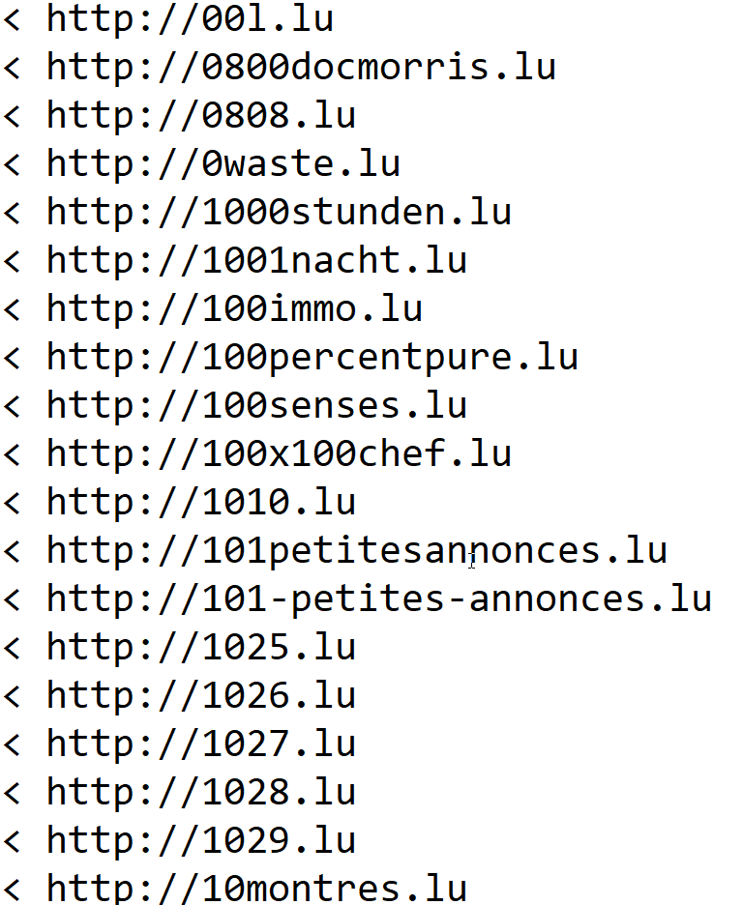
21.626 domaines
disappeared between
August 2016
and
December 2019

Slide 9
Domain Crawls
Extensive approach
All .lu domains
4 times per year
Event Collections
Events of national importance
Maximum information on a specific subject
High crawl frequency over a limited period of time
Thematic Collections Evolving lists Collaborative development
Adapted methods to different types of websites

Slide 10
2017 LOCAL
2018 NATIONAL
2019 SOCIAL
2019 EUROPEAN
947 GB
967 GB
4292 Seeds
9764 Seeds
109 Crawls
200 Crawls
166 GB
100 Seeds
5 Crawls
545 GB
1055 Seeds
100 Crawls

Slide 11
Covid-19 Collection
820 websites
4100 GB
27.000 news articles
28.000 seeds
229 Twitter profiles
2200 crawls 390 seeds daily 171 seeds weekly 209 seeds monthly
104 Facebook pages
40 Youtube channels

Slide 12
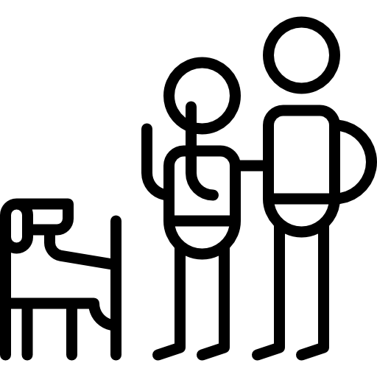
Business & Industry
Creative Industries
Education & Research
Environment & Biodiversity
Expat Communities
Art
Families & Pets
Fan-culture & Communities
Film
Health & Well-being
Humanitarian NGOs
Humanities
Luxembourg News Media
Literature
Memes & Internet culture
Music
Performing Arts
Photography
Politics & Society
Religion & Spirituality
Sciences
Sports

Slide 13
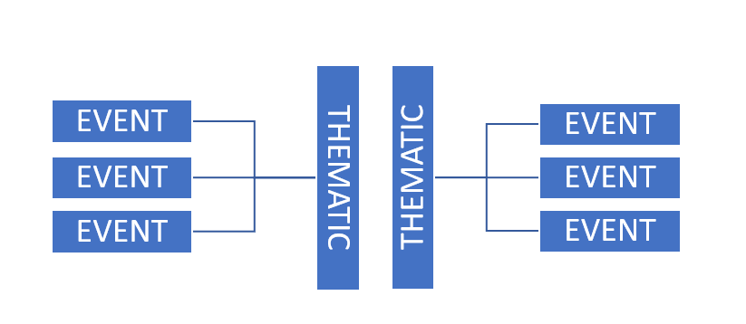
DOMAIN CRAWLS

Slide 14
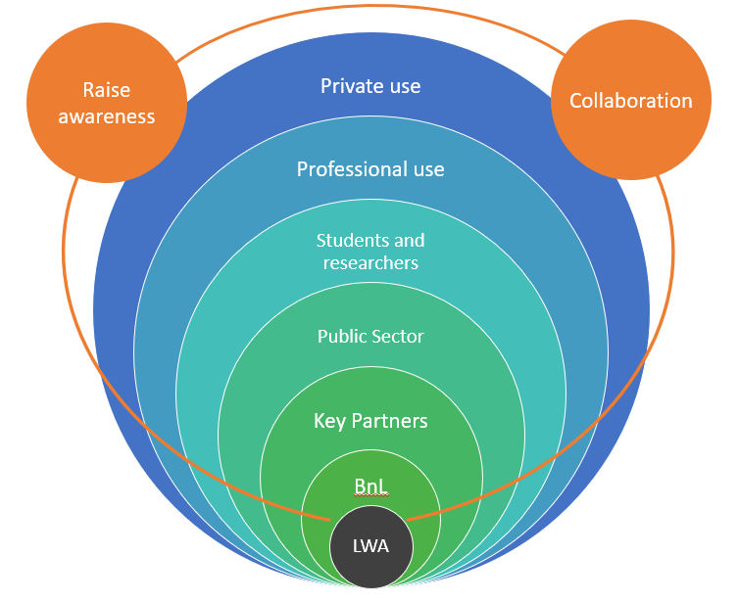
BnL

Slide 15
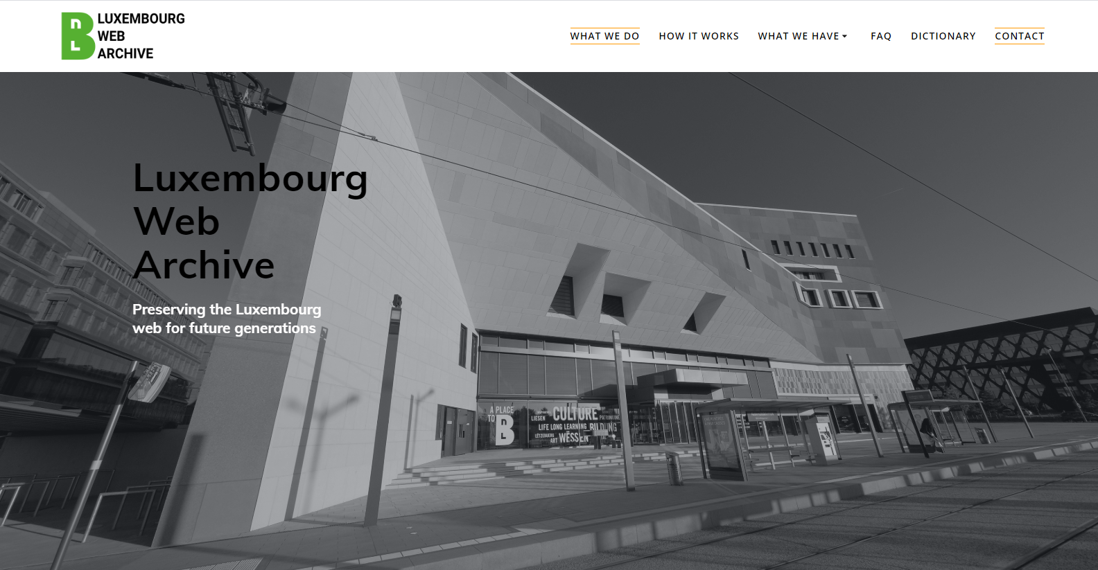
Webarchive.lu

Slide 16
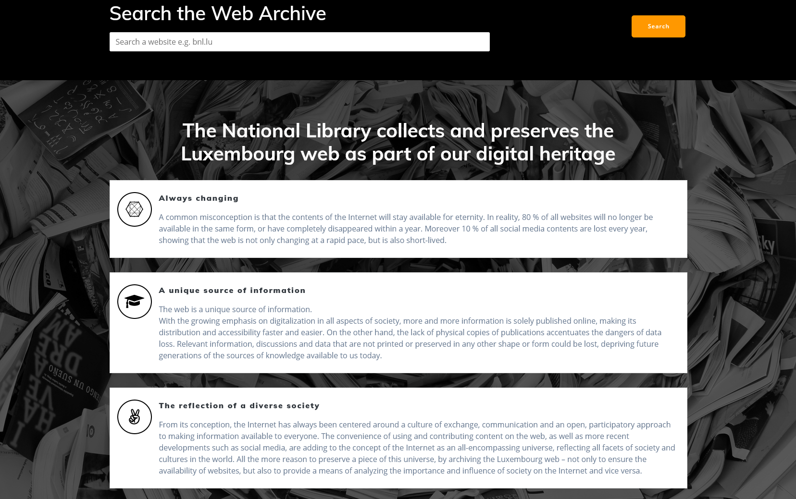

Slide 17
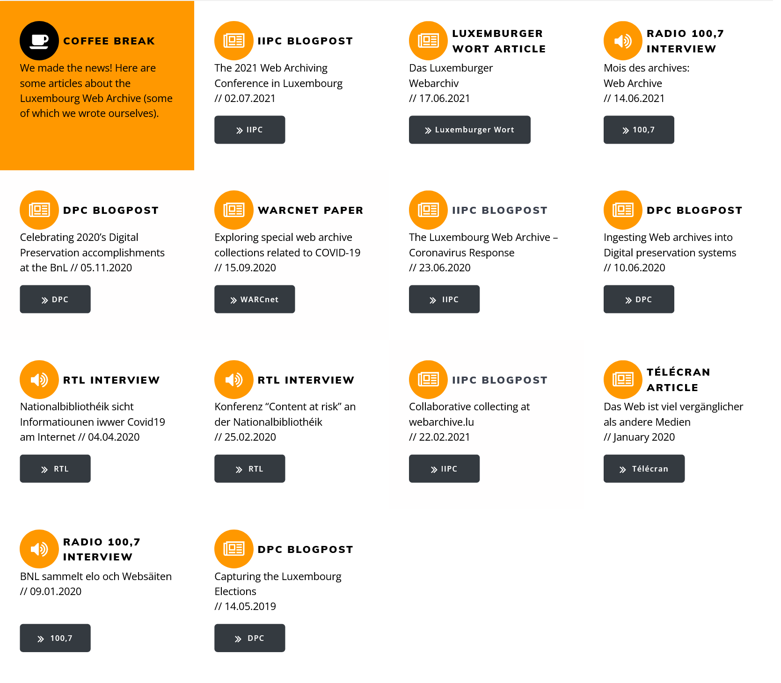

Slide 22
