Slide 1
Web Archiving and its Research Use at the National Széchényi Library (Hungary)
Gyula Kalcsó, Head of the Web Archiving Team, NSZL (H)
Early Scholars Spring School on Web Archives
23–24 April 2024, CNRS, Paris

Slide 2
Background
Digital preservation since 1999 (Hungarian Electronic Library project)
Pilot project of web archiving (from 2017 to 2020)
NSZL joined IIPC in 2018
In service (since 2021)
Establishment of the Digital Humanities Centre Department of Digital Philology and Web Archiving (2022)
Notes:
The archiving of individual digital documents has been ongoing at the NSZL since 1999, within the framework of the Hungarian Electronic Library project, originally launched as a private initiative in 1994. The first attempt to establish a Hungarian Internet Archive and to save complete websites was made in 2006, but the technical and staff requirements were not met at that time. In 2017, a pilot project on web archiving was launched as part of the renewal of the national library's IT infrastructure, and three years later this activity became essentially operational. In 2022, the Digital Humanities Centre established the Department of Digital Philology and Web Archiving, thus combining the preservation of web content and its research.

Slide 3
Legal Context
In Hungary, web archiving was included in the law on cultural institutions in 2020
National Széchényi Library was authorised for web archiving
Since January 2021, the NSZL has been archiving the Hungarian web in accordance with this regulation (national domain crawls, curated crawls)
The Government Decree also authorised the NSZL to ensure that websites created by state and local government institutions or with budget support do not need to obtain individual licences to make archived versions available to the public

Slide 4
Data in Numbers
Restricted access collection:
18 thematic collections (e.g. literature, art, culture, religion, education, science)
6 collections by genre (periodicals, news portals, podcasts, Facebook, Instagram, Twitter)
19 event-based collections (e.g. elections, sport events, epidemic, Ukraine war)
1 location based collection (Transcarpathia)
Appr. 80 thousand selected web sites harvested on a quarterly basis with screenshots
Appr. 1.37 million partially automatically harvested web sites (archived biannually)
Appr. 100 TB total size
Public collection:
360 selected and authorised or not subject to authorisation web sites harvested on a quarterly basis
102 web pages from the site of the NSZL
3 event-based collection (Rákóczi Archive, Széchényi Archive, Karikó Archive)
Appr. 1.9 TB total size

Slide 5
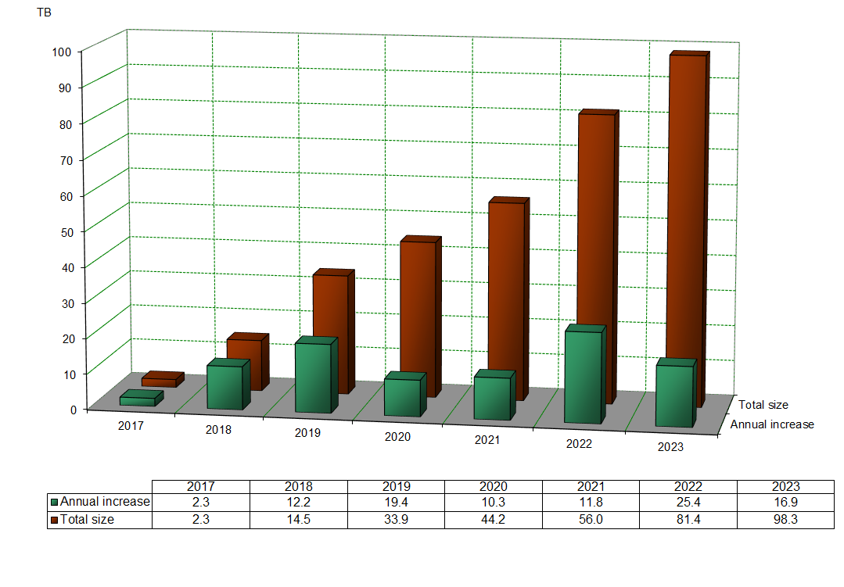

Slide 6
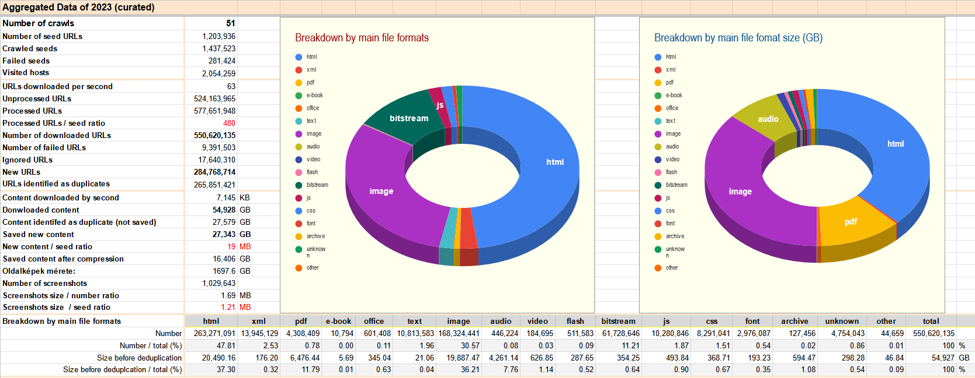
Data of Curated Crawls of 2023

Slide 7
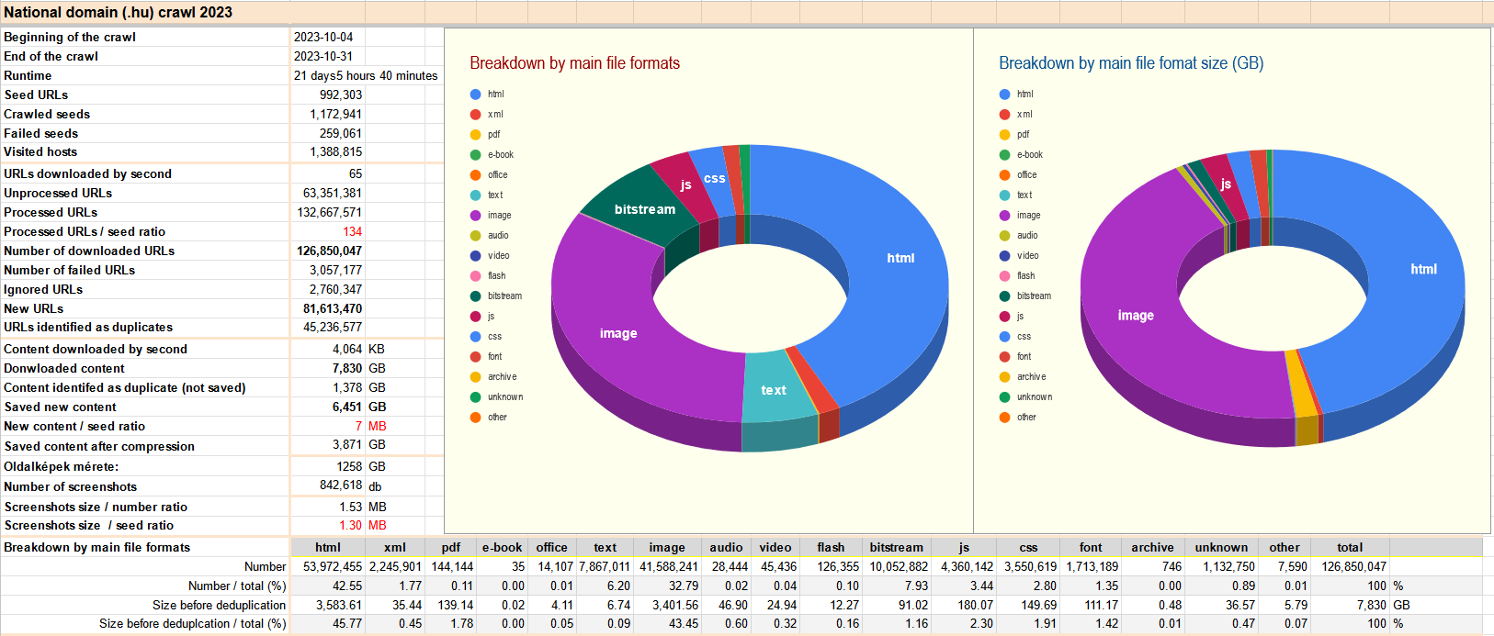
Data of the National Domain Crawl of 2023

Slide 8
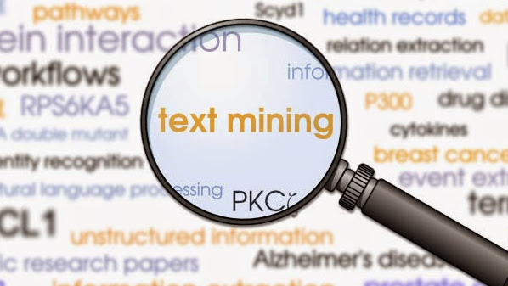
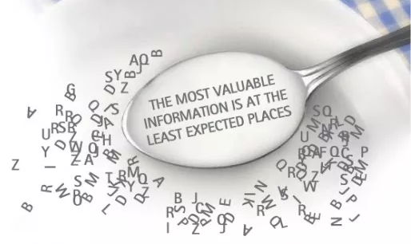
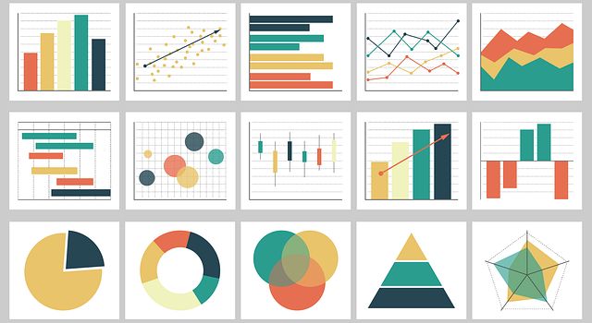
Building and Processing Corpora
1. Targeted Crawling
3. Text and Data Minig
2. Building Text Corpora
4. Data Visualization

Slide 9
A Case Study: the Ukraine War Collection
In addition to domain level broad harvests and thematic harvests, the NSZL also produces event-based collections of major cultural, political and sporting events.
Since 21 February 2022, we have been collecting news about the Russian-Ukrainian conflict and later the war from 75 news portals in Hungary and abroad.
The collection of news is based on the tags or categories used on the portals (more than 400 seed URLs).
These harvests run once a week.
The collection is not open to the public for legal reasons (although a full text search engine is available: https://ukrajnapublic.webharvest.oszk.hu/solrwayback).
A workflow was developed in the NSZL DHC to build NLP processed text corpora from archived web content to make it available for research purposes.

Slide 10
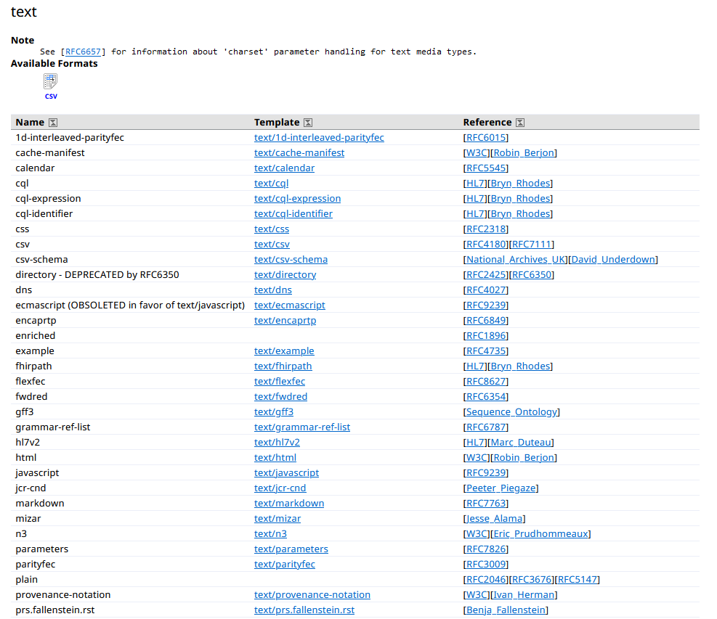
Where is the Text in WARCs? (WARC2TXT)
According to the standards, there are 92 MIME types, which are in text format (text/…, see https://datatracker.ietf.org/doc/html/rfc2045)
The text of the news is contained in the HTML in case of WARCs.
So first step is WARC2HTML.

Slide 11
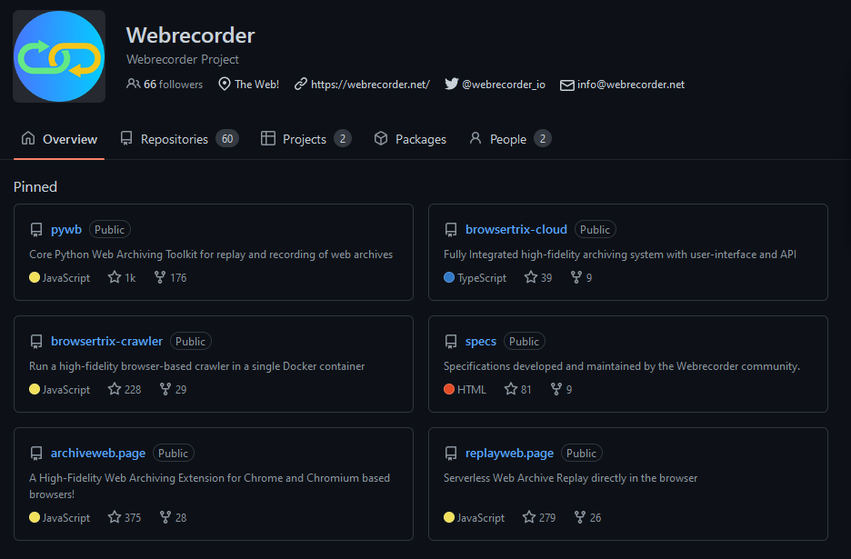
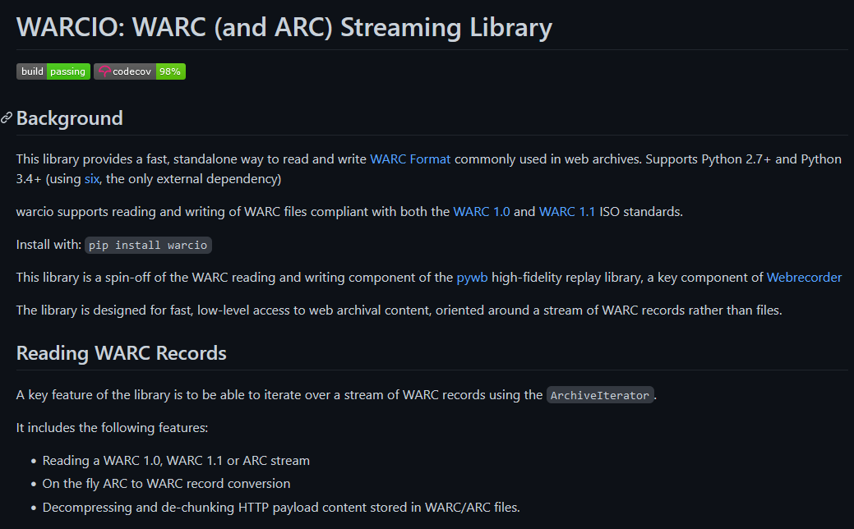
WARC2HTML

Slide 12
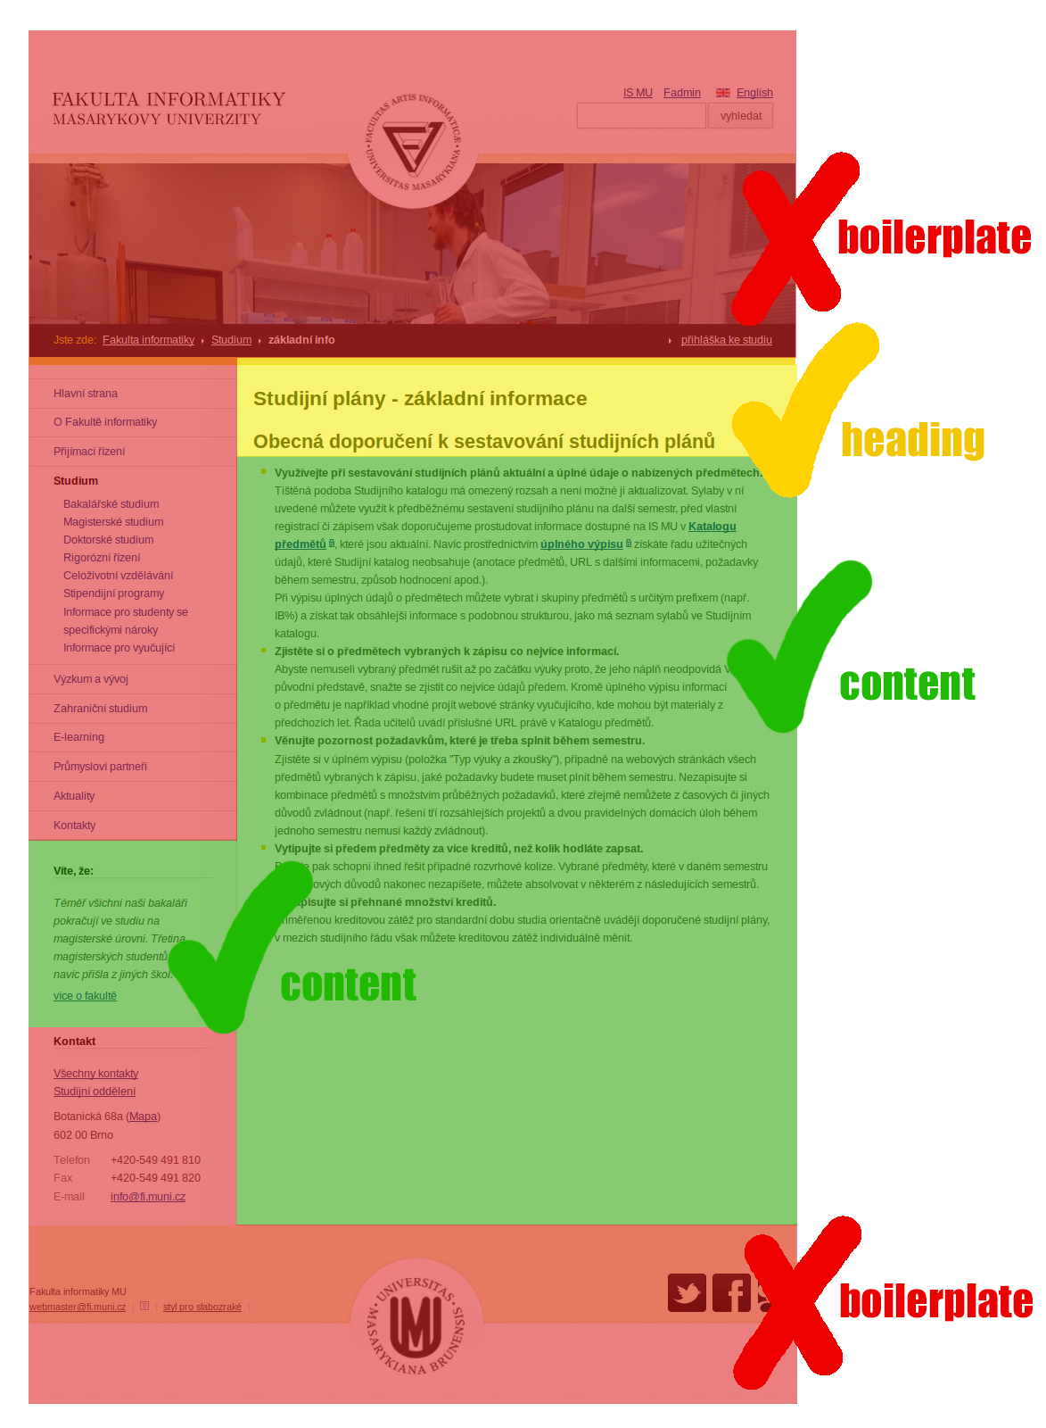
HTML2TXT (Boilerplate Removal)
jusText Python library:
removes the boilerplate from the HTML in two steps (based on context and language content)
result: plain text
(Pomikálek, J. (2011). Removing boilerplate and duplicate content from web corpora [PhD Thesis]. Masaryk university, Faculty of informatics, Brno, Czech Republic.)

Slide 13
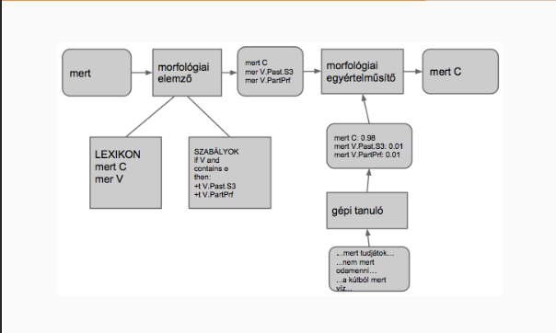
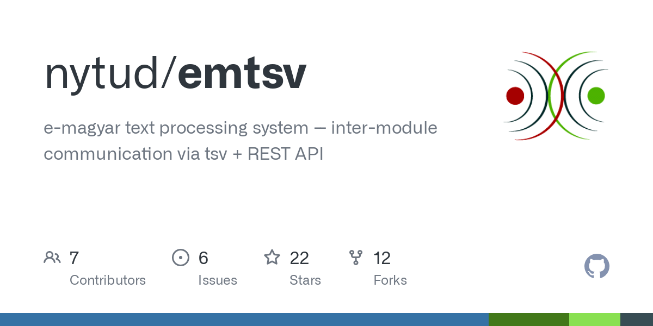
Natural Language Processing
The purpose of NLP:
breaking down the text into sentences
breaking down into words
lemmatization
morphological analysis
POS-tagging
morphological clarification
Benefits:
more precise, linguistically analysed data
the elements irrelevant for data mining (hyphens, pronouns, etc.) can be removed
(Indig, B., Sass, B., Simon, E., Mittelholcz, I., Vadász, N., & Makrai, M. (2019). One format to rule them all – The emtsv pipeline for Hungarian. Proceedings of the 13th Linguistic Annotation Workshop, 155–165. https://doi.org/10.18653/v1/W19-4018)

Slide 14
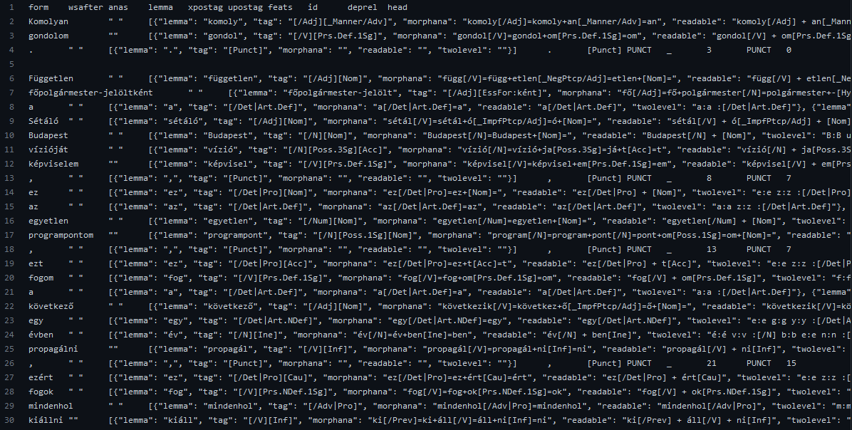

Slide 15
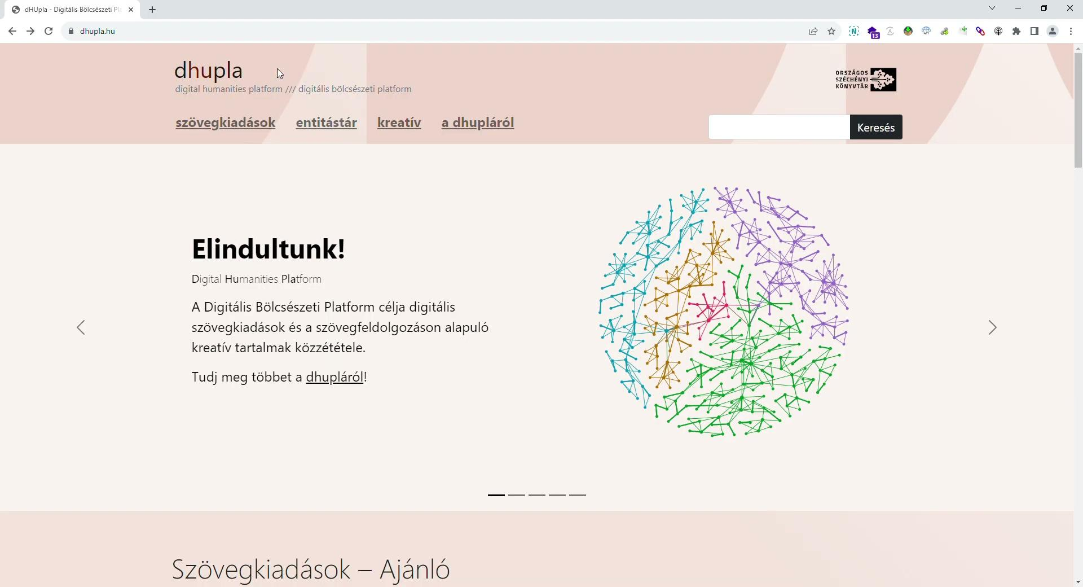

Slide 16
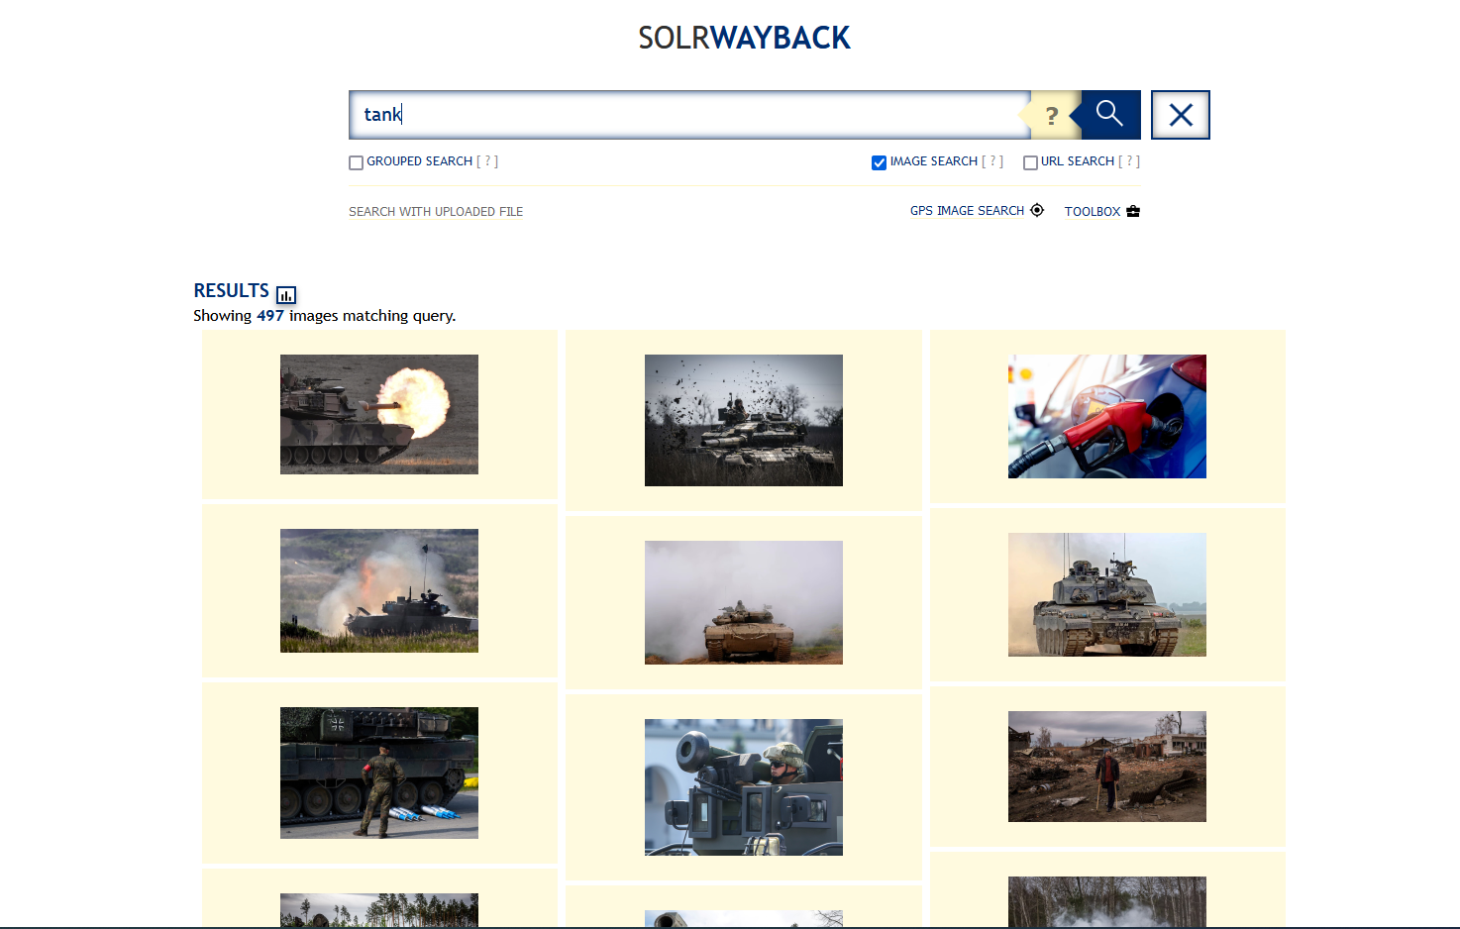

Slide 17
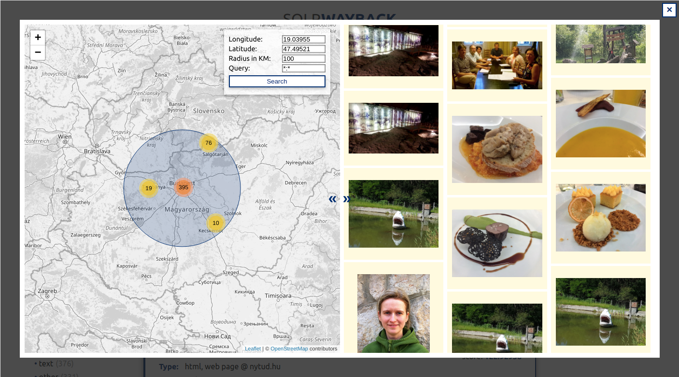

Slide 18
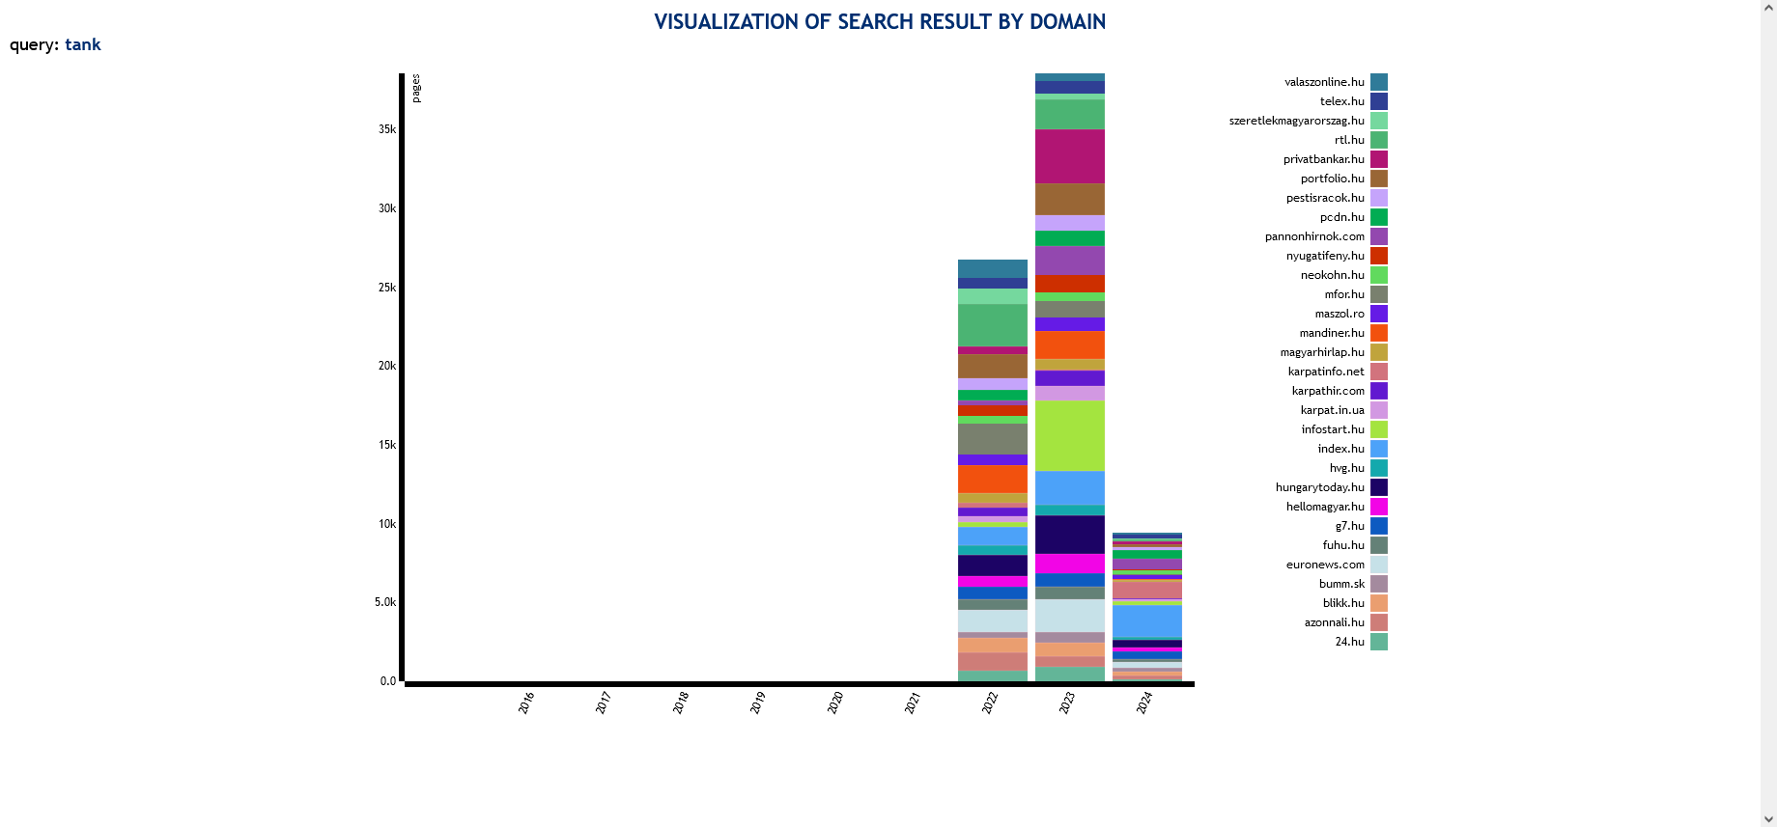

Slide 20
Moving Forward
In building text corpora:
Using metadata to refine content classification and filtering
Automating with artificial intelligence (e.g. topic modeling)
The aim: the possibility of building thematic corpora from the web archive based on different approaches
Data mining of other types of archived web content:
Extracting and processing other MIME type content (image, AV, documents, etc.)
Automating with artificial intelligence (e.g. image labeling, object detection, speech to text)
Publishing data:
Establishing a research platform through which researchers can produce data from their own corpus and process and visualise it

Slide 21
Thank You for Your Attention!
webarchivum.oszk.hu/en

