Slide 1

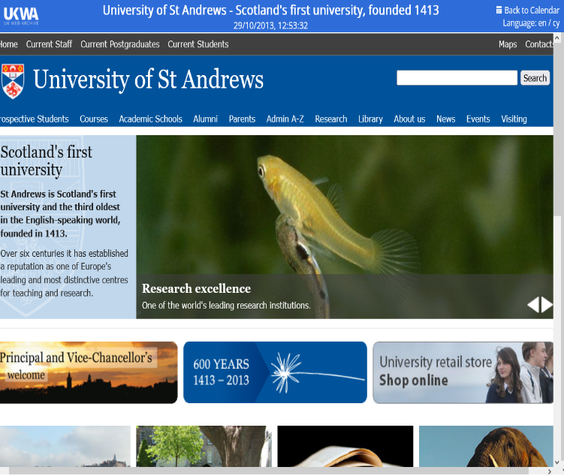
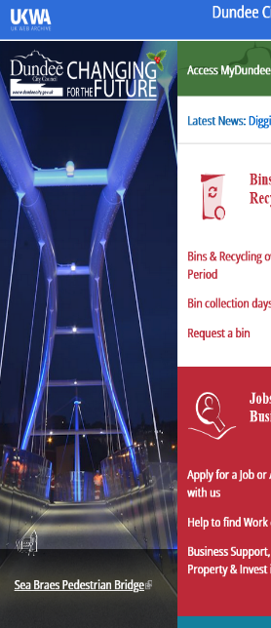
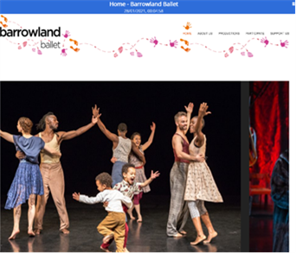
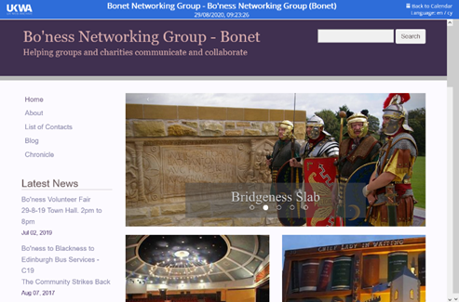
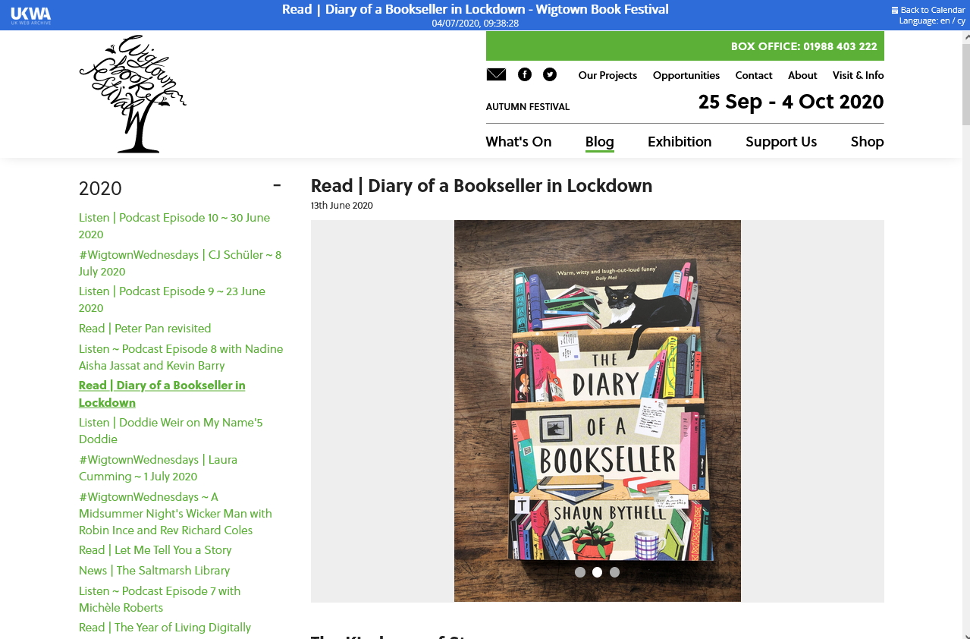
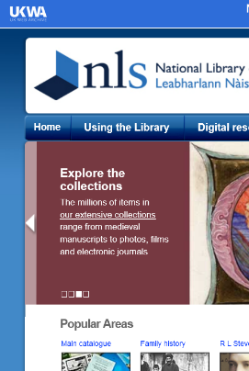
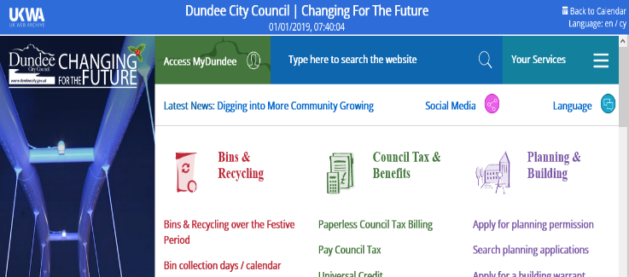
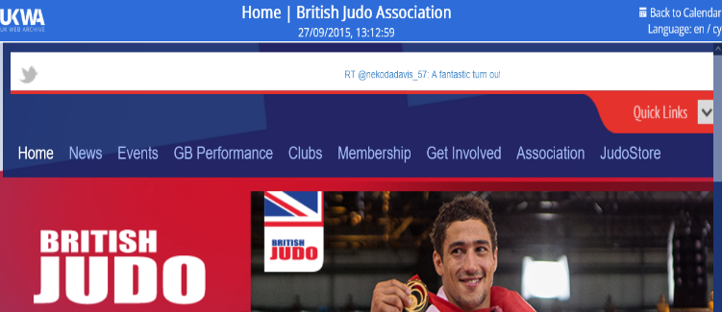
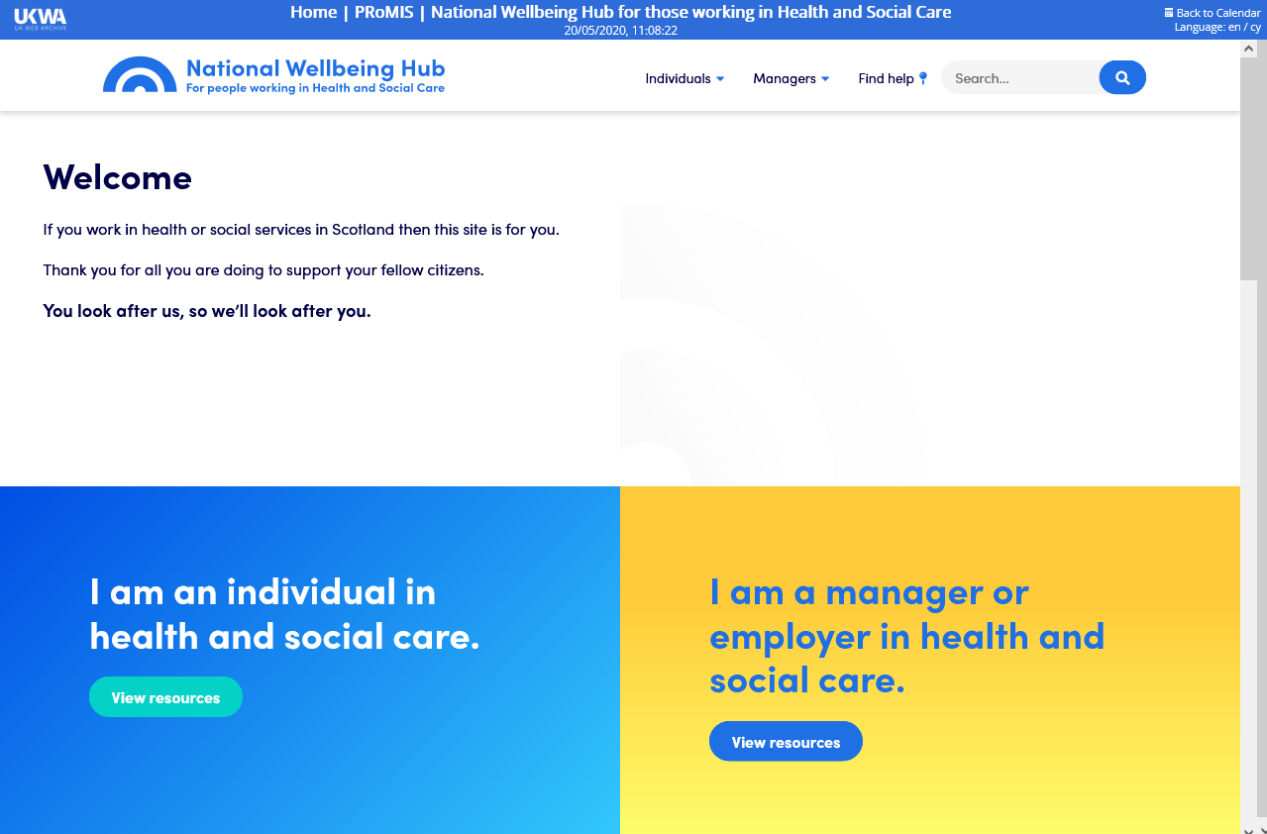
National Library of Scotland
Our web archive 1999-

Slide 2
Archiving, from 1999 to legal deposit

Slide 3
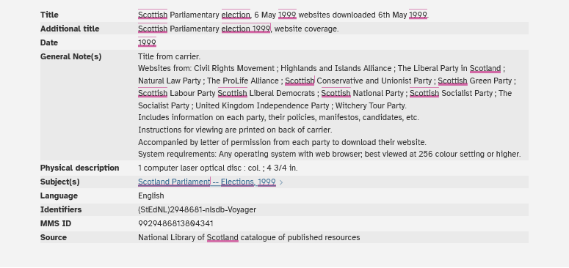
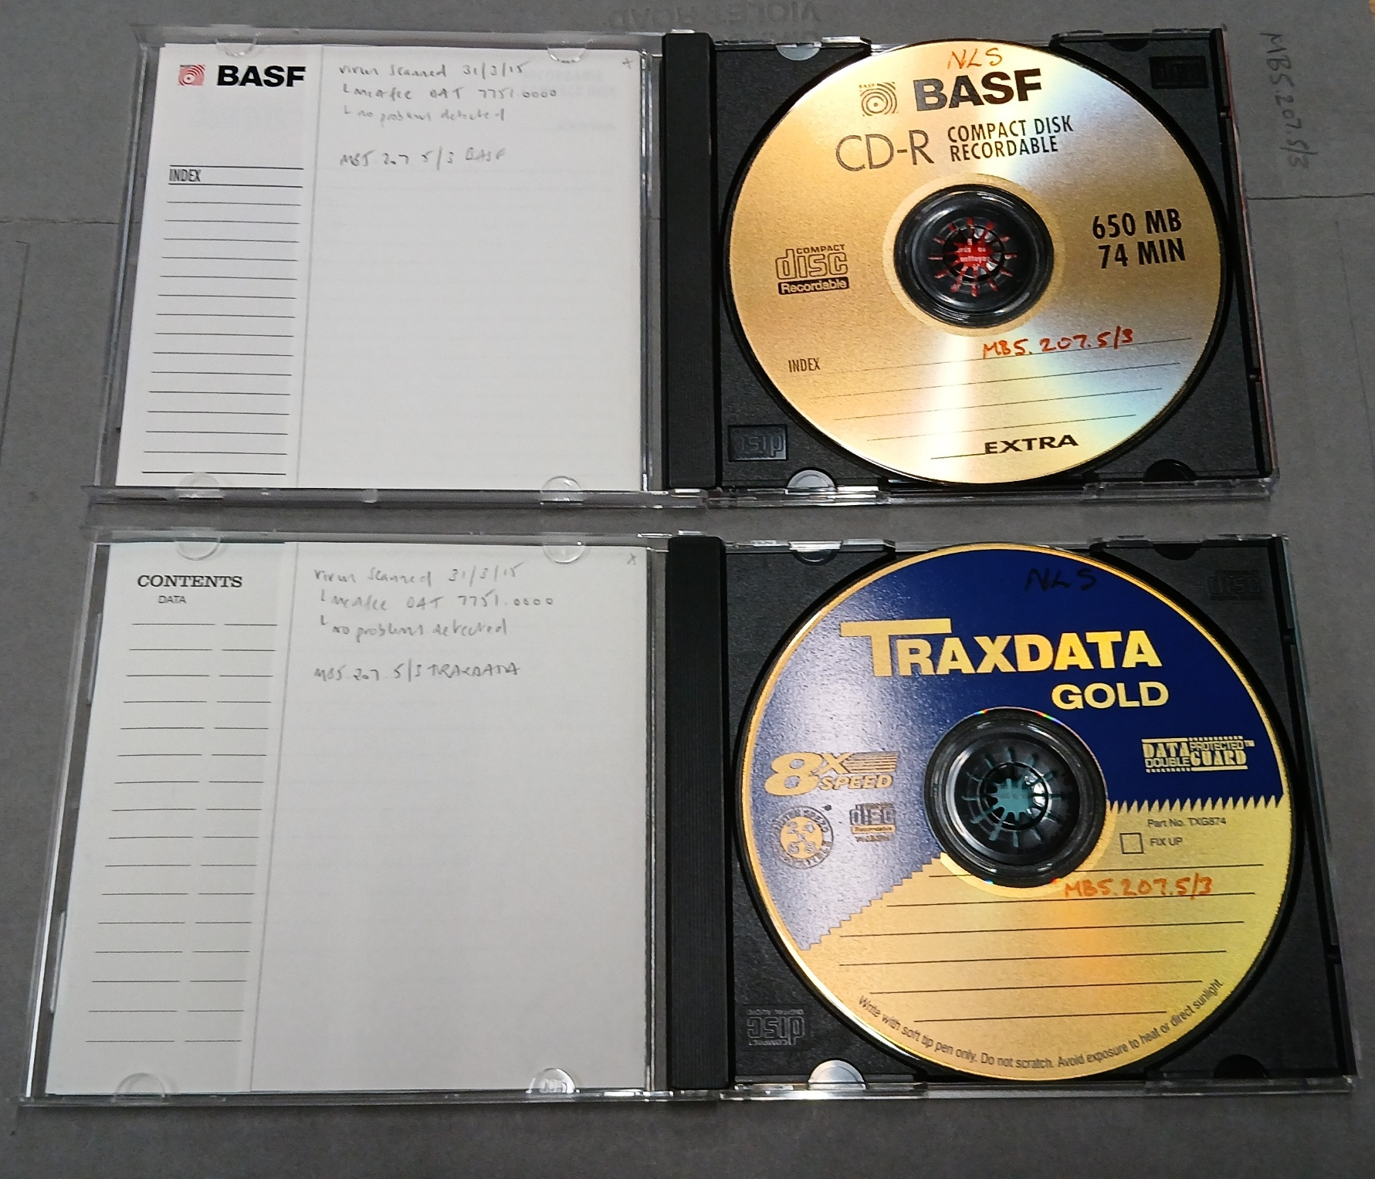
Our first web collection...
The Scottish Parliamentary election 6 May 1999

Slide 4
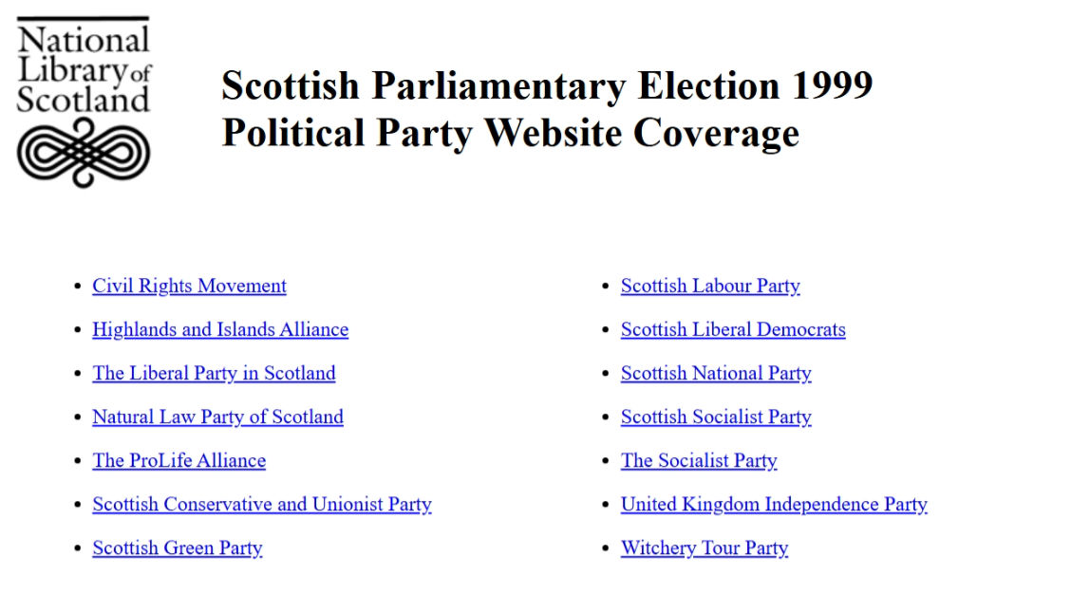

Slide 5
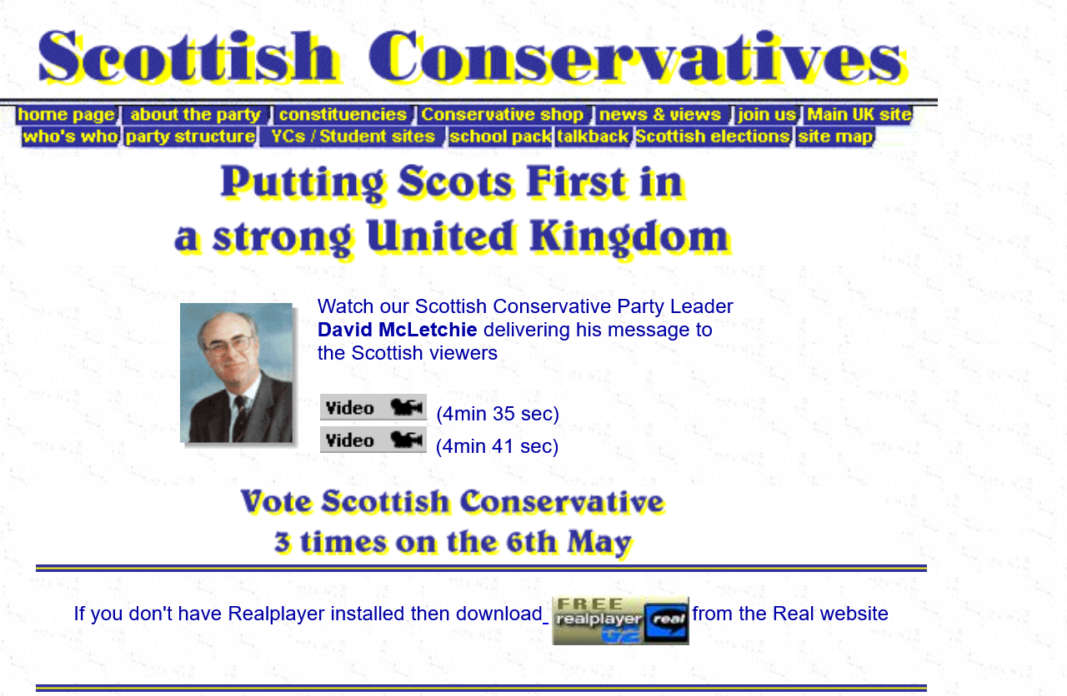

Slide 6
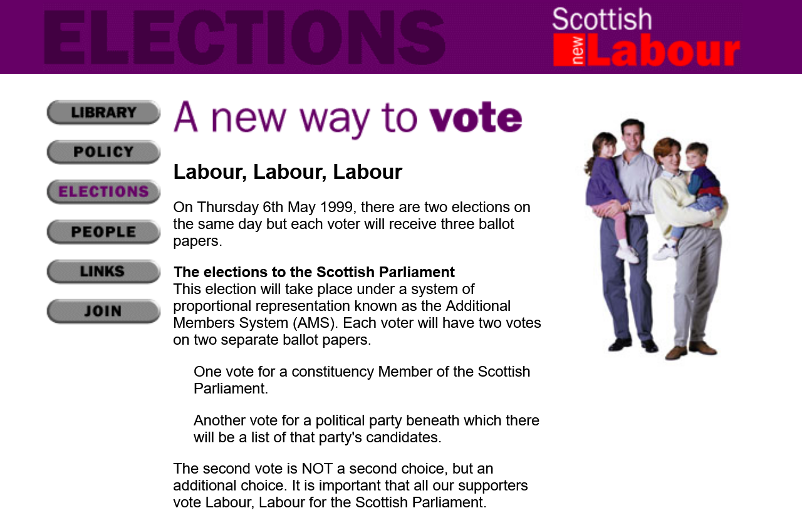

Slide 7
UK Web Archiving Consortium
UKWAC was founded in 2004
A consortium of National Library of Wales, British Library, Wellcome Library, The National Archives and JISC worked on this project to develop a test-bed for selective archiving of UK websites.
A collection of 2200 websites had been created by May 2007 using PANDAS software, developed by the National Library of Australia
During 2008-2012, NLS left UKWAC, but continued archiving on a small scale, working with Netarkivet (the Danish legal deposit web archive) and then Archive-It
Notes:
It covered these areas: Arts & Humanities; Government & Politics; Reference Works; Business & Economy; Health; Science & Technology; Education & Research; News & Media; Society & Culture.

Slide 8



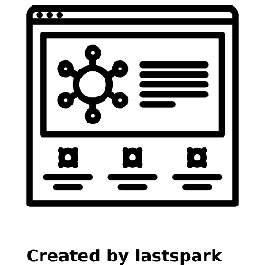
The web archive is legal deposit (2013- )
From 6th April 2013, the Legal Deposit Libraries (Non-Print) Regulations 2013 empowered NLS to harvest UK electronic publications, including websites on the open web
Legal deposit is a record of copyright and preserves authors’ work for research
we aim to build as complete a collection as possible of the published recorded memory of Scotland.

Slide 9

What do we collect?
The annual UK domain crawl collects sites with a UK top level domain, e.g. .uk, .scot, .cymru, .wales and .london
Curators design collections to capture Scottish web content that may otherwise not be crawled
Collections on the access site offer a starting point for our archive of the open web

Slide 10
If there is a domain crawl, why bother?
38% of these titles needed to be found, because they are not at .scot or .uk
News sites update frequently and the domain crawl is annual

Slide 11
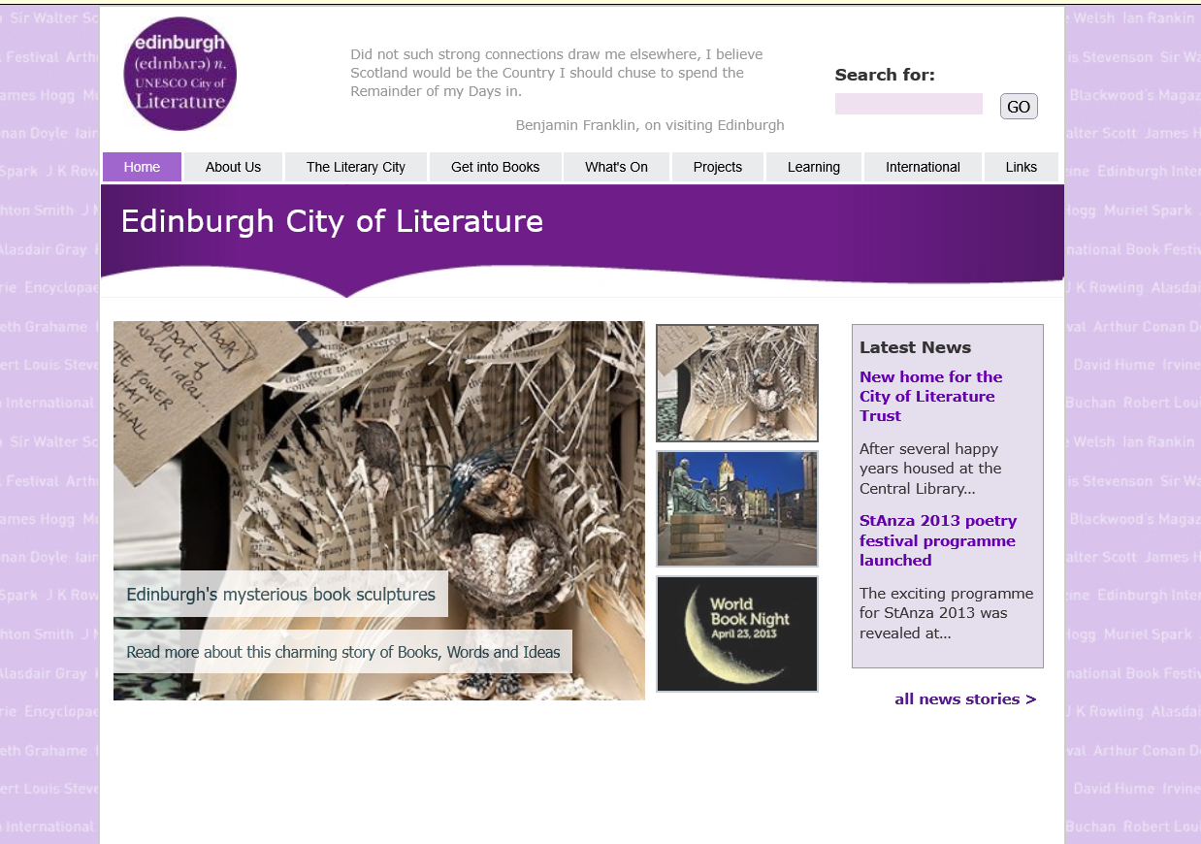

Slide 12
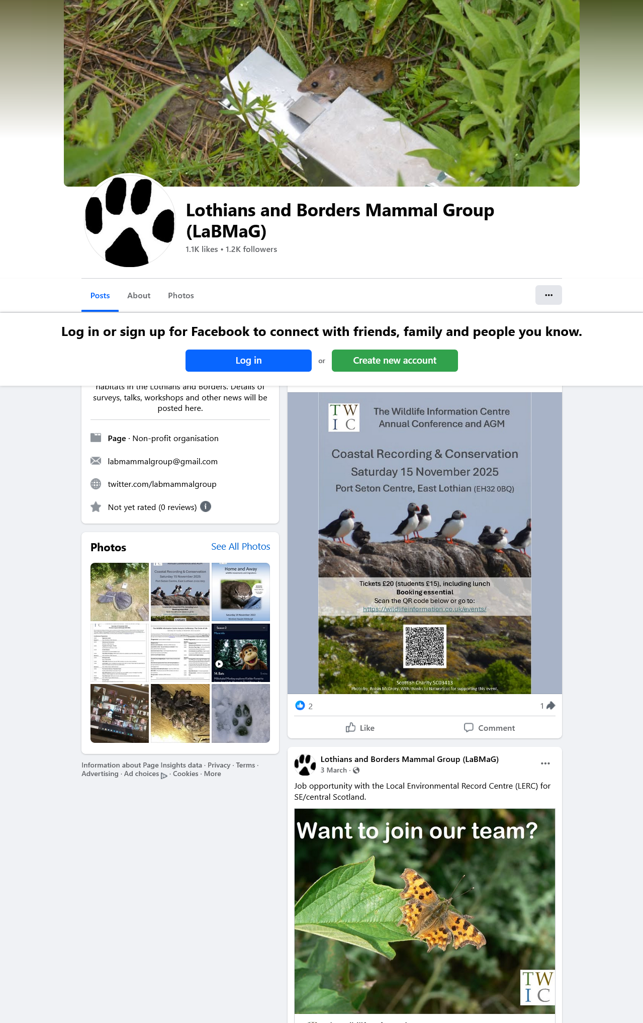

Slide 13
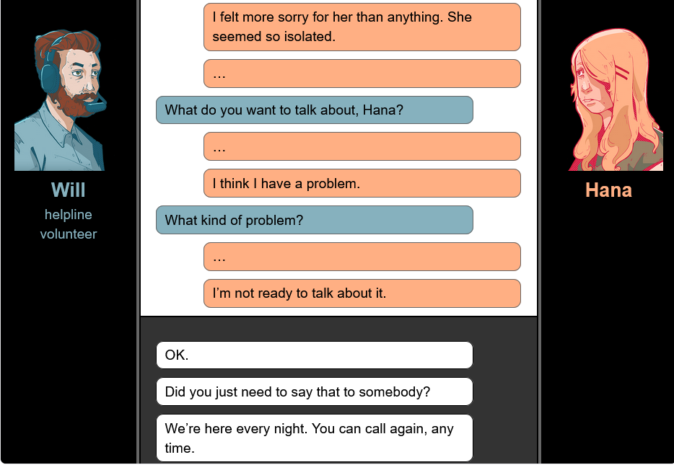

Slide 14
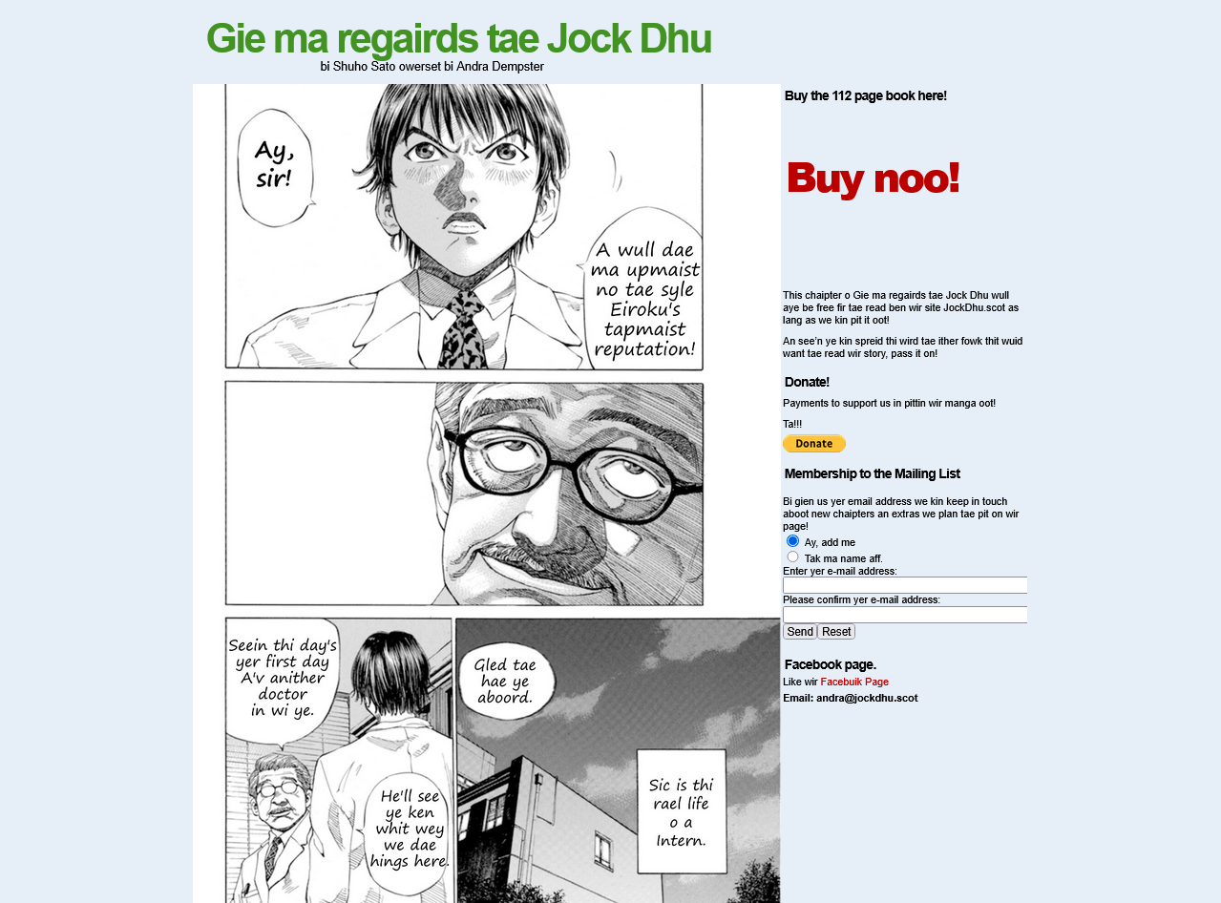

Slide 15
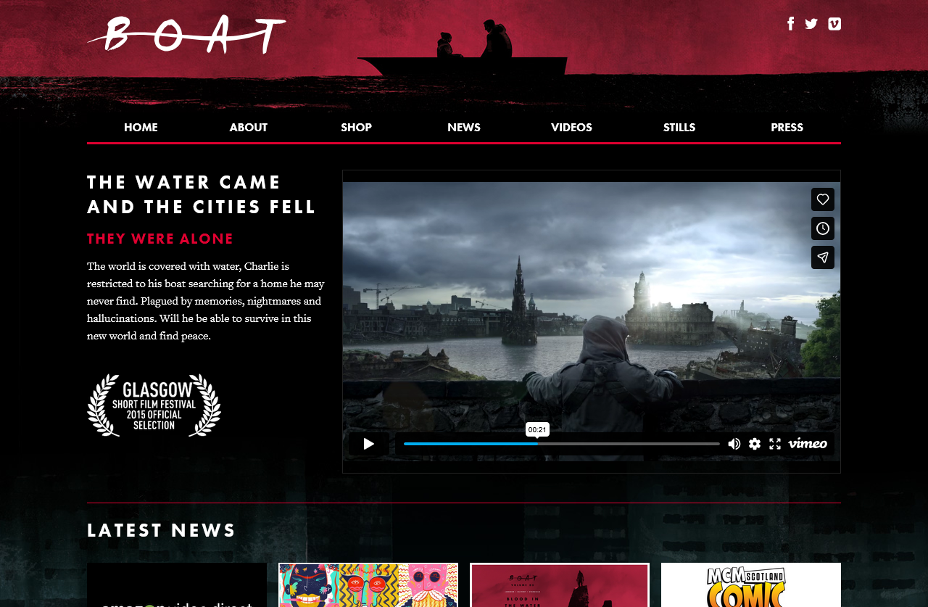
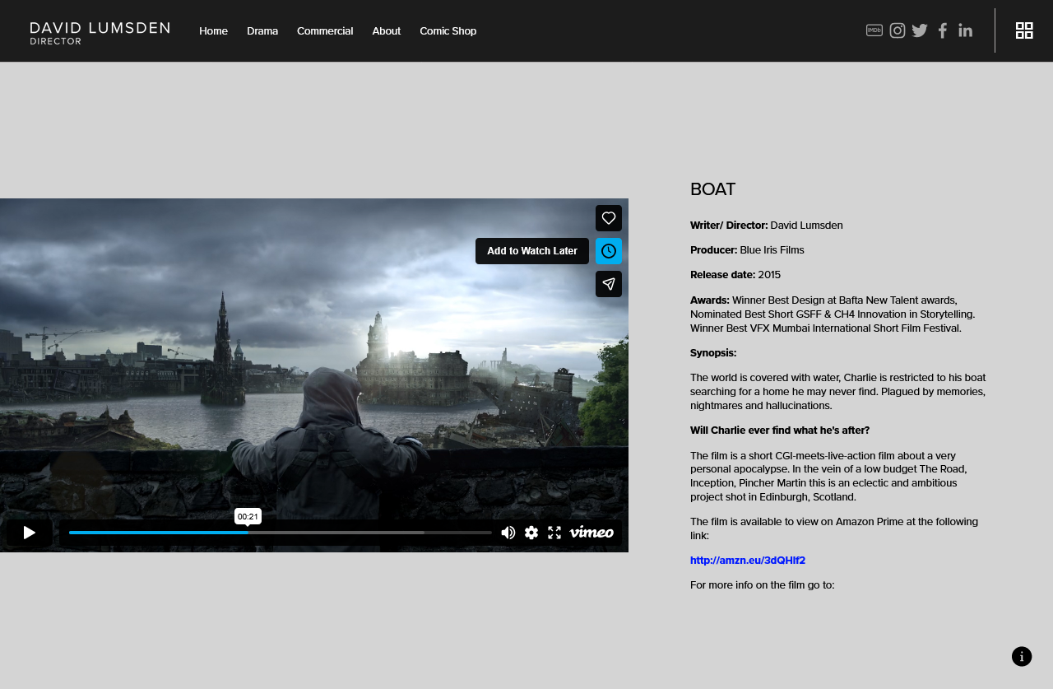

Slide 16
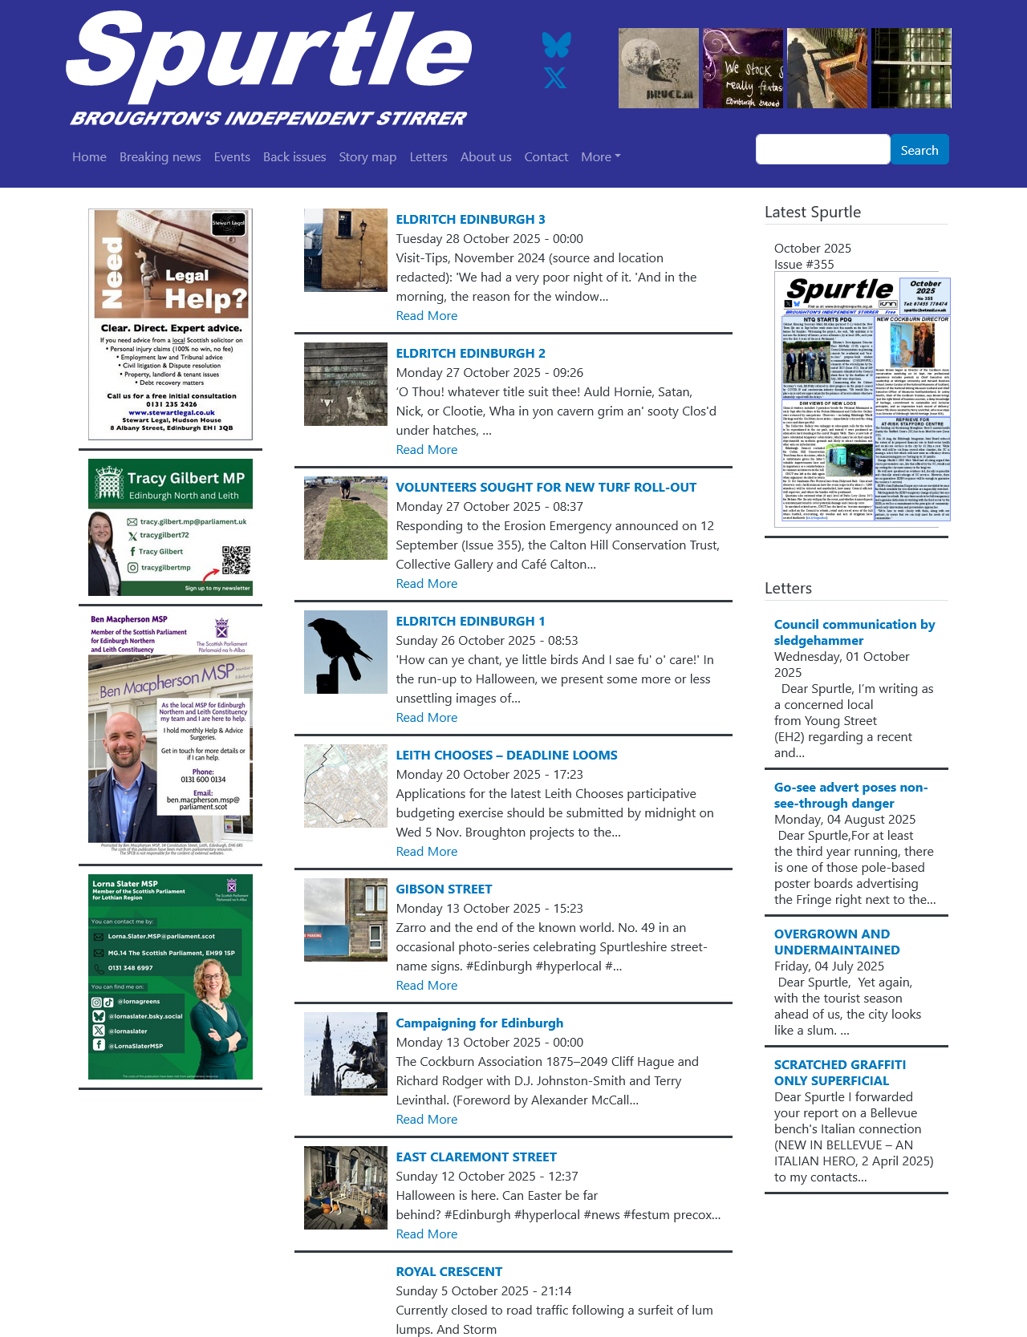

Slide 17
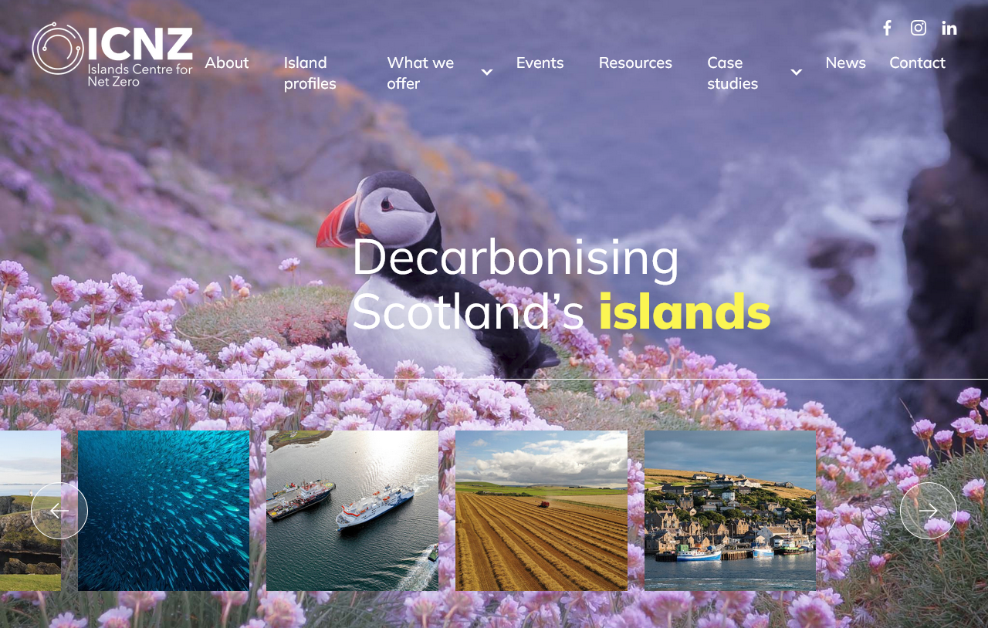

Slide 18
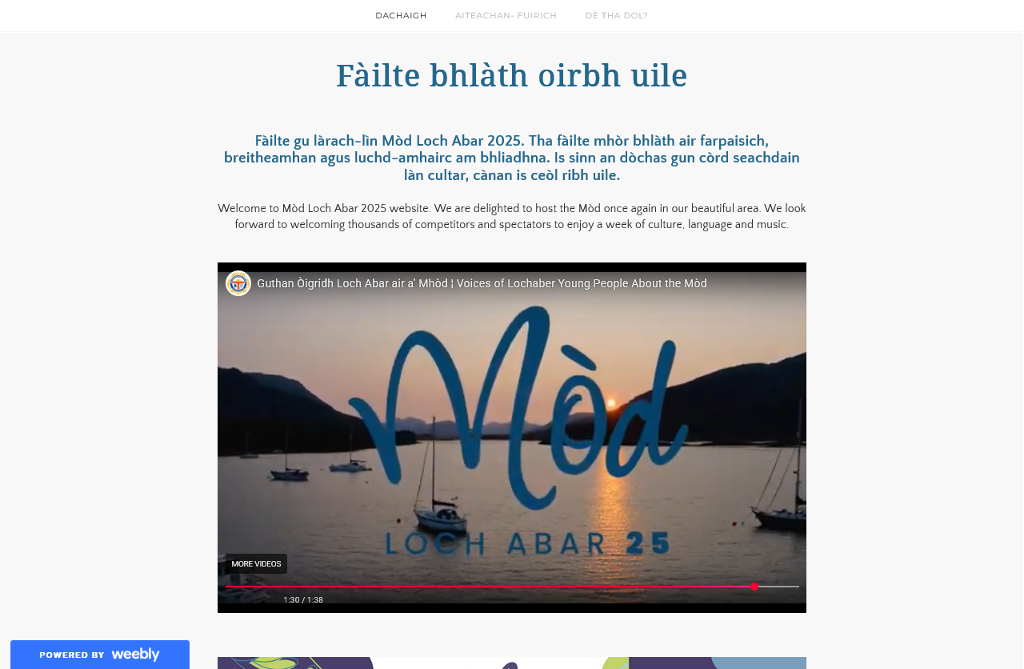

Slide 19


What we don’t collect
Anything requiring a login
Intranets
Databases
Material stored in the cloud
Most video or audio content
...and not much social media

Slide 20
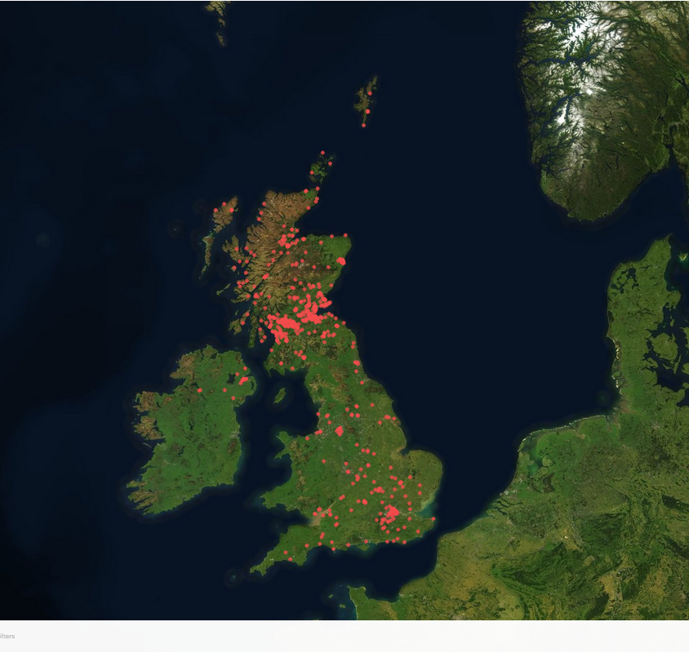
Selections by address December 2023-May 2025
  This only represents about one fifth of archived targets over this period – just those qualified for legal deposit by postal address

Slide 21
Disruption to the web archive service
The British Library is recovering from disruption following a cyber-attack in October 2023
A plan for restoration is under way, we are hoping to return access to the public in the new year
We are continuing to crawl to acquire websites and add new ones using AWS in the Cloud and using a subscription version of ArchiveWeb.page, Browsertrix.

Slide 22
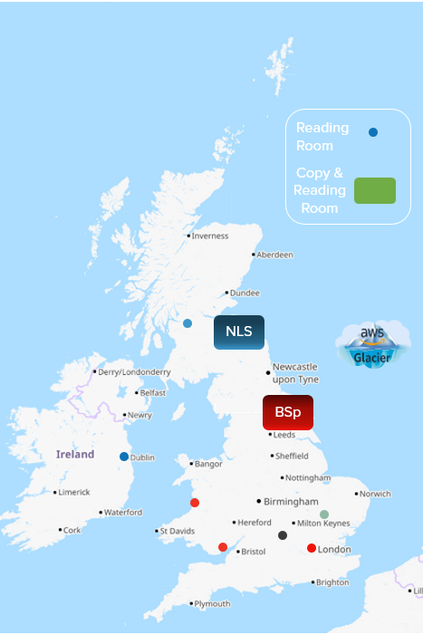

Storage and access
The Legal Deposit Libraries will provide reading room access for the archive in ten locations across the UK, three of them at NLS in Edinburgh and Glasgow
Crawling in the Cloud approved in, and developed from 2020
AWS storage includes 2020-22 domain crawls and now, frequent crawls using Legal Deposit software, Heritrix
  Heritrix is polite, and provides contact details in the user/agent request header in case of any issue
© OpenStreetMap contributors

Slide 23
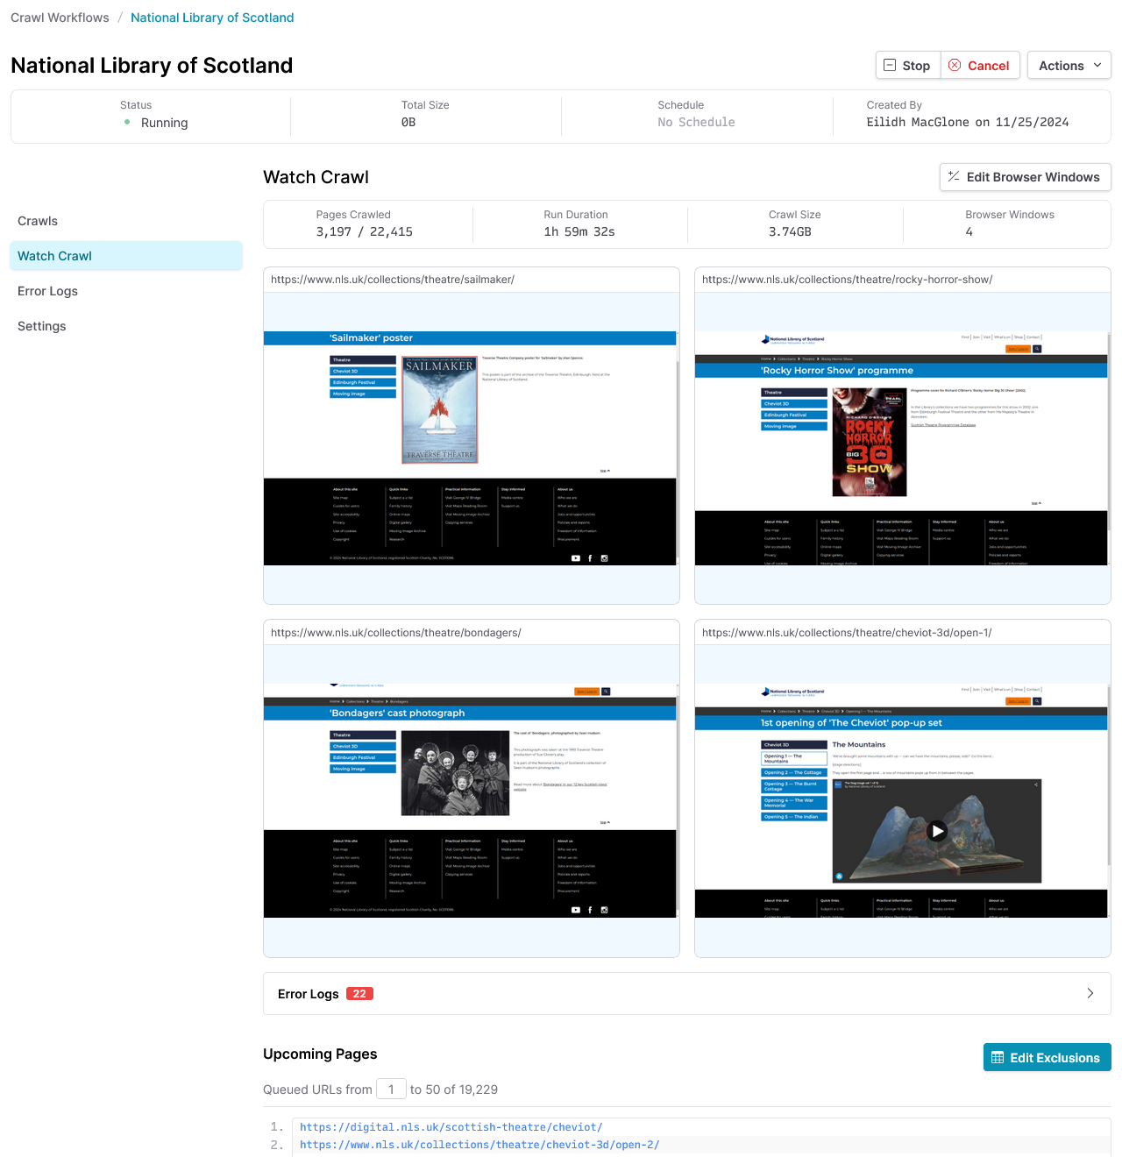
Archiving with Browsertrix
Browsertrix is used to collect websites which are more difficult to archive, for reasons including:
Javascript (Embedded Flourish visualisations, Wix),
Storage of assets (Wix, Squarespace).
Big (more room for crawler traps!)
Profiles allow for automatic acceptance of e.g. Distillery website age challenge
Archiving in Browsertrix: visual results

Slide 24
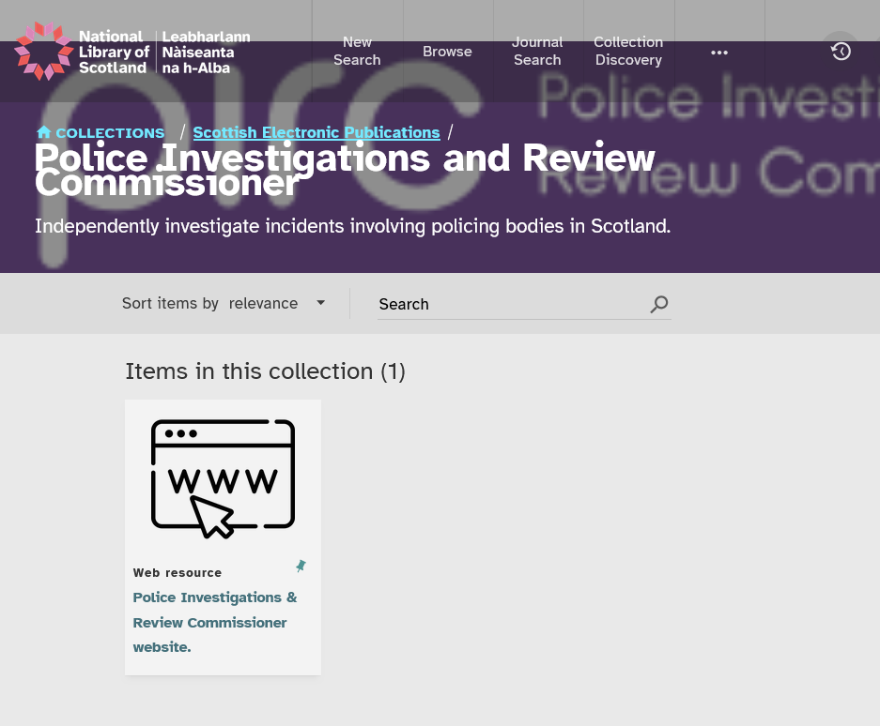
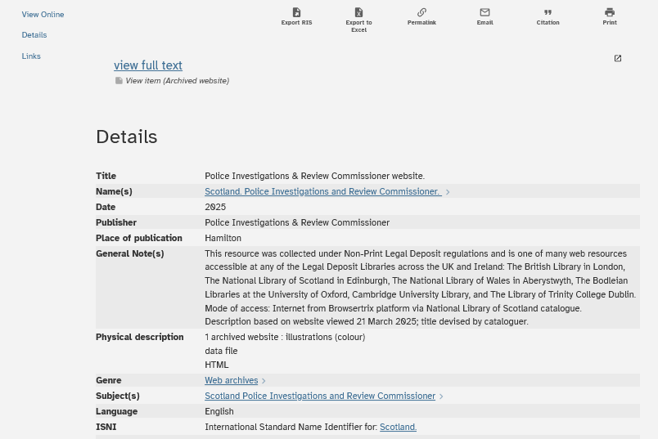
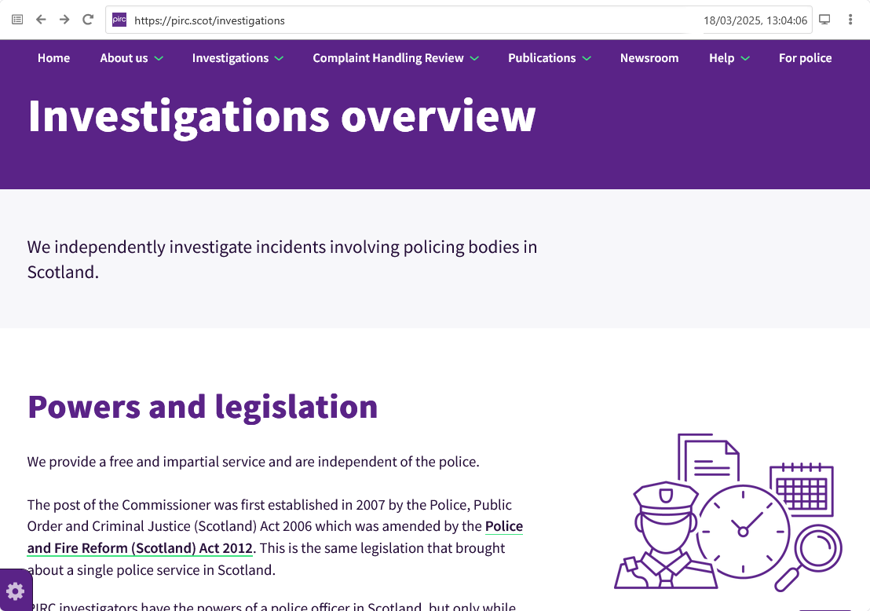
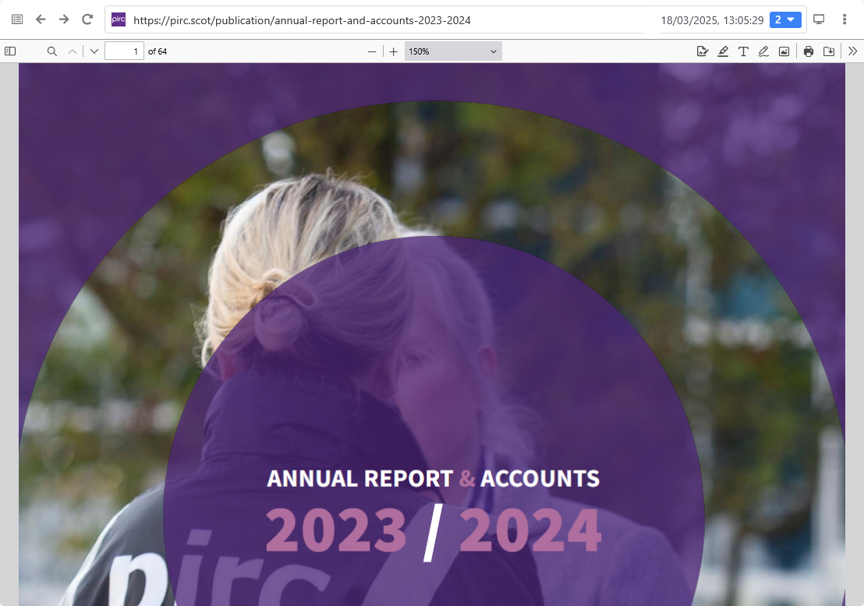
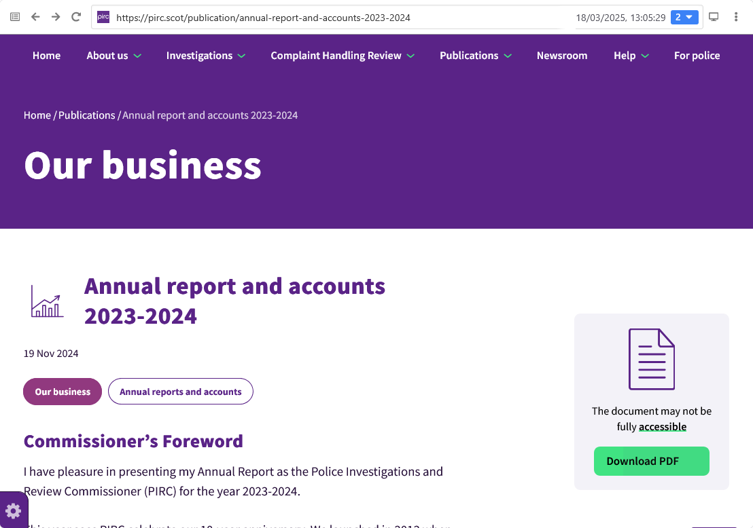
Providing access to publications in an archived website
Browsertrix allows public collections, so where licencing has allowed, we have been archiving to support our Acquisitions workflow.
The items have been catalogued as an “Electronic Collection” alongside other digital items collected by publisher on our cataloguing system

Slide 25
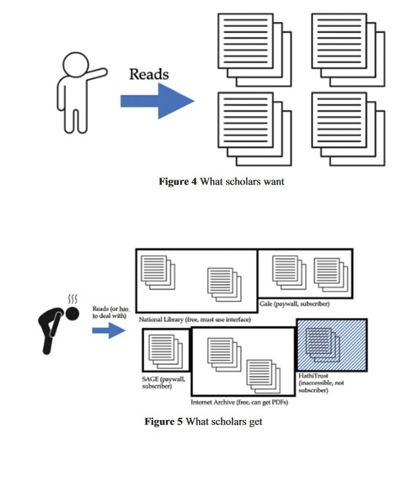
What can a librarian aim for? (realistically)
To provide readers with the means of producing repeatable results which they can:
  Read
  Reproduce
  Take home
  Publish
And be read by others
Figure 4 What scholars want
Figure 5 What scholars get
Milligan, Ian Transformation of Historical Research in the Digital Age doi.org/10.1017/9781009026055

Slide 26
Collections – embracing complexity
Scottish Parliamentary Election 6 May 1999
Science & Health
Scottish Government
Scottish Independence Referendum
Commonwealth Games 2014, 2022, 2026*
Scottish News Sites
Magic
LGBTQ+ Lives Online
Gaelic life on the web
Forth Bridge 125th Anniversary
Scottish Parliamentary Election 2007, 2011, 2016, 2021, 2026*
European Parliament Elections 2009, 2014, 2019
Scottish Churches
Sports Collection
Sports: Football
EU Referendum
Philately, Deltiology and Postal History
Poetry Zines and Journals
Coronavirus: Impact on Scotland
E-publishing Trends/Emerging Formats
Brexit
UK General Election 2010, 2015, 2017, 2019 and 2024
Ukraine 2022
COP 26 (& Climate Change)
Festivals (Edinburgh Fringe, Royal Anniual Mòd,
Glasgow Music Scene
Cost of Living
Talking About Health
Rugby Women’s World Cup
Newsletters
Church of Scotland Reform
Scottish Dining

Slide 27
Collecting priorities
Scottish History
Scottish Politics, Political Parties, Trade Unionism and Labour History
Scottish Government, Parliament and Official publications
Scottish business, economy and tourism
Scottish cinema, film, television and media
Scottish art, photography and architecture
Scottish music
Contemporary sciences

Slide 28
Maintenance collections
Regular work to meet Library collecting priorities:
Local Authorities
MSPs
MPs
Public Inquiries
News sites
Scottish Government
Universities and Colleges
National Library of Scotland
Business 100

Slide 29
Metadata

Slide 30
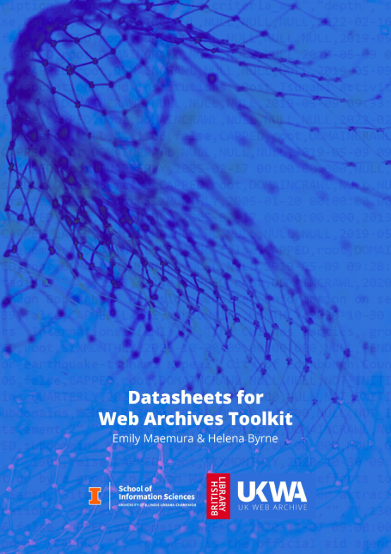
After curation: Datasheets
A datasheet records:
Contact, Distribution, Access
Dataset Contents
Intended & Inappropriate Uses
Data Collection Procedures
Representativeness
Data Quality
Pre-Processing, Cleaning, And Labelling
Privacy
Additional Details On Distribution & Access
NLS datasets are currently published on the shared UK Web Archive page, and Talking about Health (our first) at data.nls.uk

Slide 31
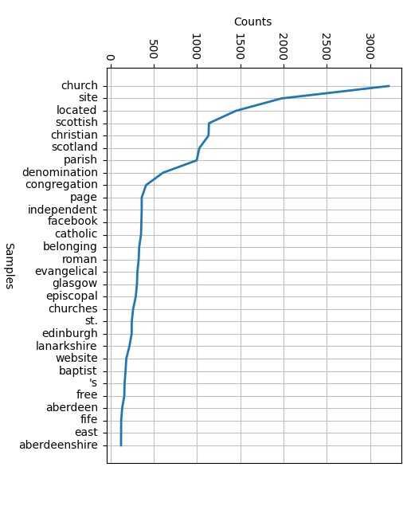
Metadata: reuse and study
Workshop Web Archives Collections as data DHNB 2025
Digital Humanities in the Nordic and Baltic Countries 2025: dhnb.eu

Slide 32
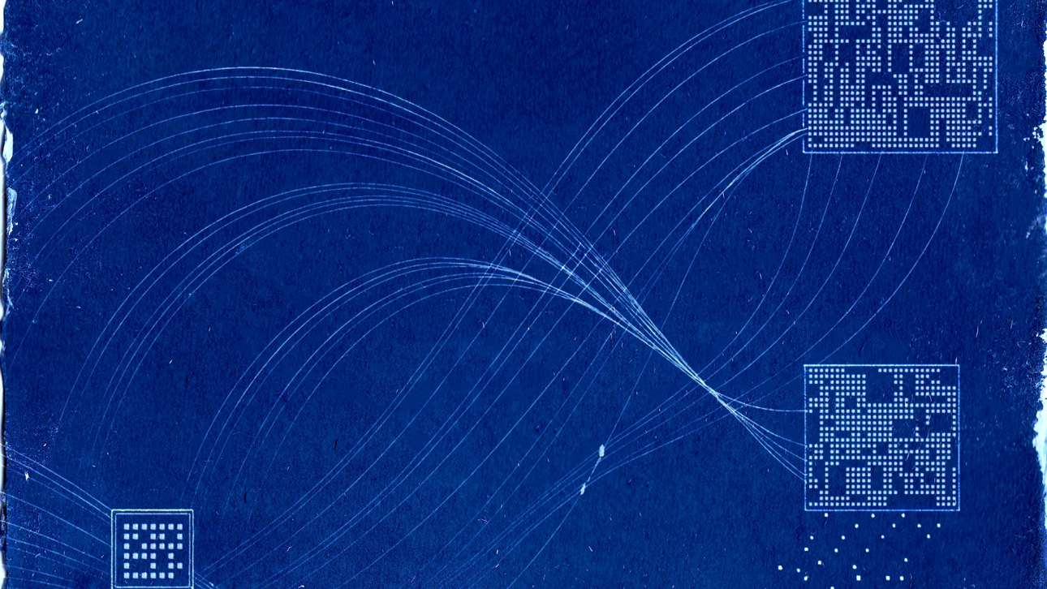

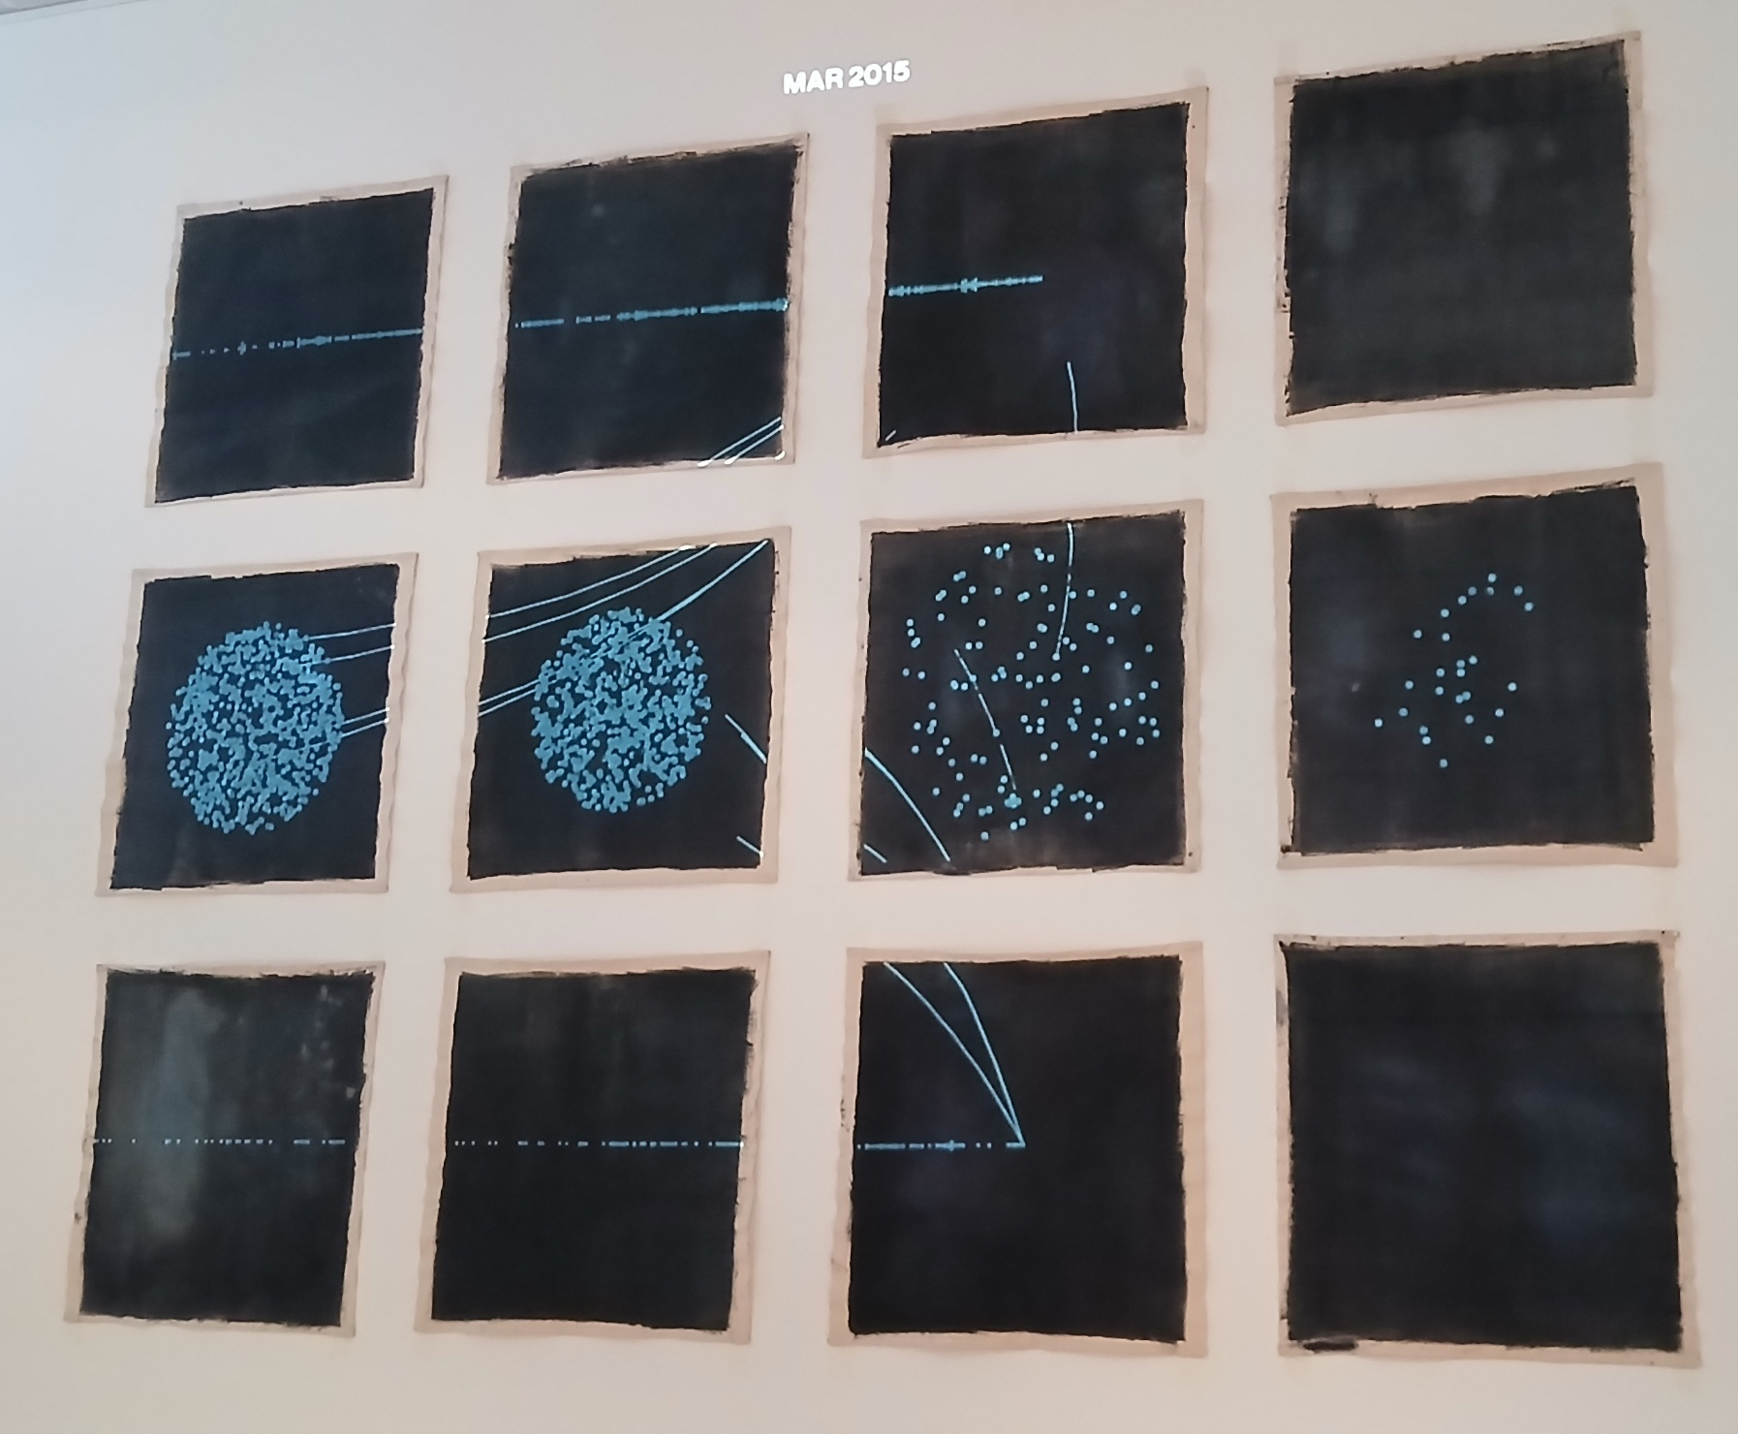
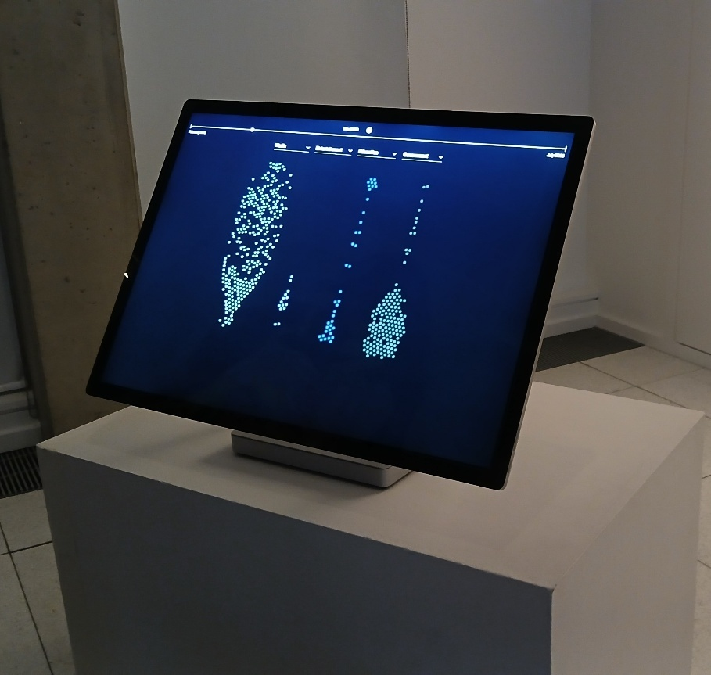
“We often think of vanished texts being ancient, working with web archives shows that material representing very modern human expression has been created and lost in the last thirty years, often leaving glimpses of their existence online but with no way of reaching it”
                – Trevor Thomson

Slide 33



Thank you
Joseph Marshall
Director of Collections Management
j.marshall@nls.uk
Eilidh MacGlone
Web Archivist, Collections Management
e.macglone@nls.uk
@natlibscot
/NationalLibraryofScotland
National Library of Scotland
@natlibscot.bsky.social
Except for images or where otherwise stated this presentation is © National Library of Scotland and is licensed under the Creative Commons Attribution 4.0 International Licence. To view a copy of this license, visit: http://creativecommons.org/licenses/by/4.0/
Notes:
Thank you!

