Slide 1
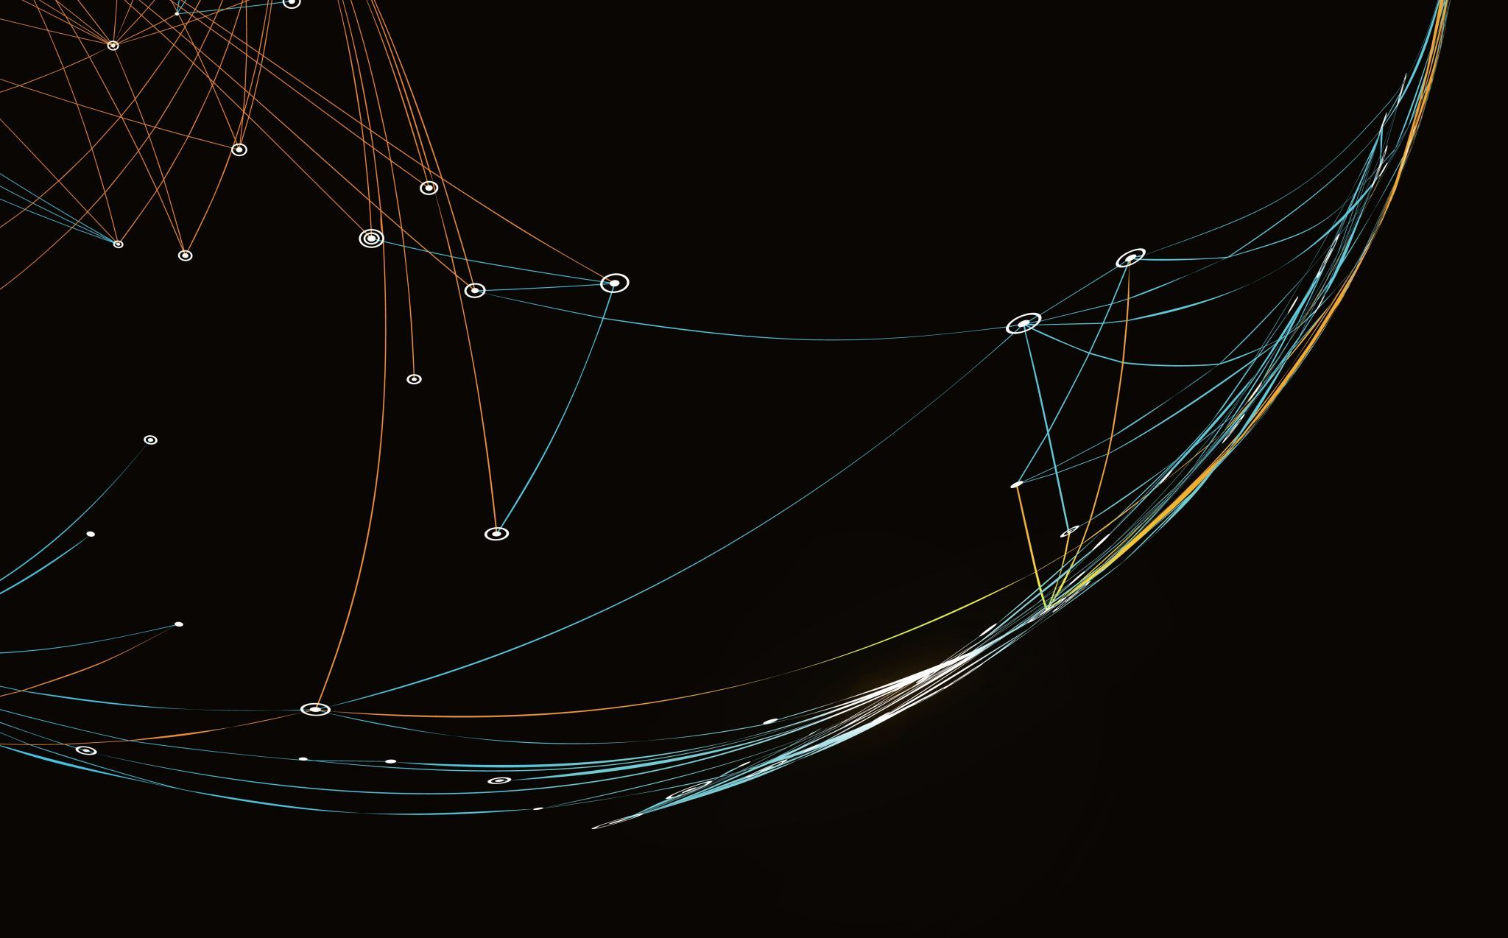

Storing URLs, targets, and other time-varying entities in a database as a path to sustainable recordkeeping
Gyula Kalcsó, National Széchényi Library, Hungary
IIPC WAC lightning talk, Brussels, 2026

Slide 2
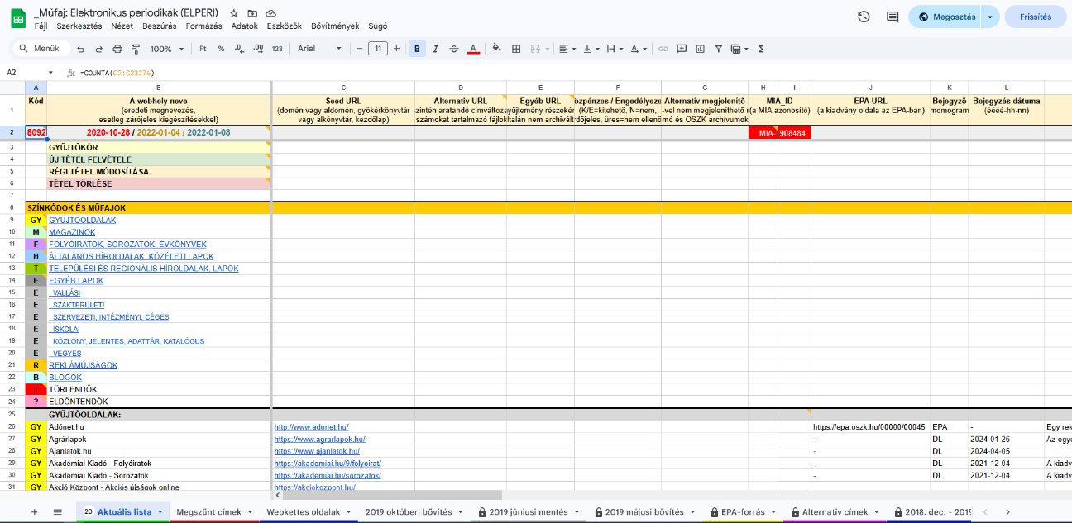
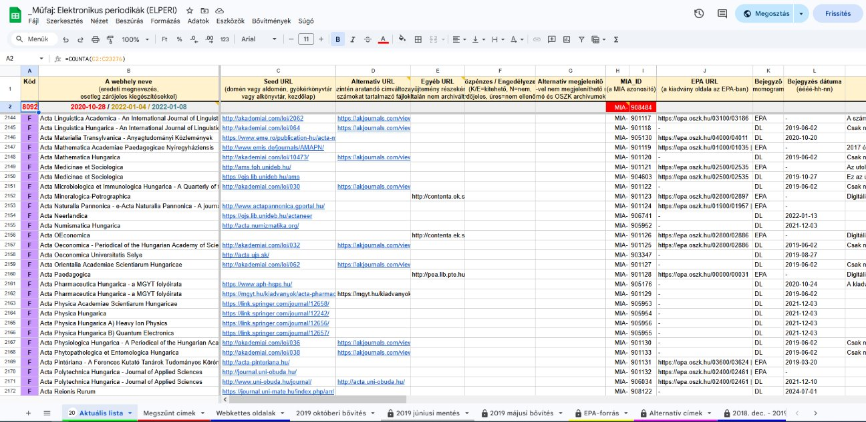
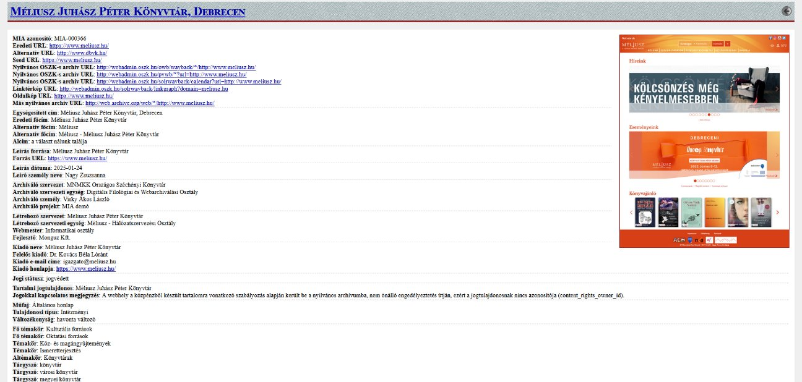
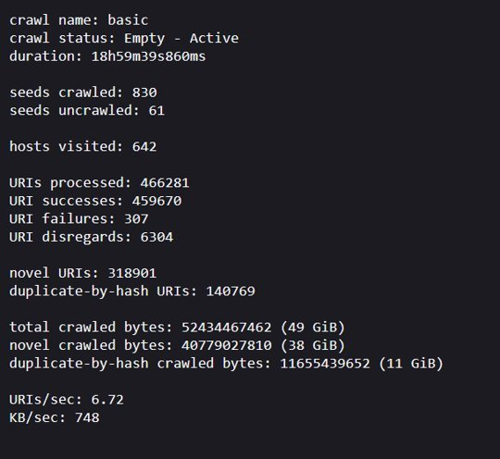
The problems to be solved
Data is stored in multiple locations, in various formats, and in a way that does not allow for interconnection.
The records of the sub-collections are inconsistent and redundant.
The records should be entity-based and should allow for the tracking of changes in the data over time.
Data from previous harvests must also be entered into the database.
The database’s interoperability with other systems must be ensured.
Automation and monitoring must be further developed.
A flexibly customizable data entry and query interface is required.

Slide 3
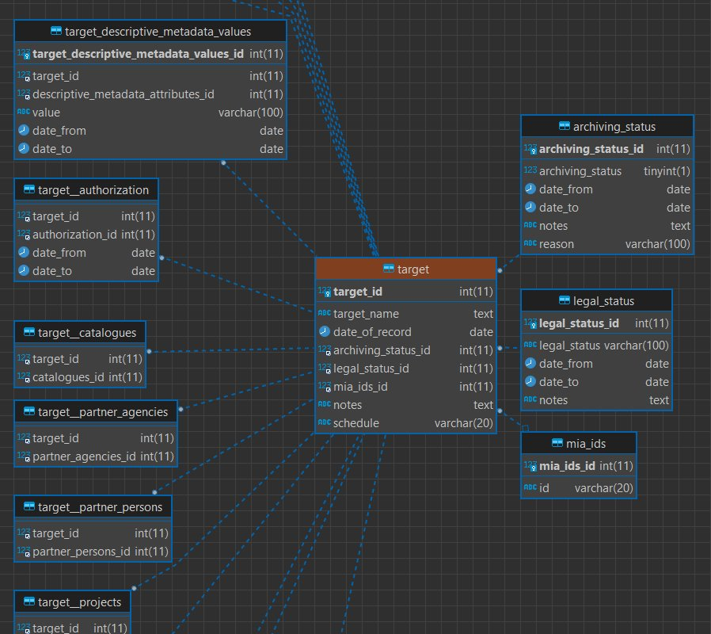
The Database
MariaDB with InnoDB engine.
Principles:
Third normal form (3NF) and minimizing redundancy.
Changes in data over time must be recorded.
N:M relations implemented with junction tables.
Historical data must be able to be loaded, including the technical and administrative metadata of the harvests.
Ensuring scalability: by using the EAV model, meaning entities, attributes, and values are stored in separate tables.
The database must be capable of interfacing with other systems.

Slide 4
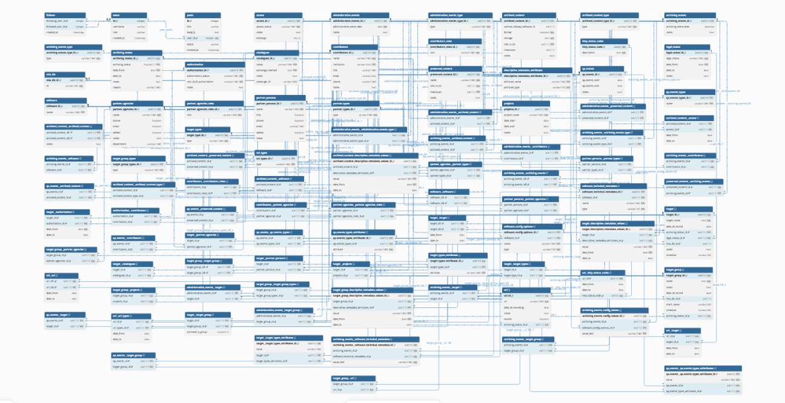

Slide 5
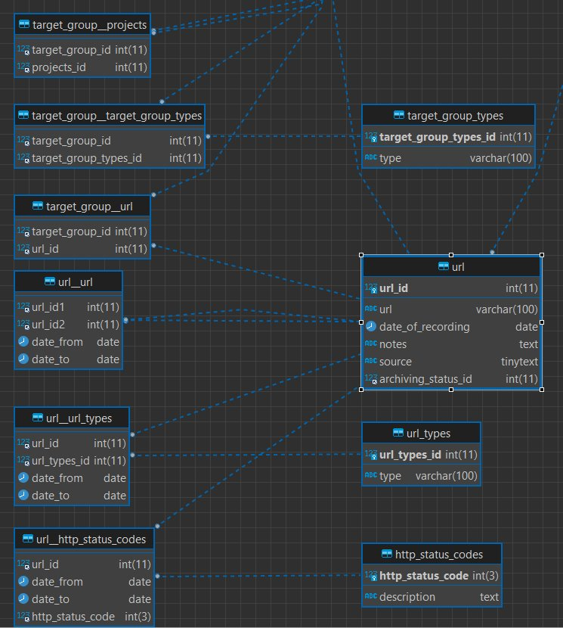
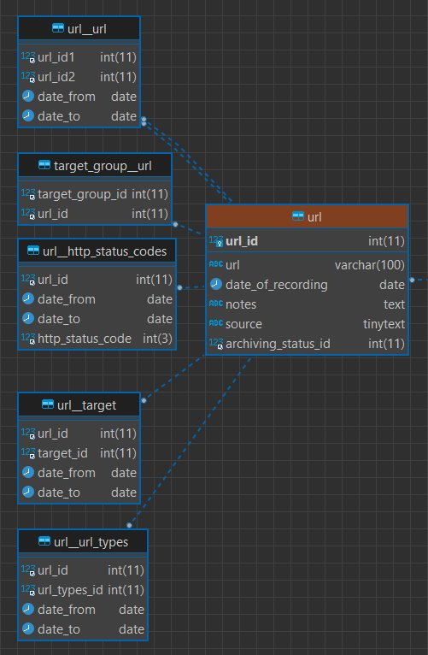
Recording changes over time
Possible changes in the URL registry:
A website’s URL changes.
A different website appears at that URL.
Traffic is redirected from that URL to another location.
The URL is discontinued.
Key junction tables: URL__target, URL__http_status_code.

Slide 6
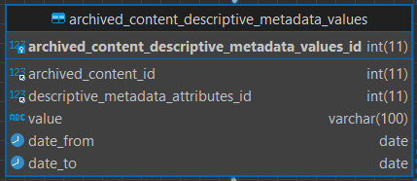
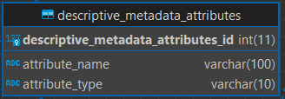
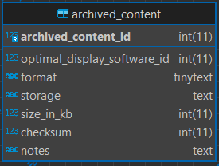
EAV in the Descriptive Metadata
Descriptive metadata related to targets, target groups, and archived content is recorded using three tables (the entities themselves, the metadata attributes describing them, and their corresponding values).
This makes it possible to expand the descriptive metadata fields as needed.

Slide 7
Thank You For Your Attention!
kalcso.gyula@oszk.hu webarchivum@oszk.hu webarchive.hu/en

